Slide 1
Big Mart Sales Prediction

Slide 2
Data Information
1. Two datasets –
i. Train dataset
ii. Test dataset
There are 12 attributes and 11 attributes in train and test datasets respectively
There is 7 Categorical column and 5 numerical column in dataset

Slide 3
Data Analysis & Data Prediction

Slide 4
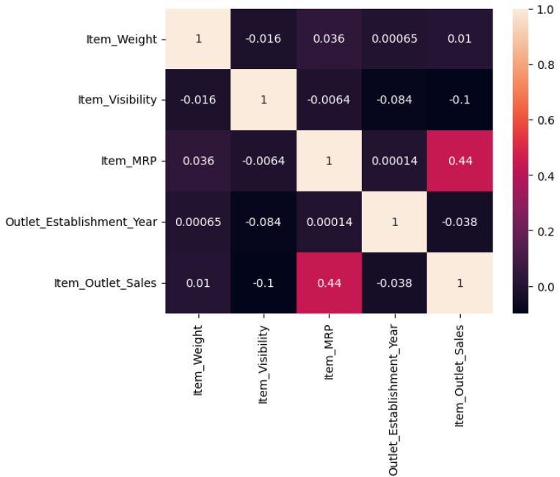
Correlation between data

Slide 5
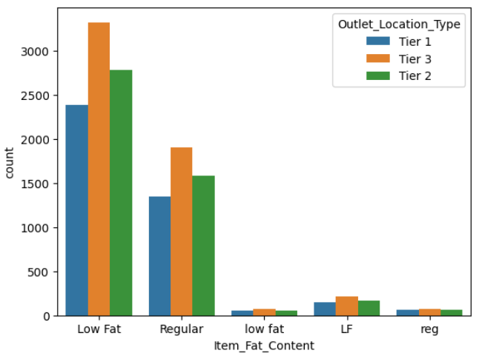
Graph of Item containing fat by their Outlet location type

Slide 6
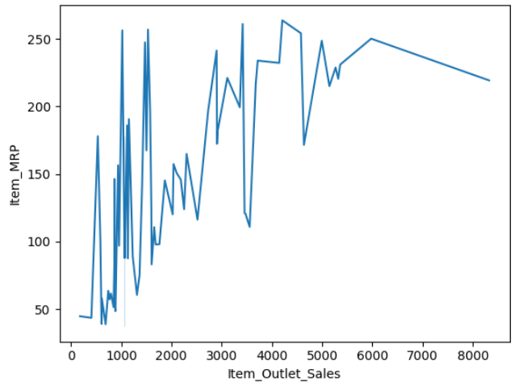
Graph of sales of Dairy in the 2002 year by Mrp

Slide 7
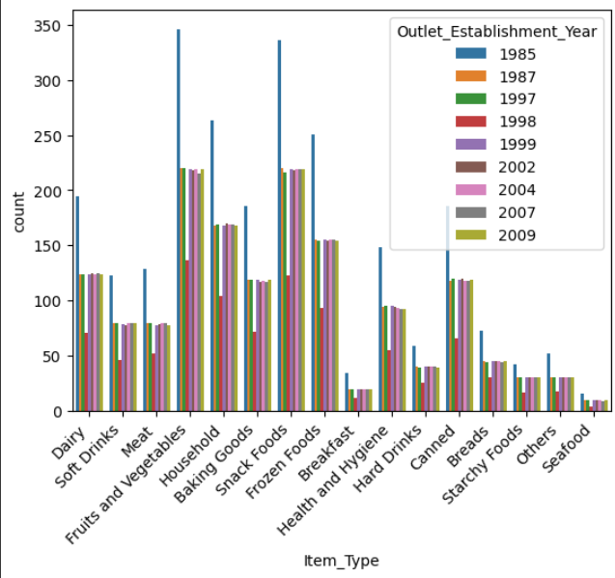
All Item Sold in respective year

Slide 8
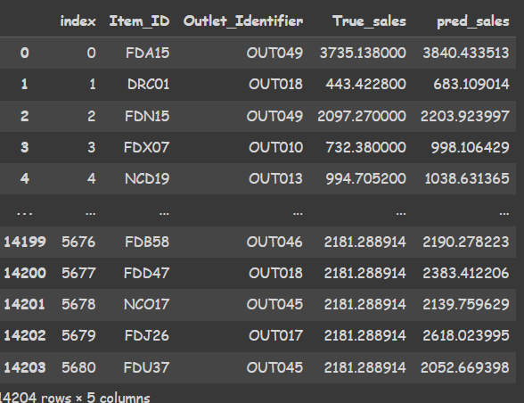
Random Forest Regressor - Algorithm used for prediction
Accuracy = 89.93 %
Prediction of sales -

