Slide 1

Datalytics 2.0
Marketing Analysis – Unlocking insights for strategic growth

Slide 2
Agenda
Price Comparison
01
Analyze the pricing strategies used by competitors
Product Comparison
02
Identify any strengths or weaknesses in your product offerings relative to computers
Market Positioning
03
Assess whether your positioning aligns with your preferences and needs of your target audience
Customer Perception
04
Analyze customer sentiment and satisfaction levels

Slide 3
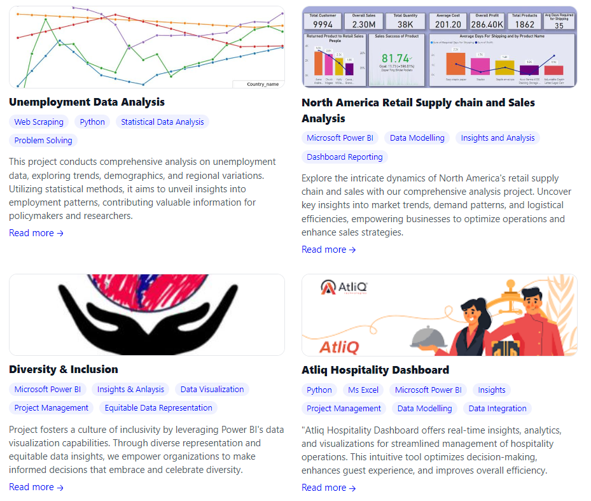

Portfolio
Hitesh Choudhary
As a recent graduate with a degree in BTech Computer Science & Engineering, I am enthusiastic about embarking on a dynamic career in data analysis. My academic background, coupled with hands-on projects and internships, has equipped me with a solid foundation in statistical analysis, data visualization, and machine learning.

Slide 4
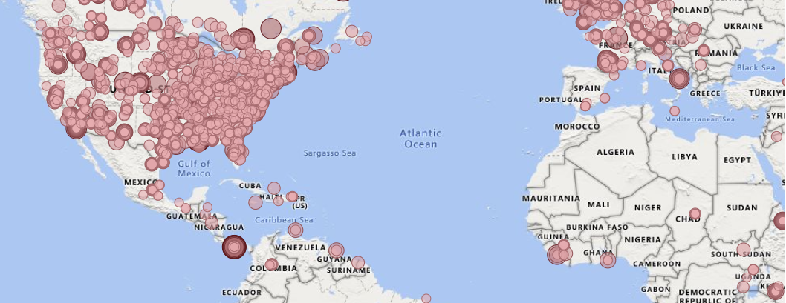
Geographic Regions
Our data indicates that the United States and regions in Africa boast the highest customer concentration within our clientele. Additionally, we have observed several key trends and insights regarding our customer base:
1. Emerging Markets: Certain emerging markets in Africa show promising growth potential, with a notable uptick in customer acquisition and engagement.
2. Urban Centers: Within the United States, urban centers demonstrate particularly high customer density, suggesting opportunities for targeted marketing campaigns tailored to urban lifestyles and preferences.
3. Digital Engagement: Both in the USA and Africa, there's a significant trend towards digital engagement, with customers showing a strong preference for online shopping and interaction.
4. Localized Preferences: Our analysis reveals distinct localized preferences within these regions, emphasizing the importance of understanding cultural nuances and adapting marketing strategies accordingly.
5. Competitive Landscape: Despite the concentration of customers, these regions also present heightened competition, requiring strategic differentiation and value proposition to maintain market share and customer loyalty.

Slide 5
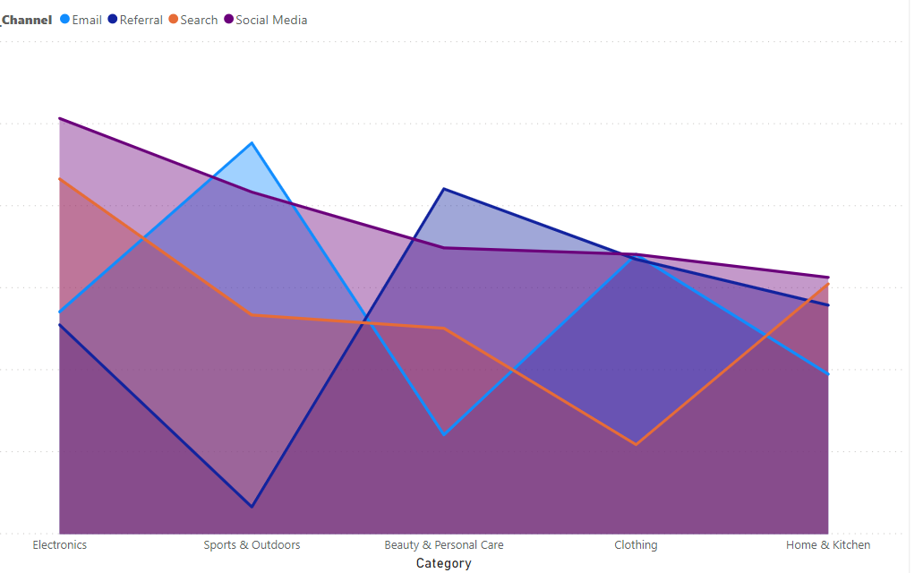
Marketing Strategies
The electronics category predominantly sees acquisition through social media channels, while the sports and outdoor segment is primarily influenced by email channels.
Understanding which marketing strategies are most effective for each segment is crucial for maximizing engagement and conversion rates.
By tailoring strategies to suit the preferences and behaviors of specific segments, businesses can enhance their outreach efforts and achieve greater success in capturing target audiences.
This targeted approach not only boosts relevance but also optimizes resource allocation, ensuring that marketing efforts yield the highest possible returns.
Evaluating the effectiveness of various channels and strategies within each segment allows for ongoing refinement and optimization, empowering businesses to stay agile and responsive to evolving consumer trends.
Contents Title
You can simply impress your audience and add a unique zing and appeal to your Presentations. Easy to change colors, photos.
Get a modern PowerPoint Presentation that is beautifully designed. I hope and I believe that this Template will your Time, Money and Reputation.

Slide 6
Prices as per Competitors market
Conducting a thorough analysis of prices and products relative to competitors in the market is essential for maintaining competitiveness and ensuring customer satisfaction. By comparing pricing strategies, businesses can identify opportunities for price optimization, such as offering competitive pricing or emphasizing value-added features to justify higher prices.
Additionally, comparing product offerings allows businesses to identify gaps in their product portfolio and capitalize on areas where competitors may be lacking. This analysis can inform product development strategies, helping businesses differentiate themselves in the market and attract customers with unique or superior offerings. PowerPoint Presentation that is beautifully designed. I hope and I believe that this Template will your Time. You can simply impress your audience and add a unique zing.

Slide 7
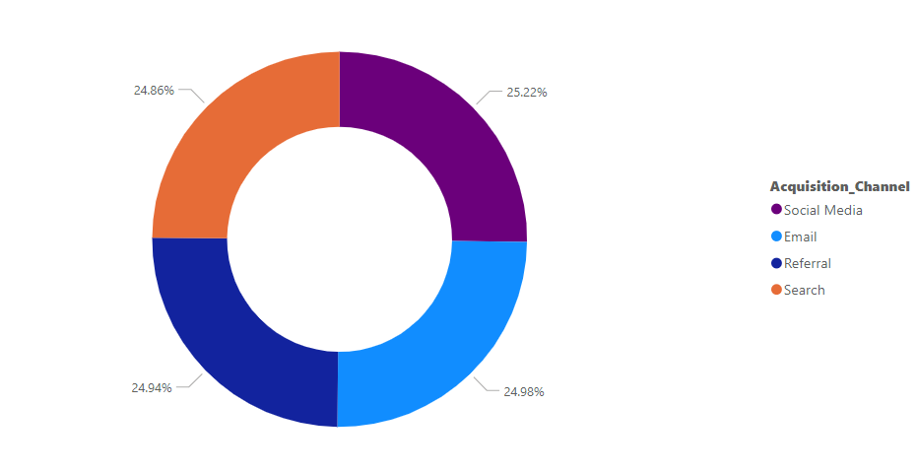
Sales by Acquisition channel
The electronics category predominantly utilizes social media channels for acquisition, while the sports and outdoor segment relies heavily on email channels. Recognizing which marketing strategies prove most effective for each segment is pivotal for maximizing engagement and conversion rates. By evaluating the effectiveness of different channels and strategies within each segment, businesses can refine and optimize their approach to remain agile and responsive to evolving consumer trends.
1. Sales distribution across acquisition channels is nearly evenly distributed, indicating a balanced approach in reaching customers through various marketing channels.
2. Understanding the nuanced preferences of each segment allows businesses to deploy targeted strategies, thereby optimizing sales potential across different acquisition channels.
15%
60%
20%
60%
20%
Text Here
60%
20%
Text Here
15%
15%
Text Here

Slide 8
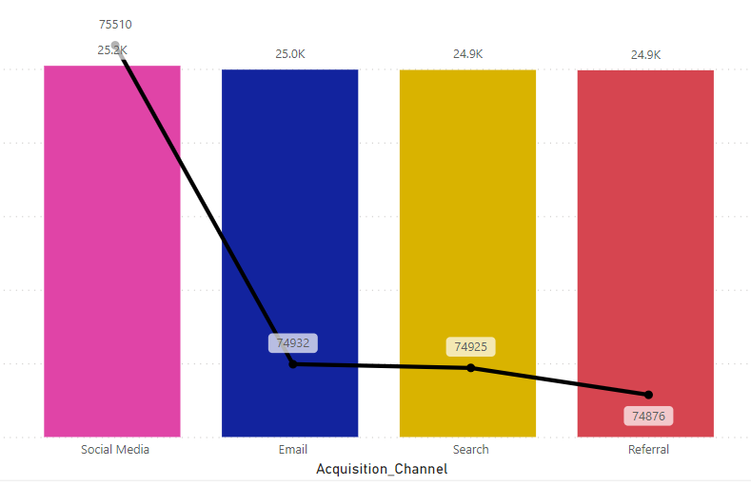
Acquistion Channel and Customers Feedback
Acquisition channels play a crucial role in shaping customer perceptions and feedback ratings. Channels that provide seamless experiences and valuable interactions tend to garner higher feedback ratings from customers. Analyzing customer feedback across different acquisition channels can unveil insights into which channels are most effective in fostering positive customer experiences and satisfaction. This data is invaluable for refining acquisition strategies and allocating resources to channels that yield the highest customer satisfaction and retention rates. Ultimately, aligning acquisition efforts with customer feedback can lead to improved brand perception and long-term customer loyalty.
STRENGTHS
WAKNESS
OPPORTUNITIES
THREATS

Slide 9
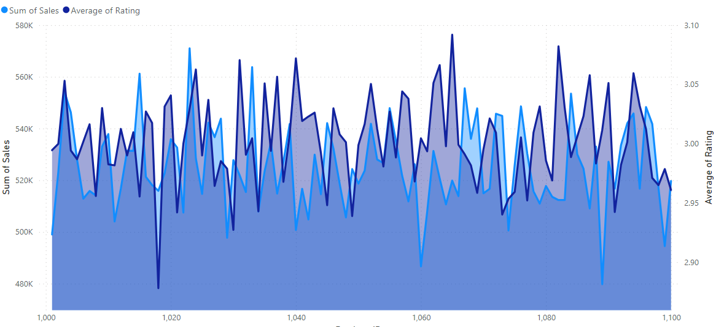
Correlations between product ratings and sales figures
The correlation between product ratings and sales figures suggests that higher-rated products tend to achieve greater sales success, reflecting the influence of customer satisfaction on purchasing decisions. Analyzing this relationship can provide valuable insights for product development and marketing strategies aimed at enhancing customer satisfaction and driving sales growth.
Text
Simply Impress
Your Audience
Text
Simply Impress
Your Audience
Main Text
Text
Simply Impress
Your Audience

Slide 10
THANK YOU
Marketing Analysis – Unlocking insights for strategic growth

