Slide 1
SUBNETTING -by Hitesh Nautiyal

Slide 2
Subnetting :-
Subnetting is a method of dividing a single physical network into logical sub-networks (subnets). Subnetting allows a business to expand its network without requiring a new network number from its Internet service provider. Subnetting helps to reduce the network traffic and also conceals network complexity. Subnetting is necessary when a single network number must be assigned to several portions of a local area network (LAN).

Slide 3
Use of Subnetting :-
Reallocating IP Addresses:- A limited number of host allocations are available for each class; for example, networks with more than 254 devices require a Class B allocation. Suppose a network administrator works with a Class B or C network and needs to allocate 150 hosts across three physical networks in three different cities. In that case, they must either request more address blocks for each network or divide the network into subnets that allow administrators to use one block of addresses across multiple physical networks.
Improves Network Speed:- Subnetting divides the large network into small subnets, and the purpose of these subnets is to divide a huge network into a collection of smaller, interconnected networks to reduce traffic. Subnets eliminate the need for traffic to pass through extraneous routs, resulting in faster network speeds.
Improving Network Security:- Subnetting helps network administrators to reduce network-wide threats by quarantining compromised areas of the network and making it more complex for trespassers to travel throughout an organization's network.
Reliving Network Congestion:- If a large portion of an organization's traffic is intended to be shared regularly across a group of computers, putting them all on the same subnet can help reduce network traffic. Without a subnet, data packets from every other computer on the network would be visible to all computers and servers.
Efficiency:- Subnetting is used to simplify network traffic by eliminating the need for additional routers. This ensures that the data being sent can move as quickly as possible to its destination, avoiding any potential detours that can slow it down.

Slide 4
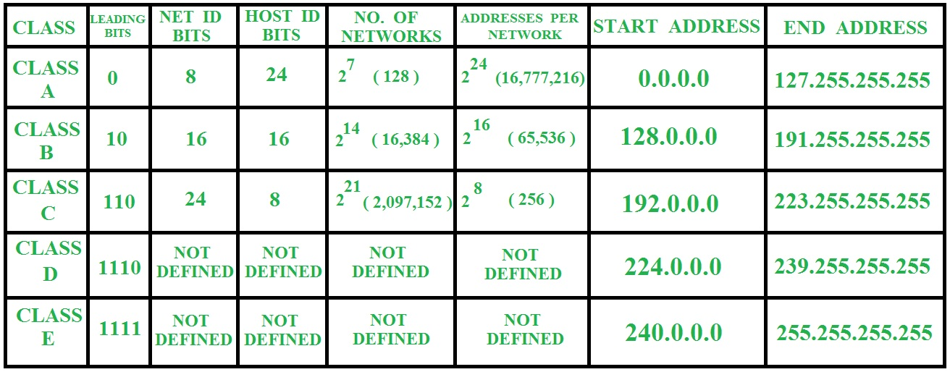
Classful Addressing :-

Slide 5
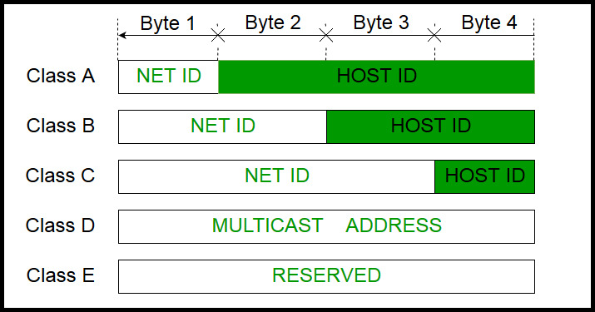
IP addressing Representation with Classes :-

