Slide 1

Department of Computer Science and Engineering Academic Year (2024-25) 22CSE48 - Mini Project using Java Review 1 Book My Stay
Team Members
1NH23CS095-Hitesh R- B section
1NH23CS103-K M Gokul- B section
Reviewer
Ms.Saranya S
Professor
Dept. of CSE, NHCE

Slide 2
Contents
Objectives
Abstract
Requirement Specification
Novelty of the work
Design
Methodology
Implementation Roadmap

Slide 3
Objectives
Develop a user-friendly hotel booking system.
Enable real-time room availability tracking.
Ensure secure and efficient transactions.
Simplify hotel management for administrators.
Implement a database-driven system using MySQL.
Enhance user experience.
Ensure robust authentication and authorization.
Provide detailed booking reports and analytics.
Make the application scalable and maintainable.

Slide 4
Abstract
The Java-based hotel booking system streamlines reservations. It enables real-time room availability tracking, ensuring efficient management and preventing overbooking. With a user-friendly interface, customers can easily book rooms while administrators manage reservations seamlessly. The system integrates MySQL for secure data storage and retrieval, with authentication mechanisms ensuring authorized access. Administrators can update room statuses, oversee bookings, and generate analytical reports for data-driven decision-making. Designed for scalability and maintainability, this solution leverages Java and MySQL to enhance efficiency, security, and long-term usability in hotel management.

Slide 5
Requirement Specification
Software Requirements
Operating System: Windows/Linux/MacOS
Programming Language: Java (JDK 8 or above)
Database: MySQL
Development Environment: IntelliJ IDEA
Frameworks & Libraries: JavaFX/Swing
Hardware Requirements
Processor: Intel i3 or higher
RAM: 4GB or higher
Storage: Minimum 10GB free space
Internet Connection: Required for cloud-based functionalities

Slide 6
Novelty of the work
Real-time room availability updates.
Secure booking system.
Integration of secure payment gateways.
Personalized user experience.
Role-based access control for users and admins.
Scalable and maintainable architecture.

Slide 7
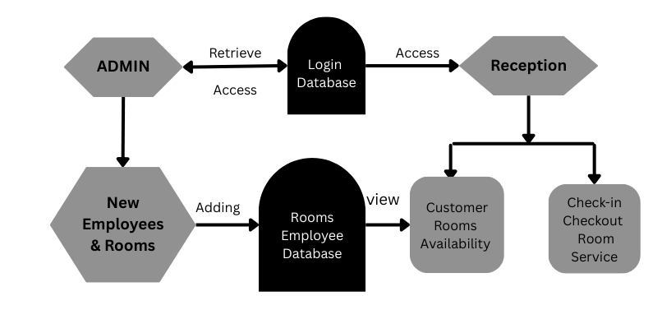
Design
System Architecture
Multi-tier architecture (Frontend, Backend , Database).

Slide 8
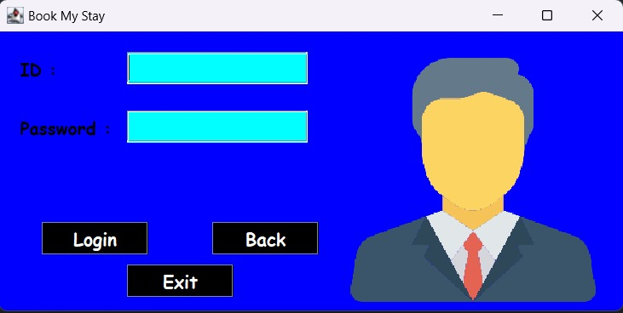
Secure authentication and authorization mechanisms.

Slide 9
System Components
Frontend (User Interface): JavaFX for desktop-based UI, Swing
Backend (Business Logic): Java
Database: MySQL for structured data storage.
Authentication Module: Secure login/logout system with role-based access.
Admin Dashboard: Management panel for hotel reservations and user control.

Slide 10
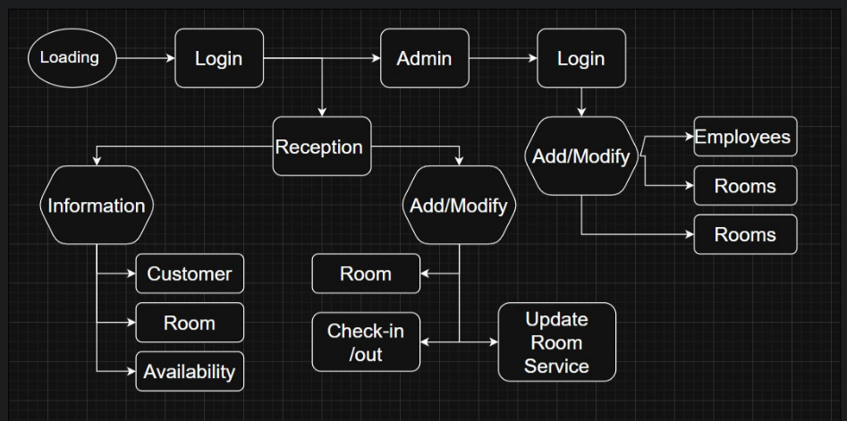
Road Map

Slide 11
Methodology
Requirement Analysis: Gather and analyze project requirements.
System Design: Plan architecture, database schema.
Database Setup: Implement MySQL for structured data storage.
Frontend Development: Develop user interface using JavaFX.
Authentication & Security: Implement user authentication and secure transactions.
Integration: Connect frontend, backend, and database components.
Testing & Debugging: Perform unit testing, integration testing, and bug fixes.
Deployment: Host the application on a suitable server.
Maintenance & Updates: Regularly update and optimize the system.

Slide 12
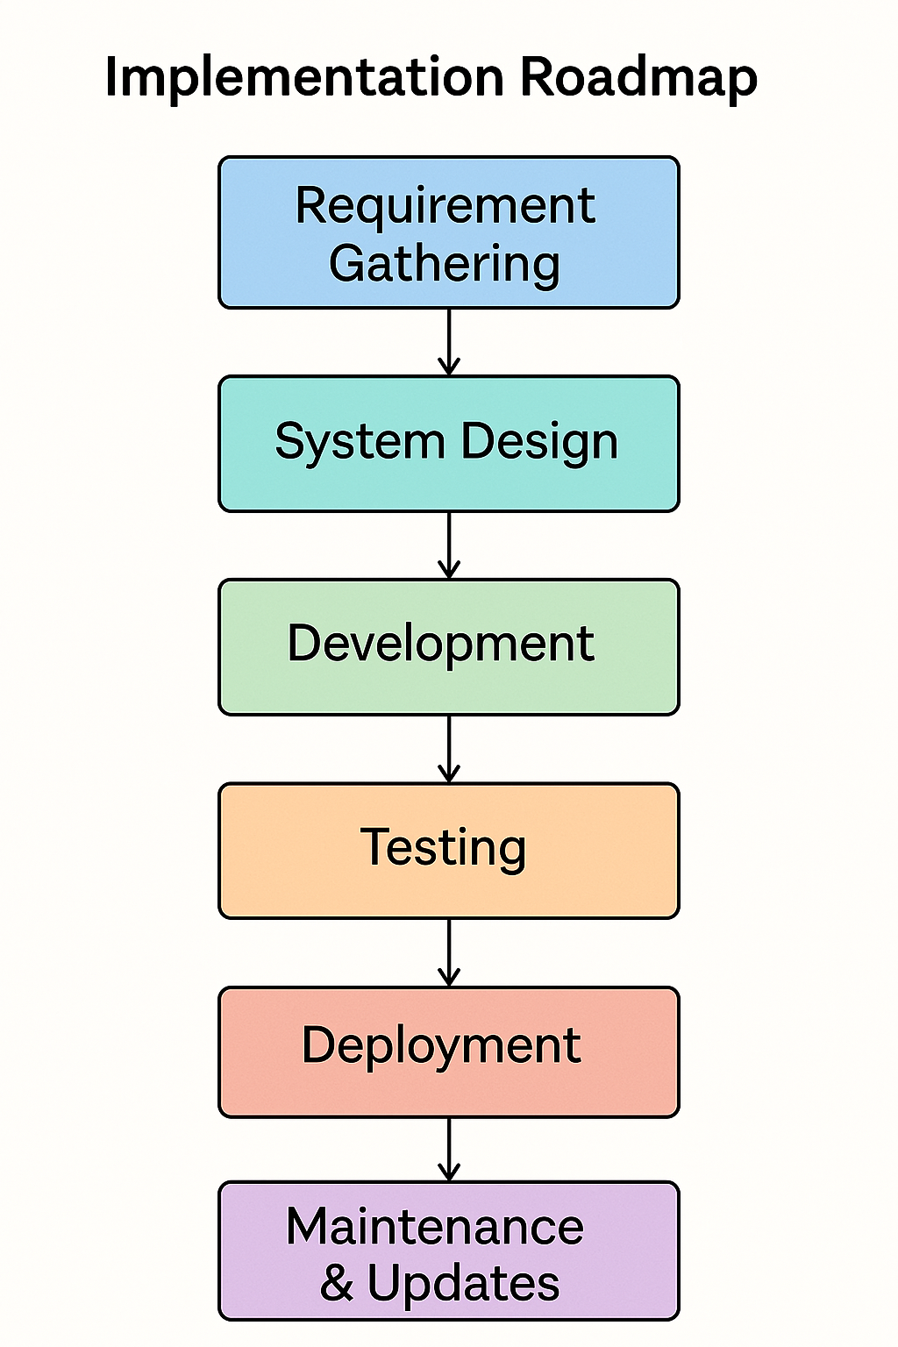
Implementation Roadmap

Slide 13
Thank You

