Slide 1


Health Governance and Services

Slide 2
TEAM MEMBERS
Project Mentor: Prof.Roshini Padate
Hitesh Sharma
Naman Chouhan
Renvil Dsa
Sankalp Rane

Slide 3
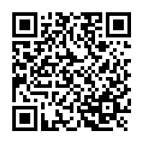


INTRODUCTION
Problem statement : The purpose of a hospital information system (HIS) is to manage the information that health professionals need to perform their jobs effectively and efficiently. It use a network of computers to collect, retrieve and process patient care and administrative information from various departments of hospital to satisfy the functional requirement
We Made A website ( 🏥 Diagnose Sastra )

Slide 4
OBJECTIVES
Different Dashboards for different users.
Cost Effective
Reduction in Errors
Data Security & Retrieving Ability
Improved Patient Care
Quality & Compliance

Slide 5
Existing system with limitations
Present system is manual. The Project Metrics has to enter all the details of project, documents, and tasks. It also maintenance the team information and also efforts estimation. For this purpose the organization maintain the size of the document, source code and update the information about team member.

Slide 6
PROPOSED SYSTEM FEATURES
1.Awareness section for diseases like covid : (To create awareness)
2.Chat bot : (For Queries and Help)
3.QR CODE : (Online Payment Option)
4.History : (Info about Doctor and his/her History)
5.Emergency no. : (Emergency help provided by the Hospital)
6.Blogs : (Discussion and Info about Hospital)

Slide 7
7.Organ donation : (Option to apply for organ donation)
8.Bed allotment system : (To check the bed allotment for the patient)
9.Notice : (To check Updates about patient from home)
10.Profiles of doctor : (Detailed Information about treating Doctor)
11.Appointment system : (For Follow ups and Personal Appointment with Doctor)
12.Mediclaim : (Financial Support for Health)
13.Invoice management: (Billing,payment,balance sheet)
14.Home visit: (Personal care by Doctor at home)
15.Offers on routine check up: (Offering discounts on regular check ups)

Slide 8
16.Feedback: (Feedback for better customer experience)
17.Branches: (Branches in particular state or city)
18.Contact for vaccine: (Help regarding vaccination centre near you)
19.About us (information regarding the hospital)
20.Tie ups with Advance Hospitals: (For advance treatment)
21.Motto : The Heart of Your HealthCare (Tag Line)

Slide 9
Web developer roles to play in Tech
All websites we use today are essentially two parts: the frontend and the backend. Both are equally important to build a fully functional website.
For front end we used HTML, CSS, JAVASCRIPT, BOOTSTRAP.
IMPORTANCE OF FRONT END -
Front-end development is a practice that enables creation of an intuitive and business concentric user experiences for web applications or website. It defines business success by improving the web performance. It takes 0.05 seconds for an average user to form an opinion of acompany by looking at their website. Hence, the programming and layout with design, functionality, and navigation experience play a vital role in the site.

Slide 10
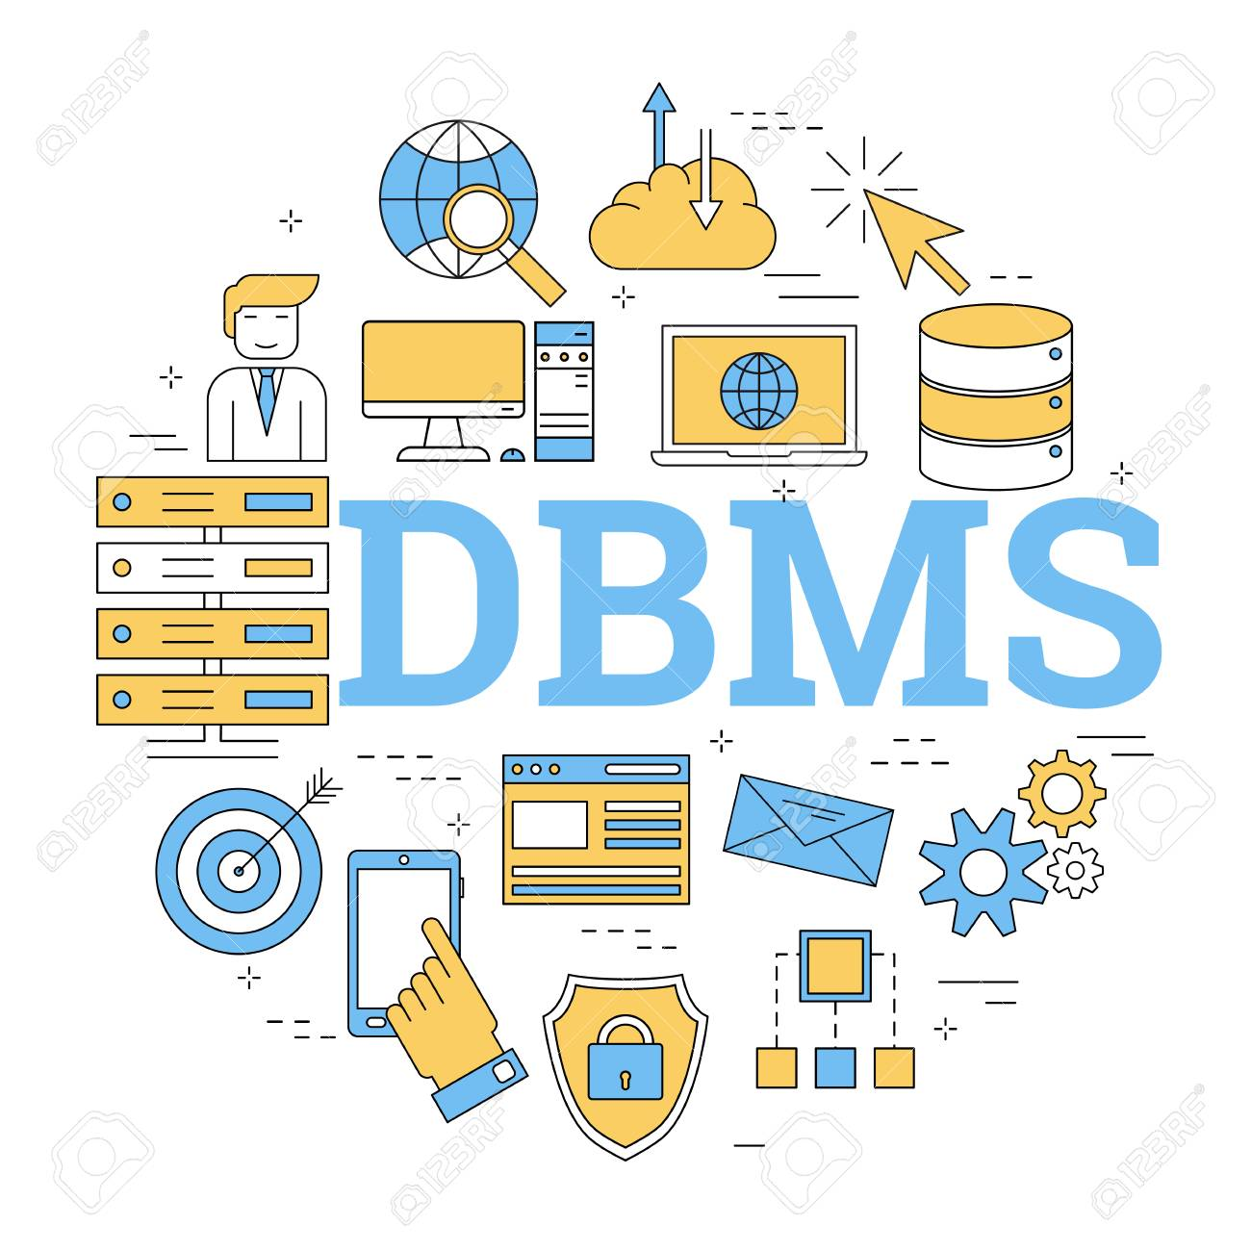
Database Management
Databases are used to store data and save memory load of the web server. When a client makes a data request, the backend acts as a middleman to retrieve the corresponding response from the database and send it to the client. A client can also submit data to be added to the database.
As a backend developer, you must be familiar with database concepts to store data (MongoDB, MySQL) in the database and also caching (Redis) for quick access of data

Slide 11
What does a backend developer do?
Backend developers are in charge of the proper functioning of a web application. They write logical code to implement the functionality and enhance the speed and efficiency of a web app.
This means that a backend developer is responsible for:
Implementation of the backend web architecture that comprises servers, databases, operating systems.
Handling client requests with APIs.
Managing database(s) and caching.
Creating the business logic to run the application.
Troubleshooting performance bottlenecks using scientific debugging.
Build reusable code and libraries for future use.
Optimizing functionality, page loading speed, and scalability of the application.
Improving site infrastructure with timely enhancements and upgrades.

Slide 12

Why do we need PHP?
PHP is a server scripting language, and a powerful tool for making dynamic and interactive Web pages.PHP is a widely-used, free, and efficient alternative to competitors such as Microsoft's ASP.
.

Slide 13
Top Features of PHP
It’s easy to learn and use: One of the main reasons PHP became so commonplace is that it is relatively simple to get started with. Even without extensive knowledge or experience in web development, most people could create a web page with a single PHP file in a relatively short period of time. The syntax is simple and command functions are easy to learn, meaning the barriers to entry with PHP are lower than with many other languages.
It’s open source: This also helps developers get started with PHP - it can be installed quickly and at zero cost. There is also open access to a wide range of PHP frameworks, such as Laravel and Symfony. This feature is also appealing to companies as it helps control the costs of web development.

Slide 14
It’s versatile: One of the major benefits of PHP is that it is platform independent, meaning it can be used on Mac OS, Windows, Linux and supports most web browsers. It also supports all the major web servers, making it easy to deploy on different systems and platforms at minimal additional cost.
It enjoys strong community support: As a veteran scripting language that is widely used, PHP now has a large and loyal community base to support it. There are tons of tutorials, FAQs, and tips to help new PHP developers and to continue pushing the boundaries of what the language can achieve through regular updates.
It’s fast and secure: Two things that every organization wants their website or application to be are fast and secure. PHP uses its own memory and competes well on speed, especially when using the newer versions. There have been questions in the past about PHP security, though it is important to note that it is not inherently more or less secure than other programming languages. One important benefit is that because of its widespread use and community support there are now many tools, frameworks and best practices to help fix vulnerabilities and protect against cyberattacks.
It is well connected with databases: PHP makes it easy to connect securely with almost any kind of database. This gives developers more freedom when choosing which database is best suited for the application being built.
It is tried and tested: One major benefit of being around for a quarter century is that PHP code has been put to the test in all kinds of real-life environments. The main bugs have been found and fixed, making the language more stable and trusted by developers. Moreover, many frameworks and tools have been built over time, helping to make PHP web development more secure, efficient and effective.

Slide 15

Handling APIs
An Application Programming Interface (API) acts as a bridge layer between two applications. It accepts incoming requests to a backend application, retrieves the relevant data and returns it in a response message.
This communication is done through clearly defined HTTP methods such as:
GET: used to retrieve a resource.
DELETE: used to delete a resource.
PUT: used to create or replace a resource.
POST: used to store new resource.

Slide 16
SERVER -
WINDOWS SERVER 2019:
For hosting the Hospital Management website, we are currently using Windows Server 2019
Windows Server is a line of operating systems that Microsoft specifically creates for use on a server. Servers are extremely powerful machines that are designed to run constantly and provide resources for other computers.
Microsoft has published Windows Server under this name since Windows Server 2003 launched in April 2003. However, even before this, server versions of Windows were available. For instance, Windows NT 4.0 was available in both workstation (for general use) and server flavors.

Slide 17
Future work
To host on a proper website .
To make index page look more user friendly.
Data for the management reviews displays graphically by executive information system .
Features To Implement:
Dynamic QR CODE : (Online Payment Option)
Organ donation : (Option to apply for organ donation)
Bed allotment system : (To check the bed allotment for the patient)

Slide 18
Reference
https://en.wikipedia.org/wiki/Health_administration
https://www.w3schools.com/java/default.asp
https://www.udemy.com/
https://www.coursera.org/in

