Slide 1


Error uploading image.
Habit Forge: Your Path to Better Habits
This presentation will explore the Habit Forge mobile application, designed to help individuals build, track, and improve their habits for a more fulfilling life.
HT
by HITESH TANWANI

Slide 2
The Habit Tracking Problem
Lack of Motivation
Inability to Track
Staying motivated and consistent with new habits is challenging in the modern world.
Many people struggle to track their progress effectively, leading to uncertainty and frustration.

Slide 3

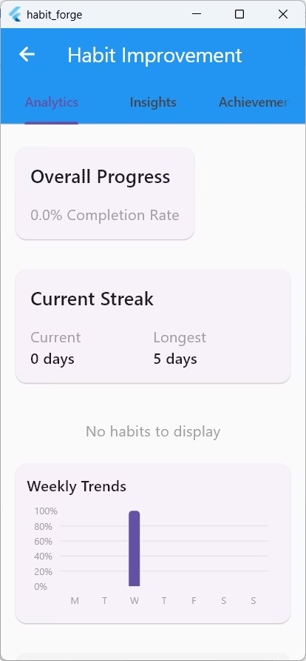
Habit Forge Solution
1
Personalized Habit Plans
2
Real-time Progress Tracking
Users can create and customize habits with detailed settings, including frequency, timing, and categorization.
Visual indicators, streak tracking, and progress summaries provide a clear picture of achievement.
3
Motivational Features
An achievement system, streak-based incentives, and celebratory feedback keep users engaged and motivated.

Slide 4

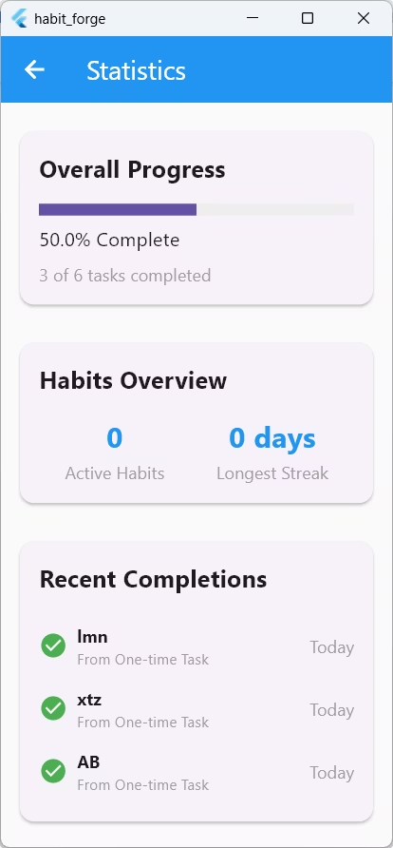
Deep Insights and Analytics
Weekly Behavior Trends
Time-of-Day Analysis
Visualize your habit completion patterns across different days of the week.
Understand when you are most likely to complete your habits, allowing you to optimize your routines.
Personalized Suggestions
Receive tailored recommendations for improving your habits and achieving your goals.

Slide 5

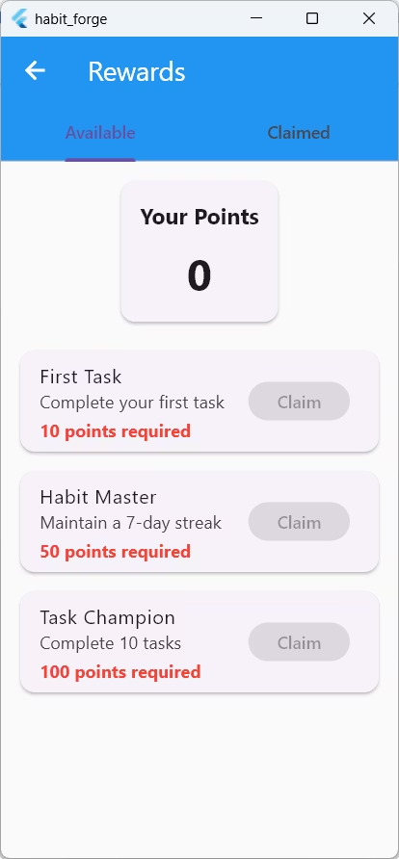


Building a Solid Foundation
Flutter
Firebase
A powerful cross-platform framework for building beautiful and performant mobile applications.
A comprehensive backend solution for database, authentication, storage, and analytics.

Slide 6




Architectural Excellence
Presentation Layer
1
UI screens and components
Business Logic Layer
2
State management and service logic
Data Layer
3
Models, repositories, and data sources
Domain Layer
4
Core business rules and entities

Slide 7
Habit Forge: A Powerful Tool for Change
Build Consistency
1
Develop long-lasting habits that positively impact your life.
Monitor Progress
2
Track your achievements, identify areas for improvement, and stay motivated.
Understand Your Patterns
3
Gain insights into your behavioral patterns to make informed decisions.

Slide 8

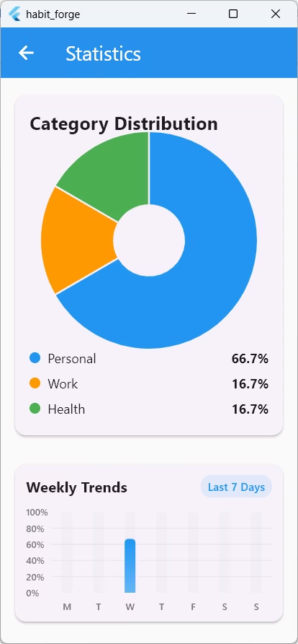



Investing in Your Future
Early Stage Investment
Habit Forge is seeking investment to accelerate development and expand its user base.
Market Potential
The habit tracking market is rapidly growing with increasing demand for self-improvement tools.
Unique Value Proposition
Habit Forge offers a comprehensive and user-friendly solution that addresses key user needs.

Slide 9

Looking Ahead
3
Key Features
Social interaction, AI-powered suggestions, health integrations
2
Goals
Expansion to new markets and increased user engagement
Habit Forge is committed to continuous innovation and growth, aiming to empower individuals to build better habits and achieve their full potential.

