Slide 1

Mutual Fund Analytics Platform
End-to-End Data Engineering, Performance Analytics & Business Intelligence
Capstone Project — Presented by Hitesh Tomar

Slide 2

Problem & Objectives
Problem
Objectives
Mutual fund datasets are distributed across multiple sources and formats.
Investors require both return and risk analysis to make informed decisions.
Manual analysis is time-consuming and lacks interactive visualization.
Build an automated ETL pipeline.
Perform exploratory and performance analytics.
Develop advanced risk analysis.
Create an interactive Power BI dashboard.
Generate actionable investment insights.

Slide 3
Dataset Overview
Datasets Used
Dataset
Purpose
Fund Master
Scheme metadata
NAV History
Daily NAV records
Scheme Performance
Returns & risk metrics
Investor Transactions
Behavior analysis
Portfolio Holdings
Sector allocation
Benchmark Indices
Performance comparison
SIP & Industry Data
Market trends
Technology Stack
Python • Pandas • NumPy • SQLite • SQL • Power BI • Jupyter Notebook

Slide 4

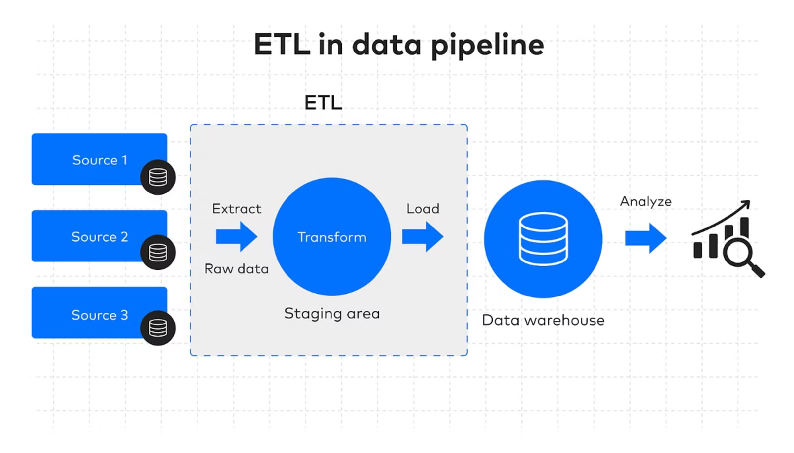
ETL Pipeline
Raw data → Ingestion → Cleaning & Validation → Feature Engineering → SQLite (warehouse) → Analytics → Power BI Dashboard
Key Tasks
Data cleaning
Missing value handling
Feature engineering
Database loading
Analytics-ready datasets

Slide 5
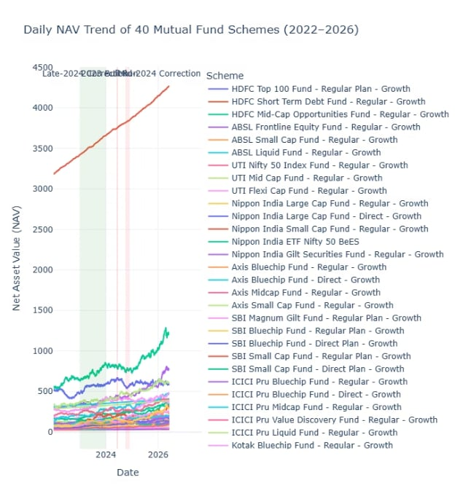
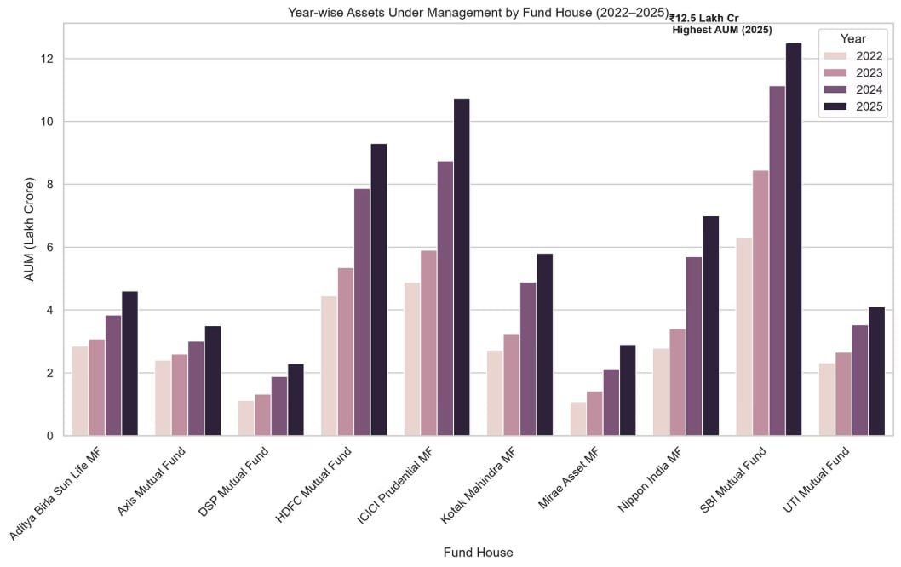
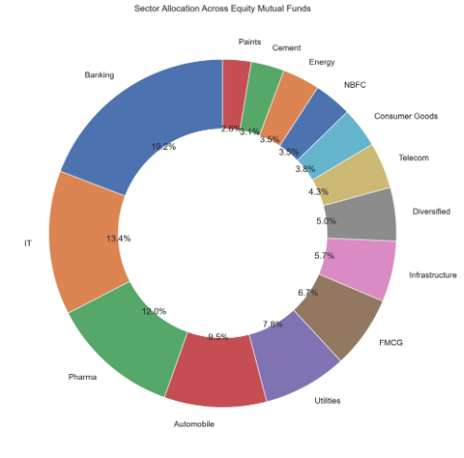
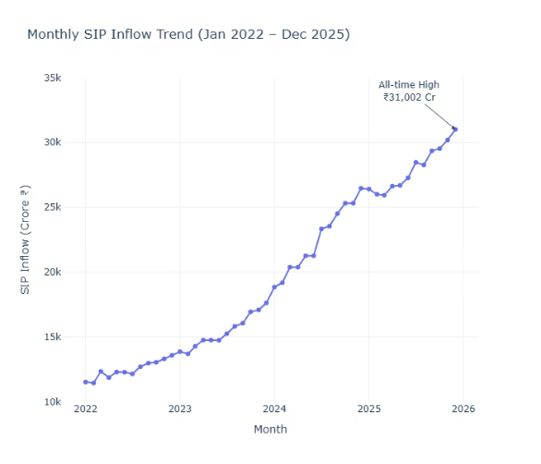
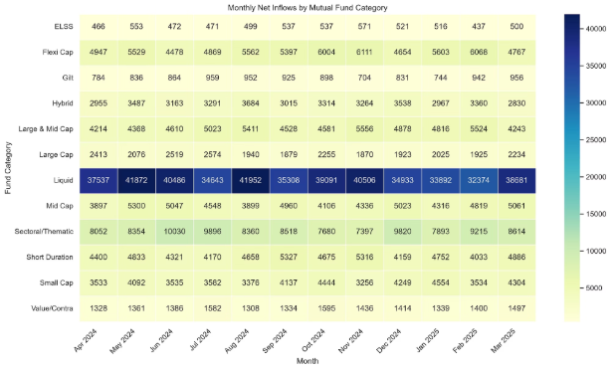
Exploratory Data Analysis
NAV Trend
Aum Growth
Sector Allocation
SIP Trends
Monthly Net Inflows
Insights
Industry AUM increased steadily.
SIP participation showed continuous growth.
Investor participation expanded over time.
Portfolios exhibited diversified sector exposure.

Slide 6
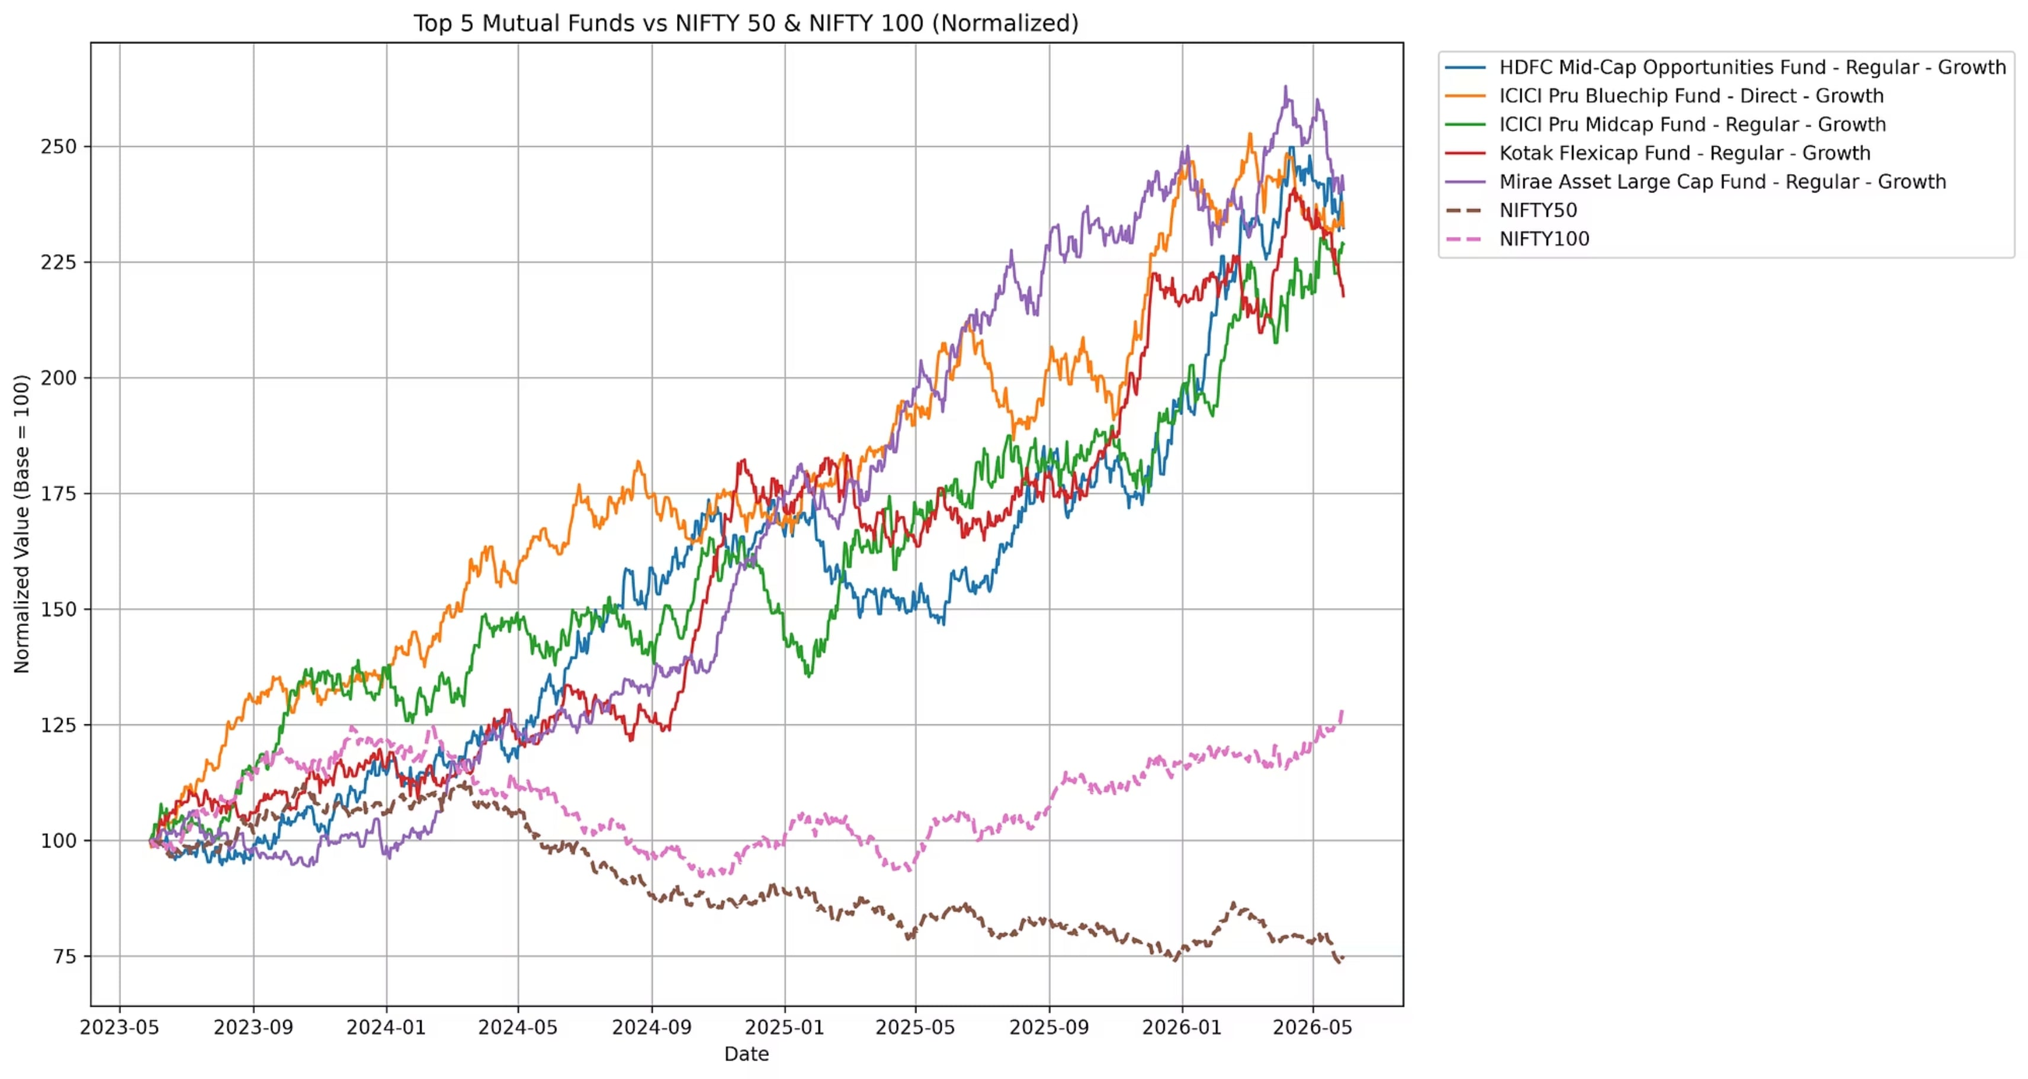
Performance Analytics
Financial Metrics Computed:
1
2
3
4
Return Metrics
Risk Metrics
Risk-Adjusted
Composite Score
Daily returns, CAGR, NAV vs benchmark
Std dev, Max Drawdown, Tracking Error
Sharpe, Sortino, Alpha & Beta
Weighted blend: return, risk, consistency, liquidity
Benchmark Comparison

Slide 7
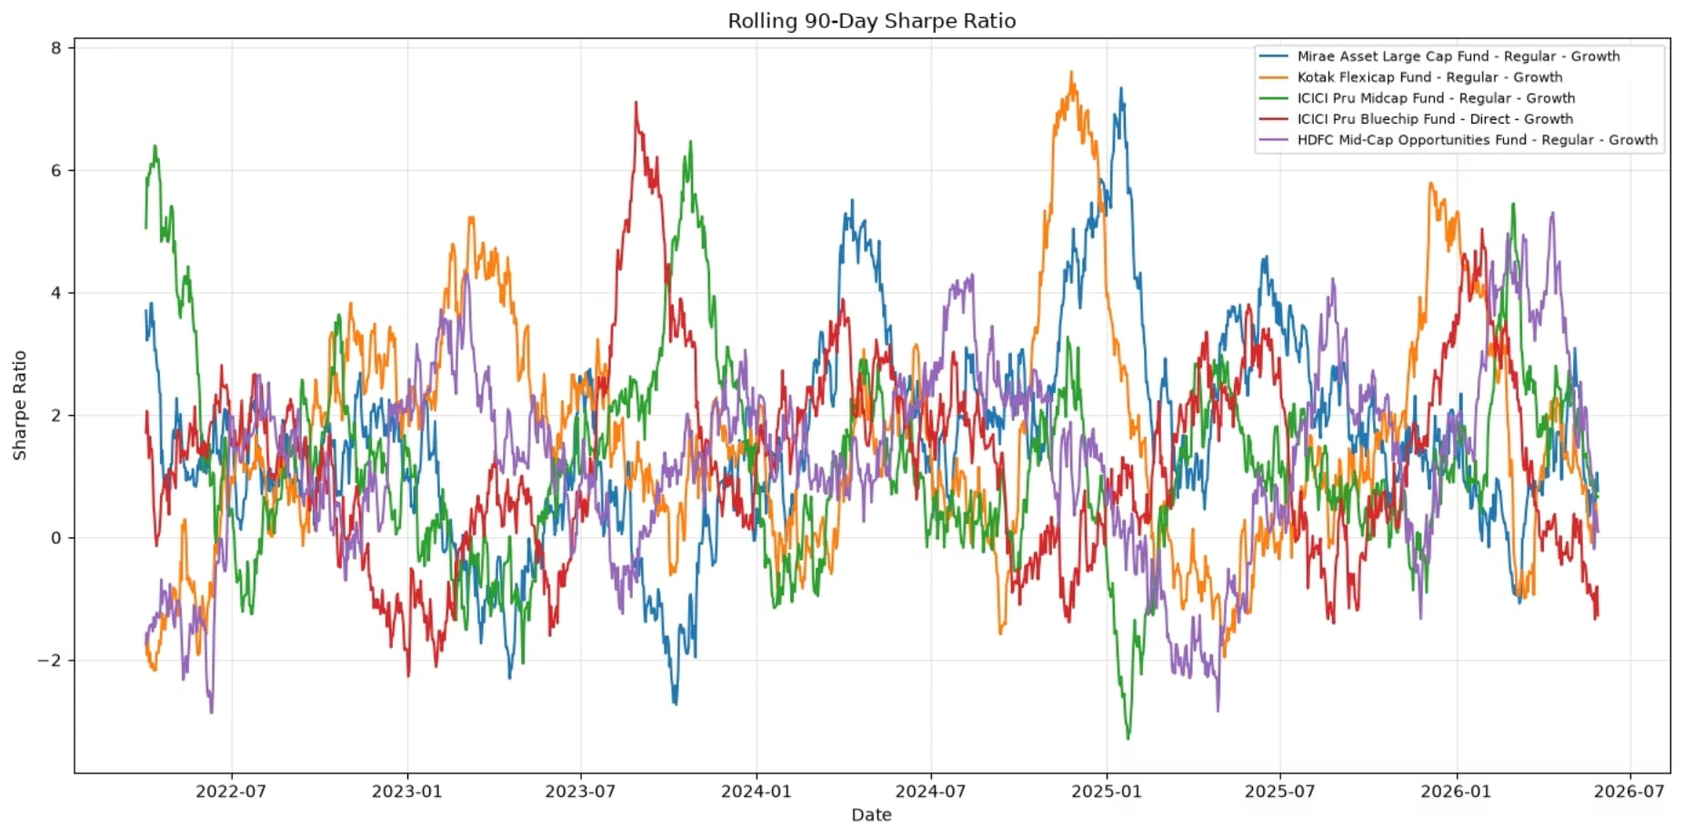
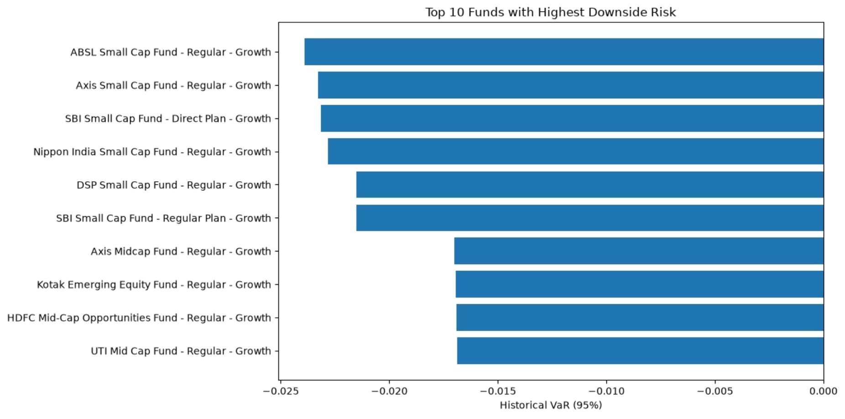
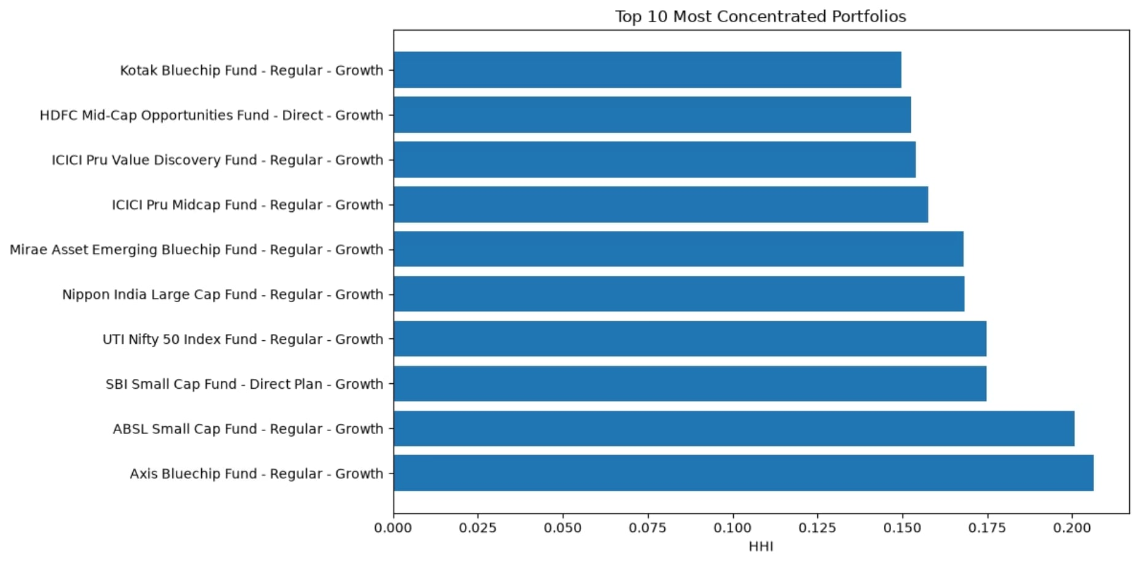
Advanced Analytics
Rolling 90-day Sharpe Ratio
Rolling Sharpe
90-day rolling estimation for momentum & risk regime
VaR & CVaR
Historical tail-risk for downside planning
Historical VaR
Sector HHI
Concentration score to flag overexposure
Rule-based Recommendations
Investor Cohort Analysis
SIP Continuity Analysis
Sector HHI Analysis

Slide 8
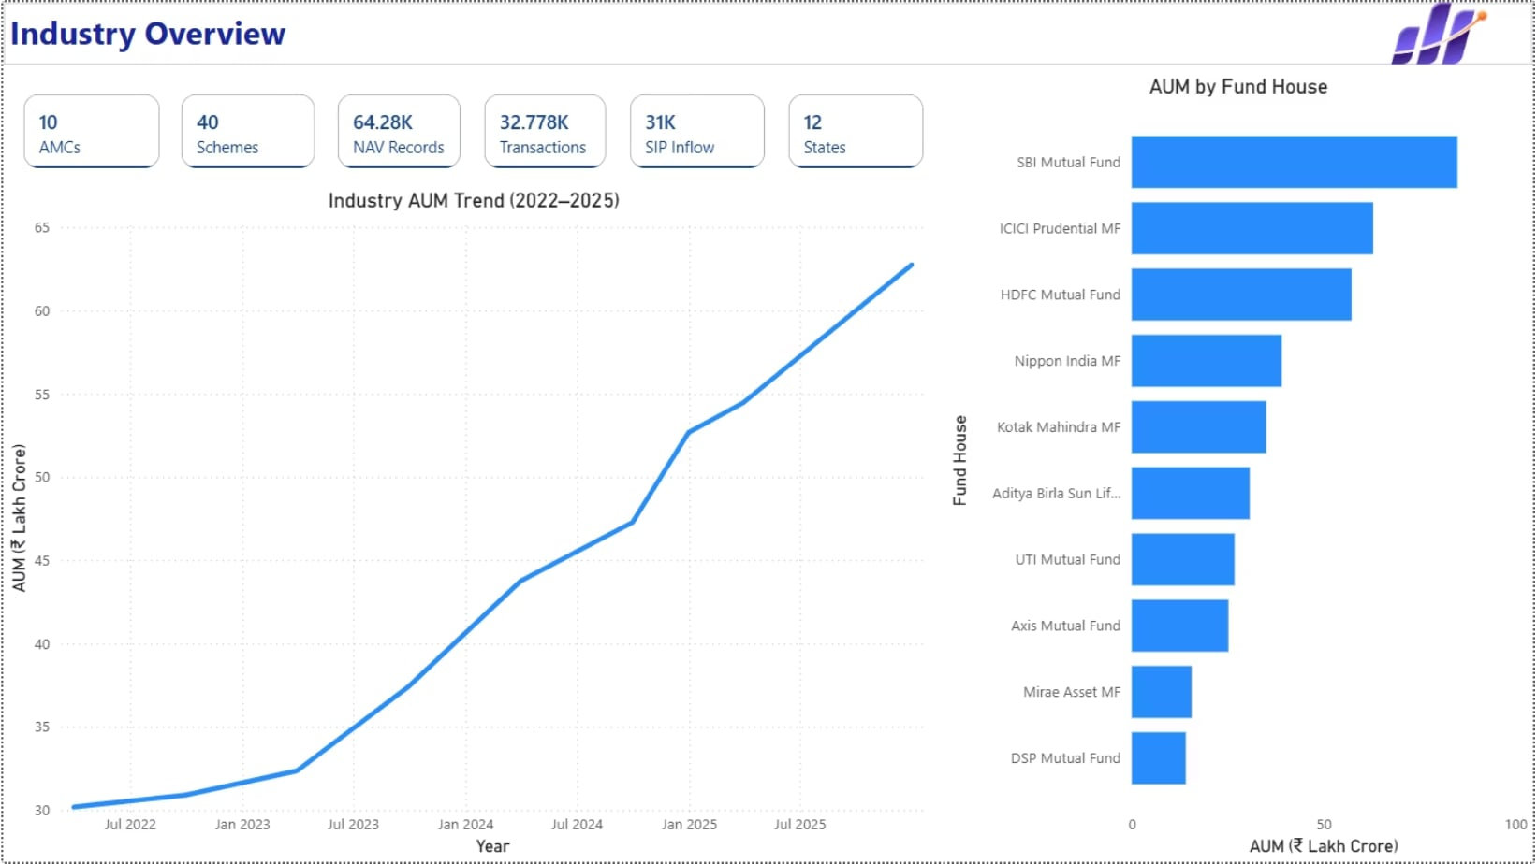
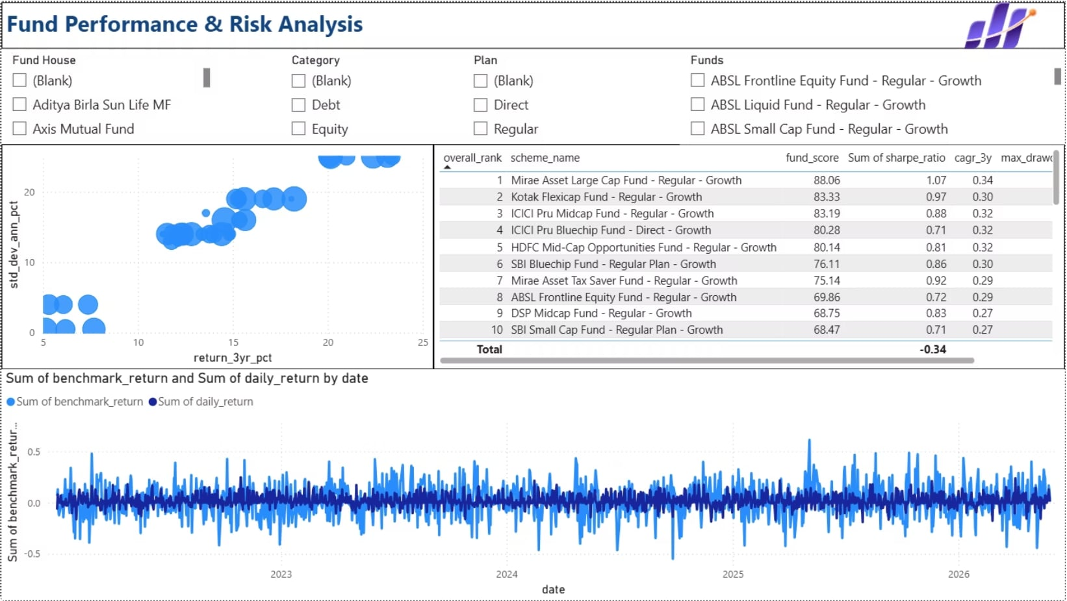
Dashboard
Industry Overview
Fund Performance
- Industry KPIs · AUM trend · AUM by fund house
- Interactive slicers, date range, category filters
- Risk vs Return scatter · Fund scorecards · NAV vs benchmark
- Tooltips & drill-through to fund detail

Slide 9
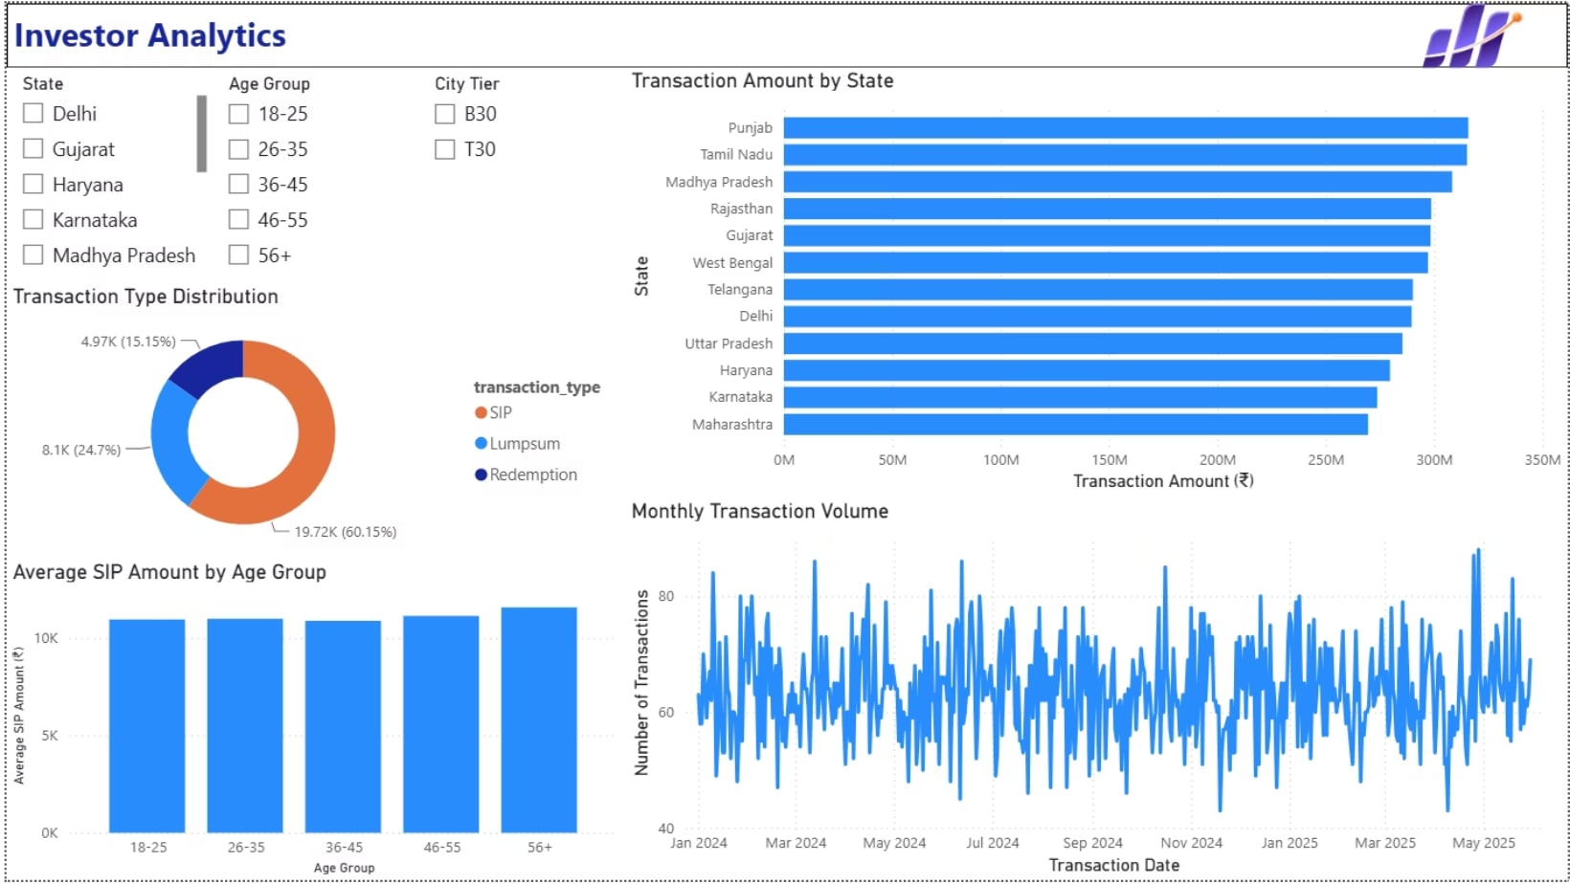
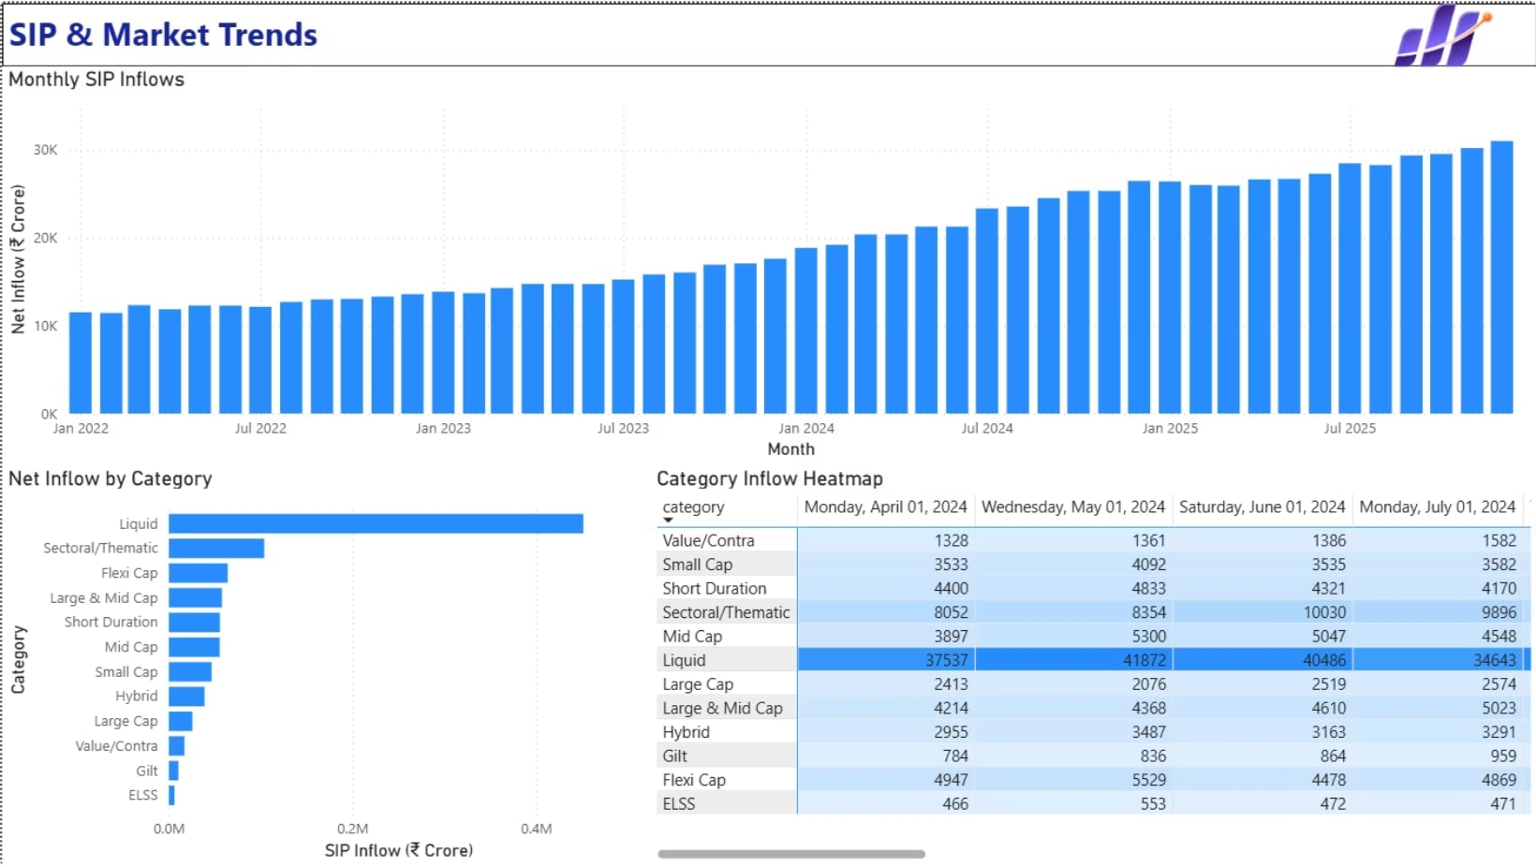
Dashboard
Investor Analytics
SIP & Market Trends
- State-wise flows · Transaction mix · Monthly activity
- SIP inflows vs market benchmark · category inflows

Slide 10
Key Findings
Findings
Strong growth in industry AUM and SIP inflows.
Risk-adjusted metrics improved fund comparison.
Small-cap funds exhibited higher downside risk.
2024 investor cohort contributed the highest investments.
SIP continuity analysis identified at-risk investors.
Dashboard enabled interactive exploration of analytics.

Slide 11
Conclusion & Future Work
Conclusion
Built a complete end-to-end mutual fund analytics platform.
Combined ETL, analytics, and business intelligence.
Generated actionable insights for investors.
Future Work
Automated ETL scheduling
Real-time market integration
Streamlit web application
Portfolio optimization
Machine learning-based recommendations

Slide 12
Thank You
Presented by
Hitesh Tomar
Bluestock FinTech Internship

