Slide 1
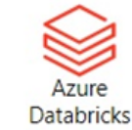
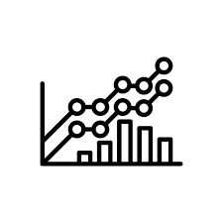

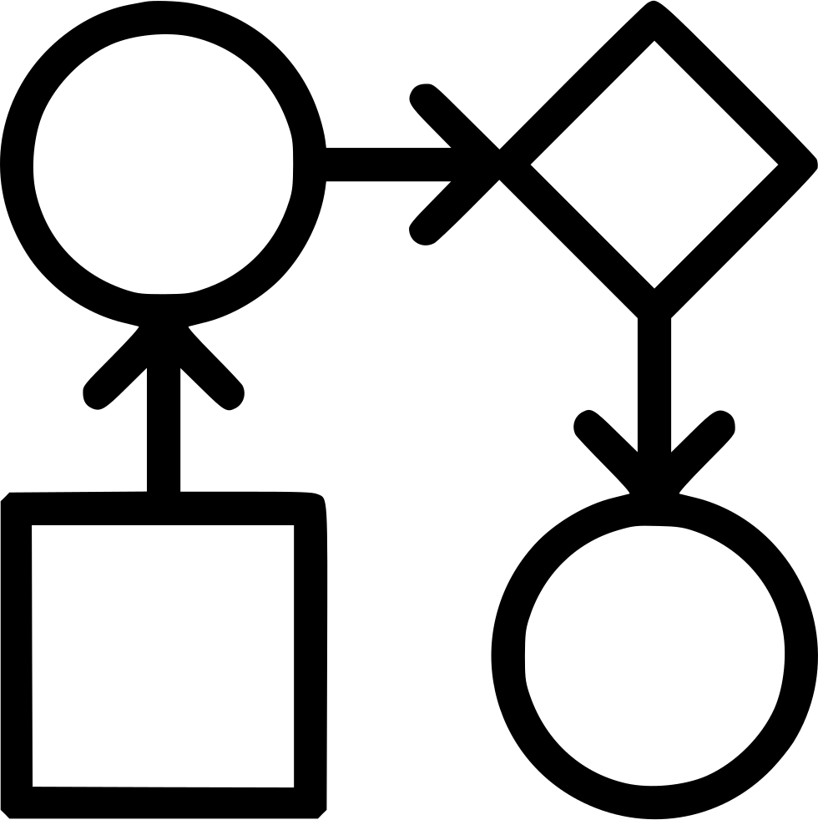


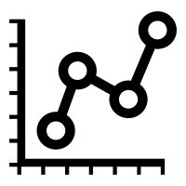

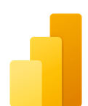


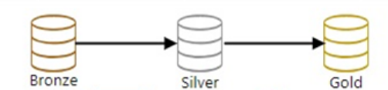
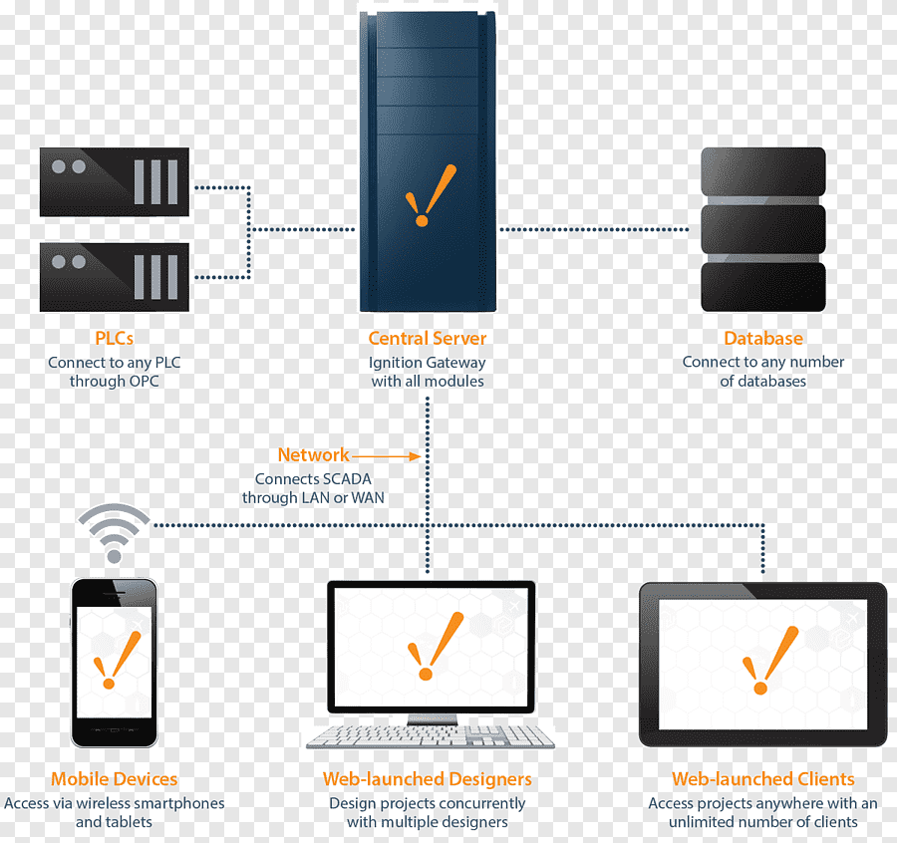

Visualize Refined Dataset​​
​​​
Data Sources
Storage
Visualization
Model Training
Workflows
Model Deployment
Sensor data​
​
Model
Parameter
Metric
Model Testing and validation
Performance Validation in Production and development environment
Model retraining in case of concept and data drift
Power BI Dashboard
Flat Files
ADLS​
Scada data
Visualize ml flow dataset​
​​
Azure SQL data​ (To Track the models)
​

Slide 2


















Reference Architecture
Data Sources
Ingestion
Storage
Data Analytics &Model Training
Deployment & Storage
Visualization
Sensor data
Azure IoT Hub
EDA
Model Training
Workflows
ADLS
Model Deployment
SQL data
ADF
Azure Data Explorer
Model
Parameter
Metric
Delta Lake
Power BI Dashboard
Model Testing and validation
Performance Validation in Production and development environment
Model retraining in case of concept and data drift
Azure SQL Database
Scada data
Flat Files
Data Engineers
Data Scientists
ML Engineers
Data Analysts
*Indicators – Recourse Utilisation
Resource in MVP
Active Directory
Cost Management
Key Vault
Monitor
DevOps
App Insight
Resource in Production and in MVP
**Note: All existing data sources can be considered for data ingestion.
Resource in Production only

