Slide 1
👥
🧪
Healthcare
Data Analytics
1,000
11,147
Patients
Lab Records
🗄️
📊
6
18
End-to-End Learning Project
DB Tables
SQL Queries
SQL
Excel
Python
ML App
👨‍⚕️
🤖
20
1
Doctors
ML App
Hiteshi Aglawe · Aspiring Data Analyst

Slide 2
About This Project
A self-driven, end-to-end data analytics project built around a single coherent healthcare dataset — designed, populated, and analysed across SQL, Excel, and Python. Every tool was applied to the same dataset so each layer of learning built directly on the previous one.
🎯
🔗
🚀
Objective
Approach
Outcome
Build real analytical skills using a healthcare scenario — not isolated tutorials — with the same dataset applied across all tools.
Apply SQL → Excel → Python progressively. Each tool's output informed the next layer of analysis and cross-validated results.
18 SQL queries from beginner to advanced, 12 Excel formulas, an ML risk model, and a deployed Streamlit prediction app.
Learning Path →
Excel
SQL (18 queries)
Python + ML
Streamlit App

Slide 3
The Dataset — 6-Table Relational Schema
👥 patients
🧪 labs
👨‍⚕️ doctors
1,000 rows
11,147 rows
20 rows
PatientID · Age · Gender · DiagnosisID · DoctorID
AdmissionDate · DischargeDate · OutcomeID · TreatmentCost
LabID · PatientID · TestName
Result · NormalRange · TestDate
DoctorID · DoctorName · Gender
DepartmentID · Specialty · ExperienceYears
🏥 departments
🦠 diagnoses
✅ outcomes
9 rows
10 rows
3 rows
DepartmentID · DepartmentName
DiagnosisID · DiagnosisName
OutcomeID · OutcomeName
(Recovered / Complicated / Deceased)
🔗 patients → diagnoses · patients → doctors · patients → outcomes · labs → patients · doctors → departments

Slide 4
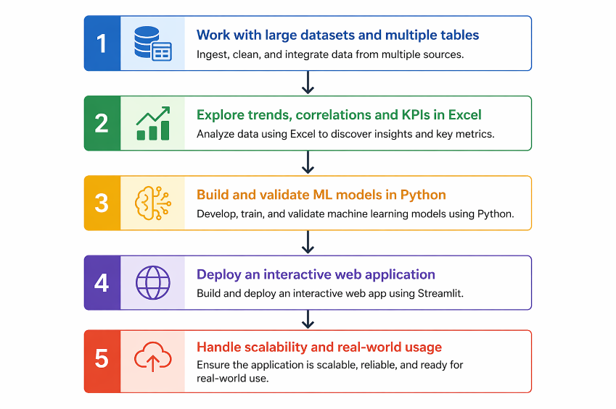
Purpose of Analysis
Key Business Questions Answered
Which patients are at highest clinical risk?
SQL Q9 · Excel Severity Score · Python ML
Which diagnosis has the highest treatment cost burden?
SQL Q4 · Excel SUMIF · Python groupby()
How do lab results trend during a patient's stay?
SQL Q7, Q16 · Python .shift() / LAG
Which doctors have the best recovery rates?
SQL Q10 · Excel SUMIF · Python merge()
What drives patient outcome — age, cost or labs?
Python Logistic Regression model

Slide 5
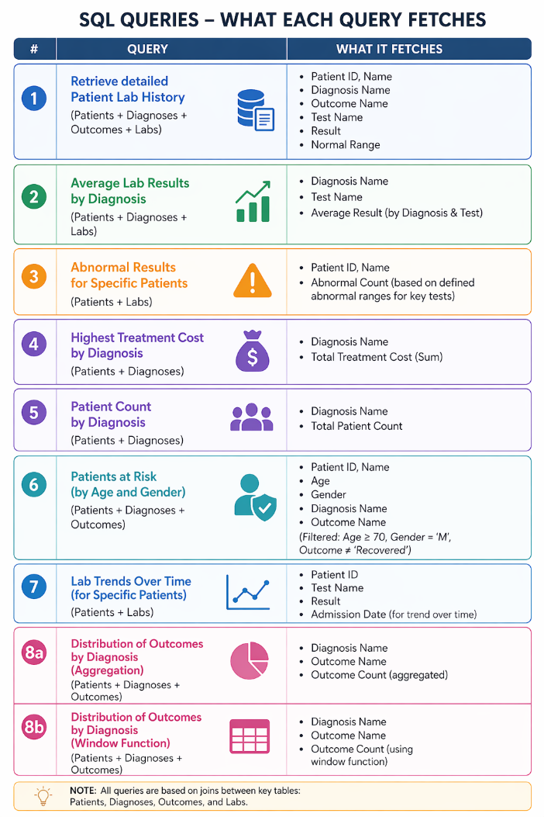
Part 1 — SQL (Microsoft SQL Server)
18 Queries
SQL Concepts Covered
Beginner
SELECT · WHERE · GROUP BY · HAVING · ORDER BY · multi-table JOINs
Intermediate
CASE WHEN · CTEs (WITH) · DATEDIFF · DATE_FORMAT · Subqueries
Window Functions
ROW_NUMBER · RANK · LAG · LEAD · SUM OVER · NTILE · PERCENT_RANK
Notable — Q9: Patient Risk Tier (CASE WHEN + CTE)
WITH AbnormalCounts AS (
SELECT PatientID, COUNT(*) AS AbnormalLabCount
FROM labs WHERE ...
GROUP BY PatientID )
SELECT Name,
CASE WHEN Age>=60 AND AbnormalLabCount>=3
THEN 'High Risk'
WHEN Age>=45 OR AbnormalLabCount>=2
THEN 'Medium Risk'
ELSE 'Low Risk' END AS RiskTier ...

Slide 6
Part 2 — Excel Data Analysis
12 Formulas
VLOOKUP
DATEDIF
Cross-sheet JOIN — pull DiagnosisName, DoctorName, OutcomeName into patient rows
Length of stay in days between AdmissionDate and DischargeDate
IF + VLOOKUP
Nested IF (3-lvl)
Lab test flag — cross-sheet lookup combined with conditional in one formula
Patient severity: Critical / Serious / Moderate / Mild — age, outcome, stay, cost
RANK.EQ + RANK.AVG
COUNTIF + SUMIF
Rank each patient's treatment cost — mirrors SQL RANK() window function
Patient count per diagnosis · Revenue per doctor — cross-sheet aggregation
📊 Pivot Tables —
Pivot 1: Count + total cost by outcome (Recovered 358 · Complicated 341 · Deceased 301 · Total ₹59.5L) | Pivot 2: Per-patient cost for age 20–23 cohort (48 patients · ₹2.67L total spend)

Slide 7
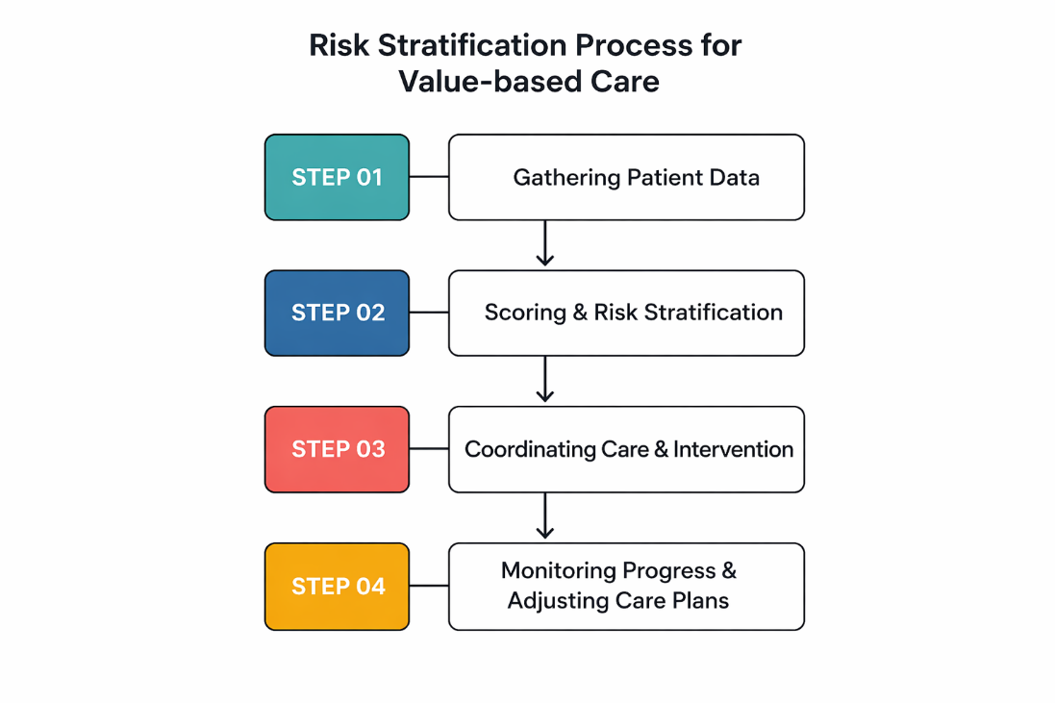
Part 3 — Python · ML Model · Streamlit App
1
Load Data
pd.read_csv() for all 6 CSVs
2
Merge (JOIN)
pd.merge() chain — patients + diagnoses + doctors
3
Feature Engineering
DATEDIFF → LengthOfStay · np.where → HighRisk
4
Abnormal Lab Count
Per-patient count of out-of-range test results
5
Model Training
LogisticRegression (class_weight='balanced')
6
Deploy App
Streamlit — live risk prediction from user inputs

Slide 8
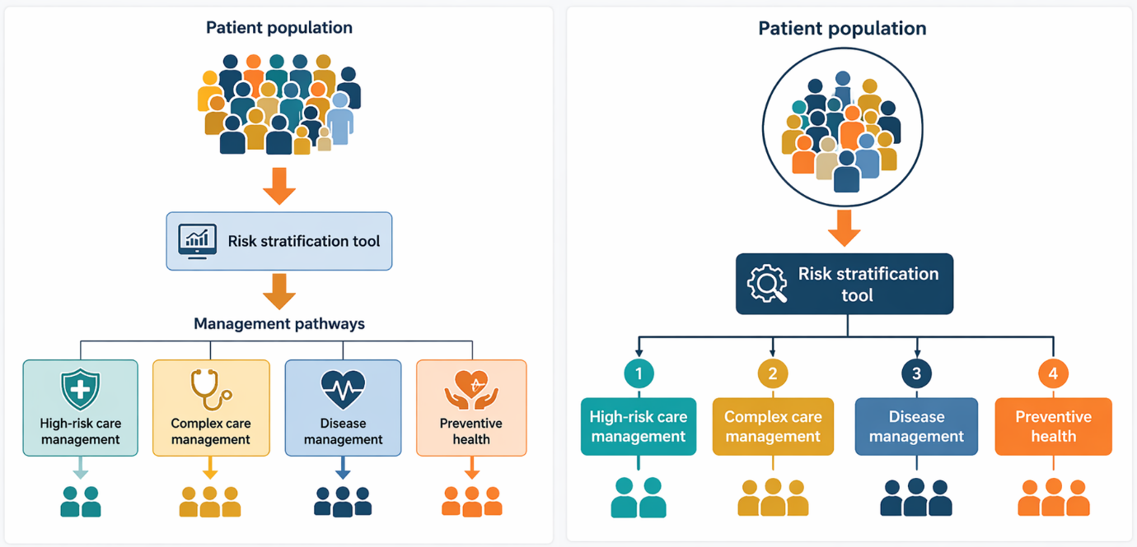
ML Model — Patient Risk Stratification
Model: Logistic Regression
Features
Age · LengthOfStay · TreatmentCost · AbnormalLabCount
Target
0 = Recovered | 1 = Complicated or Deceased
Train / Test
80% train · 20% test · random_state = 42
Class weight
'balanced' — corrects outcome imbalance in dataset
Deployment
Streamlit app · real-time prediction · .pkl model
Risk Tiers Output
High Risk
Medium Risk
Age≥60 · Bad outcome · 3+ abnormal labs
Age≥45 · Complicated · 2+ abnormal labs

Slide 9
How the Three Tools Connect
The same business questions were answered in all three tools — proving analytical thinking, not just syntax.
Business Question
SQL
Excel
Python
Abnormal lab patients
Q3 — WHERE + HAVING
IF + VLOOKUP lab flag
abnormal_conditions dict
Patient risk classification
Q9 — CASE WHEN + CTE
Nested IF severity score
np.where() → ML target
Doctor performance
Q10 — GROUP BY + aggregates
SUMIF revenue per doctor
merge() + groupby().agg()
Monthly trends
Q12 — LAG + cumulative SUM
Pivot Table by outcome
.dt.to_period() + groupby()
Cost segmentation
Q17 — NTILE + PERCENT_RANK
RANK.EQ / RANK.AVG
.rank() + pd.qcut()
Length of stay
Q13 — DATEDIFF + GROUP BY
DATEDIF formula
.dt.days difference

Slide 10
Tech Stack & What's Next
🗄️
📊
🐍
MS SQL Server
Excel (O365)
Python / Pandas
Schema design + 18 analyst queries
12 formulas + VLOOKUP + RANK + Pivot tables
EDA, feature engineering, data merging
🔢
🤖
🌐
NumPy
Scikit-learn
Streamlit
Vectorised ops, np.where, broadcasting
Logistic Regression · train/test · metrics
Interactive patient risk prediction app
What's Next →
Power BI dashboard · SQL Q19 & Q20 (cohort analysis + executive CTE dashboard) · Extended Python EDA with Matplotlib / Seaborn · Random Forest vs Logistic Regression comparison
Hiteshi Aglawe · Aspiring Data Analyst · SQL · Python · Excel · Power BI

