Slide 1
AMAZON
E-Commerce
Sales Analysis
Power BI Capstone Project
Hiteshi Aglawe
September 2026
Revenue • Customers • Products
Delivery • Ratings

Slide 2
Problem Statement
Stakeholders want to sustain performance while improving customer value.
The team is exploring ways to benefit customers through smarter discounts, loyalty benefits and a better shopping experience.
Understand the drivers of revenue, customer value and product performance.
Identify operational friction in delivery, returns and satisfaction.
Create an analysis that supports decisions across product, customer, regional and operations teams.
REVENUE
CUSTOMERS
OPERATIONS
What drives growth?
Who creates value?
What needs improvement?
Main tab: overall sales, revenue and customer satisfaction with category/date slicers.
Product tab: category performance, customer base and improvement opportunities with gender, delivery, category and age-group slicers.
Individual Product tab: detailed product profile including purchase, category, rating and revenue.
Revenue stayed broadly stable through 2015–2019, then jumped to ~₹24M in 2020 — the clearest growth signal in the dataset.

Slide 3
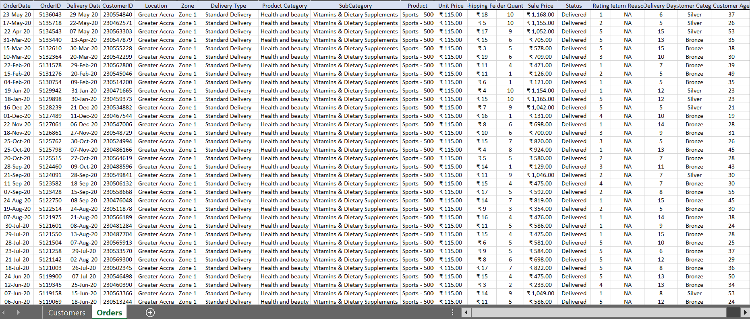
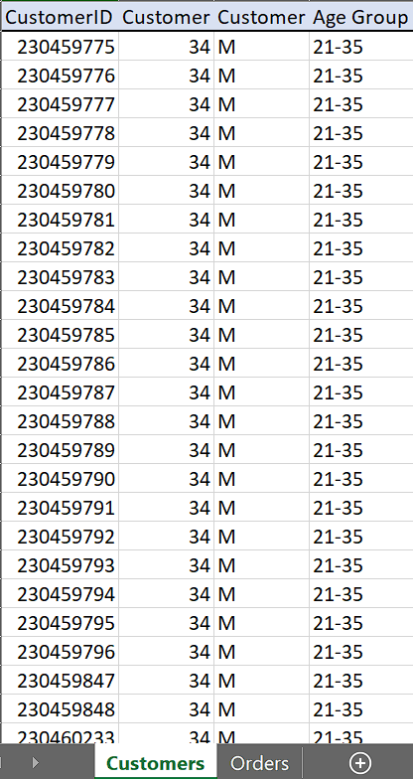
Data Overview
Key preparation: missing values were handled, text fields cleaned, data types validated, and analysis-ready calculated fields such as Delivery Days and Customer Category were created.

Slide 4
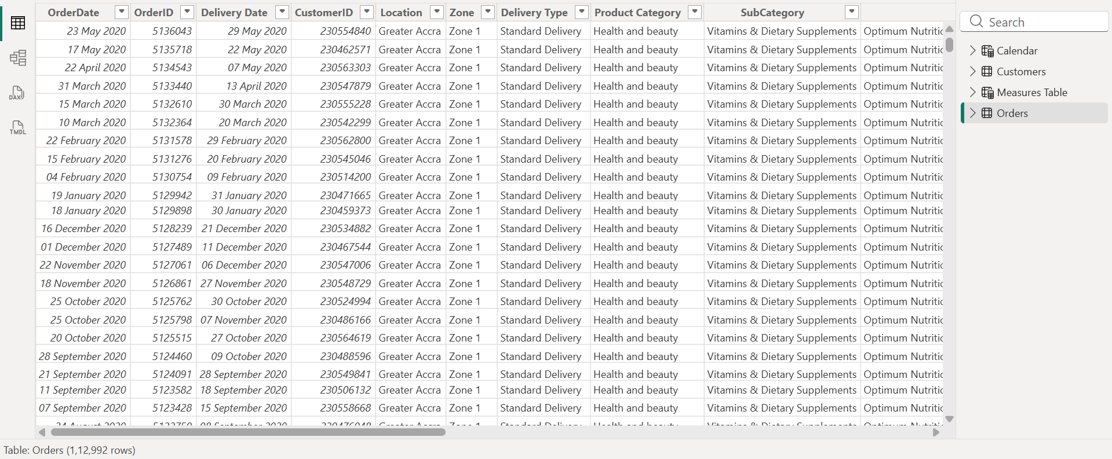
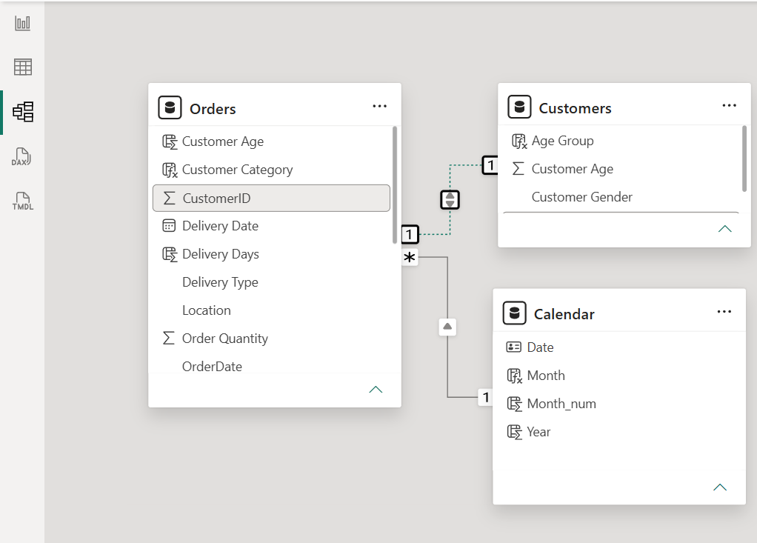
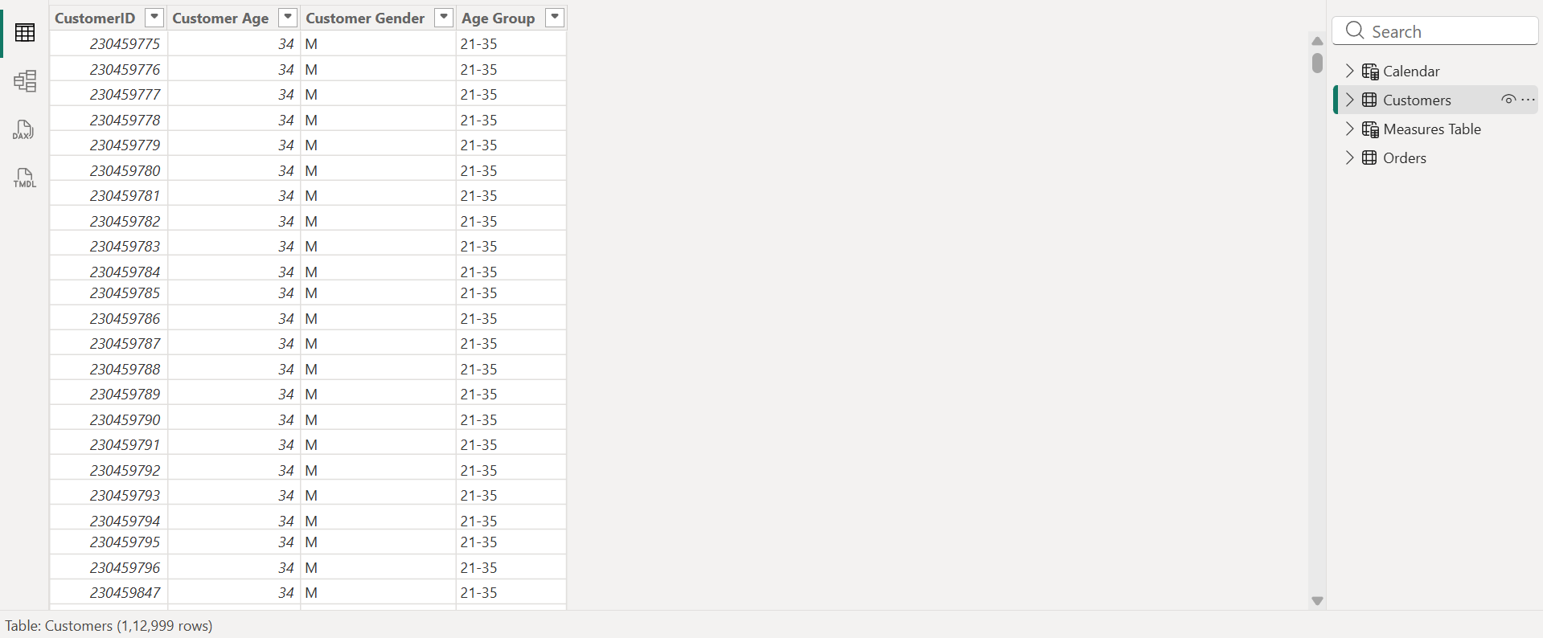
Data Overview
ROWS
CUSTOMERS
PRODUCTS
CATEGORIES
Orders + Customers model | cleaned and prepared for analysis
~113K orders
~113K
44 unique
5
Orders data after transformation
Model relationship
Customers data after transformation

Slide 5
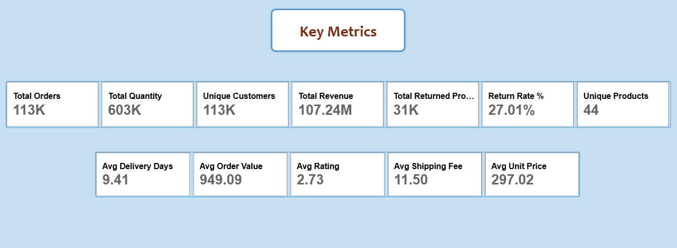
Methodology & KPI Framework
From data cleaning to business storytelling
1
Clean
2
Model
3
Measure
4
Explore
5
Recommend
Power Query profiling, null handling, text cleanup, type checks
Orders–Customers relationship and calculated fields
Revenue, orders, unique customers, ratings, delivery metrics
Time, product, location, delivery, customer and rating patterns
Turn evidence into targeted actions
Analytical features: DAX measures, calculated columns, time intelligence, slicers, field parameters and drill-oriented dashboard views.
Core question: What is happening?
Next question: Why does it matter?
Decision question: What should the business do next?

Slide 6
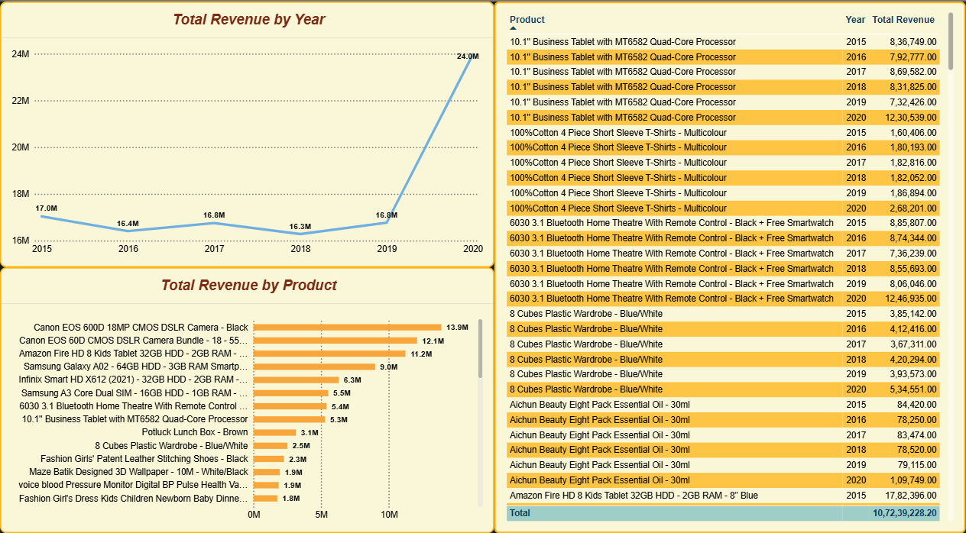
Revenue & Product Performance by year
The 2020 step-up is broad-based, while technology products lead value
Revenue was stable around ₹16–17M from 2015 to 2019, then increased to ~₹24.0M in 2020.
Phones & Tablet (~₹39M) and Electronics (~₹33M) are the strongest category contributors.
Canon EOS 600D, Canon EOS 60D and Amazon Fire HD are among the highest revenue-generating products.
The 2020 uplift appears across categories rather than being isolated to one product line.
The strong jump in 2020 suggests improved sales strategy, higher customer demand, better product performance, or expanded market reach.
Business meaning: protect the strongest technology portfolio while using targeted growth tactics to raise the long tail.

Slide 7
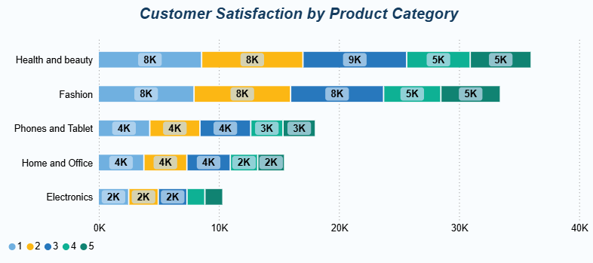
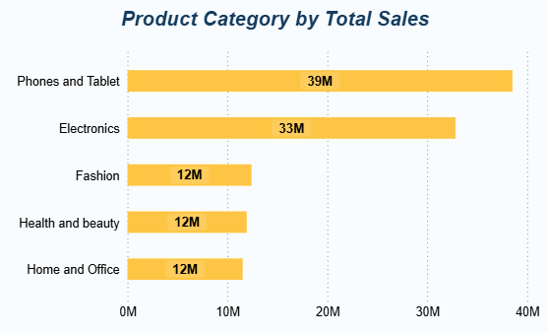
Product Category & Customer Satisfaction
Phones & Tablet and Electronics are the strongest revenue contributors, generating approximately ₹39M and ₹33M respectively.
Fashion, Health & Beauty, and Home & Office contribute around ₹12M each, leaving significant room for targeted growth.
Health & Beauty and Fashion show the highest overall rating volumes, indicating stronger customer engagement and feedback in these categories.
Electronics has the lowest rating volume despite being a high-revenue category, suggesting an opportunity to improve customer feedback collection and engagement.
High revenue does not always translate into stronger customer engagement; Amazon should protect the performance of Electronics and use targeted marketing and customer-feedback initiatives to grow the lower-revenue categories.
Lower-performing categories present an opportunity for growth through targeted marketing, discounts, product bundling, and improved customer engagement strategies.

Slide 8
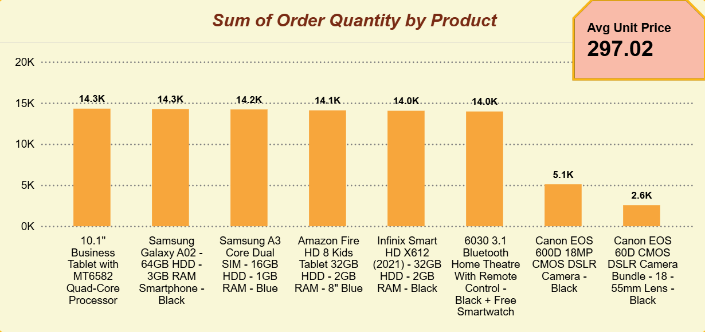
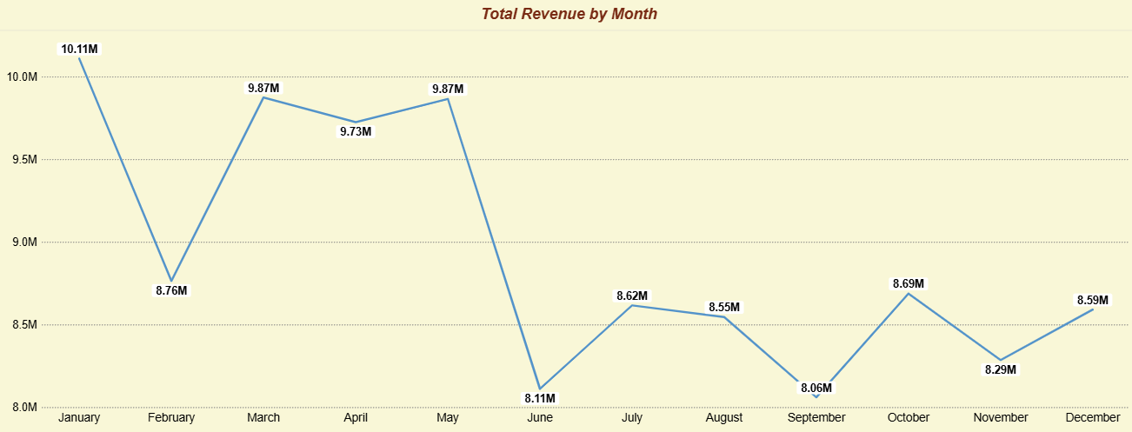
Product & Monthly Sales Trends
Focus effort where demand exists but performance is still under-optimized
Two high-price, low-volume camera products stand out: Canon EOS 600D and Canon EOS 60D bundle.
The opportunity is not simply a blanket discount: improve product visibility, content quality, bundles and affordability options first.
January is the strongest revenue month (~₹10.1M); June and September are among the weakest (~₹8.1M).
Promotions should be concentrated around weaker periods to smooth seasonality instead of discounting evenly all year.

Slide 9
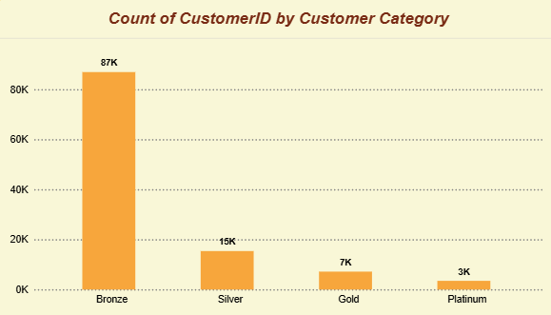
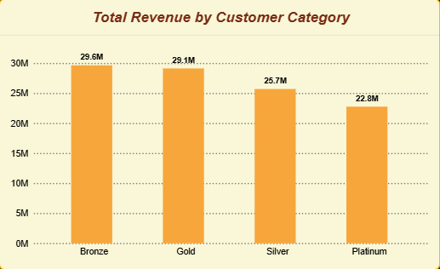
Customer Satisfaction and Category
The dataset contains first-time buyers — so the loyalty goal is conversion to a second order
Bronze is the largest customer segment, with approximately 87K customers, while Silver, Gold and Platinum have much smaller customer bases of about 15K, 7K and 3K respectively.
Revenue is more evenly distributed than customer count: Bronze generates ₹29.6M, Gold ₹29.1M, Silver ₹25.7M, and Platinum ₹22.8M, showing that smaller premium segments still contribute substantial revenue.
The analysis reveals two distinct revenue levers: Bronze drives revenue through customer volume, while Gold and Platinum contribute through higher-value customers despite their smaller populations.
Because the Orders–Customers relationship is 1:1 in this dataset, purchase frequency cannot meaningfully distinguish loyalty tiers; therefore, spend-based segmentation (Bronze → Silver → Gold → Platinum) is the most appropriate interim approach.
The immediate retention opportunity is to convert first-time buyers into second-time customers through welcome-back incentives, followed by tier-specific benefits once repeat-purchase behaviour can be measured.
For long-term customer analytics, Amazon should move toward an RFM-style segmentation (Recency, Frequency, Monetary) once sufficient repeat-order history becomes available, enabling more targeted loyalty and retention strategies.

Slide 10
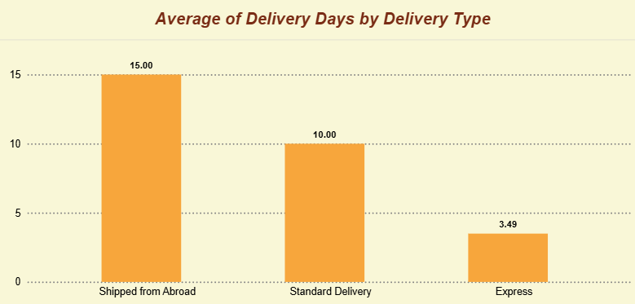
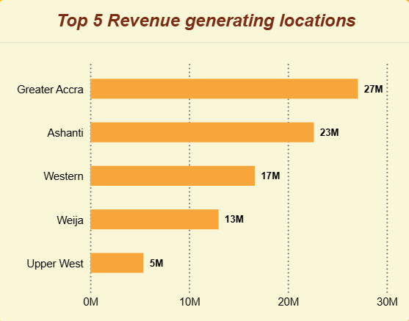
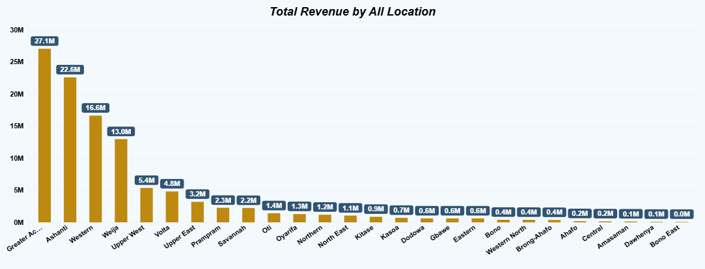
Delivery & Geography
Delivery type drives waiting time; revenue is geographically concentrated
Express averages ~3.5 days, Standard ~10 days and Shipped from Abroad ~15 days.
Average wait time is broadly similar across product categories (~9.5 days), so delivery type is the stronger operational lever.
Greater Accra (~₹27M) and Ashanti (~₹23M) are the leading revenue markets.
The top two locations contribute roughly 47% of total revenue, making regional resource allocation important.

Slide 11

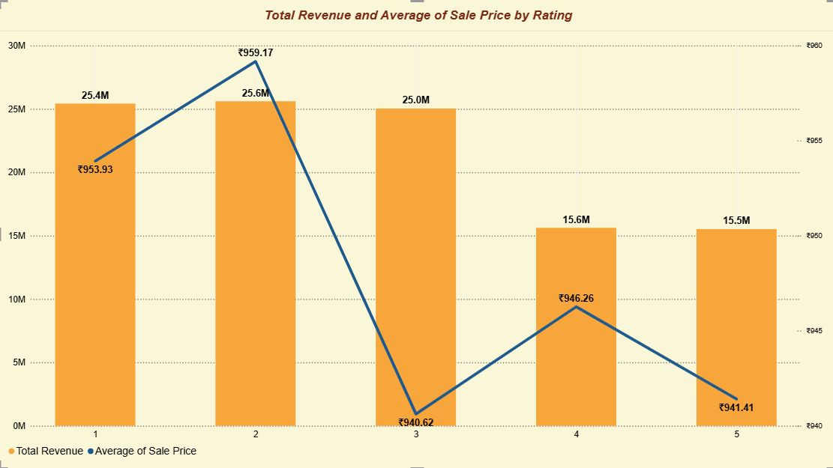
Returns & Customer Experience
Return problems are broad-based — suggesting process fixes, not one-off fixes
~31K orders are returned, roughly 27% of the 113K-order dataset.
Health & Beauty and Fashion have the highest return volumes (~9.7K and ~9K).
Return reasons span quality/defect, missing items, wrong item, expectation mismatch and description mismatch — no single dominant cause.
Average delivery time for low-rated orders is similar to higher-rated orders, so delivery speed alone is unlikely to be the root cause of poor ratings.

Slide 12
Recommendations: Customers & Products
Simple actions to grow value without broad discounts
1
Convert first-time buyers
Use a simple welcome-back offer and track second purchases.
2
Protect high-value customers
Give Gold and Platinum customers stronger benefits and early access.
3
Improve high-price, low-volume products
Improve images, details, visibility and bundles before cutting price.
4
Use promotions selectively
Target weaker months and proven-demand products instead of blanket discounts.
Expected impact: more repeat purchases, better product conversion and fewer unnecessary discounts.

Slide 13
Recommendations: Returns & Delivery
Focus on the biggest customer-experience problems
RETURNS
DELIVERY
QUALITY
Reduce avoidable returns
Improve delivery experience
Strengthen listing & packing quality
Improve product descriptions, images and packing checks in high-return categories.
Prioritize faster delivery where possible and set clear expectations for overseas orders.
Track return reason, delivery time and rating together to find the strongest operational fixes.
Use June–September promotions to support weaker periods instead of discounting all year.
Decision rule: fix customer friction first, then use targeted offers to support growth.

Slide 14
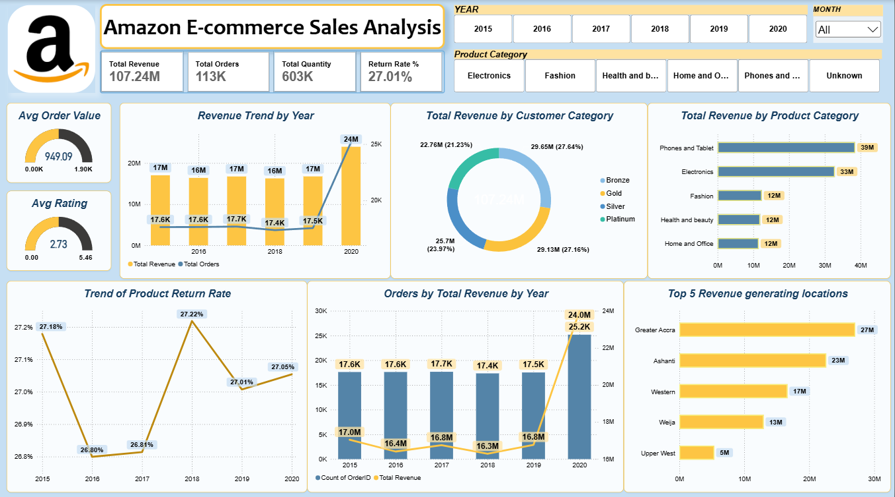
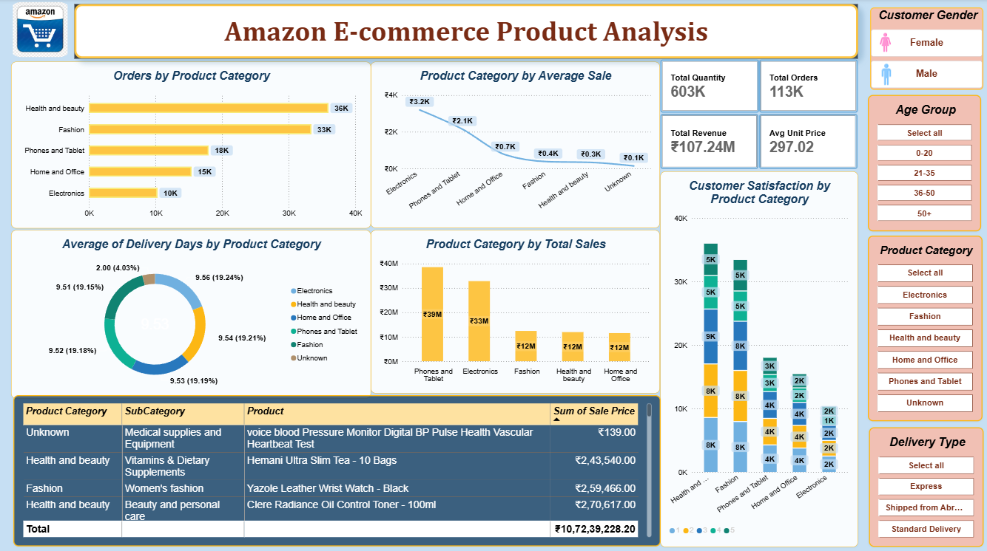

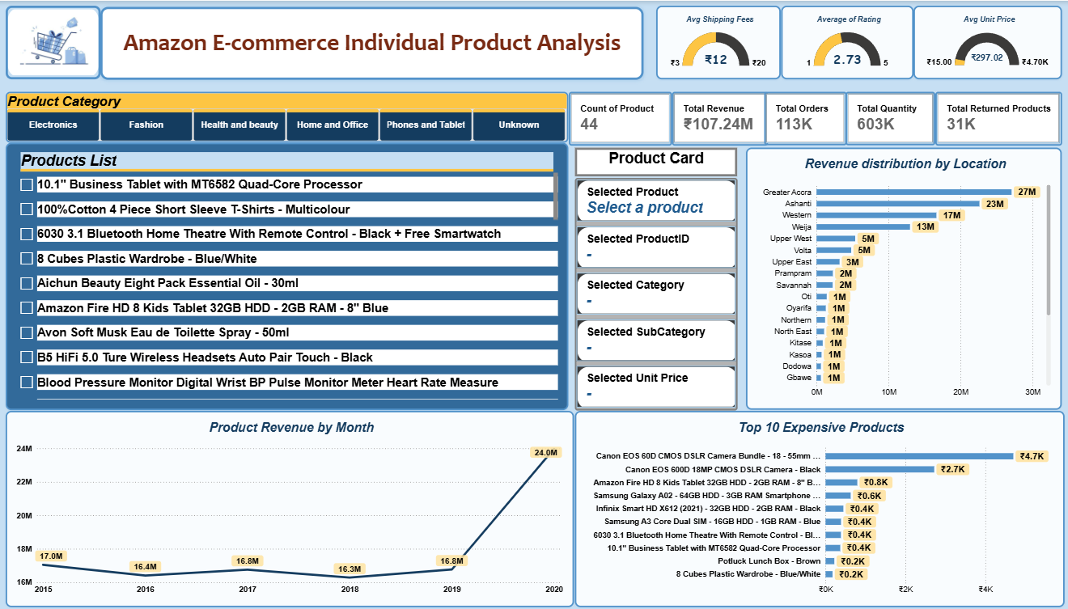
Dashboard & Visualizations
Three interactive Power BI views for quick business decisions
Sales: KPIs, revenue trend, customer segments and category performance.
Product: category, price, rating, delivery and product comparison.
Individual Product: revenue, location, rating and product trends.
Filters: Year, Category, Gender, Age Group, Delivery Type and Product.
Simple, interactive views make it easy to compare performance and focus on key business areas.

Slide 18
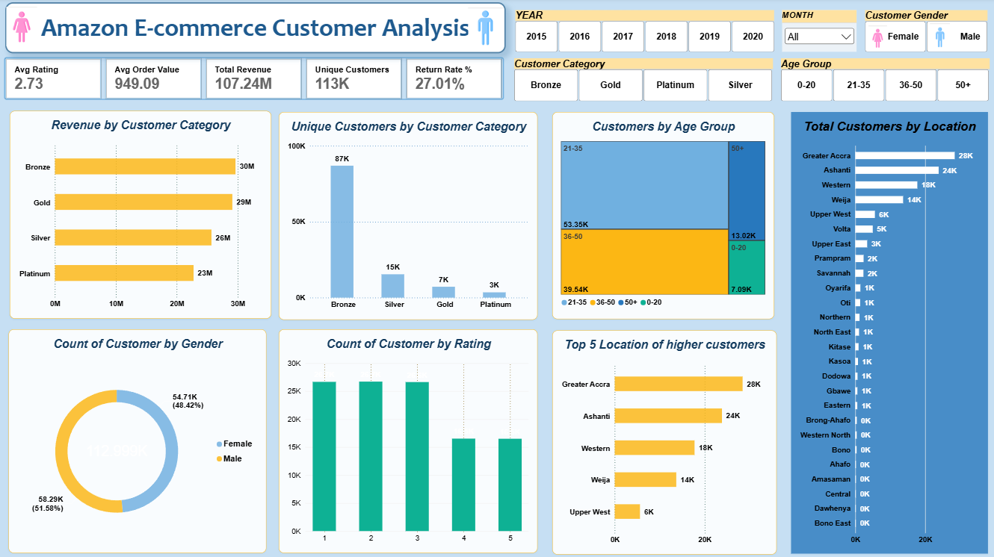

Slide 19
Conclusion
A simple view of what the analysis shows
2020 was the strongest growth year, with Phones & Tablet and Electronics leading revenue.
Bronze is the largest customer group; Gold and Platinum are smaller but still high-value.
Returns are high and spread across several reasons, so product quality and fulfilment need attention.
Delivery type has the clearest impact on waiting time, especially for overseas orders.
The dashboard turns these findings into practical actions: retain customers, reduce friction and target growth where it matters most.
Bottom line: protect strong categories, improve customer experience and use targeted growth actions.

Slide 20
Thank You
Hiteshi Aglawe

