Slide 1
SOCIAL MEDIA ANALYSIS
SQL Project
User activity • engagement • relationships • marketing insights
Submitted By: Hiteshi Aglawe

Slide 2
Agenda
1
Business problem & scope
4
Objective and Subjective findings
2
Data landscape / Database Schema
5
Marketing Strategy and Actions
3
Key Metrics and Visualization
6
Limitations & conclusion
2

Slide 3
Problem Statement
Problem statement
Tools & deliverables
The marketing team wants to use Instagram user data to increase engagement, retention and acquisition.
The analysis translates SQL findings into actionable audience, creator and content strategies.
Microsoft SQL Server / SSMS
Word documentation + management presentation
Analysis questions covered
Objective: 13 questions covering data quality, activity, engagement, network behaviour, tags and monthly engagement.
Subjective: 10 questions covering retention, influencers, segmentation, advertising, ambassadors and analytical approach.
The presentation emphasizes findings and business implications rather than reproducing the full report.
3

Slide 4
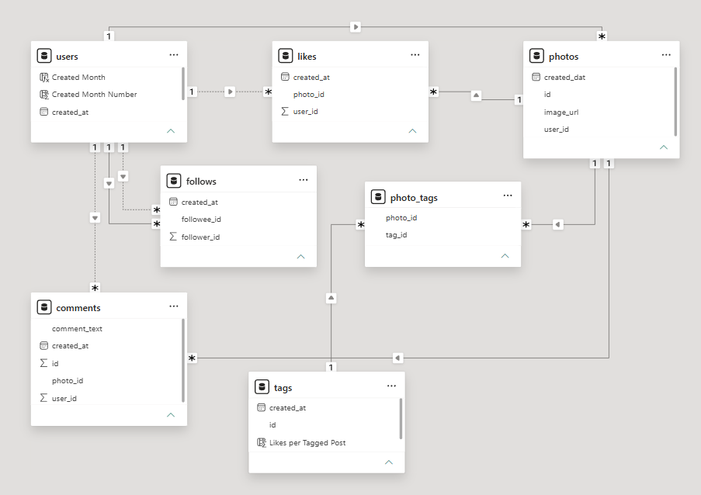
Data landscape | 7 related tables
users
Identity & registration
comments
Comments
follows
Follower/followee network
photo_tags
Photo–tag bridge
photos
Posts created
likes
Likes given
tags
Unique tags

Slide 5
Executive summary
Key facts from the SQL data and the documented analysis
100
users
base size
257
photos
posts in dataset
8,782
likes
total like records
7,488
comments
total comment records
7,623
follows
relationship records
21
tags
unique tags
Largest engagement finding
Largest retention signal
Eveline95 ranks #1 with 749 total engagement = 420 likes + 329 comments received.
26 users have no posts; 23 users have never liked any post; 31 users have used no tags.

Slide 6
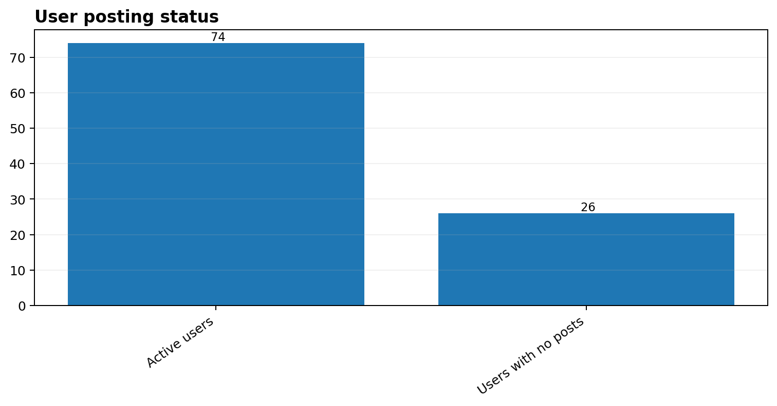
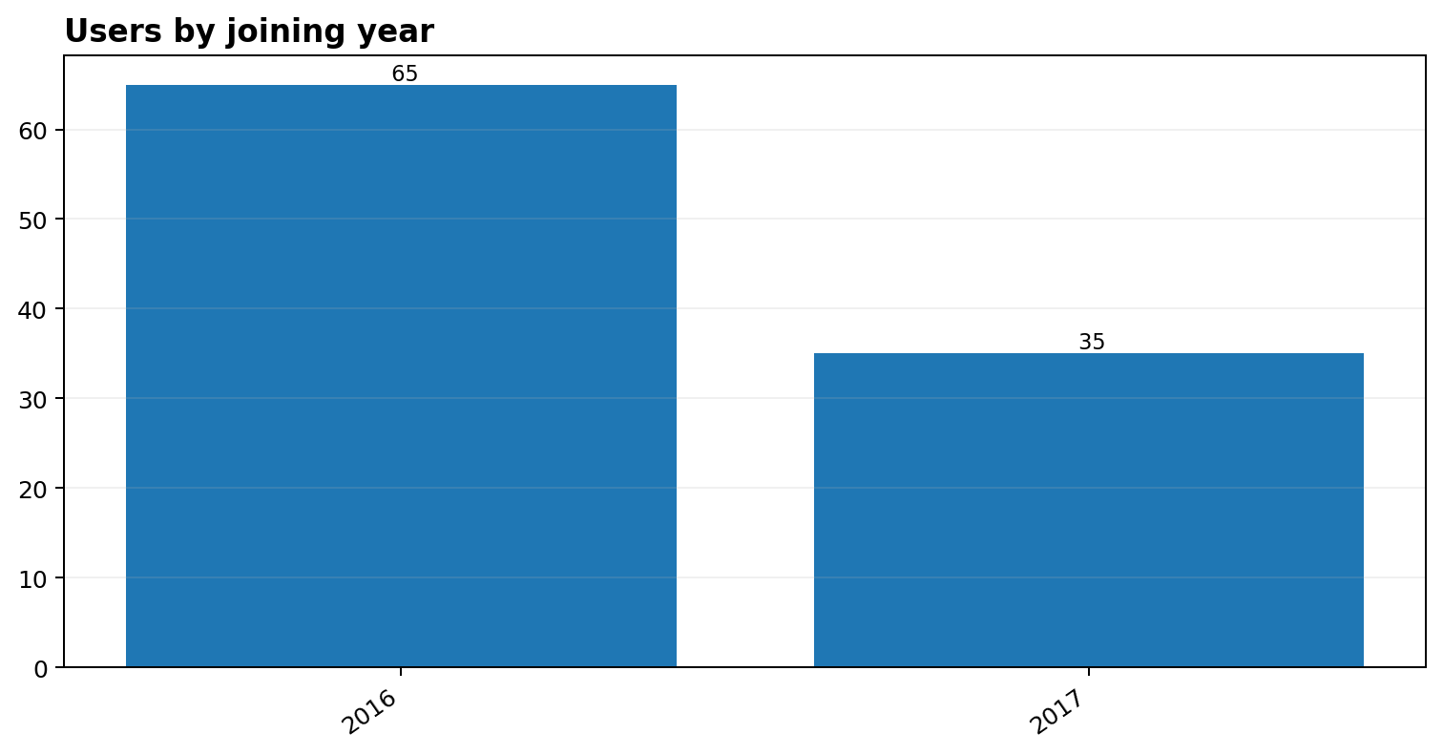
KEY METRICS AND VISUALIZATION
1. USERS ANALYSIS
31
Users with no tag usage
discoverability opportunity
23
Users who never liked
reactivation signal
74 users have at least one post; 26 have no posts. The dataset therefore contains a meaningful retention/re-engagement opportunity.

Slide 7
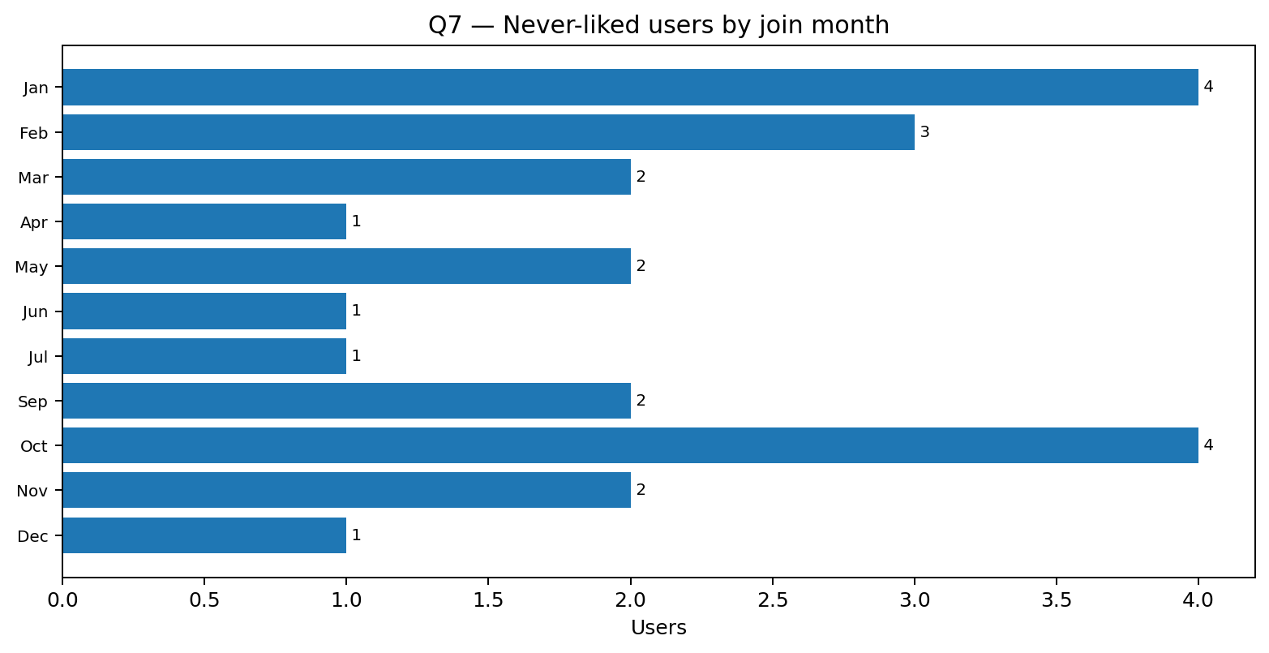
Users who have never liked a post
23
Never-liked users
Q7 result
Important nuance
“Never liked” is not the same as “completely inactive”. Some users may post or comment without liking posts.
Recommended action
Separate true inactivity from alternative interaction behaviour before launching reactivation campaigns.

Slide 8
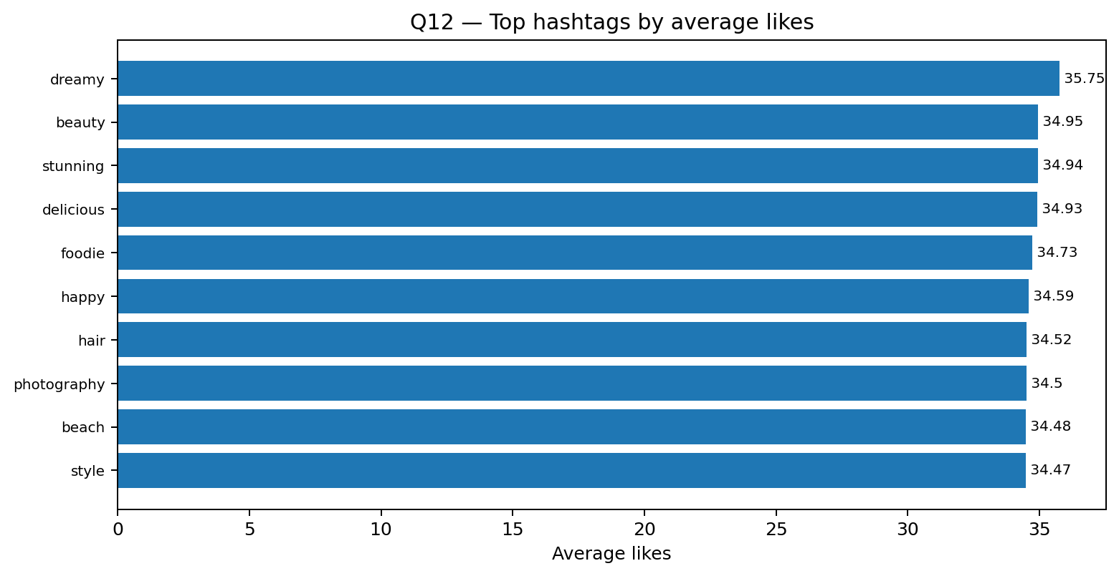
2. TAGS ENGAGEMENT
1.95
Average tags per post
Q3 result: 1.949416...
21
Unique tags
Q3/Q12 tag universe
501
Photo-tag links
Tag associations
Q12 — Top hashtag signals
1. dreamy — 35.75 avg likes
2. beauty — 34.95
3. stunning — 34.94
4. delicious — 34.93
Business use
Use higher-performing themes for content experiments and relevant ad creatives; do not rely on hashtag frequency alone.

Slide 9
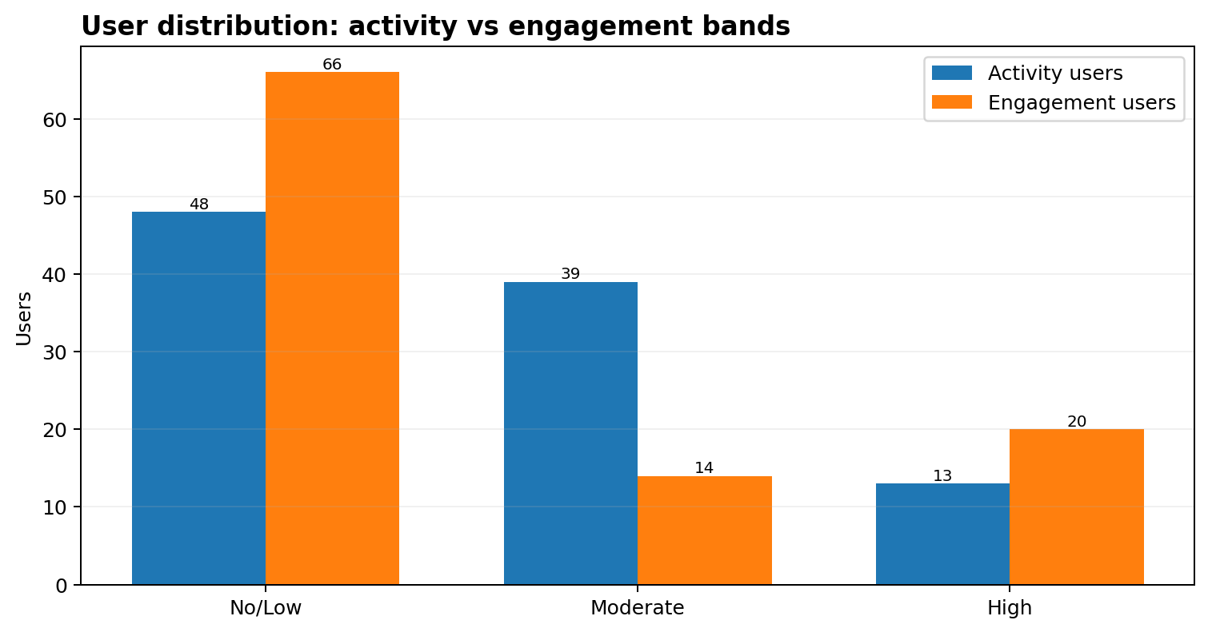
3. ACTIVITY AND ENGAGEMENT SEGMENTATION
Activity = posts + likes given + comments made.
Engagement = likes + comments received on the user's posts.
13 users have zero recorded activity; 13 fall into the high-activity band.
20 users have high engagement (300+), while 26 have zero engagement.
Use these as behavioural signals; refresh segments as behaviour changes.

Slide 10
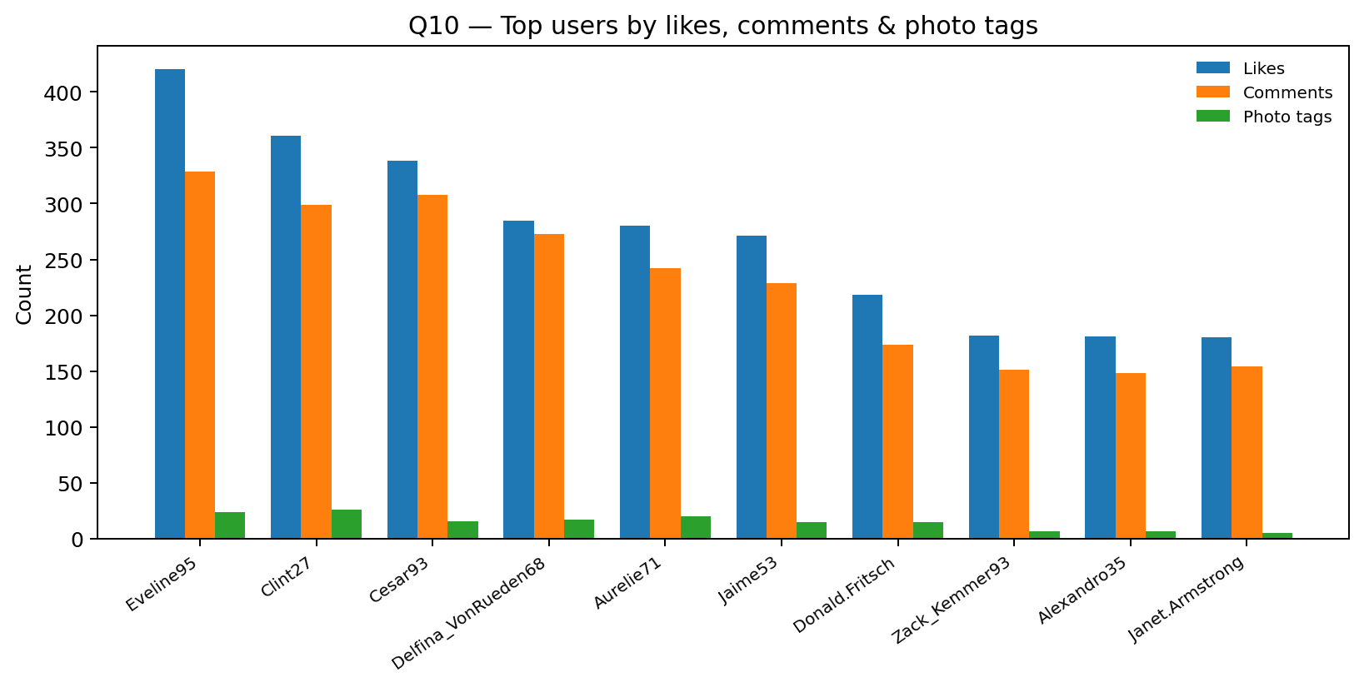
User-level interaction profile
Top user profile
Eveline95: 420 likes received, 329 comments received, 24 photo tags.
Clint27: 361 likes, 299 comments, 26 photo tags.
Why separate aggregations?
Likes, comments and tags are aggregated separately before joining to avoid join fan-out and inflated counts.
SQL technique
Three aggregation subqueries + LEFT JOIN.

Slide 11
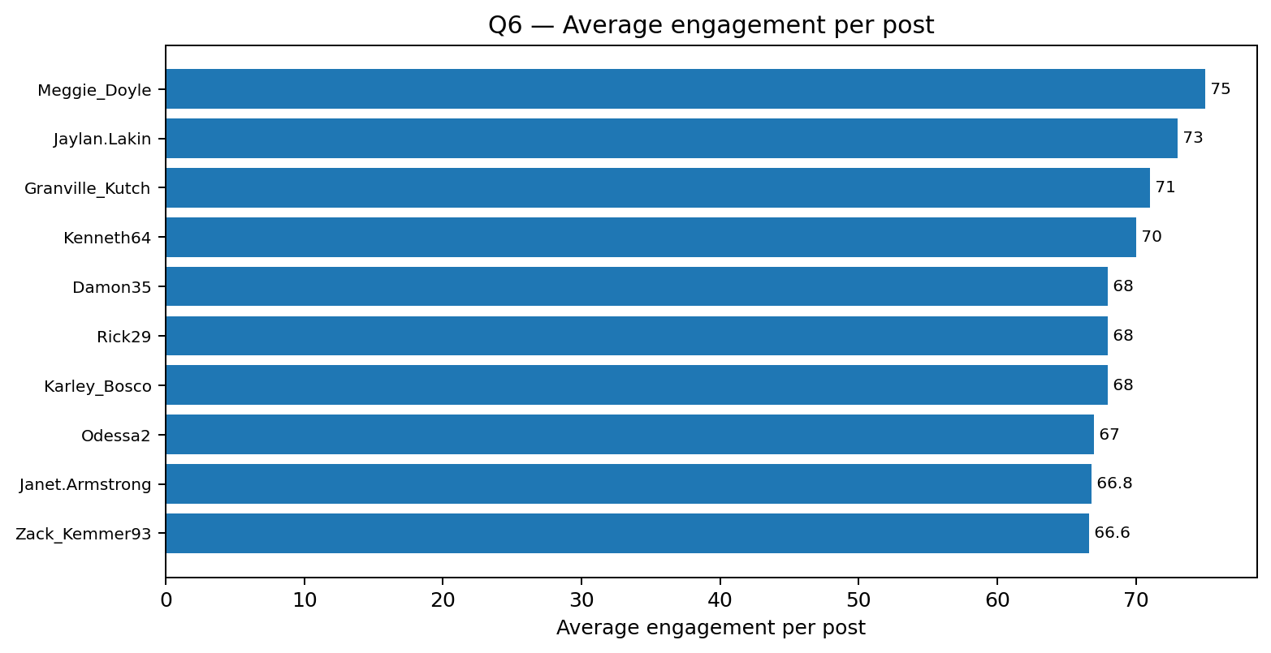
Engagement efficiency per post
Top average engagement
Meggie_Doyle — 75.0
Jaylan.Lakin — 73.0
Granville_Kutch — 71.0
Kenneth64 — 70.0
Key insight
The Q6 leaders differ from the Q4 leaders. Average engagement helps identify efficient content performers rather than only high-volume creators.
SQL technique
Per-post aggregation + SUM / COUNT.

Slide 12
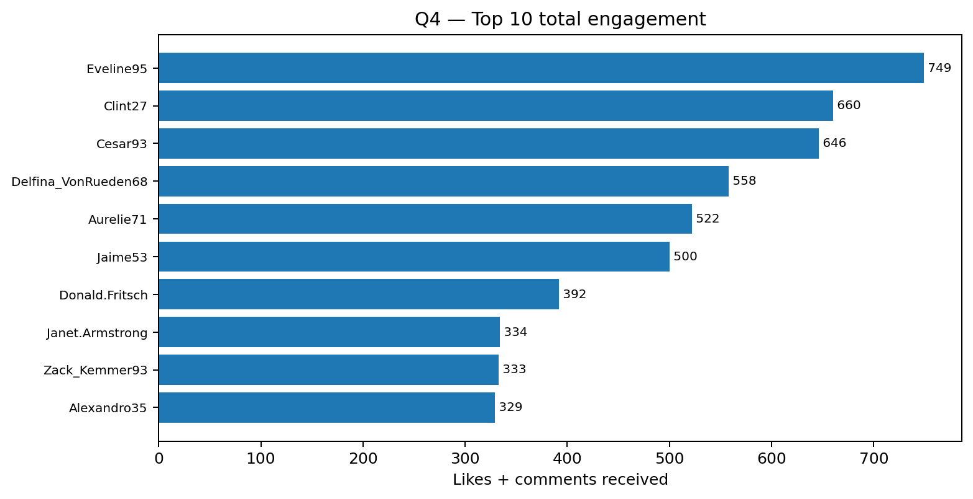
Who generates the most engagement?
Top 3
Eveline95 — 749
Clint27 — 660
Cesar93 — 646
What the ranking tells us
These users generate the strongest interaction volume on their content.
Useful for creator, loyalty and advocacy shortlists.
SQL technique
CTE + pre-aggregated likes/comments + RANK().

Slide 13
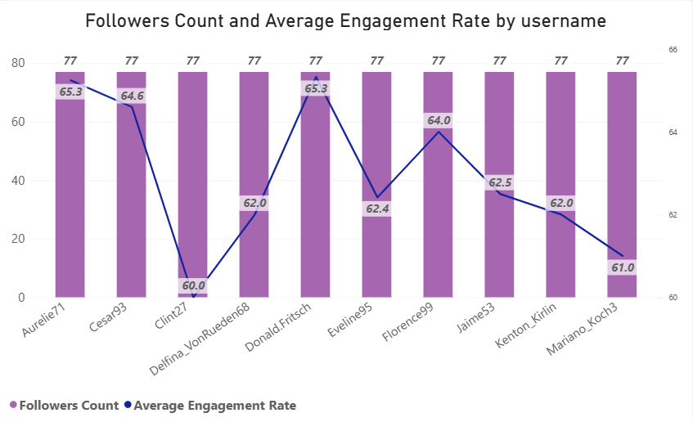
4. REACH AND CONNECTIVITY
Top 10 users are tied at max 77 followers.
Follower count can support creator reach; following count signals network connectivity.
Users with more posts generally accumulate more total engagement.
Average engagement per post stays broadly around the low-to-mid 60s across posting volumes.
Recommendation: encourage consistent quality content, not posting volume alone.
This avoids treating the strong post-count/total-engagement relationship as proof that more posts always perform better.
10

Slide 14
USER & SEGMENTATION
INACTIVE / NO ACTIVITY
LOW ACTIVITY
MODERATE ACTIVITY
HIGH ACTIVITY
13 users
Activity = 0
Priority: low-friction reactivation
35 users
Activity = 1–149
Priority: prompts, content discovery
39 users
Activity = 150–249
Priority: participation + community
13 users
Activity = 250+
Priority: loyalty / creator programs
NO ENGAGEMENT
LOW ENGAGEMENT
MODERATE ENGAGEMENT
HIGH ENGAGEMENT
26 users
Engagement = 0
Reactivation signal
40 users
Engagement < 200
Nurture + discovery
14 users
Engagement = 200–299
Strengthen participation
20 users
Engagement = 300+
Creator / advocacy potential
SEGMENTATION PRINCIPLE
Use activity + engagement + follower reach + content relevance together. A high-follower user is not automatically the most valuable user.

Slide 15
MARKETING STRATEGY
1 USER RETENTION
2 ENGAGEMENT & CONTENT
3 CREATOR & ACQUISITION
Concern
• 26 users have no posts
• 23 users never liked any post
• 13 users have zero recorded activity
Strategy
• Low-friction reactivation prompts
• Personalized content reminders
• Limited-time challenges used carefully
• Track reactivation, repeat activity and retention
Concern
• 31 users have no tag usage
• Average tags/post = 1.95
• High-performing themes are close together
Strategy
• Promote tagging education
• Test themes such as dreamy, beauty and stunning
• Use polls, prompts and community challenges
• Measure engagement lift, not just participation
Opportunity
• Top total engagement = 749
• Top average engagement/post = 75
• Highest follower level = 77
Strategy
• Shortlist creators using reach + engagement
• Reward consistent contributors
• Build creator / ambassador programs
• Validate audience fit before partnership
22

Slide 16
ACTION PLAN & SUCCESS MEASURES
01
RETENTION
Re-engage the 26 users with no posts and the 23 users who never liked a post.
Measure: reactivation + repeat activity
02
ENGAGEMENT
Use tagging prompts, polls and simple participation challenges to move low/moderate users upward.
Measure: engagement per active user
03
CREATOR PROGRAM
Shortlist creators using follower reach together with total engagement and engagement efficiency.
Measure: creator participation + engagement
04
CONTENT
Test themes associated with higher average likes, such as dreamy, beauty and stunning.
Measure: average likes / post
05
ACQUISITION
Use creator partnerships, referrals and improved onboarding to attract and activate new users.
Measure: new-user activation + retention
06
MEASUREMENT
Establish a baseline before each intervention and compare results after implementation.
Measure: lift vs baseline

Slide 17
DATA LIMITATIONS | what management should not over-interpret
No shares table — Q11 uses likes + comments only.
No content-type field — Cannot compare photos vs videos vs reels.
No age / gender / location — No reliable demographic targeting analysis.
Default interaction timestamps — Historical monthly / time-of-day trends are unreliable.
Photo timestamp limitation — Posting-time conclusions are unreliable with the supplied created_dat field.

Slide 18
CONCLUSION
01
RETENTION OPPORTUNITY
02
ENGAGEMENT & CREATORS
03
CONTENT + DATA
26 users have no posts and 23 have never liked a post.
Top total engagement is 749; top average engagement is 75 per post.
Dreamy leads the hashtag signal at 35.75 average likes.
The clearest immediate opportunity is targeted re-engagement.
Use reach + engagement together to identify valuable creators and users.
Use content themes for experimentation, while improving missing data for deeper analysis.
Use the current data to target retention, engagement and creator actions — and improve the data foundation before making deeper historical or demographic decisions.
Success should be visible in:
Reactivated users • Repeat activity • Engagement per post • Creator participation • Retention

Slide 19
THANK YOU
Social Media Analysis | SQL
Submitted By: Hiteshi Aglawe

