Slide 1
Coffee Quality Institute
Non Profit Organisation
Working With Growers, Processors, Roasters and Other Stakeholders
Help to improve coffee quality and value worldwide
Submitted by : Hitesh Verma

Slide 2
Objective:
To figure out what factors improve the coffee quality.
To figure out what factors degrade the coffee quality.
To figure out what to do for the best coffee quality.

Slide 3
What determines coffee quality?
Total Cup points-
Calculated by sum of score of sensory attributes.
Sensory Attributes:
Aroma, Acidity, Aftertaste, Flavour, Clean Cup, Body, Balance, Sweetness, Uniformity, Overall.

Slide 4
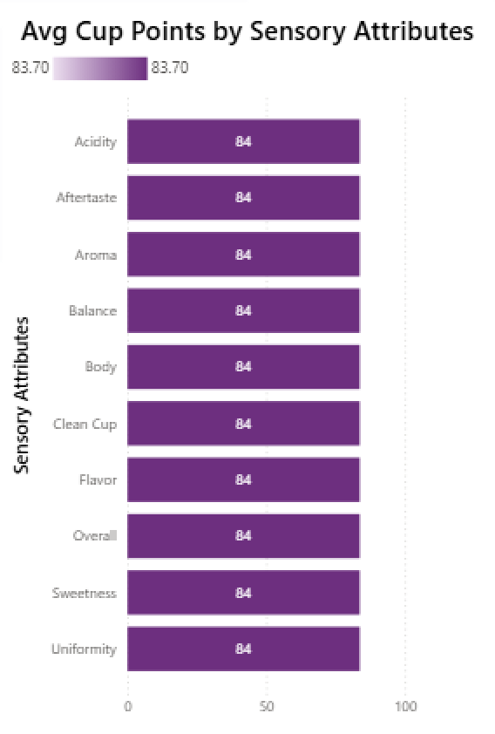
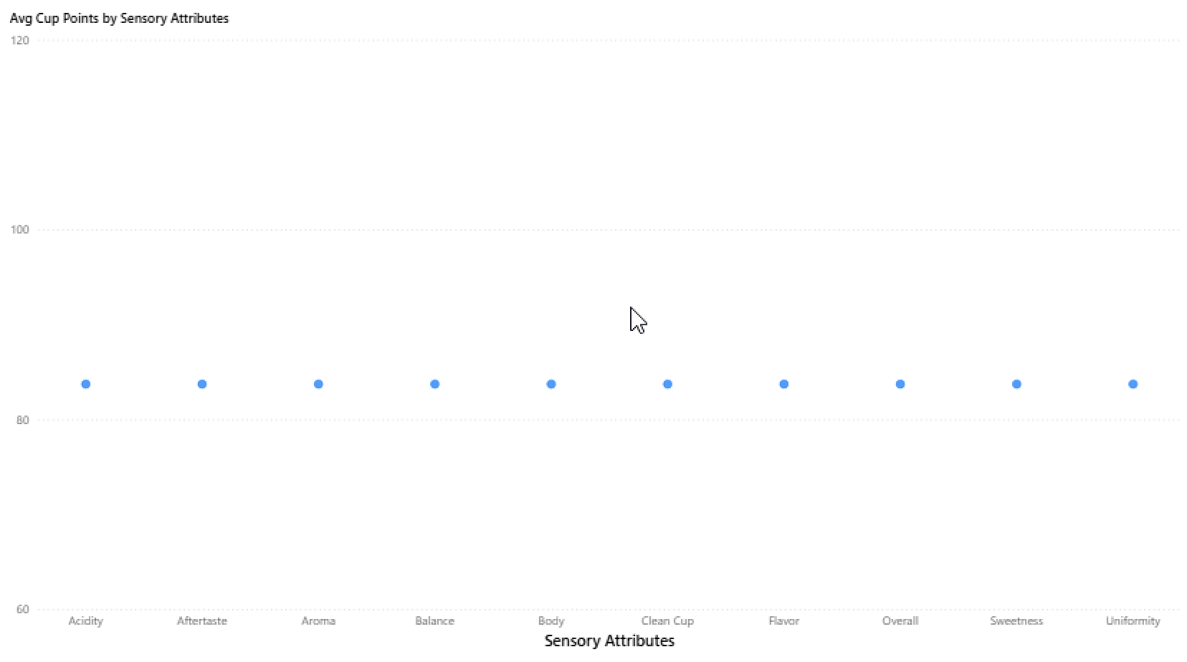
What key Attributes influence the fluctuations in coffee points?
All sensory attributes equally determine Total Cup points.

Slide 5
What could be affecting Total cup point?
Defects- Category 1 and Category 2 Defects.
Quakers
Moisture Percentage
Coffee Age
Processing Methods
Variety
Altitude
Country
Region

Slide 6
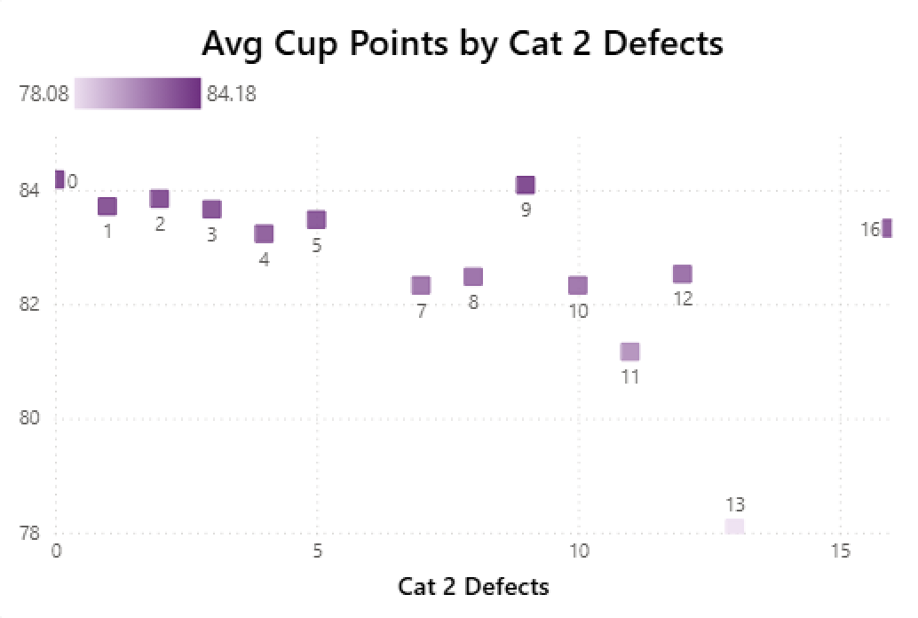
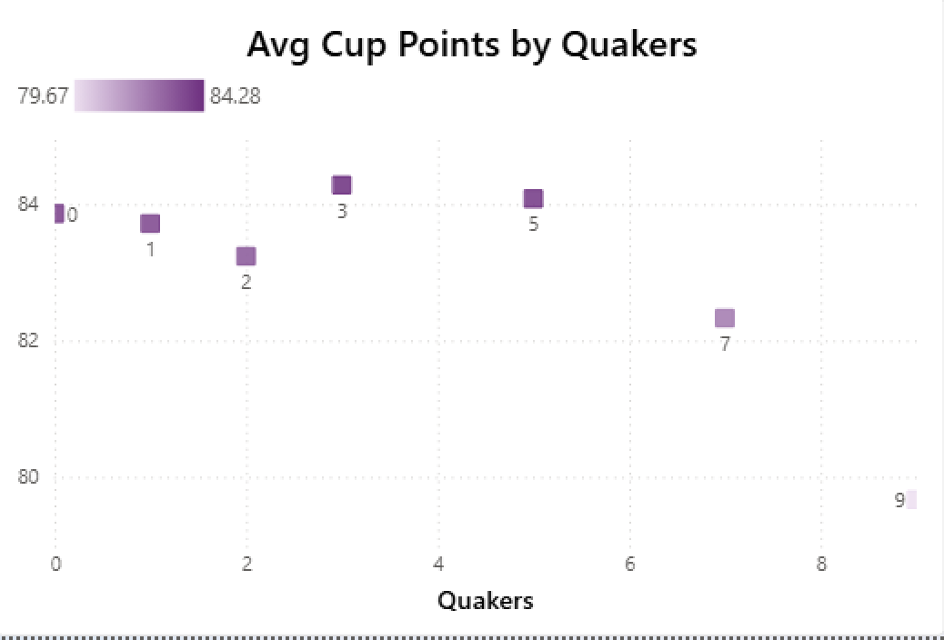
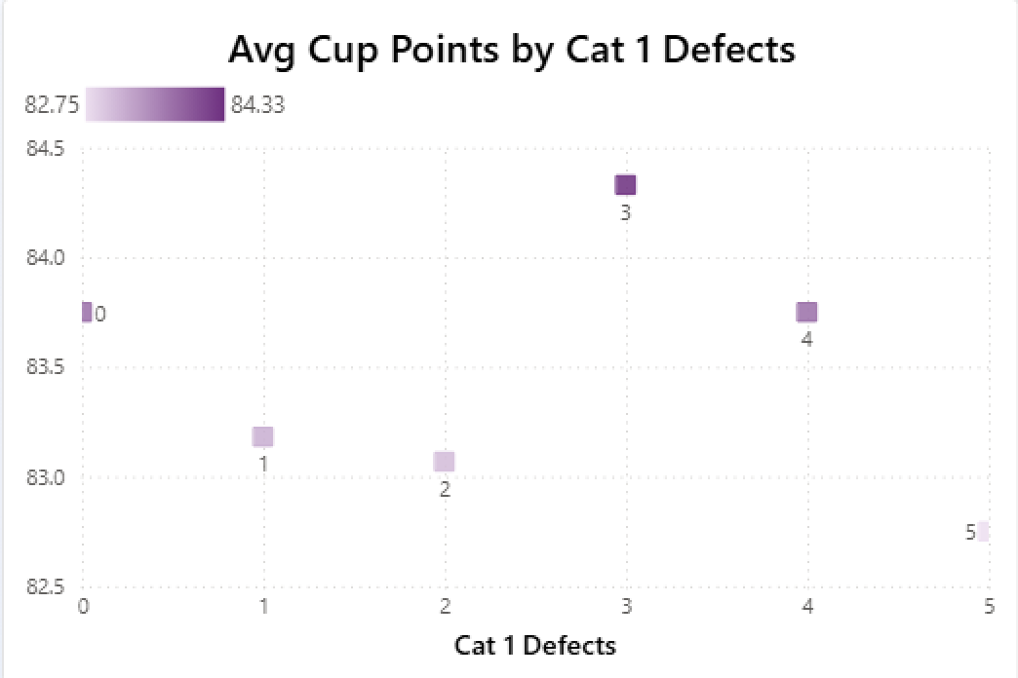
What is actually Affecting?

Slide 7
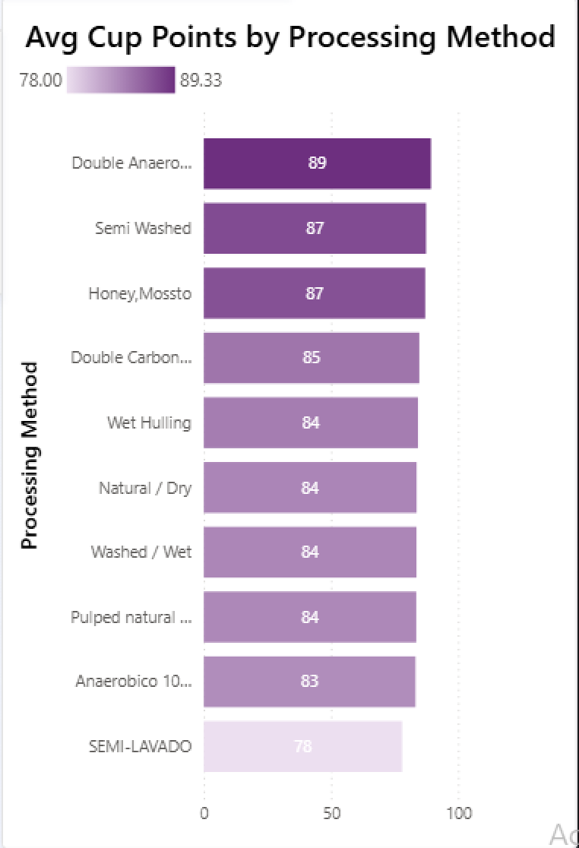
What is actually affecting?

Slide 8
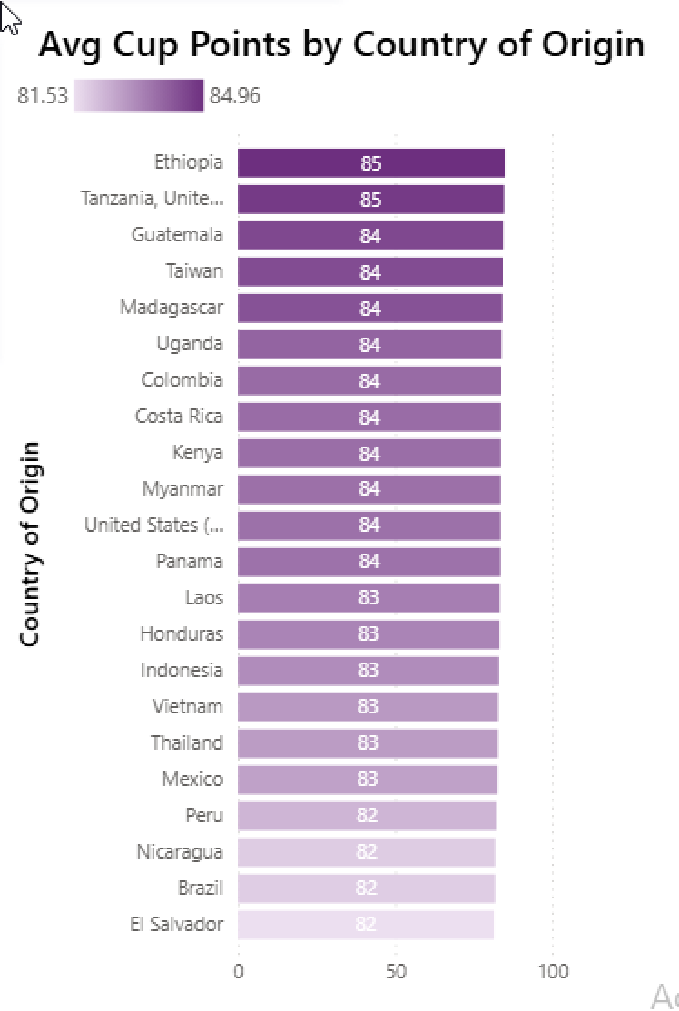
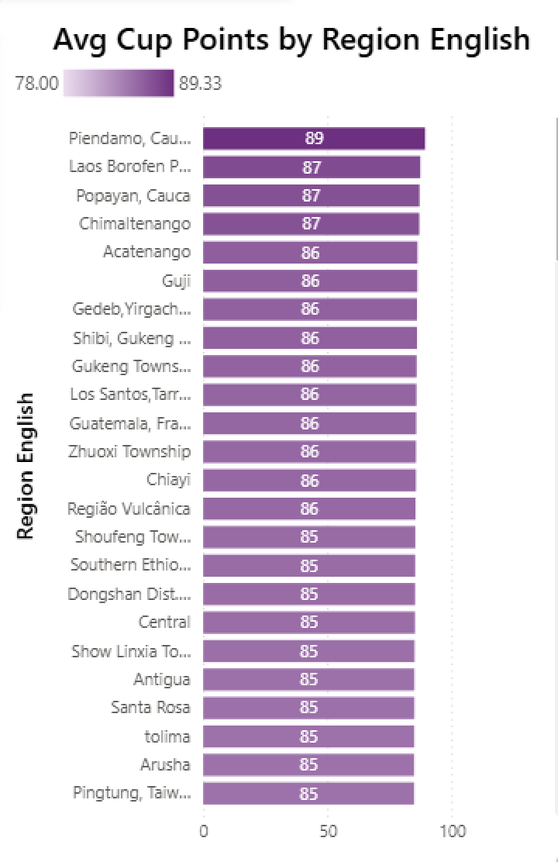
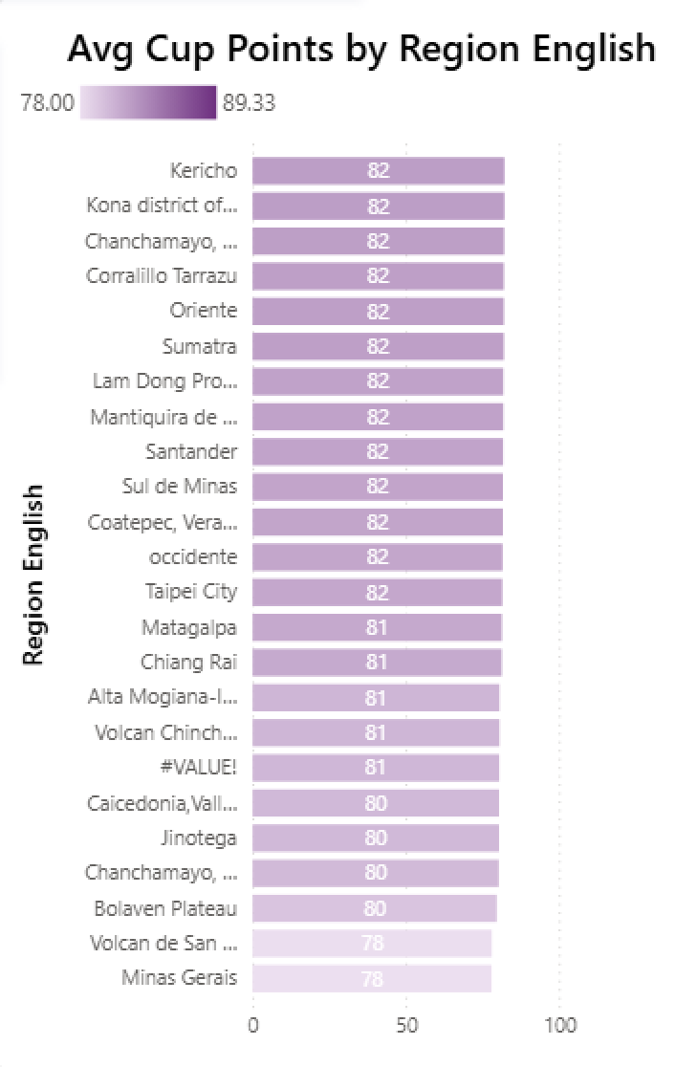
What is Actually not affecting?

Slide 9
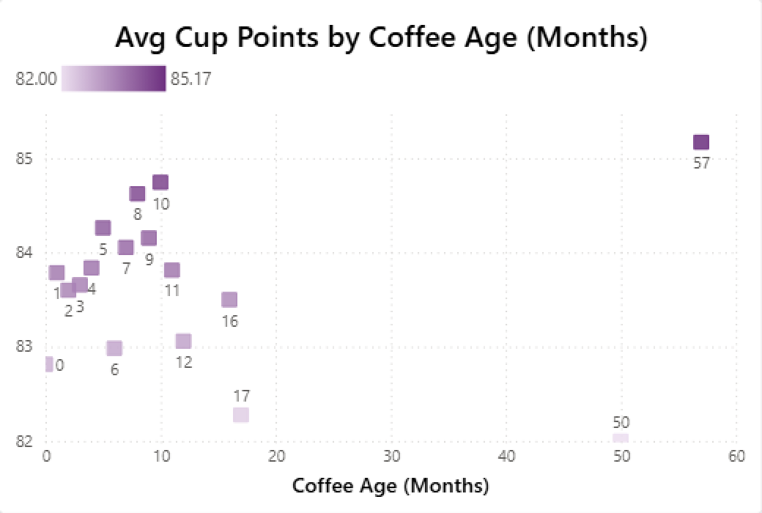
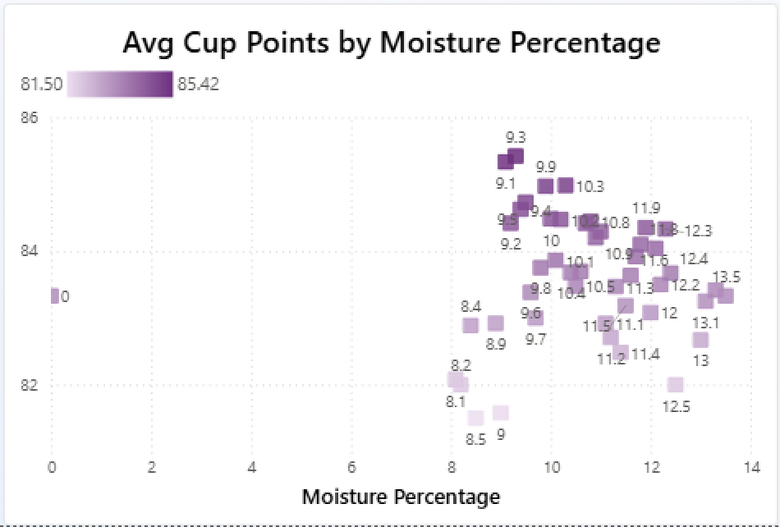
What is not affecting Total cup points?

Slide 10
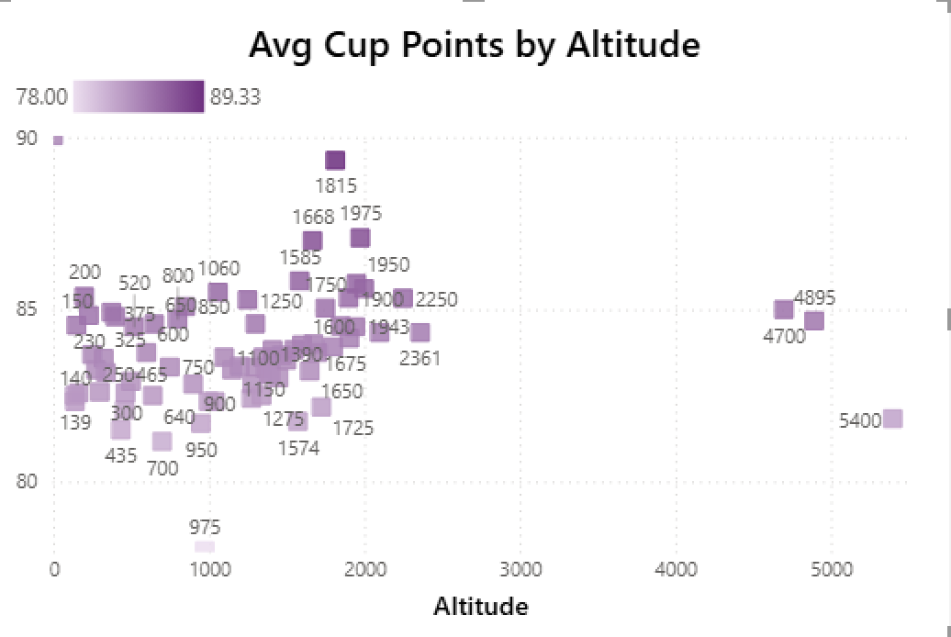
What is not affecting Total cup points?

Slide 11
Top Categories by Total Cup points:
Processing Method | Variety | Country | Region | Avg Quakers | Moisture % | Defects 1 | Defects 2
Double Anaerobic Washed | Castillo | Columbia | Piendamo Cauca | 0 | 11.80 % | 0 | 3
Variety | Processing Method | Country | Region | Avg Quakers | Moisture % | Defects 1 | Defects 2
Castillo | Double Anaerobic Washed | Columbia | Piendamo Cauca | 0 | 11.80% | 0 | 3
Country | Processing method | Variety | Region | Avg Quakers | Moisture % | Defects 1 | Defects 2
Ethiopia | Natural/Dry | Gesha | Guji | 1.73 | 11.08% | 0 | 2
Region | Processing Method | Variety | Country | Avg Quakers | Moisture % | Defects 1 | Defects 2
Piendamo Cauca | Double Anaerobic Washed | Castillo | Columbia | 0 | 11.80% | 0 | 3
The most Repeated values tell us that they are actually good and the key influencers of Total cup points.

Slide 12
Lowest Categories by Total cup points:
Processing Method | Variety | Country | Region | Avg Quakers | Moisture % | Defects 1 | Defects 2
Semi Lavado | Mundo Novo | Brazil | Minas Gerais | 0 | 11.30 % | 0 | 1
Variety | Processing Method | Country | Region | Avg Quakers | Moisture % | Defects 1 | Defects 2
Catuai and Mundo Novo | Natural/ Dry | Brazil | Alta Mogiana-Ibiraci | 1.00 | 11.60% | 0 | 2
Country | Processing method | Variety | Region | Avg Quakers | Moisture % | Defects 1 | Defects 2
El Salvador | Pulped/Natural Honey | Pacamara | Chalatenango | 5.29 | 11.20% | 0 | 4
Region | Processing Method | Variety | Country | Avg Quakers | Moisture % | Defects 1 | Defects 2
Minas Gerais | Semi Lavado | Mundo Novo | Brazil | 0 | 11.30% | 0 | 1
The most Repeated values tell us that they are actually bad and actually degrading Total cup points.
The most Repeated values in Top and lowest are not determining Total Cup Points.

Slide 13
Top Categories:
Lowest Categories:
Processing Method | Variety | Country | Region
Double Anaerobic Washed | Castillo | Columbia | Piendamo Cauca
Processing Method | Variety | Country | Region
Semi Lavado | Mundo Novo | Brazil | Minas Gerais
Moisture % and Category 1 Defects are almost same in both top and lowest Table, which means these are not the determining factors of Total Cup Points.

Slide 14
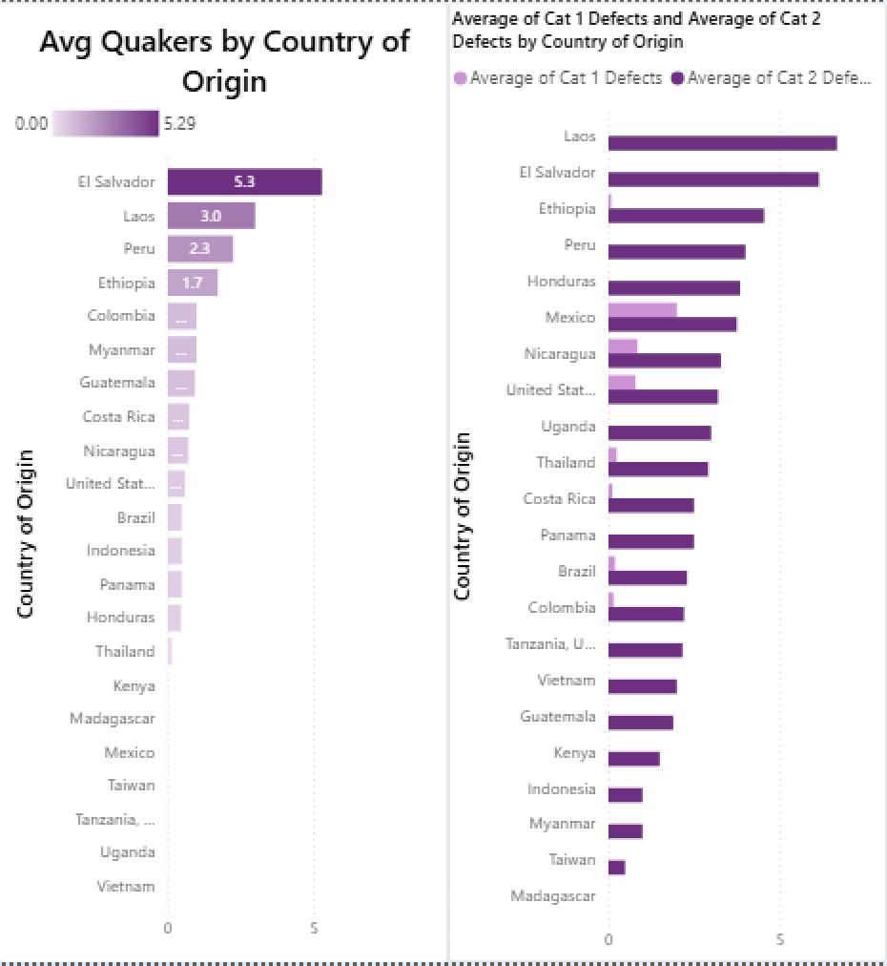
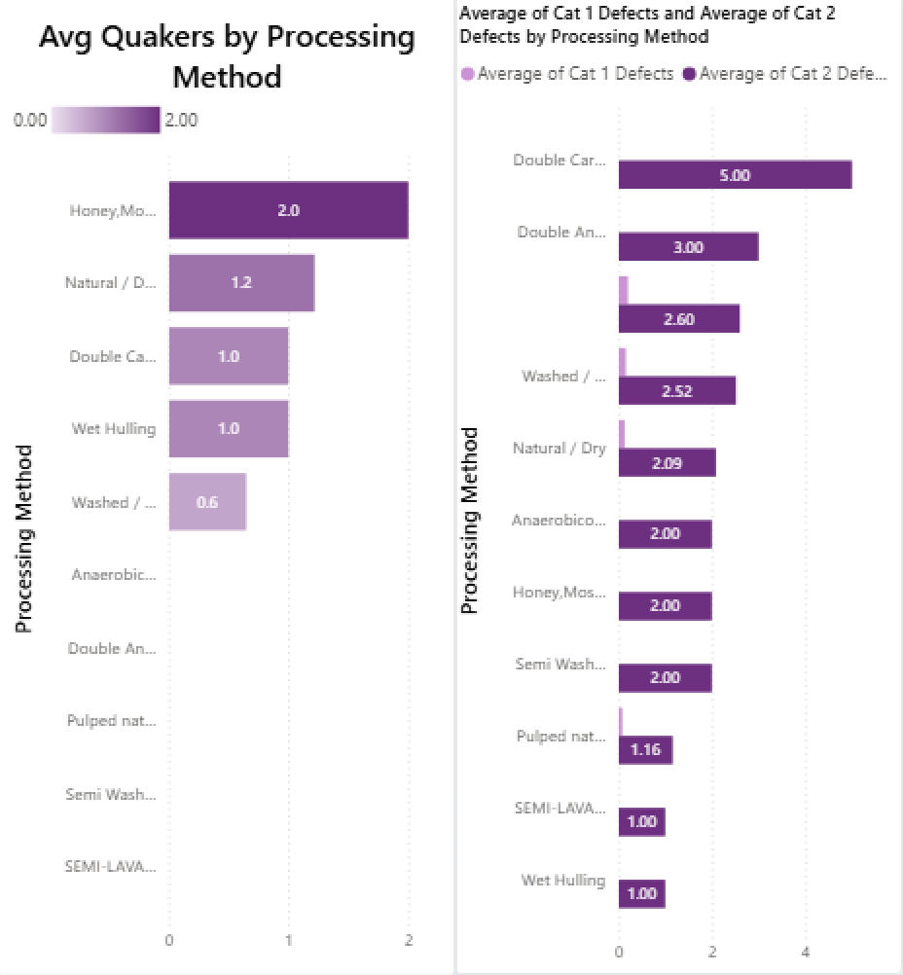
Quakers and Defects by Different Categories:

Slide 15
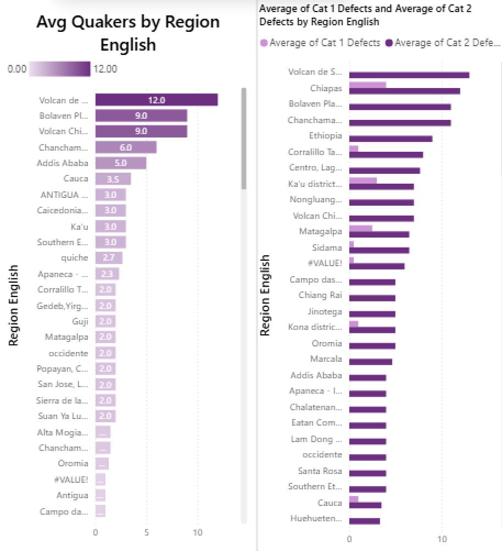
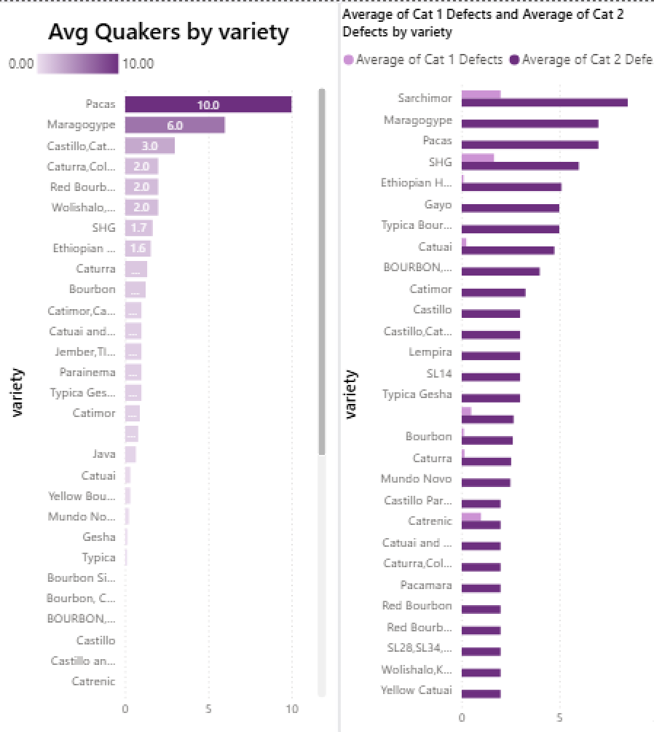
Quakers and Defects by Different Categories:

Slide 16
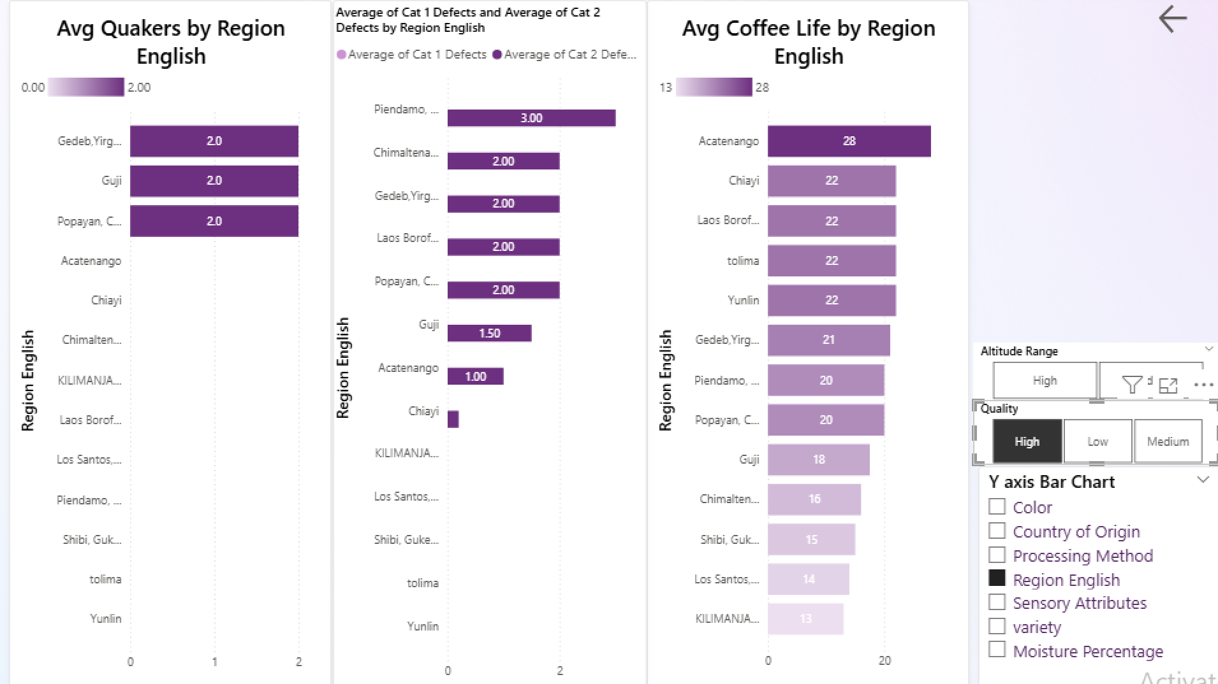
Best performing Categories with least defects and Quakers:

Slide 17
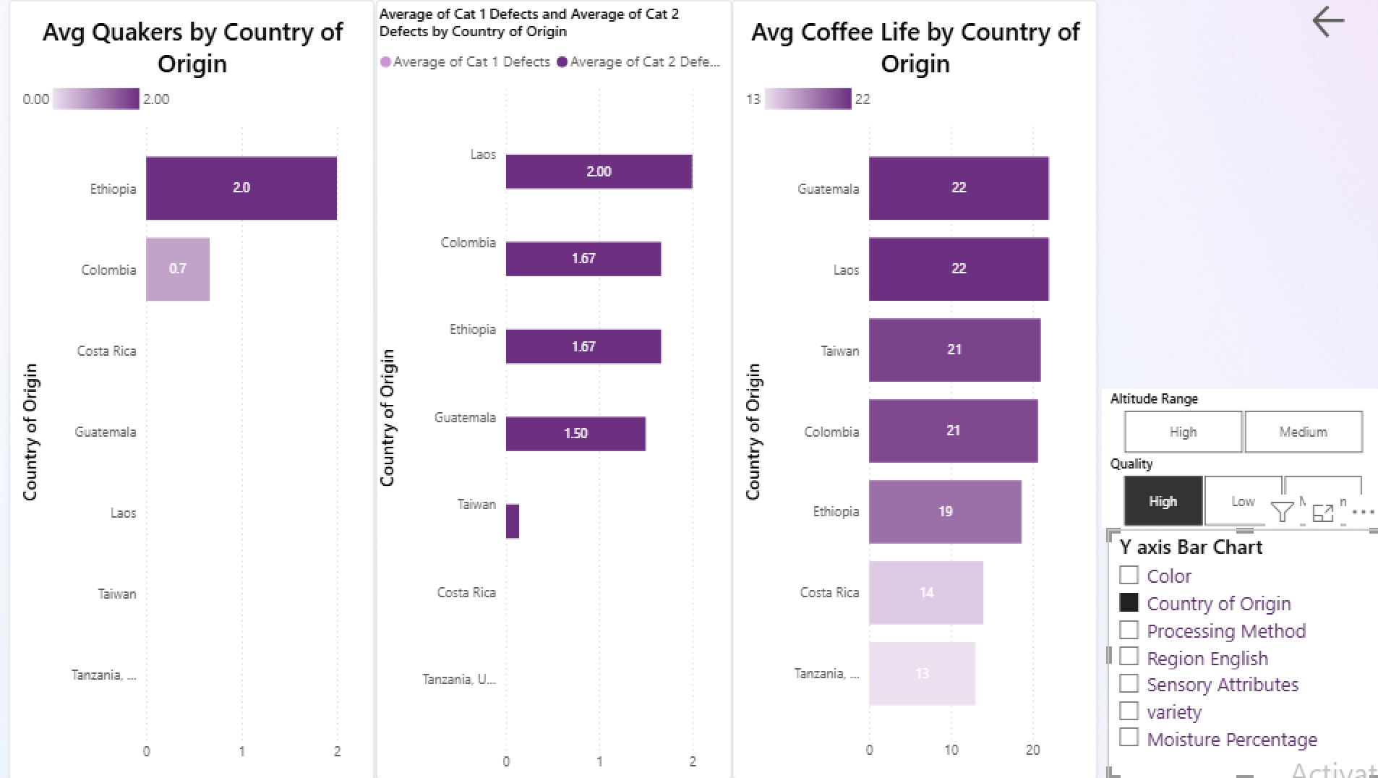
Best performing Categories with least defects and Quakers:

Slide 18
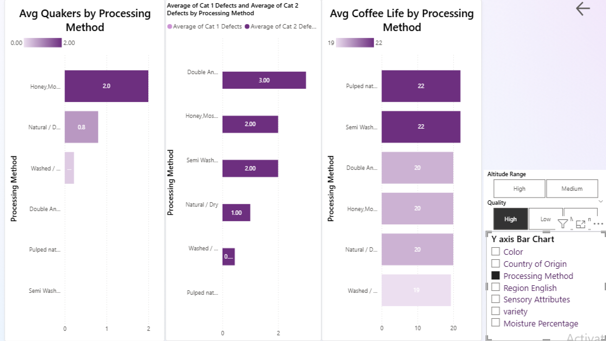
Best performing Categories with least defects and Quakers:

Slide 19
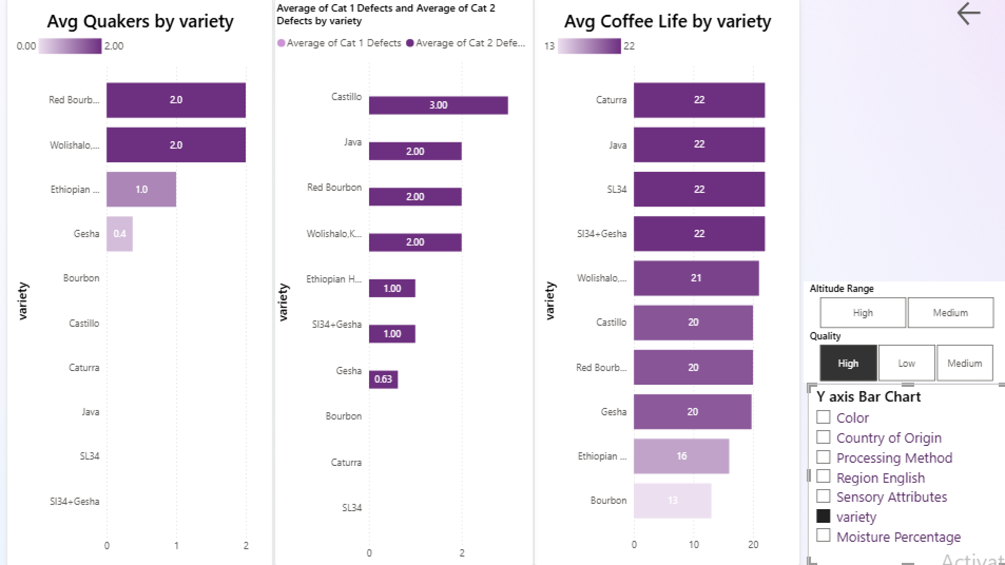
Best performing Categories with least defects and Quakers:

Slide 20
Best performing Categories with least defects and Quakers:
The common Categories with least quakers and defects in both charts will be the best .
Processing Method | Pulped Natural Honey | Washed/ Wet | Natural/ Dry
Variety | Bourbon | Caturra | SL34 | Gesha
Country | Tanzania | Costa Rica | Taiwan
Region | Kilimanjaro | Los Santos | Shibi | Tolima | Yunlin | Chiayi | Acatenango
These Categories along with the top categories can be used for a good coffee quality. The country and region will help us with things like type of soil, temperature etc. for better coffee quality with less defects and quakers.

Slide 21
Top Categories:
Lowest Categories:
Processing Method | Variety | Country | Region
Double Anaerobic Washed | Castillo | Columbia | Piendamo Cauca
Processing Method | Variety | Country | Region
Semi Lavado | Mundo Novo | Brazil | Minas Gerais
Moisture % and Category 1 Defects are almost same in both top and lowest Table, which means these are not the determining factors of Total Cup Points.

Slide 22
Thank You

