Slide 1
DATA VISUALIZATION & ANALYTICS - COURSE PROJECT
E-Commerce Visual Analytics
Understanding Customer Satisfaction and Retention in a Brazilian E-Commerce Marketplace
Project Team 8

Slide 2

PROJECT TEAM
Team 8 Members
Tanisha Sushil
22DS3000166
22ds3000166@ds.study.iitm.ac.in
Ansh Rajani
22F3000955
22f3000955@ds.study.iitm.ac.in
Hitesh Binjrawat
22F2001255
22f2001255@ds.study.iitm.ac.in
Hitesh
22F2001256
22f2001256@ds.study.iitm.ac.in
Pratik Dey
21F2000710
21f2000710@ds.study.iitm.ac.in
01 / 13

Slide 3
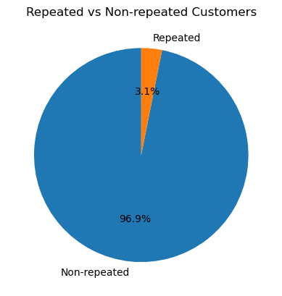
THE PROBLEM
Customers buy once. They rarely come back.
96.9%
“The marketplace looks healthy on paper - 4.16/5 average review, 93.3% on-time delivery. So why do so few customers ever come back, and where should the business intervene?”
of customers place exactly one order, ever
3.1%
repeat-purchase rate across 96,096 customers
Repeat vs. one-time customers
02 / 13

Slide 4
OUR APPROACH
From raw data to a tested recommendation
01
02
03
04
Clean
Explore
Explain
Recommend
Six raw tables cleaned — missing values and outliers handled explicitly, never silently imputed.
Order, customer, seller, and category-level EDA to find where satisfaction breaks down.
Connect review complaints to specific states, sellers, and product categories.
Size the affected customers and propose targeted, testable actions.
Datasets used
Master order table - 95,830 orders
Customer-level master table - 96,096 customers
Seller-level master table - 3,095 sellers
Product category table - 73 categories
Marketing-funnel table - 8,000 leads
Sentiment- and topic-mined customer reviews
03 / 13

Slide 5
METHODOLOGY
Built on explicit cleaning decisions, not fabricated data
1
Missing review scores were dropped, not imputed
2
Outliers were capped, originals preserved
A review score can’t be meaningfully guessed from other columns without fabricating signal.
IQR-flagged outliers were written to separate _capped columns so sensitivity could be checked, not assumed away.
3
A known data-quality flag was surfaced, not hidden
4
Placeholder values were recoded, not trusted
active_seller_flag is True for 100% of sellers - it carries no signal and is excluded from every analysis here.
95% of marketing-funnel “declared revenue” fields were unanswered-survey zeros - recoded to NaN with explicit has_declared_revenue flags.
04 / 13

Slide 6
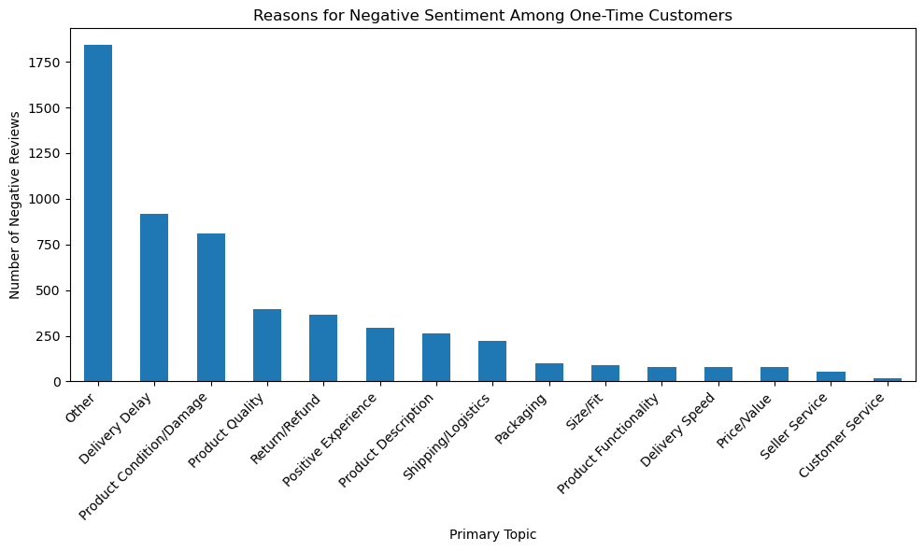
WHAT ARE THEY COMPLAINING ABOUT?
Delivery and product issues dominate negative reviews
Among one-time customers who left a negative review, delivery delay and product condition/damage are the two largest named complaint themes.
These complaints alone don’t prove causation - the rest of this analysis tests whether they actually predict dissatisfaction and non-return.
05 / 13

Slide 7
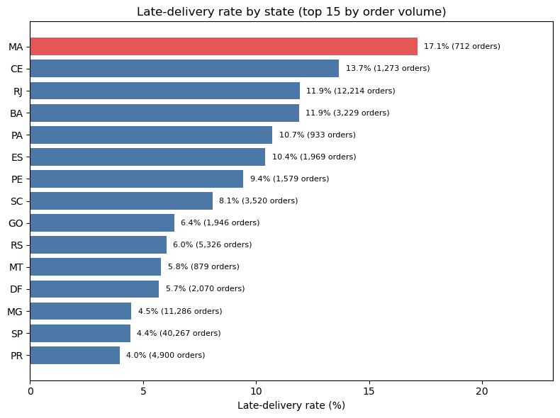
WHERE IS DELIVERY BREAKING DOWN?
Two different delivery problems, not one
AL: 20.8% late
Small volume (394 orders) – a genuine reliability problem
RJ: 11.9% late
2nd-largest market (12,214 orders) – a reliability problem hiding inside a big market
SP handles the most orders (40,267) yet keeps a low 4.4% late rate – proof that high volume doesn’t have to mean poor reliability.
06 / 13

Slide 8
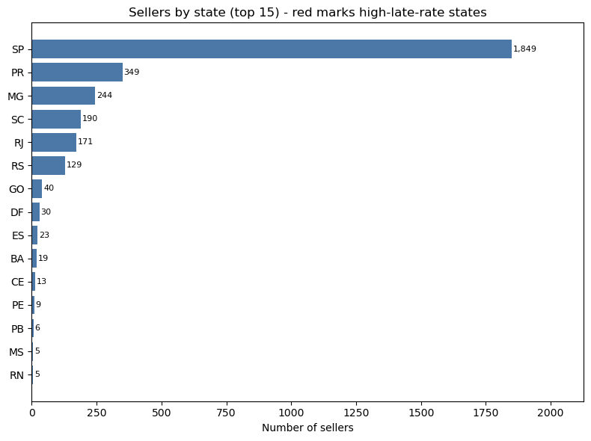
SUPPLY SIDE
Seller density explains some states — not all of them
State | Sellers | Orders | Late-delivery rate
MA | 1 | 712 | 17.1%
PI | 1 | 471 | 13.8%
CE | 13 | 1,273 | 13.7%
RJ (3rd-most) | 171 | 12,214 | 11.9%
SP (benchmark) | 1,849 | 40,267 | 4.4%
Growing the seller base is a good lever for MA / PI / CE – each has just a handful of local sellers. But RJ already has a deep seller base and still runs a high late rate, so its problem is more likely logistics or carrier-side.
07 / 13

Slide 9
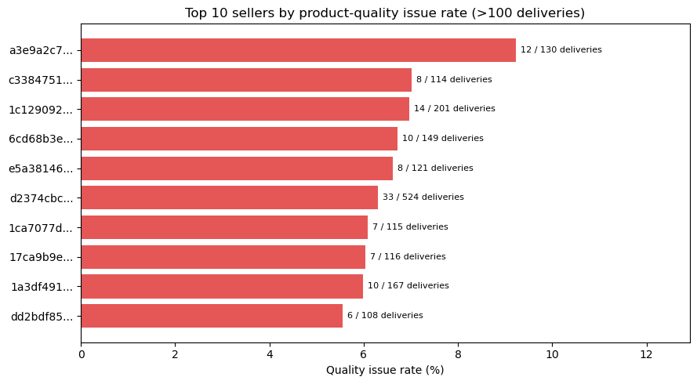
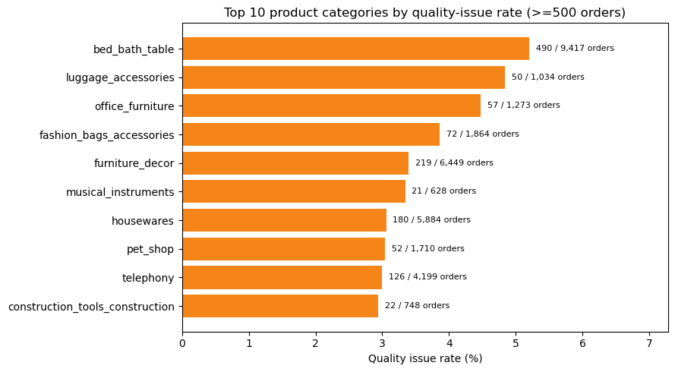
WHO AND WHAT DRIVES QUALITY COMPLAINTS?
A small, identifiable group drives most quality issues
Top sellers by quality-issue rate (>100 deliveries)
Top categories by quality-issue rate (≥500 orders)
Highest-risk categories are mostly bulky or fragile goods (furniture, luggage, home goods) – exactly where damage-in-transit is most likely. Both point to targeted fixes, not a blanket policy.
08 / 13

Slide 10
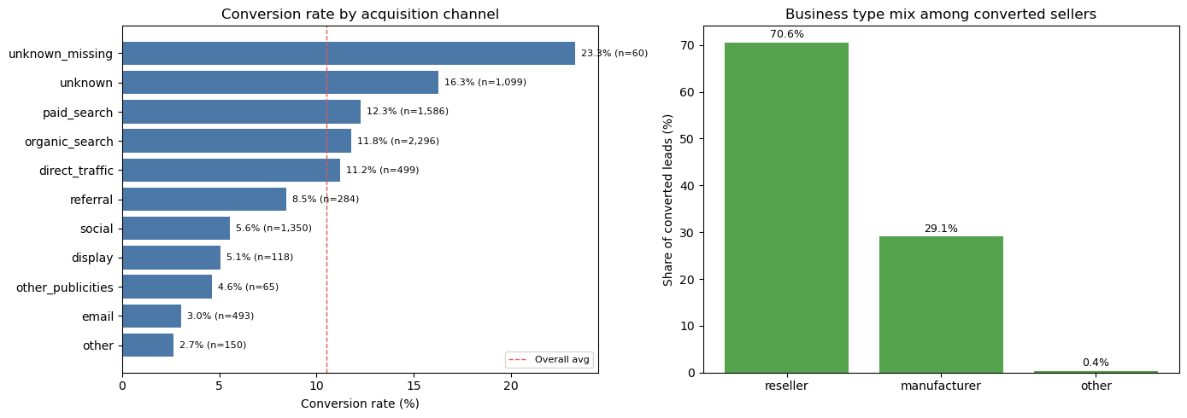
WHERE DO SELLERS COME FROM?
Acquisition volume and conversion quality diverge
Conversion rate by channel (left) & business-type mix among converted sellers (right)
10.5%
overall lead-to-seller conversion (842 of 8,000 leads)
Reseller : Manufacturer ≈ 2 : 1
among converted sellers. High-volume channels (social, email) convert well below average.
09 / 13

Slide 11
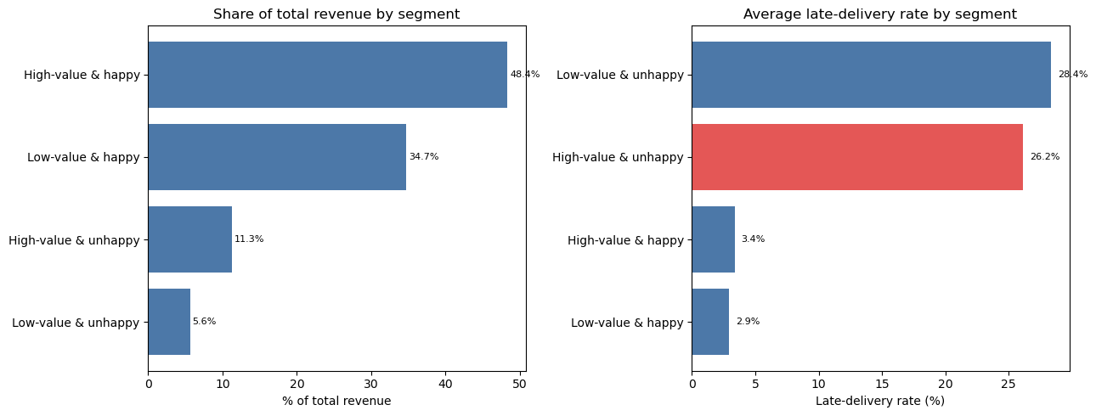
SIZING THE FIX
Who should we fix this for, first?
Revenue share (left) & average late-delivery rate (right) by value × satisfaction segment
~4,200
high-value & unhappy customers – 11.3% of total revenue
8× higher
late-delivery rate (26%) versus equally valuable, satisfied customers (3%). Fixing their delivery experience protects real revenue without a platform-wide overhaul.
10 / 13

Slide 12
RECOMMENDATIONS
Five targeted actions, ordered by leverage
1
Delivery-promise SLA
2
Targeted quality program
3
Regional logistics fix
Protect the high-value-unhappy cohort first – delivery delay is the clearest driver at every level.
Audit the small group of high-issue sellers; set packaging standards for bulky/fragile categories.
Focus on AL / MA / PI (low seller density); investigate RJ’s carrier/logistics issue separately.
4
Second-order retention nudge
5
Revisit acquisition mix
Conditioned on a clean first delivery – that’s where the platform loses a customer for good.
Reallocate spend away from high-volume, low-conversion channels (social, email).
Ordered by leverage, not by ease – delivery fixes come first because the evidence for them is strongest at every level of the data.
11 / 13

Slide 13
LIMITATIONS
What this analysis can and can’t claim
Observational, not experimental
Fixed observation window
No finding here is a controlled causal estimate – see the note on causality below.
The 3.1% repeat rate is a lower bound: customers who joined late had less time to re-order.
Small-sample segments
Marketing-funnel revenue is largely unusable
3+-seller orders (59), sellers with >100 deliveries, and the two middle delay bands are directional, not statistically precise.
Only 5.3% of converted deals carry a genuine declared-revenue figure; the rest are recoded placeholders.
A note on causality:
delivery delay correlates strongly and consistently with dissatisfaction across order, customer, and seller levels – the strongest evidence a purely observational analysis can offer. But a seller or customer with unrelated problems could show both delay and dissatisfaction independently, without one causing the other. These recommendations are the best-supported next actions to test operationally – not settled facts to act on blindly.
12 / 13

Slide 14
Delivery reliability is the lever.
Fix it for the right 4,200 customers first.
Every table, every level of analysis pointed the same direction – and now it’s sized, prioritized, and ready to test.
CODE REPOSITORY
TECHNICAL REPORT
INTERACTIVE DASHBOARD
github.com/Hiteshpanghal900/
ecommerce-visual-analytics
report/technical_report.pdf
dashboard/app.py
Thank you – questions welcome.

