Slide 1
Account Retention Modelling
Project Incharge: Mr. Sandeep Jain
Submitted by: Hitesh Walia

Slide 2
INTRODUCTION
In today’s modern world we are dealing with tremendous amount of data daily and it is increasing day by day so the scope of Machine Learning has increased a lot. Machine learning concepts are used almost everywhere, such as Healthcare, Finance, Infrastructure, Marketing, Self-driving cars, recommendation systems, etc. It gives enterprises a view of trends in customer behaviour and business operational patterns, as well as supports the development of new products.

Slide 3

OBJECTIVE
To Create a model that will predict the customer churn/attrition in a bank based on various factors.
Customer Churn/Attrition: The shifting from one service provider to its competitor in the market.

Slide 4
OBJECTIVE
If a bank is able to know about these things then it could perform certain actions to retain its customers if he is planning to leave, he/she can be offered some special discounts or perks as it is much more expensive to sign in a new client than keeping an existing one.

Slide 5
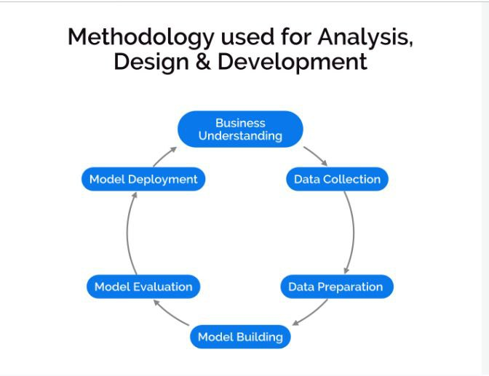

Slide 6
SYSTEM REQUIREMENTS
Software
OS: Windows 7 or higher
Web Browser: Chrome or Firefox
Code Editor: Google Colab
Python Libraries: Numpy, Pandas, Matplotlib, Sklearn,Seaborn
Hardware
RAM: 4 GB or higher
Intel Pentium 2.70 Ghz processor
.64 bit system

Slide 7
DATA COLLECTION
Data Collection is done through kaggle. It has the following attributes:
RowNumber
CustomerId
Surname
CreditScore
Geography
Gender
Age.
Tenure
Balance
NumOfProducts
HasCrCard
IsActiveMember
EstimatedSalary
Exited

Slide 8
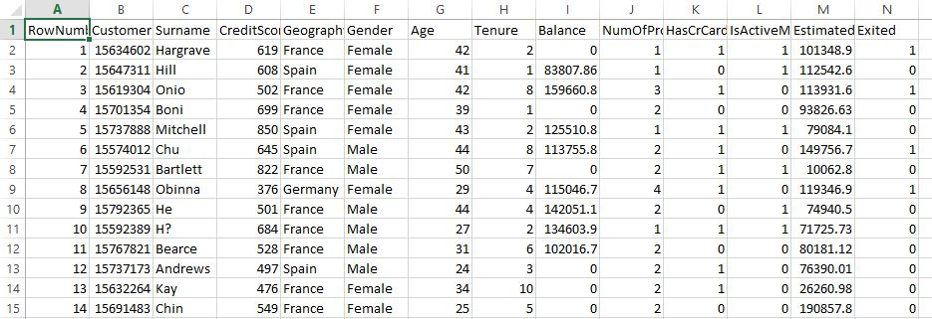

Slide 9


