Slide 1

IILM UNIVERSITY, GREATER NOIDA
INTERNSHIP REPORT PRESENTATION
Cisco Networking Academy
Networking Internship
Cisco Networking Academy Program | Delivered by IILM University
Yadav Hitesh Shravan
Roll No. 2410031458 | Section 3CSE8 | B.Tech CSE
June 2026

Slide 2






ABOUT THE STUDENT
Candidate Profile
ROLL NUMBER
2410031458
Yadav Hitesh
Shravan
INSTITUTE
IILM University, Greater Noida, U.P.
PROGRAMME
B.Tech – Computer Science & Engineering
B.Tech CSE, Section 3CSE8, Batch 2024-2028
INTERNSHIP DOMAIN
Cisco Networking Academy — Networking
DURATION
16 Jun 2026 – 20 Jun 2026
Cisco Networking Academy Internship • Yadav Hitesh Shravan
02

Slide 3


ABOUT THE PROGRAM
Cisco Networking Academy at IILM
The Cisco Networking Academy is Cisco's global IT skills and career-building program, delivering structured courses in network simulation and core networking fundamentals. At IILM University, Greater Noida, the program is delivered by the School of Computer Science and Engineering under Instructor Mr Abhinav Raghav, giving engineering students hands-on exposure to enterprise networking concepts and tools using Cisco Packet Tracer.
Cisco-Certified Curriculum
IILM University Delivery
Instructor-Led
Structured Cisco Networking Academy course content delivered end to end.
Delivered by the School of Computer Science and Engineering, IILM University.
Guided throughout by Mr Abhinav Raghav, Instructor, IILM University.
Cisco Networking Academy Internship • Yadav Hitesh Shravan
03

Slide 4
PROBLEM STATEMENT
Bridging Theory and Practical Networking
Many engineering students learn networking concepts such as IP addressing, VLANs, routing, and switching only at a theoretical level, with limited hands-on practice designing, configuring, and troubleshooting an actual network. This internship addressed that gap through structured, simulation-based training in Cisco Packet Tracer, followed by an applied branch-office network design and fault-diagnosis project.
This internship addressed that gap — practically applying core networking concepts:
Learn Basics
→
Explore Topologies
→
Master Essentials
→
Apply to Project
Cisco Networking Academy Internship • Yadav Hitesh Shravan
04

Slide 5






PROJECT OBJECTIVES
What the Internship Set Out to Achieve
Design the Topology
Explore Devices & Links
Master Networking Essentials
Plan device layout, VLAN structure and IP addressing in Packet Tracer.
Connect and configure devices to observe practical networking behaviour.
Learn addressing, subnetting, switching and routing fundamentals.
Apply VLAN & ACL Security
Practice Fault Diagnosis
Build a Python Assurance Tool
Segment traffic with VLANs and filter it using ACLs and NAT.
Inject and troubleshoot faults across the simulated network.
Match symptoms to documented faults and suggest fixes.
Cisco Networking Academy Internship • Yadav Hitesh Shravan
05

Slide 6








TECHNOLOGIES & TOOLS
The Toolkit Behind the Internship
Packet Tracer
NetAcad Platform
VLANs & Trunking
DHCP & DNS
Network simulation
Course delivery
Traffic segmentation
Addressing & resolution
Static Routing
ACL
NAT
Python
Inter-network paths
Traffic filtering
Internet access
Fault-diagnosis tool
Cisco Networking Academy Internship • Yadav Hitesh Shravan
06

Slide 7





SYSTEM ARCHITECTURE
From Learning Modules to Applied Network
Learning Layer
Cisco NetAcad modules — Packet Tracer basics, exploration, and essentials
↓
Simulation Layer
Topology built and configured directly in Cisco Packet Tracer
↓
Design Layer
VLAN structure, IP addressing and inter-VLAN routing plan
↓
Security Layer
ACLs and NAT filter and translate traffic between segments
↓
Validation Layer
Faults injected and diagnosed to verify the design works
↓
Applied Layer
Python tool matches symptoms to fixes, reinforcing troubleshooting
Cisco Networking Academy Internship • Yadav Hitesh Shravan
07

Slide 8
METHODOLOGY
The Learning-to-Application Journey
1
MODULE
2
MODULE
3
MODULE
4
MODULE
Getting Started with Cisco Packet Tracer
Exploring Networking with Cisco Packet Tracer
Networking Essentials
Applied Project — SmartBranch 360
Interface, device palette, and basic simulation workflow
Building and connecting devices to explore networking behaviour
Core fundamentals — addressing, subnetting, switching, routing
Branch-office network design, fault injection and Python diagnosis tool
16 Jun 2026
16 Jun 2026
20 Jun 2026
Following completion
Cisco Networking Academy Internship • Yadav Hitesh Shravan
08

Slide 9
EXPECTED OUTCOMES
Skills and Capabilities Gained
Working familiarity with the Cisco Packet Tracer environment and simulation workflow
Practical understanding of core networking essentials — addressing, subnetting, switching and routing
Ability to design a segmented network using VLANs, inter-VLAN routing, DHCP, DNS, ACLs and NAT
Hands-on experience diagnosing and fixing simulated network faults
Skill to build a Python tool that matches symptoms to documented faults and fixes
Three Cisco Networking Academy certificates of completion, issued by IILM University
Cisco Networking Academy Internship • Yadav Hitesh Shravan
09

Slide 10
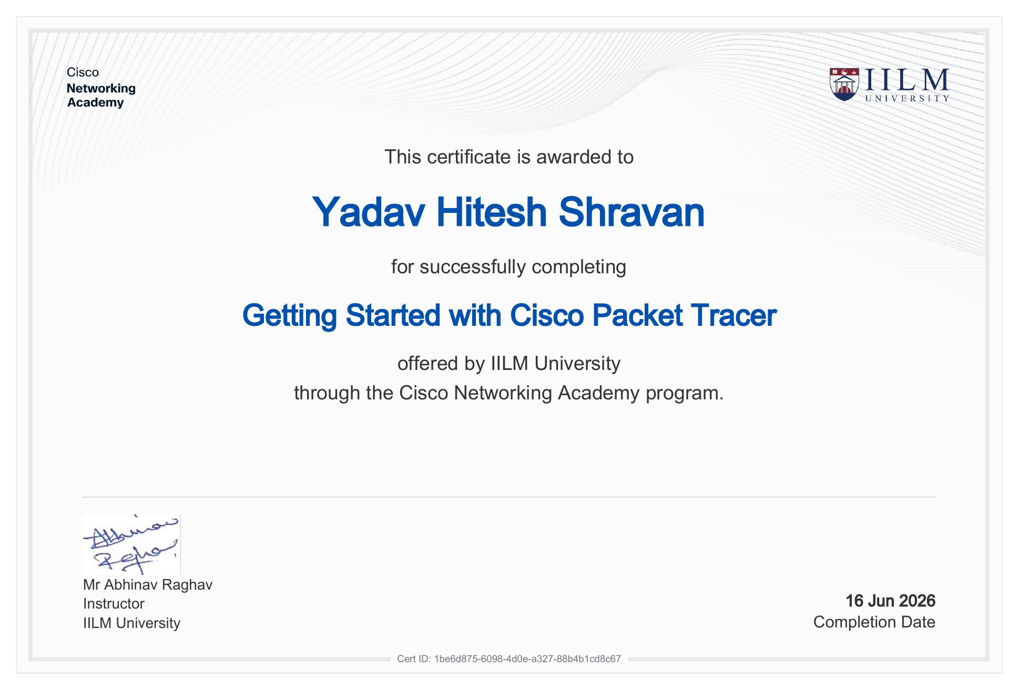
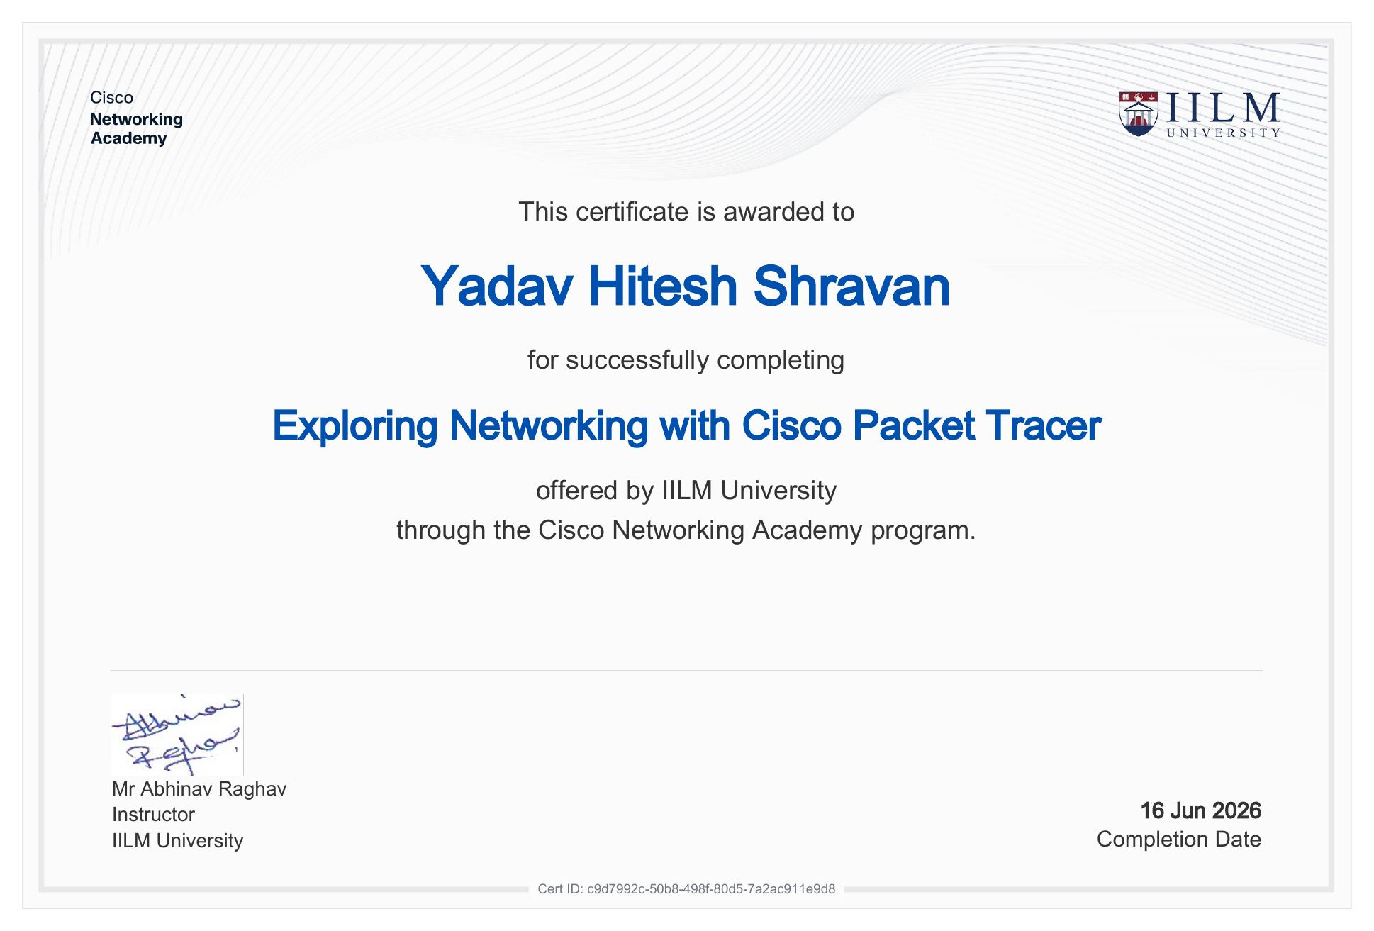
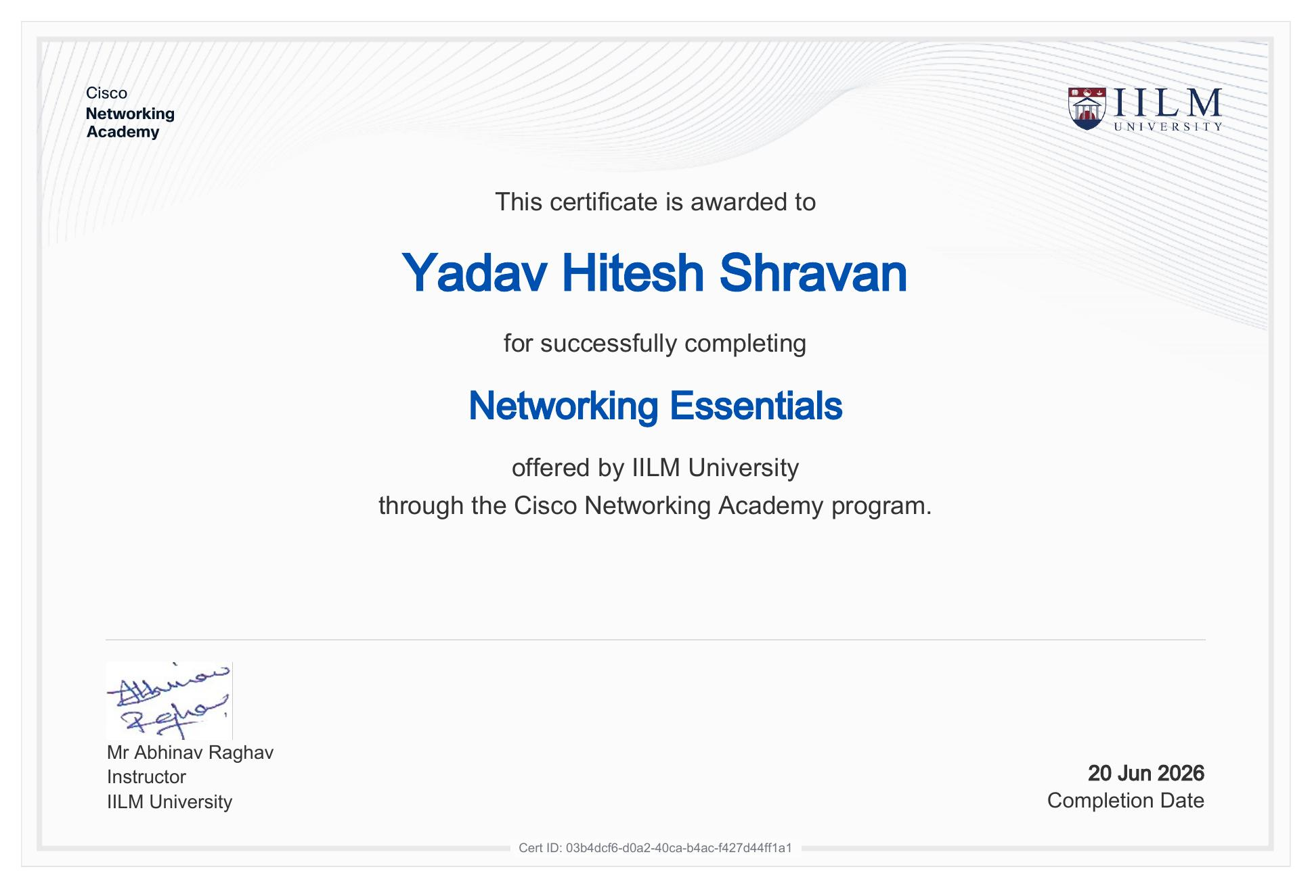
CERTIFICATION
Certificates of Completion
Getting Started with Cisco Packet Tracer
Exploring Networking with Cisco Packet Tracer
Networking Essentials
Completed: 16 Jun 2026
Completed: 16 Jun 2026
Completed: 20 Jun 2026
Cert ID: 1be6d875-6098-4d0e-a327-88b4b1cd8c67
Cert ID: c9d7992c-50b8-498f-80d5-7a2ac911e9d8
Cert ID: 03b4dcf6-d0a2-40ca-b4ac-f427d44ff1a1
Cisco Networking Academy Internship • Yadav Hitesh Shravan
10

Slide 11

Thank You
Cisco Networking Academy Internship | IILM University, Greater Noida
Yadav Hitesh Shravan
Roll No. 2410031458 | Section 3CSE8 | IILM University, Greater Noida

