Slide 1
MediSphere AI
Clinical intelligence for hospitals that operate in many countries
Capstone project | 11-day AI Application Development course | Edvergencex x TTIT

Slide 2
The problem
Multi-country hospitals run on disconnected tools
Emergency triage is slow and varies between sites and nurses
Guidelines are scattered; clinicians need answers with sources
Patient reports arrive as scans and PDFs that nobody can search
Every country has its own language, emergency number and rules for data
Leaders need one view of waits, triage mix and readmission risk
4
hospital sites
4
languages
5
user roles
MediSphere AI | Edvergencex x TTIT capstone

Slide 3
Architecture
Each request passes the same safety pipeline
Clinician UI
API
Guardrails
RAG, agents, tools
Data
Role-based screens, voice, 4 languages
Sign-in, RBAC, rate limits, audit chain
PII masking, injection filter, crisis routing
Hybrid search, NEWS2, drug checker
SQLite to PostgreSQL, FHIR R4 export
Python core with a stdlib server and an optional FastAPI app; same route pipeline for both
Own hybrid retriever (BM25 + LSA vectors) works with no external service
Optional live LLM; offline mode keeps the demo fully working
MediSphere AI | Edvergencex x TTIT capstone

Slide 4
How the 11 days fit in
Day 1 Python for AI
Day 2 Data and APIs
Day 3 Prompt engineering
Day 4 LLM apps
Typed modules, config, tests
pandas dashboard, REST routes
Role prompts, structured output
Tools, memory, follow-ups
Day 5 Multimodal
Day 6 Automation
Day 7 Embeddings
Day 8 RAG
OCR of lab reports, voice input
9-step intake workflow
Vector store and search
Cited answers, abstain rule
Day 9 Advanced RAG
Day 10 Agentic AI
Day 11 Deployment
Hybrid search, guardrails, audit
Plan, tools, review, trace
Docker, CI, health checks
MediSphere AI | Edvergencex x TTIT capstone

Slide 5
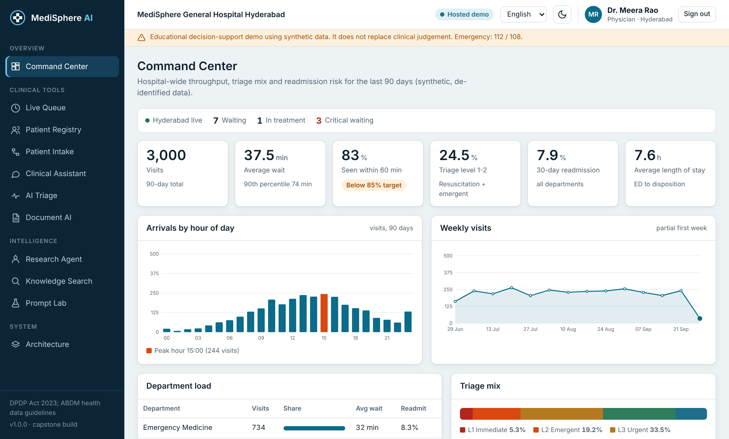
Command Center
Hospital view of the last 90 days
Throughput, waits, triage mix and readmission risk
Live emergency count for the selected site
Synthetic, de-identified data
MediSphere AI | Edvergencex x TTIT capstone

Slide 6
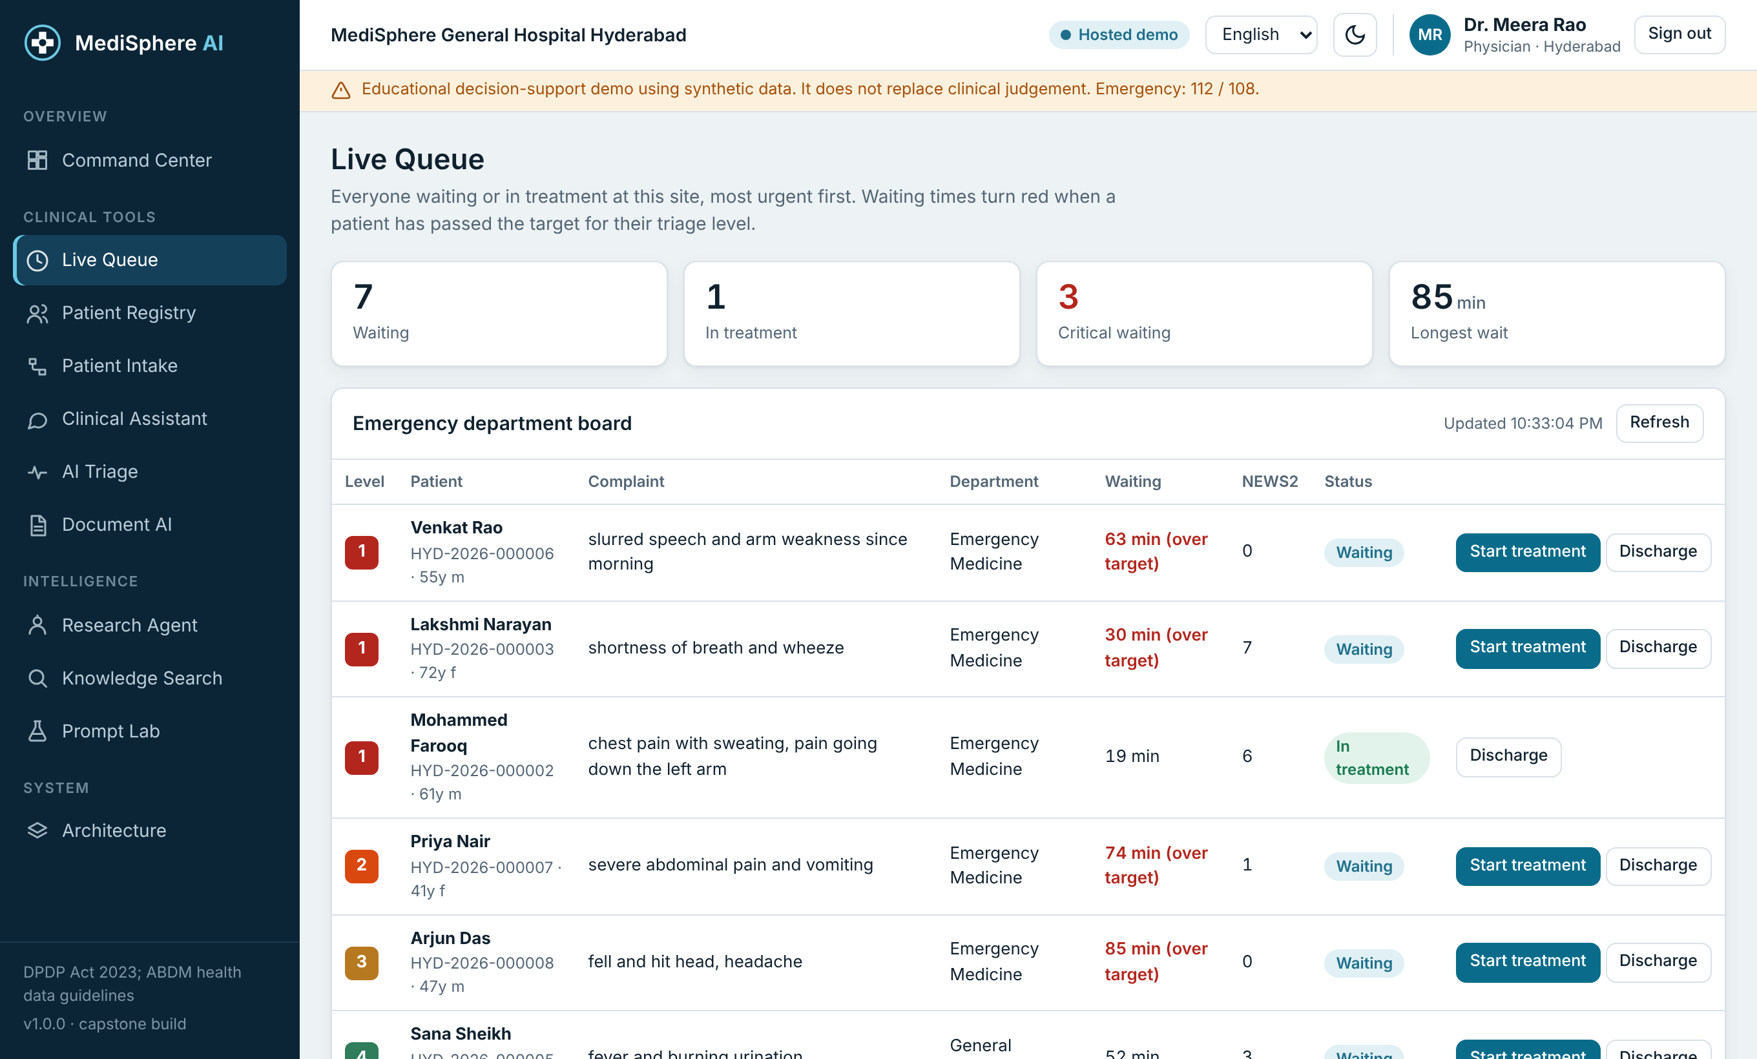
Live Queue
Most urgent patient first
Waits turn red past the target for the triage level
Nurses start treatment from the queue
Data kept per hospital site
MediSphere AI | Edvergencex x TTIT capstone

Slide 7
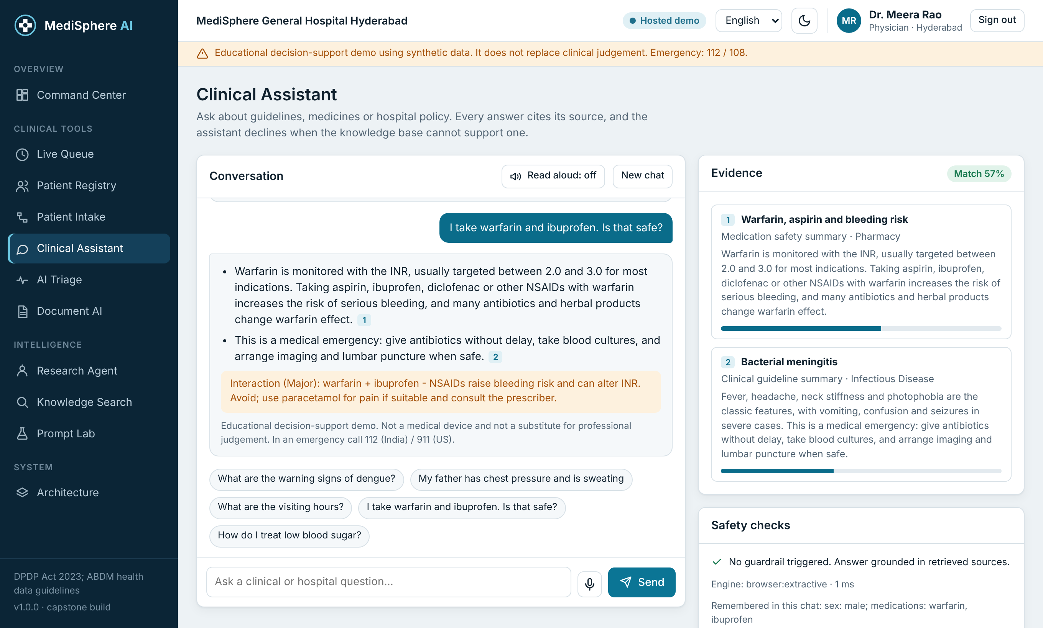
Clinical Assistant
Answers with sources
Hybrid search over 38 guideline documents
Says it does not know when evidence is weak
Drug-interaction alert and emergency banner
MediSphere AI | Edvergencex x TTIT capstone

Slide 8
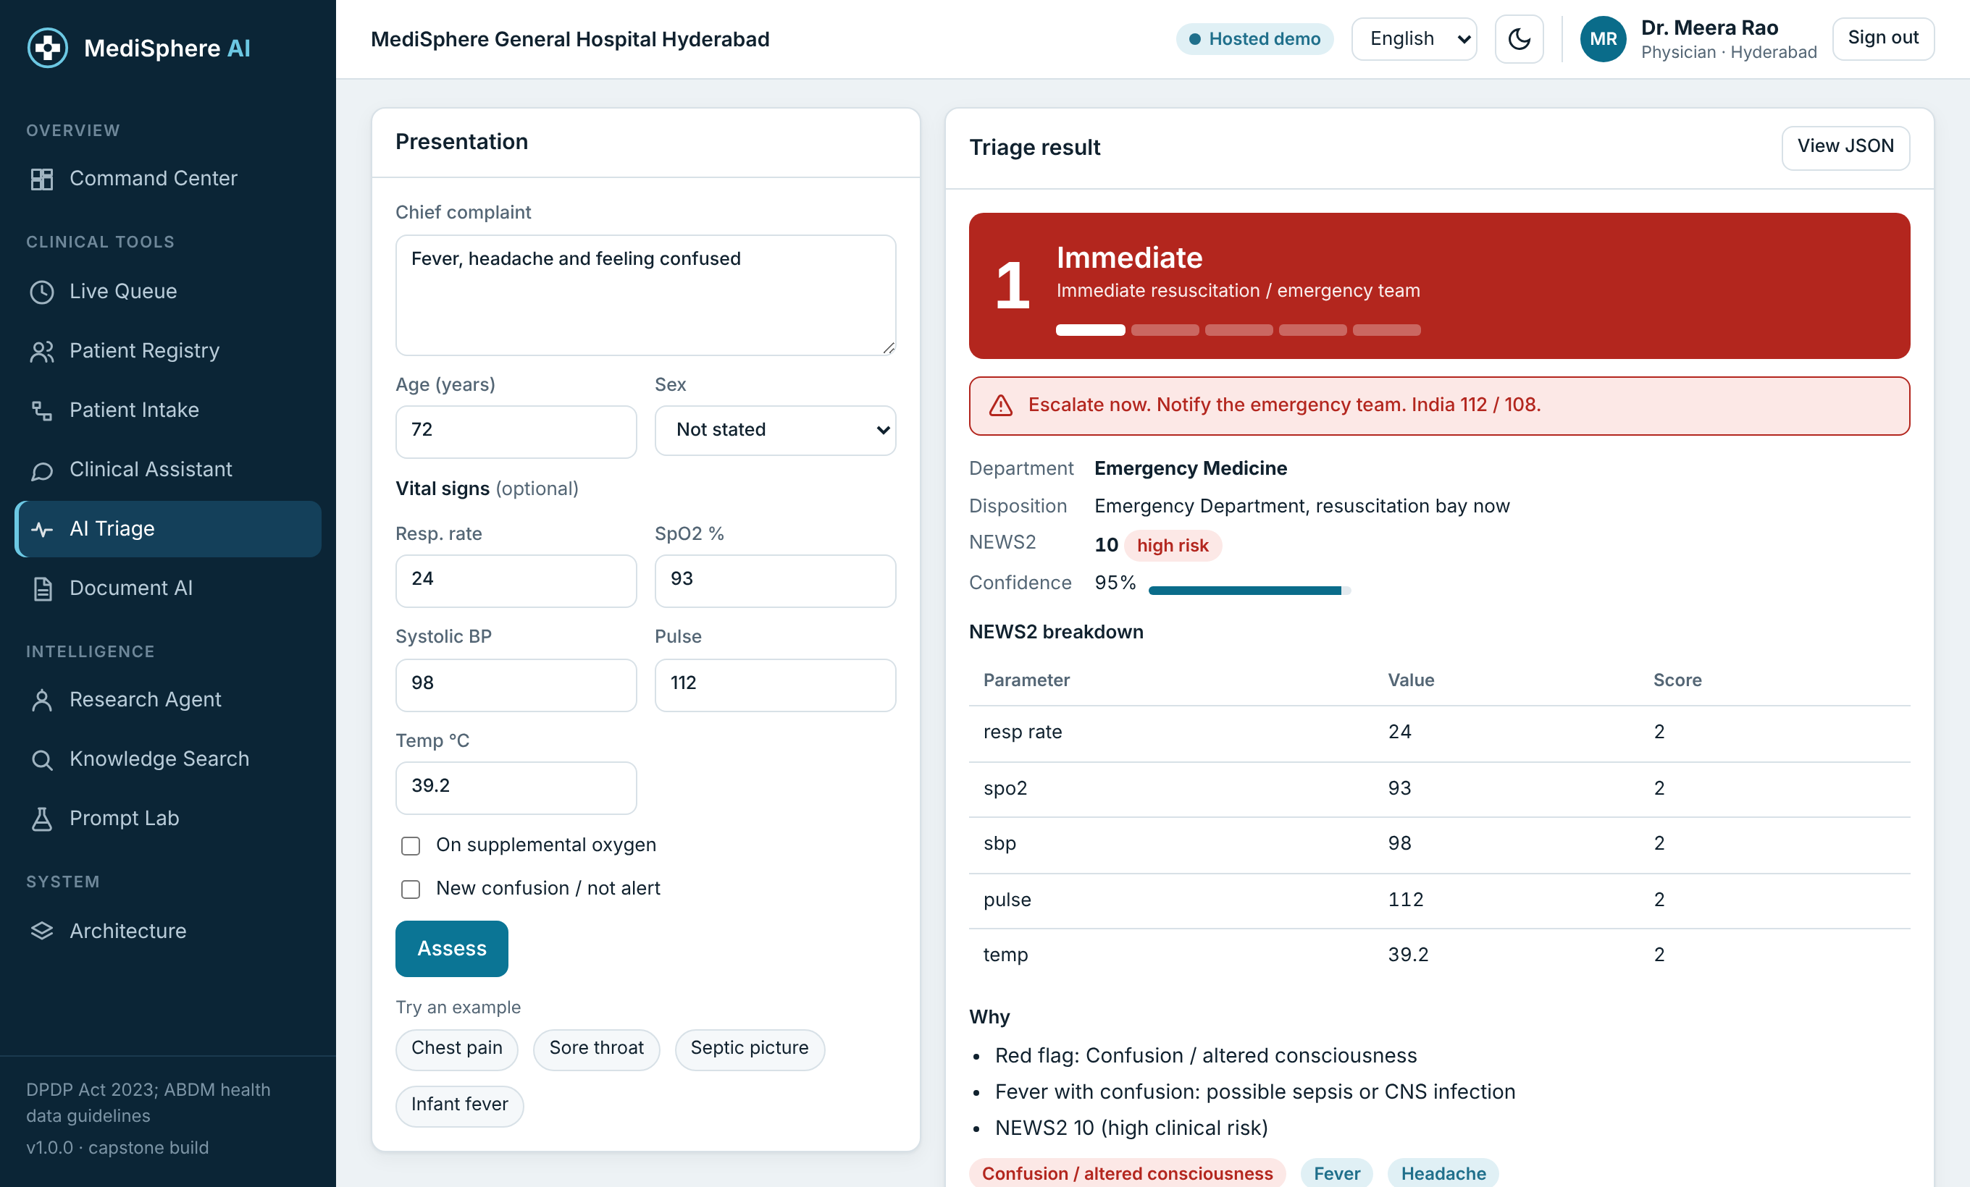
AI Triage
Structured, explainable
Validated 5-level triage record
NEWS2 early-warning breakdown and reasons
Staff can override; every change is audited
MediSphere AI | Edvergencex x TTIT capstone

Slide 9
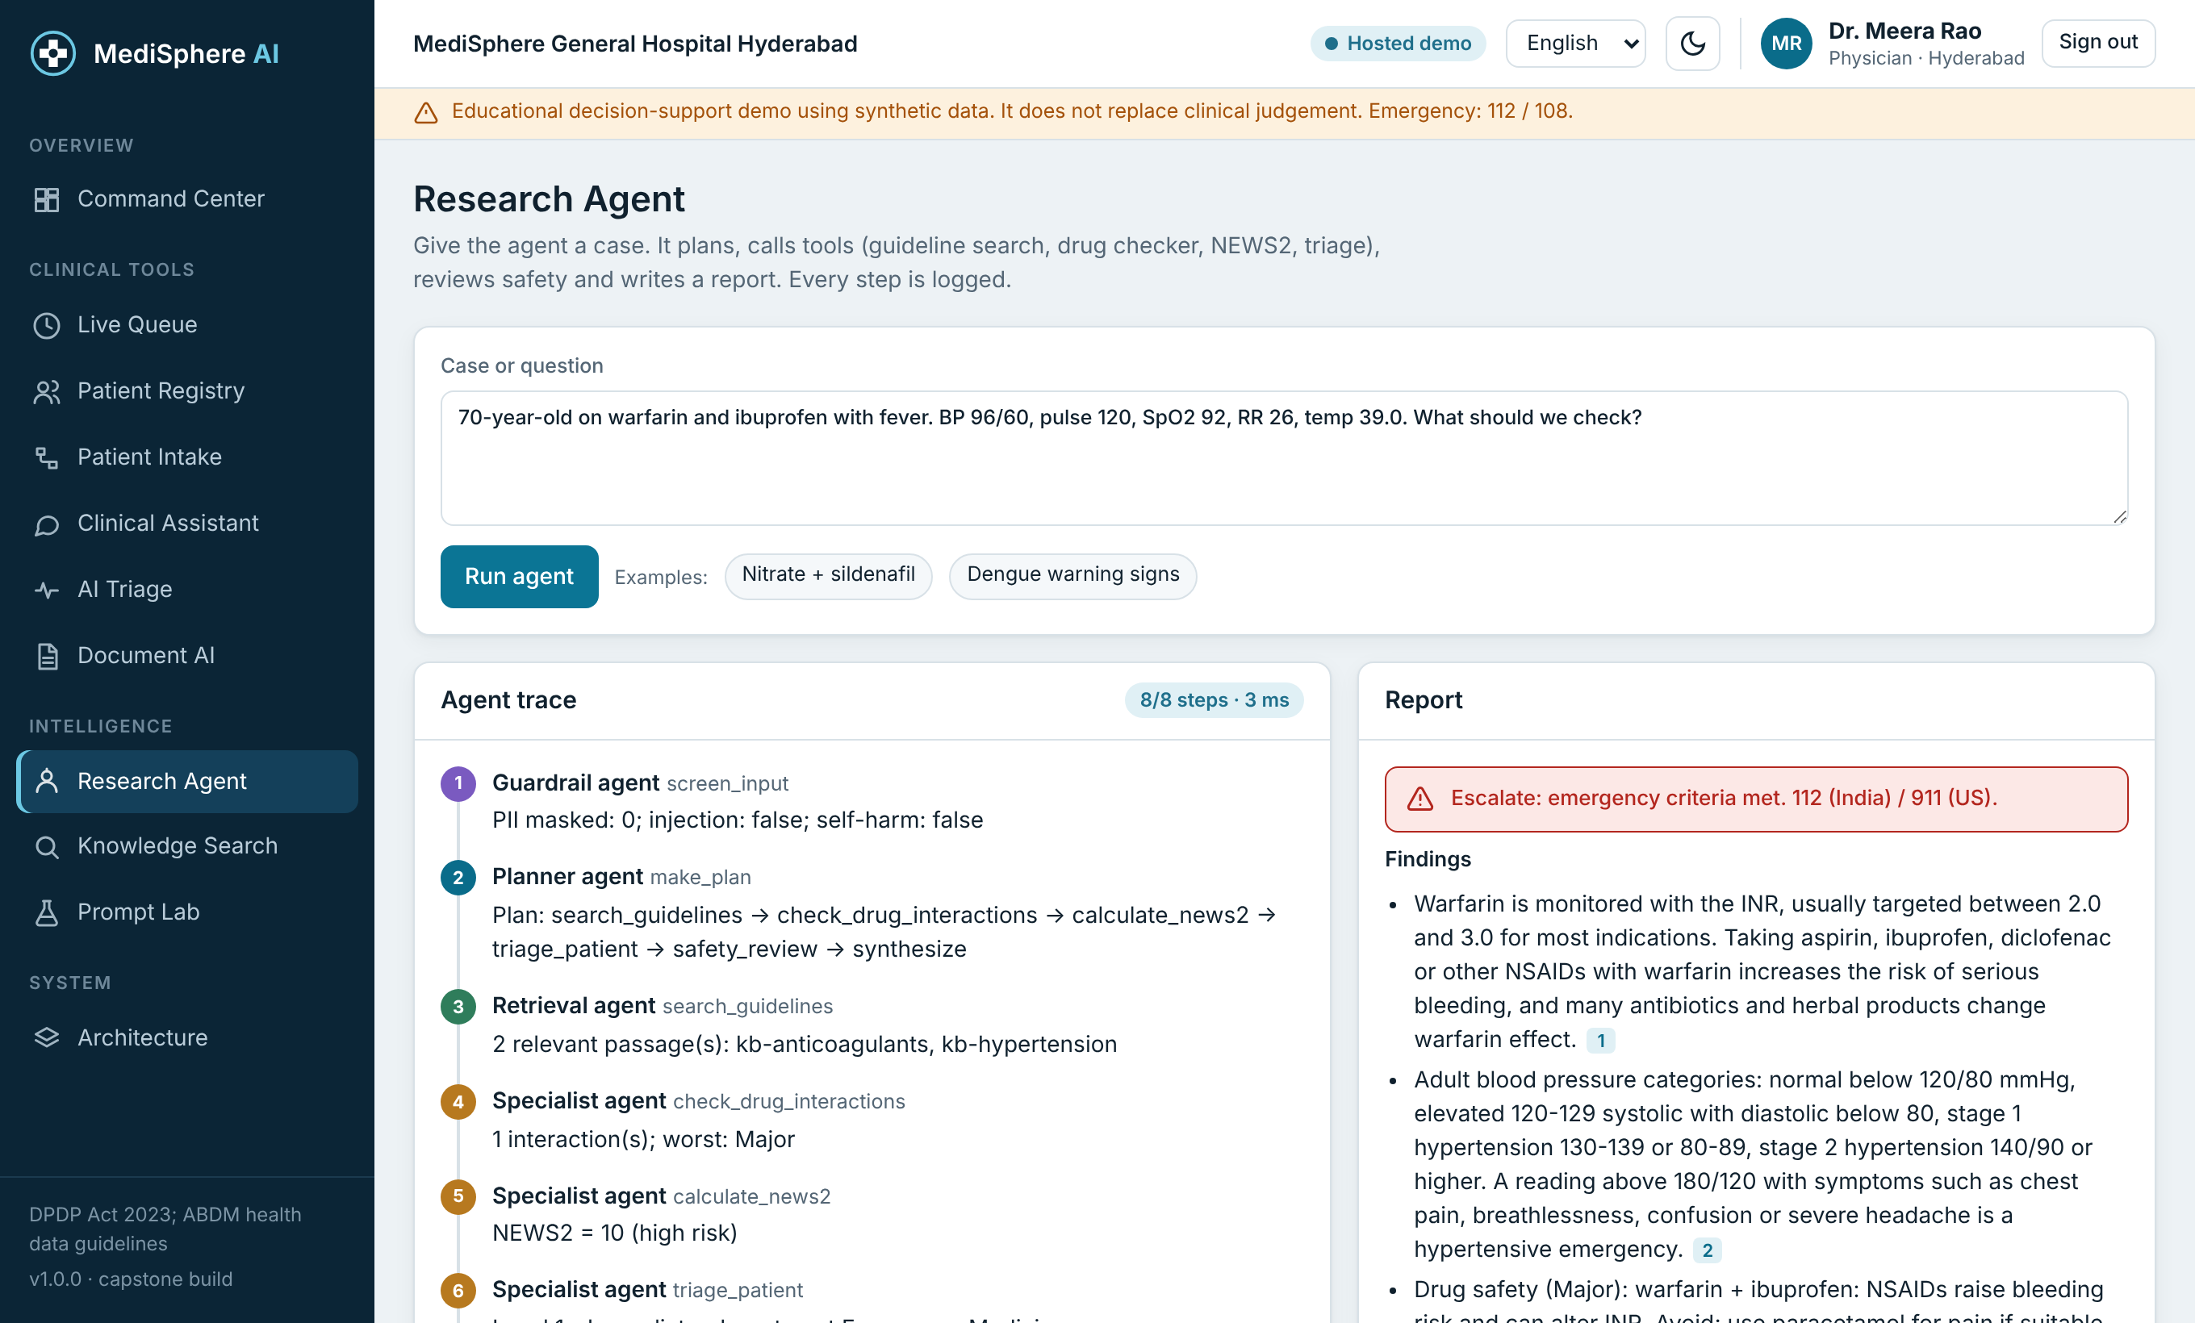
Research Agent
Plan, tools, review, report
Bounded loop with a full trace
Safety review before the report is shown
Uses the same tools as the assistant
MediSphere AI | Edvergencex x TTIT capstone

Slide 10
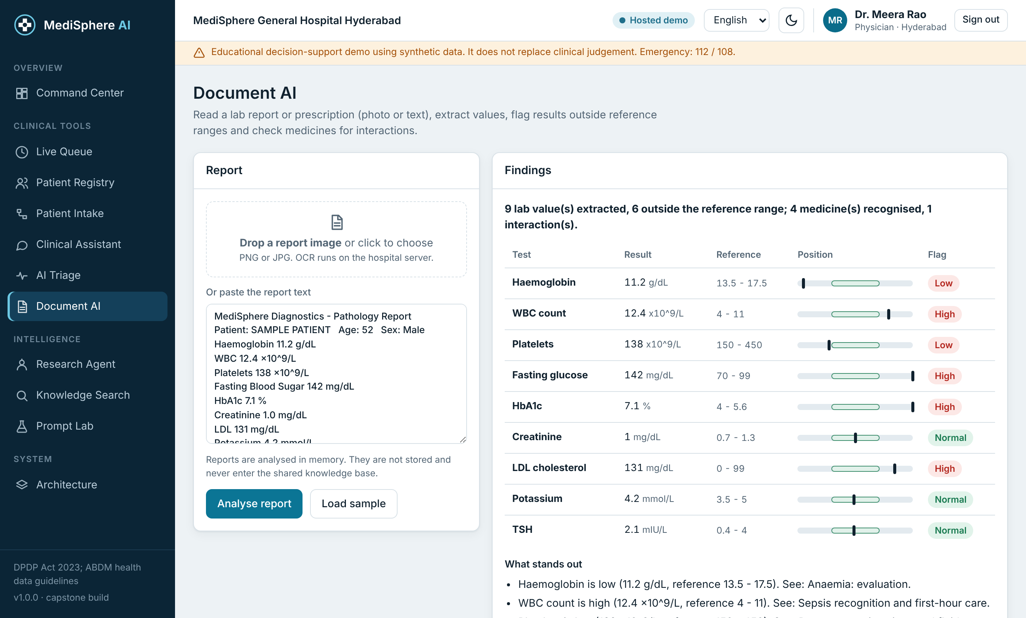
Patient reports
OCR with lab parsing
Reads scans and PDFs, flags abnormal values
Checks the medicine list for interactions
Analysed in memory; never stored or indexed
MediSphere AI | Edvergencex x TTIT capstone

Slide 11
Security and compliance
Five roles with least-privilege access: admin, doctor, nurse, receptionist, analyst
PBKDF2 passwords, signed expiring sessions, lockout after 5 failures, rate limits
SHA-256 hash-chained audit trail that detects tampering
Per-site data isolation and optional field encryption
FHIR R4 export with LOINC codes
Guardrails: PII masking, prompt-injection filter, crisis routing, no personal drug doses
MediSphere AI | Edvergencex x TTIT capstone

Slide 12
Testing and results
36
38
9
automated tests passing
knowledge documents
workflow steps traced
Tests cover retrieval, guardrails, triage rules, auth, RBAC, audit chain, site isolation, FHIR and OCR
Browser run on the real server checked every screen and found no console errors
MediSphere AI | Edvergencex x TTIT capstone

Slide 13
Limits and next steps
Limits
Next
Decision support only; not a medical device
Rules, knowledge base and drug table need clinical validation
Demo uses fictional data
FastAPI and live-LLM modes were not run in the build environment
Clinical review and a pilot at one site
PostgreSQL and single sign-on
Live HL7/FHIR connection to the hospital record
Larger multilingual knowledge base
MediSphere AI | Edvergencex x TTIT capstone

Slide 14

Thank you
Scan to open the live demo (fictional data)

