Slide 1
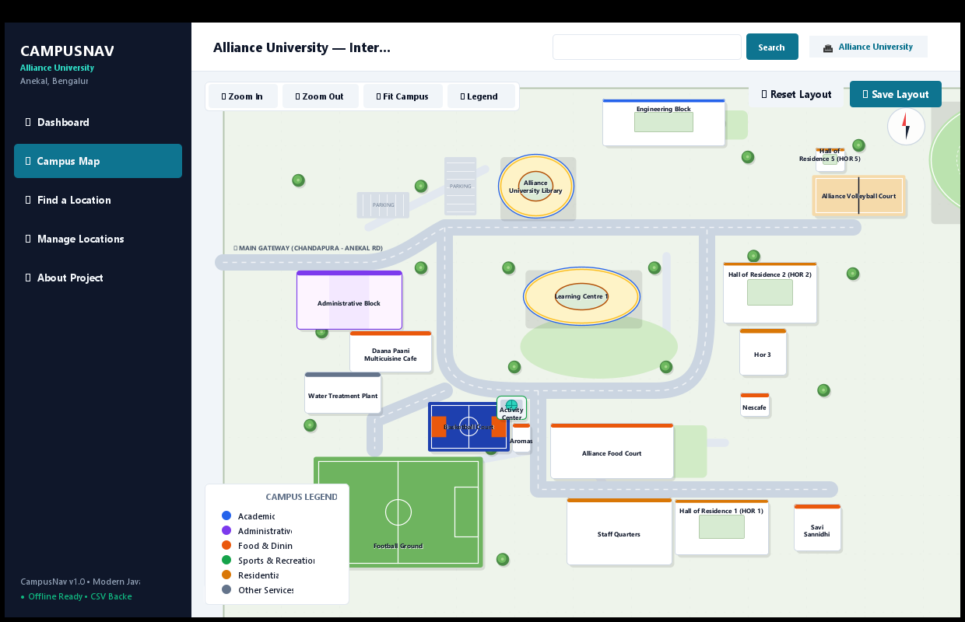
ALLIANCE UNIVERSITY • DEPARTMENT OF COMPUTER SCIENCE & ENGINEERING
Alliance Campus Navigator
An Interactive Java-Based Campus Facility Finder
━━━━━━━━━━━━━━━━━━━━━━━━━━━━━━━━━━━━━━━━━━━━
Student: B. Hithesh Reddy
Course: B.Tech in Computer Science and Engineering
Project Type: Java Micro Project
Academic Year: 2026–2027
Live Desktop Application Screenshot
• Java Swing & Java2D Vector Map Engine
• Drag-and-Drop Facility Repositioning
• Offline Persistent CSV Storage

Slide 2
OVERVIEW
Introduction — Project Background & Motivation
🏛 The University Campus Environment
• Alliance University encompasses a sprawling, multi-acre central campus in Anekal, Bengaluru.
• The campus houses numerous diverse departments: Academic schools, administrative blocks, student hostels, sports grounds, and food courts.
• Navigating between departments poses a challenge for freshmen, visiting parents, guest lecturers, and recruitment partners.
• Traditional physical signboards or static image maps fail to provide searchability, categorized filtering, or interactive facility details.
💡 The Campus Navigator Solution
✔ A standalone, offline-first Java desktop application built tailored specifically for Alliance University.
✔ Dynamic Java2D Vector Schematic: Illustrates core campus geography including roads, green spaces, and key building footprints.
✔ Structured Facility Database: Organizes 20 core university facilities into 6 functional categories.
✔ Unified User Experience: Offers instant multi-criteria search, one-click building centering, and real-time layout management.
✔ Zero External Dependencies: Runs purely on standard Java SE runtime with lightweight CSV file persistence.
Alliance Campus Navigator | B.Tech CSE Micro Project | Alliance University, Bengaluru
2 / 12

Slide 3
PROBLEM FORMULATION
Problem Statement & Project Motivation
OFFICIAL PROBLEM STATEMENT
"To develop a user-friendly desktop application that presents campus facilities through an interactive schematic map and allows users to search, identify, and manage location information."
⚠ Campus Navigation Challenges
• Sprawling multi-block layout creates orientation difficulties.
• New students and visitors struggle to find lecture halls and admin offices.
• Static PDF/image campus maps lack keyword search and interaction.
🎯 Target User Personas
• First-Year Students: Quickly locate class blocks, labs, and dining.
• Visitors & Parents: Locate Administrative Block and seminar halls.
• Campus Admins: Add, edit, or reposition facilities dynamically.
✨ Core Motivations
• Eliminate dependency on proprietary, paid mapping APIs (Google Maps API).
• Deliver 100% offline reliability without internet access.
• Build a robust, extensible Java OOP showcase for B.Tech evaluation.
Alliance Campus Navigator | B.Tech CSE Micro Project | Alliance University, Bengaluru
3 / 12

Slide 4
PROJECT SCOPE
Project Objectives & Scope Boundaries
🎯 Core Project Objectives
✔ Desktop GUI Engineering: Build a high-performance desktop application using modern Java SE (Swing & AWT).
✔ Dynamic Vector Map: Draw an illustrative schematic map using Java2D vector primitives—roads, grounds, and buildings.
✔ Category Taxonomy: Organize 20 campus landmarks into 6 color-coded operational categories.
✔ Multi-Criteria Search: Enable instant search across facility names, categories, and keyword descriptions.
✔ Interactive Dragging: Allow dragging buildings on the canvas with coordinate persistence.
✔ File Persistence: Manage records using UTF-8 RFC 4180 CSV files without database setup.
⚖ Scope & Boundary Definitions
• Schematic Diagram:
The map represents visual spatial relationships rather than sub-meter satellite survey accuracy.
• No GPS/Turn-by-Turn:
Intentionally designed for orientation; does not require GPS hardware, mobile sensors, or turn-by-turn routing.
• Self-Contained Data:
Accuracy and positions are derived from the local CSV dataset (locations.csv & map_layout.csv).
• Local Persistence:
Stores layout and location changes locally on the host machine without cloud dependencies.
Alliance Campus Navigator | B.Tech CSE Micro Project | Alliance University, Bengaluru
4 / 12

Slide 5
TECHNOLOGY SELECTION
Technology Stack & Architectural Tooling
☕ Java 21+ Platform
Core Programming Language
• Provides modern object-oriented language features and high performance.
• Utilizes standard Java SE runtime with zero external JAR library dependencies.
• Ensures cross-platform desktop execution on Windows, macOS, and Linux.
🖥 Java Swing & AWT
Desktop Graphical User Interface
• Manages application shell, sidebar, card layouts, dialogs, and tables.
• Guarantees thread-safe UI updates on Swing's Event Dispatch Thread (EDT).
• Uses custom component painting for modern rounded cards, buttons, and badges.
🎨 Java2D Graphics API
Custom Vector Map Engine
• Dynamically renders roads, pedestrian paths, green spaces, and buildings.
• Applies anti-aliasing rendering hints for clean visual presentation.
• Executes world-to-screen AffineTransform transformations for smooth zoom & pan.
📄 RFC 4180 CSV Storage
Persistence Layer
• Implements robust UTF-8 CSV parsing and writing via CsvUtils.
• Safely escapes embedded commas, quotes, and multi-line descriptions.
• Eliminates SQL database setup, ODBC drivers, and administrative server overhead.
💻 VS Code & PowerShell
Development & Build Environment
• Organized project structure with clean separation of src, data, out, and test.
• Direct compilation via javac -encoding UTF-8 -d out.
• One-click launch script run.ps1 for seamless evaluation and live demonstration.
🐙 Git & GitHub
Version Control & Collaboration
• Full version control tracking code evolution and file revisions.
• Public GitHub repository: Hithesh-07/Alliance-Campus-Navigator.
• Transparent commit history and automated unit/integration test coverage.
Alliance Campus Navigator | B.Tech CSE Micro Project | Alliance University, Bengaluru
5 / 12

Slide 6
ARCHITECTURE
System Architecture & End-to-End Data Flow
PRESENTATION LAYER (ui package)
CampusNavFrame (Shell & Nav) ◄► DashboardPanel | CampusMapPanel (Java2D Canvas) | LocationSearchPanel | LocationManagementPanel
APPLICATION & BUSINESS LOGIC LAYER (data package)
• CampusDataManager (Singleton): Central state controller & observable data source.
• DataChangeListener: Reactive observer notifying UI views of additions, updates, or deletions.
• DefaultCampusData: Hardcoded baseline fallback for instant initialization and Reset Layout.
• CsvUtils: RFC 4180 parsing engine with quote escaping and stream buffering.
DATA DOMAIN MODELS (model package)
• CampusLocation: id, name, category, description
• MapItem: id, x, y, width, height, shapeType
• Category Enum: ACADEMIC, ADMINISTRATIVE, FOOD, SPORTS, RESIDENTIAL, OTHER
PERSISTENCE STORAGE LAYER (data/ directory)
• data/locations.csv ── Stores metadata (id, name, category, description)
• data/map_layout.csv ── Stores 2D spatial footprints (id, x, y, width, height, shapeType, customColorHex)
Alliance Campus Navigator | B.Tech CSE Micro Project | Alliance University, Bengaluru
6 / 12

Slide 7

CAMPUS GEOGRAPHY
Campus Schematic Map & Facility Taxonomies
🏛 Campus Facility Categorization
• Academic (Blue):
Alliance School of Business, Library, Eng. Block, Law, Liberal Arts, LC-1
• Administrative (Purple):
Administrative Block (Chancellor's office, Admissions, Registrar)
• Food & Dining (Orange):
Alliance Food Court, Daana Paani Multicuisine Cafe
• Sports & Recreation (Green):
Football Turf Ground, Cricket Ground, Volleyball, Basketball
• Residential (Amber):
Hall of Residence 1 (HOR 1), HOR 2, HOR 5, Staff Quarters
• Other Services (Slate):
Water Treatment & Recycling Plant, Western Gateway
Actual Java2D vector rendering showing selected Alliance School of Business (Rotunda), Library Dome, Football Ground, and Cricket Oval.
Alliance Campus Navigator | B.Tech CSE Micro Project | Alliance University, Bengaluru
7 / 12

Slide 8
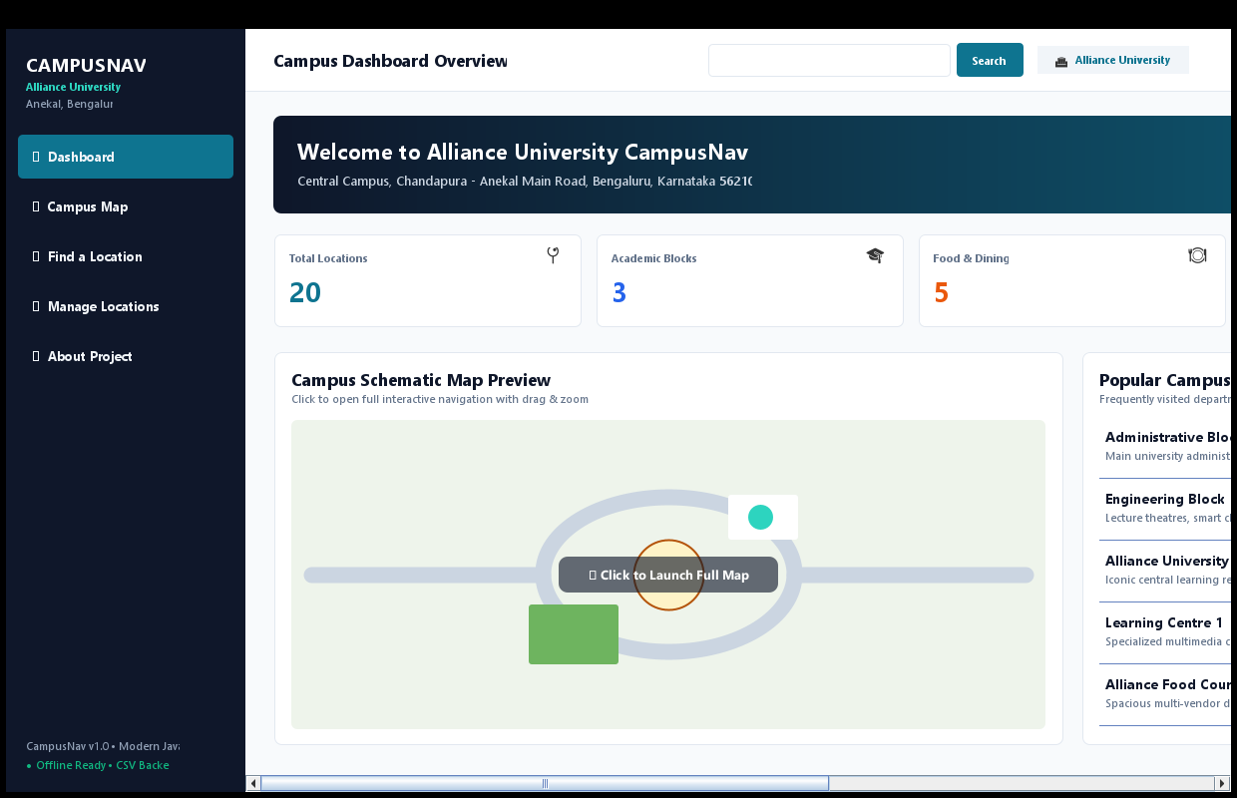
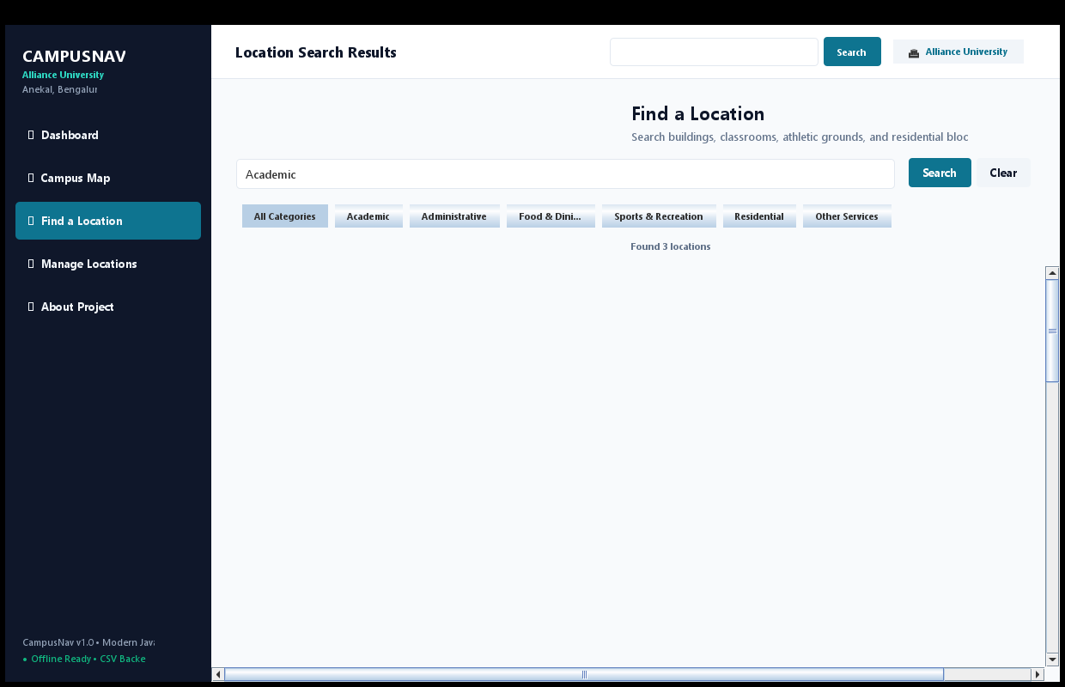
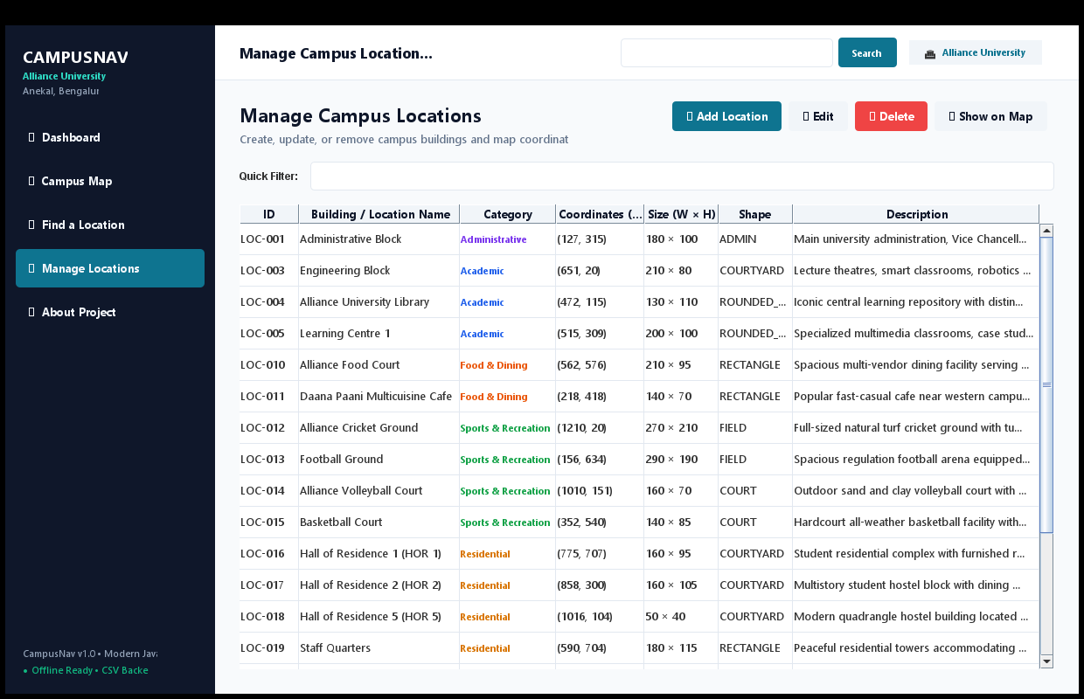
USER EXPERIENCE
User Interface Showcase & Interactive Features
Dashboard Analytics View
Multi-Criteria Search Engine
Location Management (CRUD)
• Live summary metric counters (Academic, Food, Sports, Hostels).
• Interactive mini-map preview card with instant launch shortcut.
• Quick-access popular university hubs list.
• Real-time keystroke filtering across names, IDs, and descriptions.
• One-click category filter chips (All, Academic, Sports, etc.).
• 'Show on Map' button automatically navigates & highlights.
• Searchable table showing coordinates (X, Y) and dimensions.
• Modal dialogs for Add / Edit with validation checks.
• Instant cross-view sync and persistent CSV updates.
Alliance Campus Navigator | B.Tech CSE Micro Project | Alliance University, Bengaluru
8 / 12

Slide 9
SOURCE CODE DESIGN
Object-Oriented Programming (OOP) Implementation
🏛 OOP Principles Applied in Source Code
• Inheritance: CampusNavFrame extends JFrame; CampusMapPanel, DashboardPanel, LocationSearchPanel extend JPanel; LocationDialog extends JDialog.
• Polymorphism: @Override paintComponent(Graphics g) customized across map and buttons; interface implementation in NavigationController.
• Encapsulation: CampusLocation and MapItem enforce private fields with strict getters, setters, and boundary constraints (e.g. Math.max(30, width)).
• Event-Driven Architecture: Swing event listeners (MouseAdapter, KeyAdapter) handle real-time canvas dragging and live search filtering.
• Observer Pattern: DataChangeListener decoupled event bus triggers instant cross-panel refreshes when records change.
💻 Actual Source Code Example: Map Drag Translation
// From ui/CampusMapPanel.java (World Coordinate Translation)
public Point2D toWorld(Point screenPt) {
double wx = (screenPt.x - panX) / zoom;
double wy = (screenPt.y - panY) / zoom;
return new Point2D.Double(wx, wy);
}
@Override
public void mouseDragged(MouseEvent e) {
if (isDraggingBuilding && draggingItem != null) {
Point2D worldPt = toWorld(e.getPoint());
double newX = worldPt.getX() + dragStartBuildingX;
double newY = worldPt.getY() + dragStartBuildingY;
draggingItem.setX(Math.round(newX));
draggingItem.setY(Math.round(newY));
hasUnsavedChanges = true;
repaint();
}
}
Key Logic: Screen pixels are inverted through zoom/pan transforms, ensuring that dragging never corrupts saved logical coordinates.
Alliance Campus Navigator | B.Tech CSE Micro Project | Alliance University, Bengaluru
9 / 12

Slide 10
DATA PERSISTENCE
File Handling & Persistent CSV Architecture
Persistent File | CSV Column Schema | Domain Purpose | Read / Write Lifecycle
data/locations.csv | id, name, category, description | Stores facility identities, names, category groupings, and editable descriptions. | Loaded on start-up; written on Add, Edit, or Delete.
data/map_layout.csv | id, x, y, width, height, shapeType, customColorHex | Stores 2D spatial positions, bounding dimensions, and architectural shape geometry. | Loaded on start-up; written on Save Layout & reset on Reset Layout.
⚡ Key Implementation Highlights in CsvUtils & CampusDataManager
✔ RFC 4180 Compliance: Handles quotes, commas inside text, and escaped quotes ("") through custom state-machine parsing.
✔ UTF-8 Encoding: Guarantees safe encoding across all operating systems without character corruption.
✔ Automatic Initial Seeding: If CSV files are missing on first run, DefaultCampusData automatically populates all 20 records.
✔ Data Integrity: Synchronizes memory models with disk; deleting a location removes both its record and its spatial map footprint.
Alliance Campus Navigator | B.Tech CSE Micro Project | Alliance University, Bengaluru
10 / 12

Slide 11
QUALITY ASSURANCE
Verification Testing, Results & Known Limitations
Test Suite | Test Objective | Verification Method | Status
CSV Escaping | RFC 4180 quotes & commas | testCsvEscaping() | PASSED
Default Seeding | 20 default campus records | testDefaultDataIntegrity() | PASSED
CRUD Lifecycle | Add, edit, delete & sync | testDataManagerPersistence() | PASSED
Search & Filter | Case-insensitive queries | testSearchFiltering() | PASSED
Map Hit Bounds | World-space coordinate hit | testMapGeometryAndBounds() | PASSED
🖥 GUI Smoke Test Verification
CampusNavGuiSmokeTest verified frame creation on Swing EDT, view card switching, and layout resizing without headless or rendering exceptions.
⚖ Documented Limitations
• Schematic map is an illustrative diagram, not a GPS GIS projection.
• No turn-by-turn routing (intentionally out of scope).
• Single-user desktop architecture without multi-user concurrent locking.
Alliance Campus Navigator | B.Tech CSE Micro Project | Alliance University, Bengaluru
11 / 12

Slide 12
Conclusion, Future Scope & Viva Discussion
🏆 Project Summary & Achievements
✔ Successfully developed an offline-first desktop navigation system for Alliance University.
✔ Integrated Java2D custom drawing with real-time drag-and-drop map layout modification.
✔ Implemented full CRUD lifecycle with synchronized CSV storage.
✔ Demonstrated sound OOP architecture, clean separation of concerns, and thread-safe Swing execution.
✔ 100% test pass rate across backend persistence and GUI smoke suites.
🚀 Future Enhancement Scope
• Shortest Path Routing: Implement Dijkstra or A* pathfinding algorithm for pedestrian pathways.
• Database Integration: Migrate from CSV to SQLite/PostgreSQL for enterprise scalability.
• Mobile & Web Companion: Develop responsive companion apps using modern web technologies.
• Multi-Floor Indoor Navigation: Support level-by-level indoor layout diagrams for complex academic blocks.
🔗 GitHub Repository: https://github.com/Hithesh-07/Alliance-Campus-Navigator
Thank You! Questions & Viva Discussion Welcome.

