Slide 1
ABSTRACT
Security is the main confront of internet, Distributed Denial of Service (DDoS) is the major cause of threat. DDoS reduces the network resources, and results in bandwidth depletion. The main aim of DDoS is to prevent legitimate users from assessing the services. There also exists a difficulty to differentiate between flash crowd and DDoS attack traffic. The various existing solutions which are given in order to detect DDoS has been discussed in this slide The goal of the ppt is to review method being used to detect a DDoS attack.

Slide 2


TABLE OF CONTENTS
WHAT IS DDOS
METHODS TO FIND DDOS
METHOD USED IN THIS PROJECT
METHODOLOGY
IMPLEMENTATION
CONCLUSION

Slide 3
DDOS
Distributed Network Attacks are often referred to as Distributed Denial of Service (DDoS) attacks. This type of attack takes advantage of the specific capacity limits that apply to any network resources – such as the infrastructure that enables a company’s website. The DDoS attack will send multiple requests to the attacked web resource – with the aim of exceeding the website’s capacity to handle multiple requests… and prevent the website from functioning correctly.

Slide 4

TARGETS OF DDOS
Typical targets for DDoS attacks include:
Internet shopping sites
Online casinos
Any business or organisation that depends on providing online services

Slide 5
WHY DDOS
the attacker’s main goal is to make your website inaccessible using botnets. Botnets are basically an army of connected devices that are infected with malware. Your website’s server becomes overloaded and exhausted of its available bandwidth because of this army. Much of the time, the attack doesn’t usually even breach your data or go over any security parameters.
THE REASON ARE
1)Some (not-so) Friendly Competition
2) DDoS for Hacktivism
3) Politics
4) Seeking Their Revenge
5) FOR FUN

Slide 6
METHODS FOR DDOS DETECTION
Traceback methods
Entropy Variation
Intrusion Detection and PreventionSystem(IDS/IPS)

Slide 7
METHOD USED IN THIS PROJECT
Entropy Variation

Slide 8
Entropy Variation
WORKING
The Entropy can be calculated such as H (Y) =íPr [Y= y] .log (Pr [Y=y])
Where y is sample space of Y, it measures uncertainty of Y. The flow entropy is stable in non-DDoS attack whereas it decreases in DDoS attack. The detecting algorithm is made to run on entire routers in Local Area Network (LAN).The flow entropy is used as a metric especially for the edge routers in order to monitor the network traffic .In the absence of attack, the flow entropy rests in a uniform range. If information distance is less than a given threshold, then the DDoS attack is confirmed and routers start discarding packets from the cautious flows before they reach the victim.

Slide 9
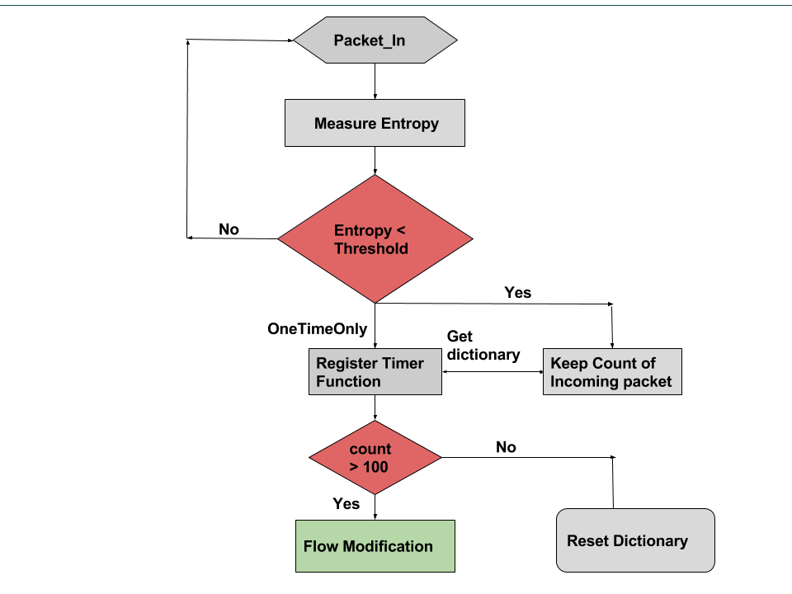

Slide 10
CONCULSION
The review paper, mainly characterizes
the DDoS attack
DETECTION METHOD USED FOR DDOS ATTACK
METHOD USED IN THIS PROJECT

Slide 11
REFERENCE LINK
https://www.researchgate.net/publication/322407312_Detection_techniques_of_DDoS_attacks_A_survey

