Slide 1
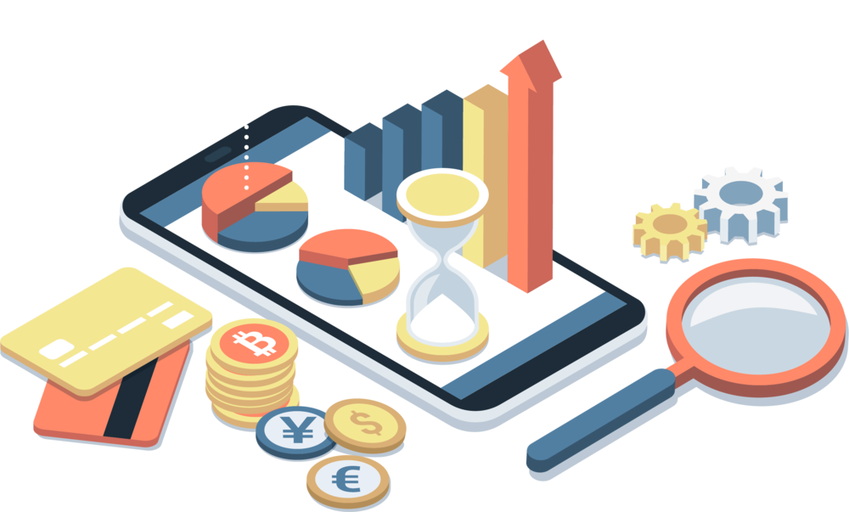
BUDGET TRACKING APP
FOR INDUSTRIAL TRAINING(21CSI-322)
SUBMITTED BY:
HITIKA
21BCS1485
21BCS_KRG_IOT 1-A

Slide 2


Technologies used:
1: Frontend: Flutter
2: Backend: Services from google cloud platform
3: Can be run on android, ios , mac-os, edge, windows with a single code-base
This Photo by Unknown Author is licensed under CC BY-NC-ND
This Photo by Unknown Author is licensed under CC BY

Slide 3
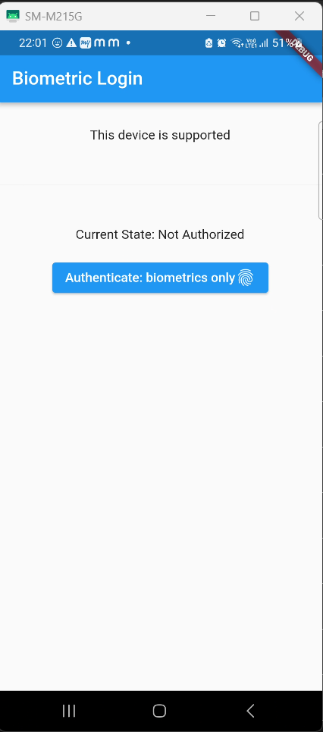
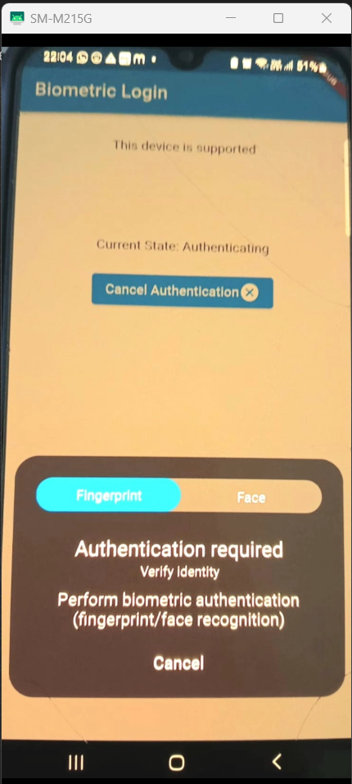
Biometric authentication
Fingerprint and Face Recognition

Slide 4
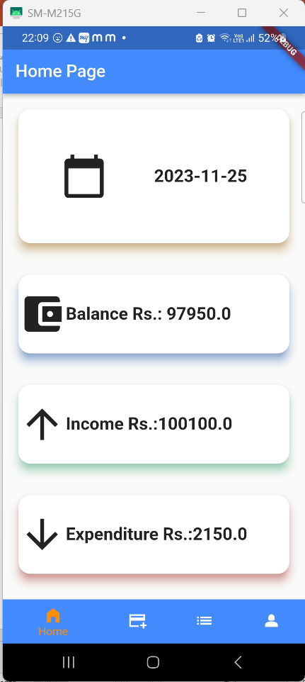
Home Page:
Includes summary of all the expenses of the month
1:date
2: Monthly Balance amount
3: Monthly income
4: Monthly expenditure

Slide 5
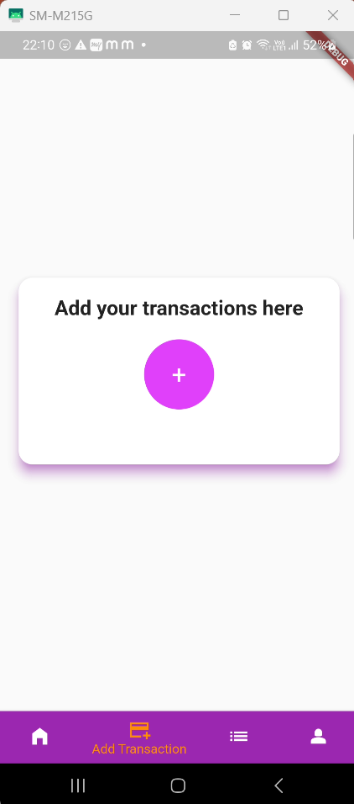
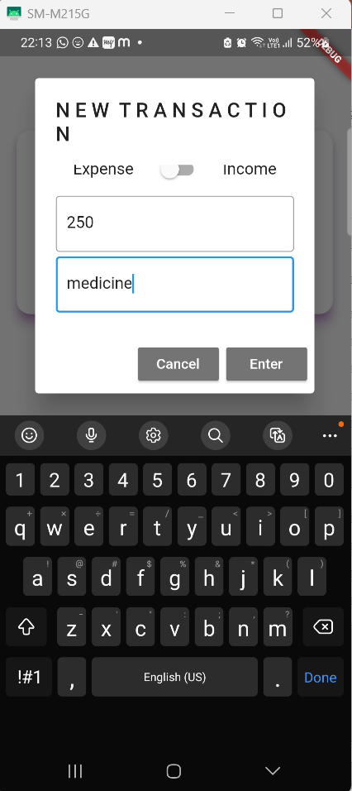
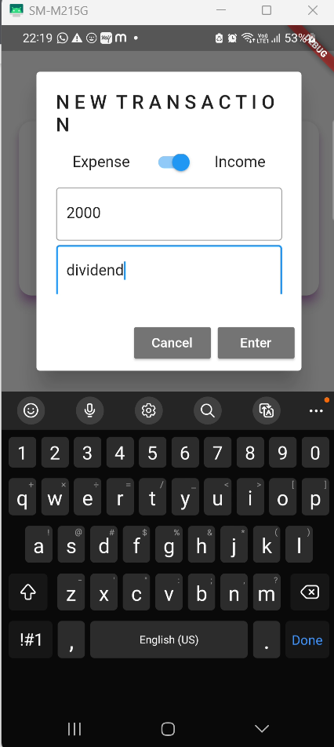

Slide 6
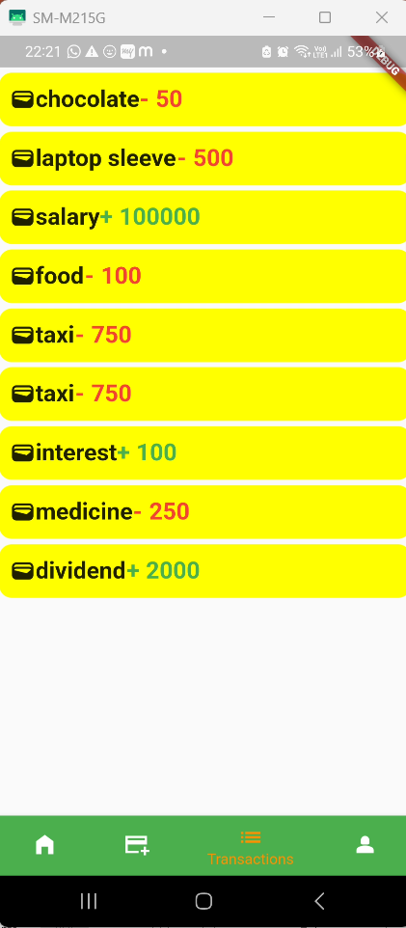
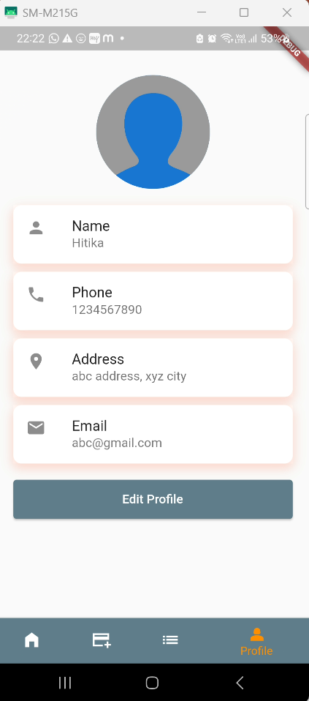
List of all transactions(incomes and expenditure)
Profile section

Slide 7

Future Scope:
1: Automatically fetch transaction information from bank transaction messages.
2:Improve user experience by adding categories to choose from .
3: Adding options to invest in market or setting a limit on daily spending based on your budget

Slide 8


