Slide 1
IMC Programming Assignment 1: Instructions
Lecturer: Dr. Rajiv Ratn Shah, rajivratn@iiitd.ac.in
TA: Vaishali Dabral, vaishali17066@iiitd.ac.in

Slide 2
Information
Submit to BackPack by August 31, 2018

Slide 3
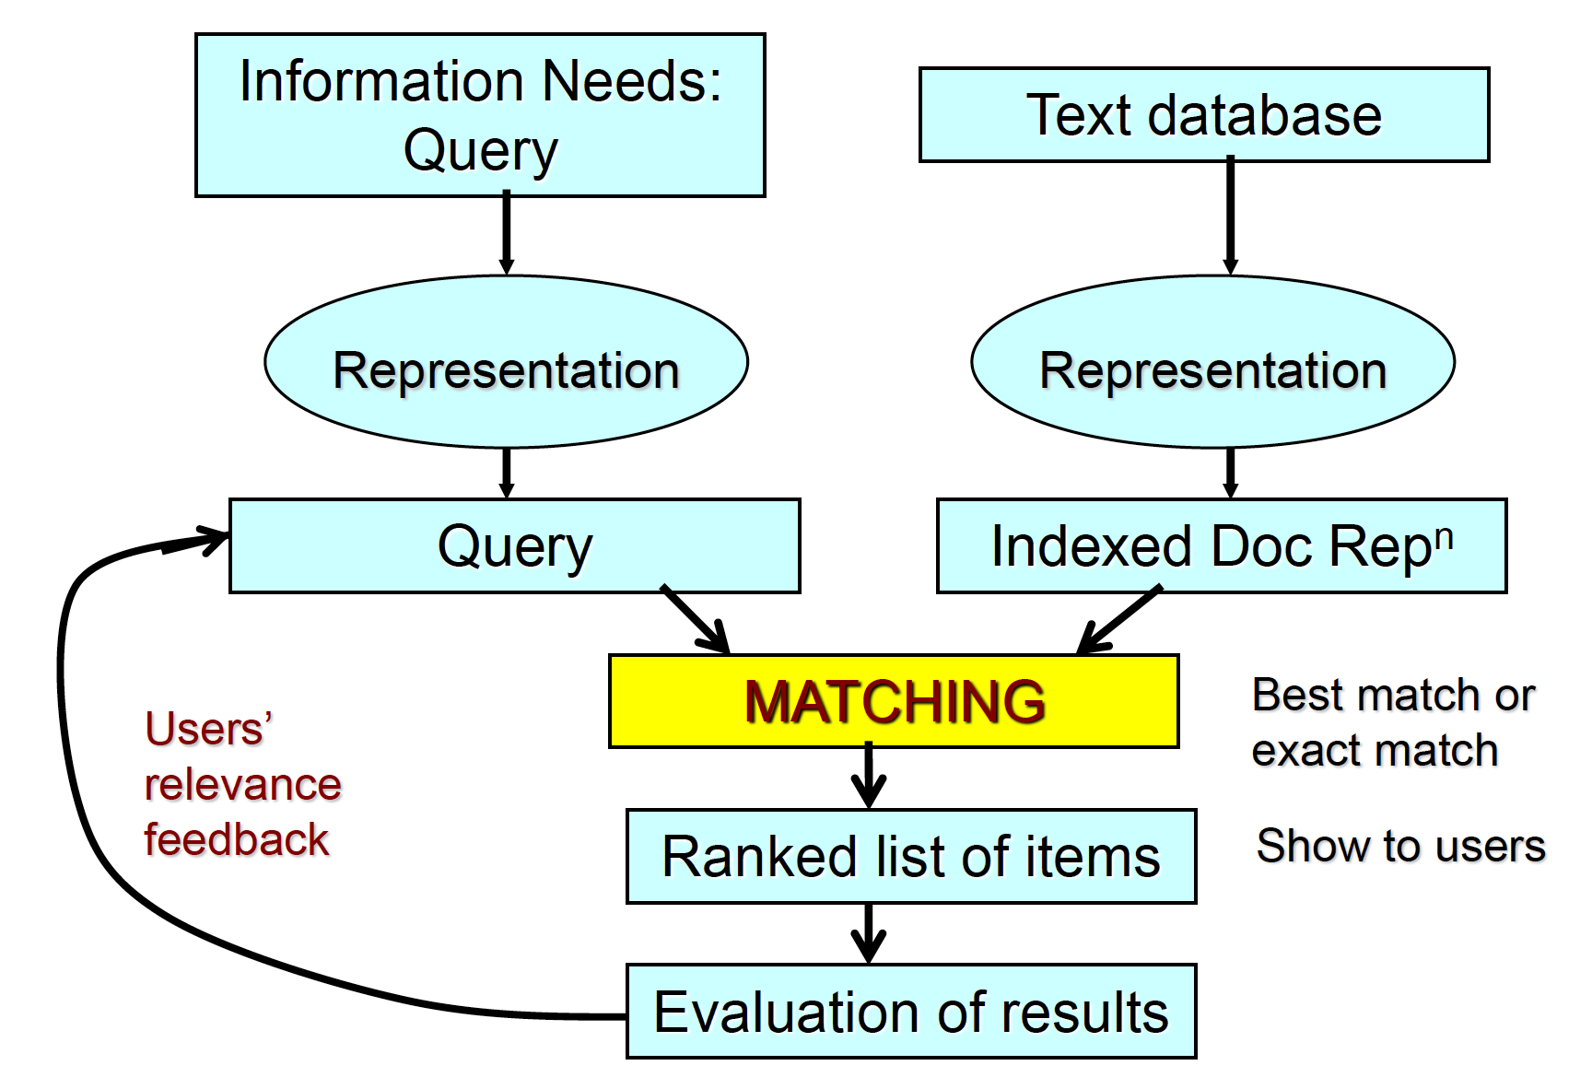
The task: Text Search
Given a textual query, rank a collection of documents according to relevancy.

Slide 4
The Dataset: Medline Collection
A collection of articles from a medical journal
1033 documents, 30 (textual) queries
Query Example: “electron microscopy of lung or bronchi.”
Three files:
med.all: contains the 1033 documents
med.que: contains the 30 queries
med.rel: contains the ground truth (which documents are relevant for each query)

Slide 5
What is provided
Code (self-explanatory) to do the following operations:
Loading the dataset
Performing text search using TF-IDF
Evaluating performances with MAP
A README.txt with the instructions to run the code

Slide 6
What you need to do
Implement the relevance feedback function (see lecture notes):
Using vector adjustment only
Using vector adjustment and query extension
Performance (MAP) is expected to increase with the relevance feedback function
Please, write you code in the file ‘relevance_feedback.py’

Slide 7
How to run the code
Download the required Python packages:
nltk: http://www.nltk.org/install.html
sklearn: http://scikit-learn.org/stable/install.html
Download the package ‘punkt’ with nltk (for tokenization):
Open Python, run the commands ‘import nltk’ and ‘nltk.download()’, go to the tab Models and search for the package ‘punkt’
Unzip the project file ‘imc_lab1.zip' anywhere on the filesystem
Unzip the dataset file 'med.tar.gz' in the folder /data
Run the python file 'lab1.py'
on Linux or Mac, open a terminal, cd to ‘imc_lab1/' and execute 'python lab1.py'

Slide 8
How to run the code
midasIIITD$ python lab1.py Baseline Retrieval MAP: 0.518385904086 Retrieval with Relevance Feedback MAP: 0.518385904086 Retrieval with Relevance Feedback and Query Expansion MAP: 0.518385904086

Slide 9
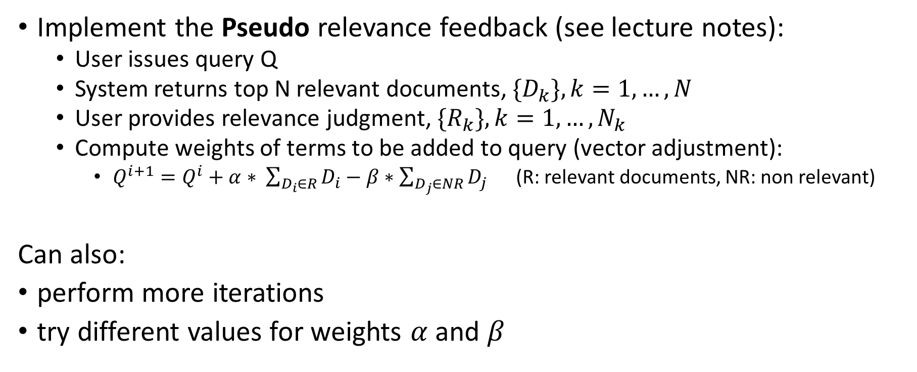
Relevance Feedback (vector adjustment only)
Implement the Pseudo relevance feedback (see lecture notes):
User issues query Q
System returns top N relevant documents, ${\{D}_{k}\}, k=1,…,N$
User provides relevance judgment, ${\{R}_{k}\}, k=1,…,N_{k}$
Compute weights of terms to be added to query (vector adjustment):
$Q^{i+1}=Q^{i}+α∗ \sum_{D_{i}∈R}{D_{i}−β∗\sum_{D_{j}∈NR}{D_{j}}}$ (R: relevant documents, NR: non relevant)
Can also:
perform more iterations
try different values for weights $α$ and $β$

Slide 10
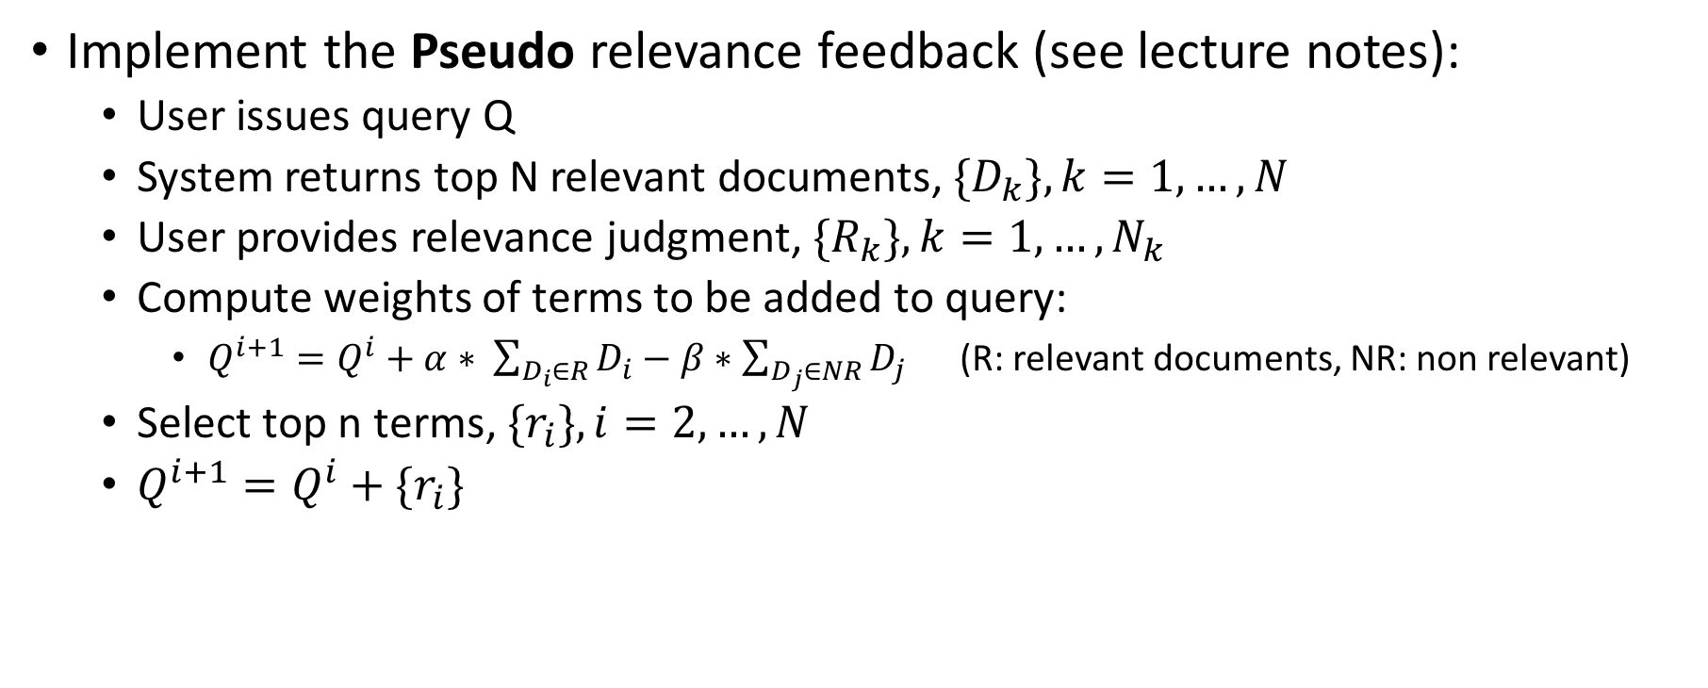
Relevance Feedback (with query extension)
Implement the Pseudo relevance feedback (see lecture notes):
User issues query Q
System returns top N relevant documents, ${\{D}_{k}\}, k=1,…,N$
User provides relevance judgment, ${\{R}_{k}\}, k=1,…,N_{k}$
Compute weights of terms to be added to query:
$Q^{i+1}=Q^{i}+α∗ \sum_{D_{i}∈R}{D_{i}−β∗\sum_{D_{j}∈NR}{D_{j}}}$ (R: relevant documents, NR: non relevant)
Select top n terms, ${\{r}_{i}\}, i=2,…,N$
$Q^{i+1}=Q^{i}+{\{r}_{i}\}$

Slide 11
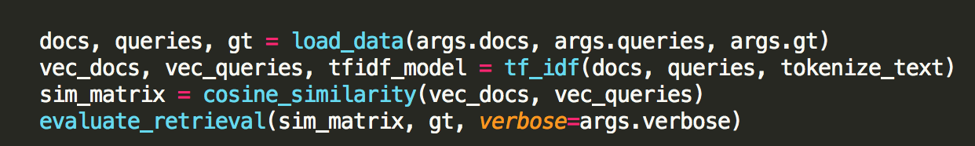
A glance at the code
sim_matrix[i,j] contains the cosine similarity between document i and query j.
The top k relevant document for query q can be obtained with: np.argsort(-rf_sim_matrix[:, i])[:k]
Evaluate_retrieval(…) computes and prints the Mean Average Precision

Slide 12
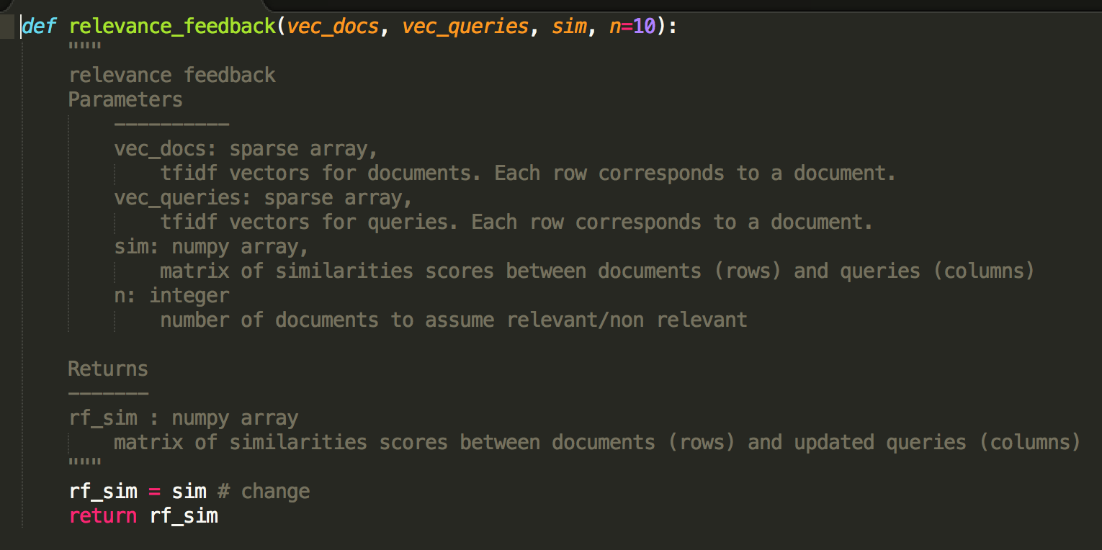
A glance at the code (2)

Slide 13
Assessment
Relevance feedback (7.5 marks)
Implementation
Results
Folder structure
README
Additional (Upto 2.5 marks)
Enhanced UI
Details of proposed advance techniques
Implementing the proposed advance techniques
Comparison with Relevance feedback

Slide 14
References
Lecture Notes
Salton and Buckley, Improving Retrieval Performance by Relevance Feedback, Journal of the American Society for Information Science, 1990

