Slide 1
PROJECT REPORT
TRAVEL PLAN GENERATOR
Dinesh Akurathi (da831)
Hittishi Kurlagunda (hk919)
Srija Maddineni (sm2780)

Slide 2

Objective :
In this project, we are trying to implement a travel plan according to the user's needs. The user can request a specific travel route in the form of a graph, then request the best possible route according to
a) Price: The path that is low at cost
b) Time: The route that takes the least amount of time
c) Directness: The route with the fewest number of connections
The user will request routes through text prompts, according to their needs. When a user is required to find the cheapest route, we change the weights of the graph into prices, similarly when they require for the shortest path, the weights are updated as distances.

Slide 3
Data Set :
The data set that this project contains, n cities, with all the modes of transportation that are
available, belonging to that particular city along with the cost of transportation through different modes of transportation. Given a data set containing cities and their transportation modes i.e., bus transportation, train networks, and flight networks, we choose to find the best possible path from a given source location to the destination location while considering user needs such as time, distance, combination of all.
The data set is listed with different cities represented and indexed as nodes along with the weights between the nodes. Cities are represented as node and the paths between them are
Edges.
Below is a dictionary containing a small proto type of different cities in the list along with distances between them as weights of the edges.
We have considered different data sets for Prims and Krushkal, another data set for A* algorithm.

Slide 4
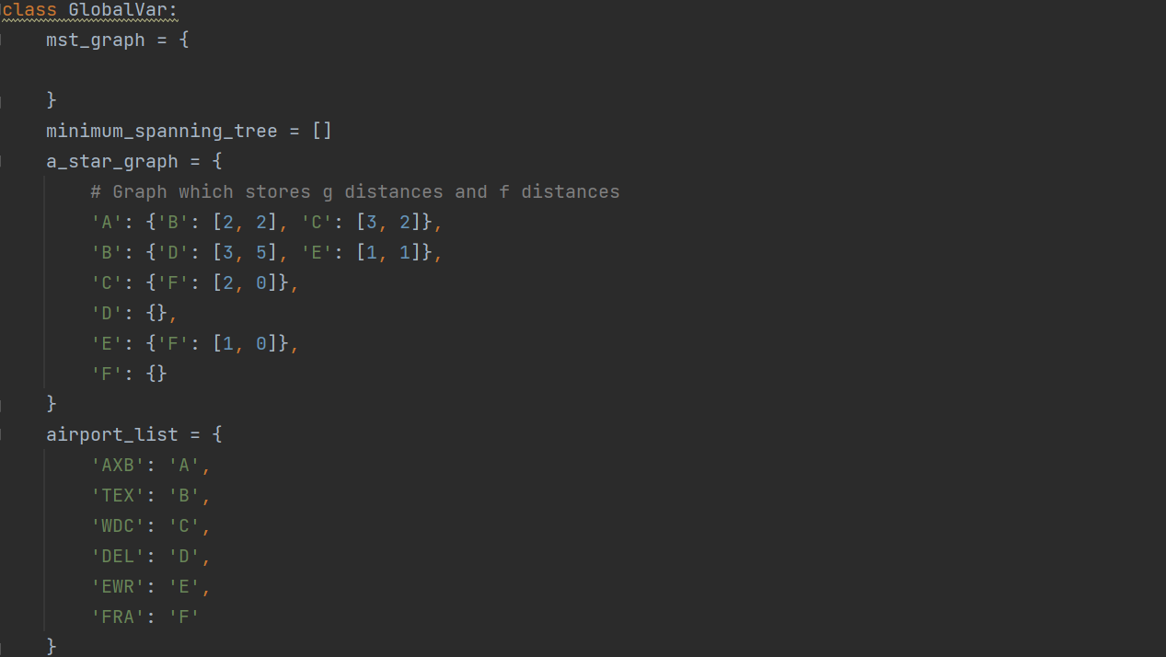

Slide 5
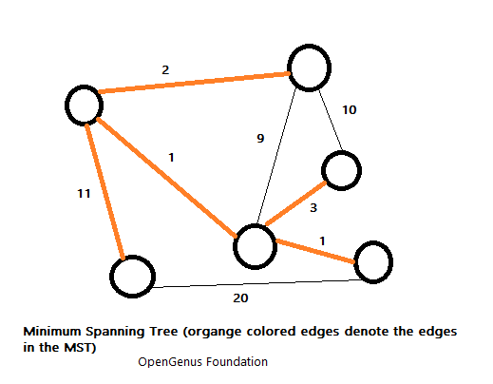
Concept of Minimum Spanning trees:
A minimum spanning tree (MST) or minimum weight spanning tree is a subset of the edges of a connected, edge-weighted directed or undirected graph that connects all the vertices together, without any cycles and with the minimum possible total edge weight. It is a spanning tree whose sum of edge weights is as small as possible.
More generally, any edge-weighted undirected graph (not necessarily connected) has a minimum spanning forest, which is a union of the minimum spanning trees for its connected components.

Slide 6
Prims :
Prim's Algorithm is a greedy algorithm that is used to find the minimum spanning tree from a graph. Prim's algorithm finds the subset of edges that includes every vertex of the graph such that the sum of the weights of the edges can be minimized.
Prim's algorithm starts with the single node and explores all the adjacent nodes with all the connecting edges at every step. The edges with the minimal weights causing no cycles in the graph got selected.
Prim's algorithm is a greedy algorithm that starts from one vertex and continues to add the edges with the smallest weight until the goal is reached. The steps to implement the prim's algorithm are given as follows -
First, we have to initialize an MST with the randomly chosen vertex.
Now, we have to find all the edges that connect the tree in the above step with the new vertices. From the edges found, select the minimum edge and add it to the tree.
Repeat step 2 until the minimum spanning tree is formed.

Slide 7
Pseudocode of Prim's Algorithm :
The pseudocode for prim's algorithm shows how we create two sets of vertices U and V-U. U contains the list of vertices that have been visited, and V-U is the list of vertices that haven't. One by one, we move vertices from set V-U to set U by connecting the least weight edge. The following pseudocode is used to construct the MCST(minimum cost spanning tree), using prim's algorithm that is as follows:
PRIMS MCST(G, w)
/* Input: An undirected connected weighted graph G = (V, E).
/* Output: A minimum cost spanning tree T(V, E') of G
{
Т ← ф // T contains the edges of the MST
A ← (Any arbitrary member of V)
while (A≠V)
{
find an edge (u, v) of minimum weight such that u ∈ V - A and v ∈ A
A ← A U {(u, v)}
B ← B U(u)
}
return T
}

Slide 8
Krushkal:
Kruskal's Algorithm is used to find the minimum spanning tree for a connected weighted graph. The main target of the algorithm is to find the subset of edges by using which we can traverse every vertex of the graph. It follows the greedy approach that finds an optimum solution at every stage instead of focusing on a global optimum.
In Kruskal's algorithm, we start from edges with the lowest weight and keep adding the edges until the goal is reached. The steps to implement Kruskal's algorithm are listed as follows -
First, sort all the edges from low weight to high.
Now, take the edge with the lowest weight and add it to the spanning tree. If the edge to be added creates a cycle, then reject the edge.
Continue to add the edges until we reach all vertices, and a minimum spanning tree is created.

Slide 9
Kruskal Algorithm Pseudocode :
The Kruskal algorithm takes an undirected connected weighted graph G(V, E), where V represents the number of vertices and E represents the number of edges in the graph. The output of the Kruskal algorithm is a minimum cost spanning tree T(V, E') of the given graph G. Here, the V is the same as the given graph, but the E' is changed as we do not include all the edges of the graph G. The pseudocode of Kruskal algorithm is as given below:
KRUSKAL MCST (G, W)
{
Sort the edges of E in order of increasing weight
A←Ø
for (each vertex v є V[G])
do MAKE_SET(v)
for (each edge (u, v) є E, taken in increasing order of weight)
{
if (FIND SET (u) ≠ FIND_SET (V))
A←A ∪ {(u, v)}
MERGE(u, v)
}
return A
}

Slide 10
Algorithm without using MST
A*
It is a searching algorithm that is used to find the shortest path between an initial and a final point.
It is a handy algorithm that is often used for map traversal to find the shortest path to be taken. A* was initially designed as a graph traversal problem, to help build a robot that can find its own course. It still remains a widely popular algorithm for graph traversal.
It searches for shorter paths first, thus making it an optimal and complete algorithm. An optimal algorithm will find the least cost outcome for a problem, while a complete algorithm finds all the possible outcomes of a problem.
Another aspect that makes A* so powerful is the use of weighted graphs in its implementation. A weighted graph uses numbers to represent the cost of taking each path or course of action. This means that the algorithms can take the path with the least cost, and find the best route in terms of distance and time.

Slide 11
Pseudo code example of A* algorithm built of greedy algorithm :
open_list, closed_list = empty list of possible positions
adjacent_value=0
next_position=null
push start_position to open_list
while open_list is not empty
current node = pop open_list
for each adjacent position of current_node (ap_current) with value (av_current)
if adjacent_value is less than av_current or ap_current is in closed_list
adjacent_value= av_current
next_position= ap_current
push ap_current to closed_list
push next_position to open_list

Slide 12
Prim’s Algorithm | Kruskal’s Algorithm
It starts to build the Minimum Spanning Tree from any vertex in the graph. | It starts to build the Minimum Spanning Tree from the vertex carrying minimum weight in the graph.
It traverses one node more than one time to get the minimum distance. | It traverses one node only once.
Prim’s Algorithm has a time complexity of O(V²), V being the number of vertices and can be improved up to O(E log V) using Fibonacci heaps. | Kruskal’s algorithm’s time complexity is O(E log V), V being the number of vertices.
Prim’s algorithm gives connected components as well as it works only on connected graphs. | Kruskal’s algorithm can generate forest(disconnected components) at any instant as well as it can work on disconnected components.
Prim’s algorithm runs faster in dense graphs. | Kruskal’s algorithm runs faster in sparse graphs.
It generates the minimum spanning tree starting from the root vertex. | It generates the minimum spanning tree starting from the least weighted edge.
Applications of prim’s algorithm are Travelling Salesman Problem, Network for roads and Rail tracks connecting all the cities etc. | Applications of Kruskal algorithm are LAN connection, TV Network etc.
Prim’s algorithm prefers list data structures. | Kruskal’s algorithm prefers heap data structures.

Slide 13
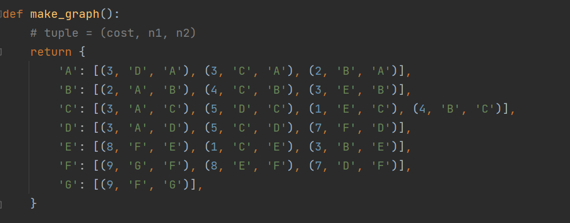
Implementation
def make_graph():
It takes the list representation of cities and distances between them and makes a graph, to implement variants of BFS algorithms.
Here we use prim’s algorithm and kruskal’s algorithm, which uses minimum spanning trees out of the given graph to find the shortest path.

Slide 14
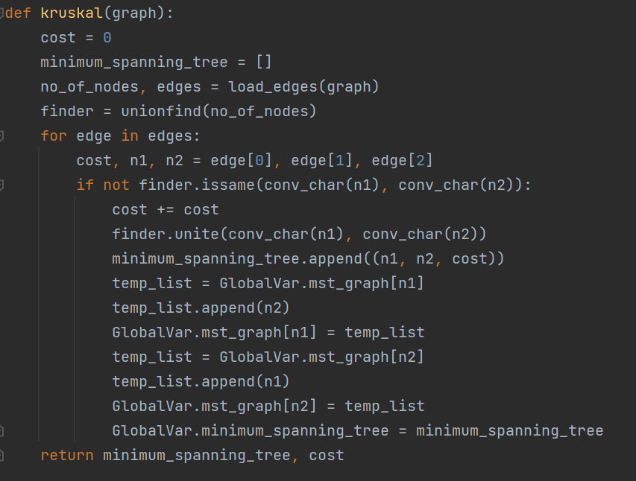
.
def krushkal(graph):
This function calculates the MST of the graph and finds the shortest path in the MST tree to give a path from source to destination.

Slide 15
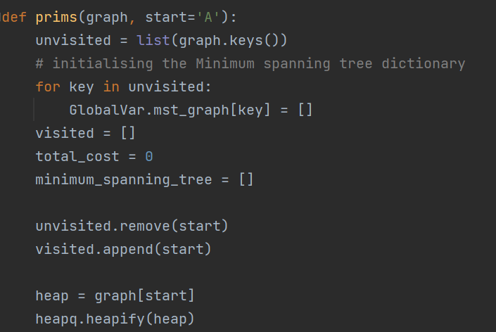
.
def prims(graph) :
This function uses the prims algorithm, calculates the MST of the graph and finds the shortest path in the MST tree to give a path from source to destination.

Slide 16
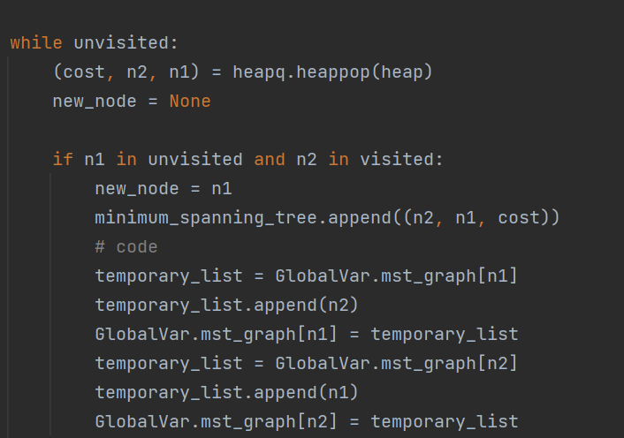
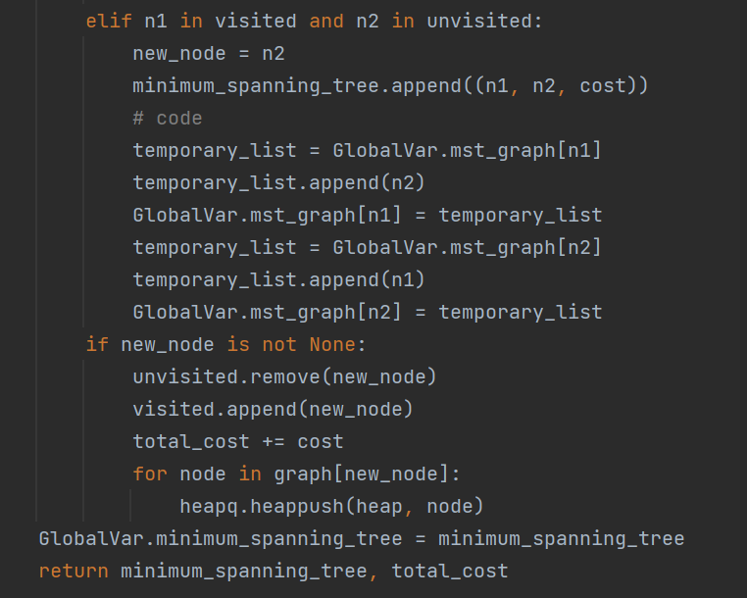

Slide 17
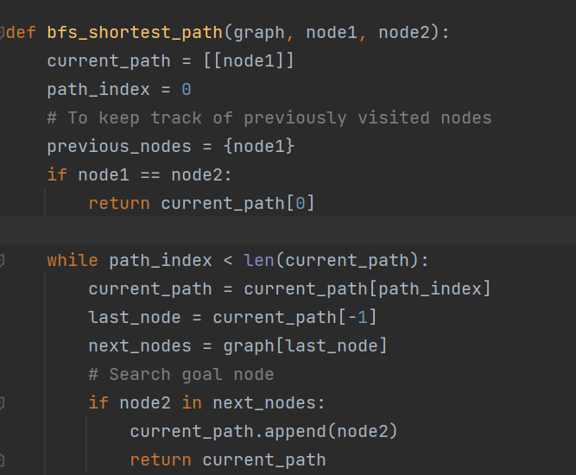
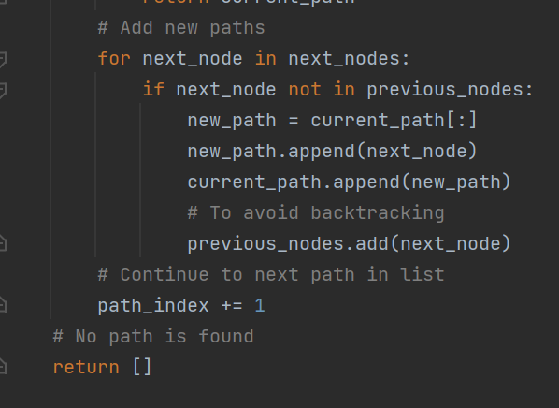

Slide 18
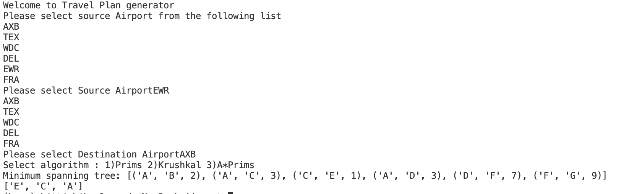
Outputs :
PRIMS :

Slide 19
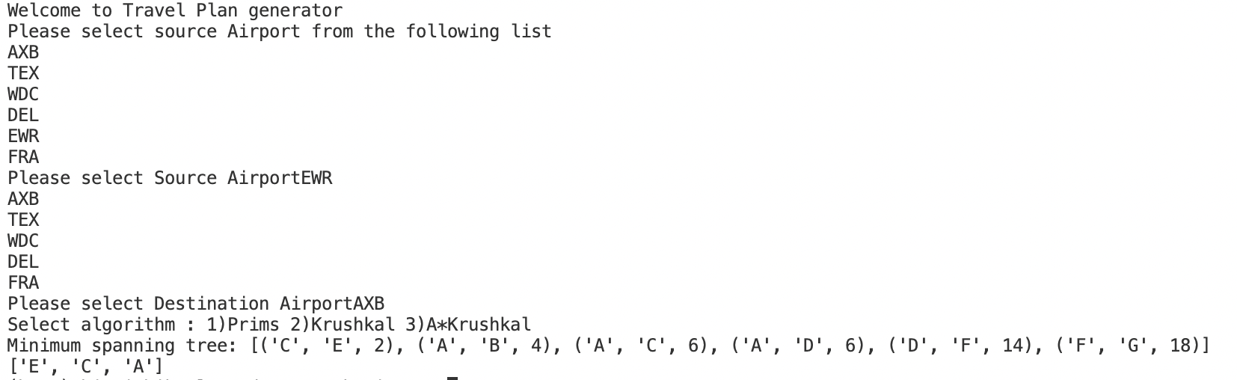
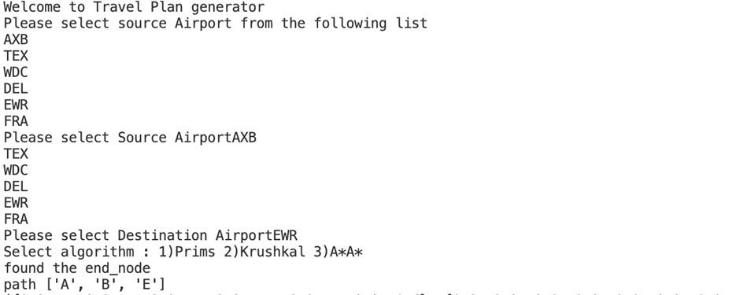
KRUSHKAL
A*

