Slide 1
MILESTONE 1 · DS & AI LAB · MAY 2026
Multimodal Damage Assessment
for Insurance Claims
Problem Definition & Literature Review
Satyajeet Kumar
Agnesh Kundu
Anuj Gautam
Pranab Kumar Manna
Venkata Siva Kamal Guddanti
Group 1
Notes:
Welcome slide. Introduce the team and the project title. Mention that this is Milestone 1 covering problem definition and literature review.

Slide 2
Agenda
1
Problem Statement
6
Gaps in Existing Solutions
2
Problem Motivation
7
Our Contribution
3
Prior Research
8
System Architecture
4
RAG & Industry
9
Success Metrics · Dataset Plan
5
Modular Pipeline v/s VLMs
10
Risks & Challenges
Notes:
Walk through the agenda briefly. 10 topics, should take 15-20 minutes total.

Slide 3
The Problem
Stakeholders
Manual. Slow. Inconsistent.
When a vehicle is damaged, a claims assessor must:
PRIMARY
Manually review all submitted photographs
Cross-reference the policyholder's insurance document
Write a preliminary assessment report
Claim Assessors
Faster first-pass reports; less repetitive manual work
This process takes one to several business days and is prone to inter-assessor variability.
PRIMARY
Insurance Companies
Reduced processing time; standardised initial assessments
We build an AI decision-support system to automate the initial assessment stage.
SECONDARY
Policyholders
Faster decisions; transparent, traceable documentation
Notes:
The core problem: manual, multi-step claims assessment is slow and inconsistent. The system is decision-support only; humans retain final authority.

Slide 4
Why This Matters
$10B
⏱
⚖
Throughput Bottleneck
Assessor Variability
to $15B
Manual photo review is the largest time cost per claim
Same damage, different severity ratings between assessors
India Motor Insurance Market
2026 → 2031
📄
📈
Policy Cross-referencing
Scalability
Multi-page policy docs read repeatedly for every claim
Surge events (storms, floods) flood the pipeline
Notes:
The India motor insurance market alone is $10B+ and still heavily manual. Highlight the four pain points and mention that automating the INITIAL stage only (with human review) keeps the risk bounded.

Slide 5
Prior Research: Computer Vision
Foundational
Detection
Patil et al. (2017)
YOLOv8 IEEE (2024)
First CNN-based binary classifier for vehicle damage. Established that deep learning could distinguish damaged from undamaged vehicles.
Fine-tuned on 4,000+ images with 21 car-part classes & 8 damage types. Strong mAP for simultaneous part + damage segmentation.
SOTA
Two-Stage
HL-YOLO MDPI (2025)
Mask R-CNN He et al. (2017)
+2.5% precision, +5.8% recall, +3-4% mAP over YOLO11 baseline via heterogeneous convolutions. Closest to our chosen approach.
Higher segmentation fidelity via vehicle-then-damage pipeline. Achieves better masks but at significantly greater compute cost.
Notes:
The field started with binary classification in 2017, shifted to localisation via YOLO. HL-YOLO (2025) is the current state of the art. Mask R-CNN is high quality but expensive.

Slide 6
Prior Research: RAG & Industry
RAG for Document Understanding
Industry & Academic Landscape
Chunk Size Matters
Industry (proprietary):
Tractable, CCC Intelligent Solutions, Mitchell
Deployed CV systems in production. However:
Technical details are proprietary
No policy grounding in any public demo
Inaccessible to researchers / small insurers
Closest Academic Analogue:
MIMIC-CXR: vision model detects, LLM generates a structured report. We adapt this paradigm to vehicle damage assessment.
200-400 token chunks with overlap consistently outperform large-chunk retrieval for precise clause-level recall in legal documents.
Bi-encoders Beat BM25
MiniLM-L6-v2 and MPNet outperform sparse BM25 retrieval for semantic matching of insurance-style queries.
Faithfulness is Critical
Without grounding, LLMs hallucinate coverage entitlements. RAG with source attribution substantially reduces this (ES-RAG, 2024).
Notes:
RAG was introduced by Lewis et al. (2020). For insurance policy retrieval the key insight is small chunks + bi-encoders + explicit source attribution. Industry has deployed this but in black boxes.

Slide 7
Why Not Just Use a VLM?
Florence-2, Qwen2.5-VL, LLaVA, GPT-4V are compelling but the modular pipeline is a better fit for the project:
1
Separation of Concerns & Debuggability
Each stage (detect, retrieve, generate) can be isolated and fixed independently. A monolithic VLM is a black box: a bad output gives no signal as to what went wrong, slowing iteration in a time-boxed project.
2
Measurable, Ground-truth Comparable Detection
YOLO outputs bounding boxes and class labels, directly evaluable against VehiDE (mAP@50, F1 per class). VLM damage descriptions are free-form text — not comparable to bounding-box annotations without extra post-processing.
3
Cost, Latency & Deployment
YOLO-nano/small runs on CPU and fits within Hugging Face Spaces limits. Large VLMs need paid APIs or dedicated GPU memory Spaces cannot reliably provide. Modular pipeline keeps each component lightweight and swappable.
Notes:
Acknowledge that VLMs are impressive. The argument is not capability — it is interpretability, evaluability, and deployment feasibility given our constraints.

Slide 8
Gaps in Existing Solutions
Gap 1
Detection Without Structured Reporting
YOLO fine-tunes and CarDD benchmark models output bounding boxes and class indices not human-readable reports. No open-source system bridges detection output to a final claim assessment.
Gap 2
LLM Reports Without Policy Grounding
General-purpose LLMs (GPT-4, Gemini) hallucinate coverage entitlements, incorrect exclusions, and fabricated deductible values without access to the actual policy. RAG grounding is absent from all publicly demonstrated systems.
Gap 3
No Accessible Decision-Support Demo
Industry systems (Tractable, CCC) are closed and proprietary. There is no open, deployable vision-plus-language claim assessment tool. Our Hugging Face Spaces deployment addresses this gap directly.
Notes:
Three distinct gaps our project fills: vision-to-report bridging, policy grounding, and accessibility. Each gap directly maps to one component of our pipeline.

Slide 9
Our Contribution
Not a new model architecture three meaningful contributions:
🚀 Open-Source End-to-End Pipeline
🔗 Pipeline Integration
A publicly accessible system combining YOLO-based damage detection with policy-aware LLM report generation. Specifically designed for claim assessors, dramatically reducing time to first-draft assessment.
YOLO detections are converted to structured format, then fed to an LLM together with RAG-retrieved policy clauses, enabling accurate, grounded, non-technical reports. The integration of all three components is the core technical contribution.
🌐 Accessible Deployment on Hugging Face Spaces
The first open, interactable demonstration of a vision-plus-language vehicle claim assessment tool — accessible to researchers and small insurers who cannot access proprietary industry systems.
Notes:
Stress that the contribution is integration, usability, and accessibility — not a novel architecture. This sets appropriate expectations for a course project.

Slide 10
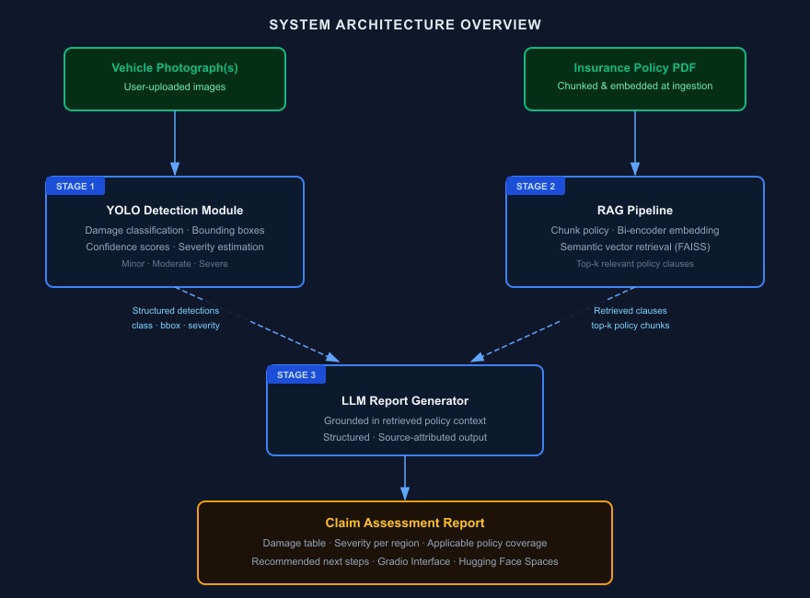
System Architecture
Notes:
Walk through three stages: Stage 1 - YOLO detects damage and classifies severity. Stage 2 - RAG pipeline chunks the policy PDF, embeds it, and retrieves the top-k relevant clauses. Stage 3 - LLM combines both outputs into a structured report. Human assessor reviews the report before any decision.

Slide 11
Success Metrics
Vision Model (YOLO)
RAG Pipeline
Metric | Target
mAP@50 | ≥ 0.70
mAP@50-95 | ≥ 0.50
Per-class F1 (all 6 classes) | ≥ 0.65
Inference speed | Report only
Metric | Target
Retrieval Precision@3 | ≥ 0.80
Faithfulness score | ≥ 0.85
Notes:
mAP@50 ≥ 0.70 is the primary vision target. Faithfulness ≥ 0.85 is the primary RAG target. Human evaluation with 3 raters keeps subjectivity controlled. Ablation study is key to demonstrating each component's contribution.

Slide 12
Dataset Plan
Vision Datasets
Dataset | Size | Annotation Type | Role
VehiDE | 13,945 images | Bounding boxes, 32k+ instances | Primary training & evaluation
CarDD | Varies by split | Pixel-level segmentation masks | Supplementary segmentation fine-tuning
COCO Car Damage | ~500 images | COCO-format bounding boxes | Supplementary architecture comparison
Car Damage Severity | ~2,300 images | Minor / Moderate / Severe labels | Severity classifier calibration
Policy Data to be created by Team
5 synthetic insurance policy PDFs (8-12 pages each) covering collision, comprehensive coverage, deductibles, exclusions, claim limits, and third-party liability.
Each policy has coverage clauses mapped to all 6 damage classes enables ground-truth evaluation of RAG retrieval precision.
50 synthetic incident descriptions paired with test images for end-to-end report quality evaluation.
Notes:
VehiDE (13k+ images) is our primary source. No public dataset pairs policy documents with vehicle damage — we create synthetic policies ourselves, which also lets us define ground-truth clause retrievals.

Slide 13
Risks & Mitigations
⚠ Dataset Imbalance
⚠ Severity Estimation
Dents/scratches dominate rare classes. Mitigation: class-weighted loss, augmentation oversampling, per-class F1 monitoring.
BBox-area proxy has failure modes. Mitigation: calibrate against Car Damage Severity dataset + human annotator consensus.
⚠ Domain Shift
⚠ RAG Faithfulness (Synthetic Policies)
Training on studio images; real claims are mobile photos in variable conditions. Mitigation: brightness/contrast/perspective augmentation + realistic stress-test set.
Synthetic docs may be simpler than real policies. Mitigation: varied phrasing, negations, and distractor clauses to stress-test retrieval.
⚠ LLM Hallucination on Edge Cases
LLM may invent coverage when no clause is retrieved. Mitigation: explicit prompt instruction to state 'not covered' rather than infer from parametric knowledge.
Notes:
Five known risks, each with a concrete mitigation. Domain shift and hallucination are the highest-priority risks. The human-in-loop review requirement means errors are caught before decisions are made.

Slide 14
Thank You
Questions & Discussion
GitHub: HiveCase/Group-1-DS-and-AI-Lab-Project
Demo: Hugging Face Spaces (to be deployed)
Course: DS & AI Lab · May 2026 · Group 1 · IIT Madras
Notes:
End slide. Invite questions. Be ready to discuss VLM comparison, severity estimation approach, and synthetic policy design.

