Slide 1
DATA SCIENCE & AI LAB · GROUP 1
Multimodal Damage Assessment
for Insurance Claims
Milestone 5. Model Evaluation
Satyajeet Kumar Anuj Gautam Pranab Kumar Manna Venkata Siva Kamal Guddanti Harsh Pal

Slide 2
01 · INTRODUCTION
From Trained Checkpoints to an Evaluated Model
Milestone 4 produced several fine-tuned checkpoints across two parallel tracks. This milestone evaluates one of them in depth: a COCO-pretrained YOLO11m-seg model, fine-tuned on Google Colab, tuned with a corrected Optuna hyperparameter search, and assessed against appropriate segmentation metrics with error analysis and documented limitations.
3
6
Model checkpoints compared
Damage classes evaluated
MILESTONE 5 OBJECTIVES
Evaluate with appropriate metrics
12
+11.8%
1
Box and mask precision, recall, mAP50, and mAP50-95 — the COCO-style conventions this task calls for.
2
Provide error analysis
Optuna hyperparameter trials
Mask mAP50 gain, tuned vs. baseline — test split
Where the model fails, which classes drive it, and why — grounded in per-class evidence, not assumption.
6.6 : 1
3
Discuss limitations and improvements
What this evaluation does not yet cover, and the concrete next steps that would close those gaps.
scratch : shattered_glass training-instance imbalance — carried forward from Milestone 2/4, and shown in Section 6 to not be the dominant driver of error.
Multimodal Damage Assessment for Insurance Claims · Milestone 5
1

Slide 3
02 · SCOPE DISCLOSURE
One Track of Two — Read Before the Results
Milestone 4's own "Prepared for Milestone 5" section names the Kaggle-trained, CarDD-pretrained YOLOv8s-seg checkpoint (test mask mAP50 = 0.3549) for this evaluation. This report instead evaluates a separate, individually-run track, documented here for the first time. The two are not directly comparable — different pretrained weights, environment, and split.
MILESTONE 4's INTENDED TRACK
TRACK EVALUATED IN THIS REPORT
Platform: Kaggle, T4 GPU Pretrained source: CarDD (domain-specific) Selected checkpoint: YOLOv8s-seg, DFL boundary-precision, 80 total epochs Test mask mAP50: 0.3549 — provisional Status: Not evaluated in this report
Platform: Google Colab, T4 GPU Pretrained source: COCO (general-purpose) Selected checkpoint: YOLO11m-seg, Optuna-tuned, 40 epochs Test mask mAP50: 0.447 — held-out split, see Sections 5–6 Status: Evaluated in full below
If the group's final submission needs both tracks covered, the CarDD-track evaluation should be prepared separately from the Kaggle-side logs, which are not available in this working environment.
Multimodal Damage Assessment for Insurance Claims · Milestone 5
2

Slide 4
03 · EVALUATION SETUP
Three Checkpoints, One Shared Split
MODELS EVALUATED
Run | Epochs | Config
Baseline | 40 | optimizer="auto" → AdamW, lr fixed at 0.001
Extended | 60 | Baseline continued, no config change
Tuned | 40 | AdamW, lr0≈0.000105, wd≈0.00029, degrees≈5.5
EVALUATION PROTOCOL
Metrics reported in this deck are computed on the held-out test split (2,047 images), never touched for training, checkpoint selection, or the Optuna search. A separate val-vs-test gap check (Section 9) confirms this checkpoint generalised cleanly, with no meaningful overfitting to the validation split used during development.
6 damage classes: dent · scratch · crack · broken_lamp · shattered_glass · flat_tyre, plus unlabelled background images (~7% of the dataset, no damage annotated).
DATASET SPLIT (SHARED ACROSS RUNS)
Split | Images | Role
Train | 9,545 | Fine-tuning
Val | 2,047 | Checkpoint selection, Optuna feedback
Test | 2,047 | Held out — evaluation pending (Section 10)
Cross-validation: not applicable — a single fixed stratified split was used throughout, consistent with the project's established leakage-safety practice.
Ground truth: pre-existing YOLO-format polygon annotations shipped with VehiDE — no manual re-annotation performed.
Multimodal Damage Assessment for Insurance Claims · Milestone 5
3

Slide 5
04 · PERFORMANCE METRICS
Box and Mask, Reported Together
Instance segmentation predicts a class, a box, and a pixel mask per detection — so both Box and Mask variants of each metric are reported. Mask metrics are structurally harder to score well on than Box (a pixel-precise boundary is a stricter target than a rectangle), so a gap between them is expected, not a defect.
Metric | Definition | Why it is used here
IoU | Overlap area ÷ union area of predicted vs. ground-truth region. | Base unit underlying every metric below.
Precision | Fraction of predicted damage that was correct. | False-positive rate — spurious flags cause claim disputes.
Recall | Fraction of actual damage the model found. | Missed-damage rate — a missed dent under-assesses a claim.
mAP50 | Mean AP at 50% IoU, averaged across all 6 classes. | Standard, relatively forgiving detection benchmark.
mAP50-95 | mAP averaged across IoU thresholds 50%–95%. | Stricter — rewards precise localisation, not rough overlap.
Multimodal Damage Assessment for Insurance Claims · Milestone 5
4

Slide 6
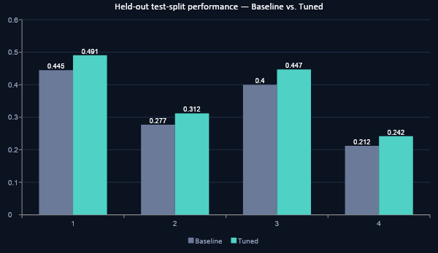
05 · EXPERIMENTAL RESULTS
Every Metric Moved in the Same Direction
READ ACROSS EVERY METRIC
The Tuned run improves on all four reported metrics with no regression on any — measured on data neither model ever trained or was selected on. This supports attributing the gain to the hyperparameter correction itself, not to chance or split luck.
+10.3%
+14.2%
Box mAP50
Mask mAP50-95
Val-vs-test gap check (Section 9): every metric within 0.012 of its validation-split value — clean generalisation, no overfitting to the split used during development. Inference: 45ms/image, 22 img/sec.
Multimodal Damage Assessment for Insurance Claims · Milestone 5
5

Slide 7
06 · HEADLINE FINDING
More Instances Did Not Mean
Better Performance.
scratch
shattered_glass
MOST training instances of any class
FEWEST training instances of any class
10,070
1,513
training instances
training instances
0.288
0.775
mask mAP50 — one of the two weakest classes
mask mAP50 — the best-performing class, ~2.7x scratch's score
This ranking is identical to Milestone 4's independent finding on the separate CarDD-pretrained track. Two differently-pretrained models, on two platforms, reproduce the same class-difficulty pattern — evidence this reflects visual distinguishability of the damage types, not a quirk of either track's setup.
Multimodal Damage Assessment for Insurance Claims · Milestone 5
6

Slide 8
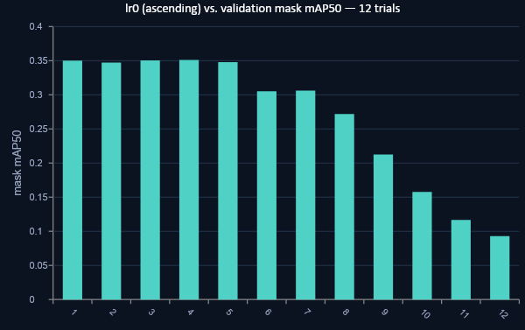
07 · HYPERPARAMETER TUNING
A Bug Fix, Then a Clean Signal
THE BUG
An earlier search used optimizer="auto". Ultralytics silently overrides any passed lr0 under this setting — confirmed in the log: "'optimizer=auto' found, ignoring 'lr0=...'". Every trial in that search actually trained at the same fixed lr=0.001; the search varied lr0 in name only.
THE FIX AND THE SIGNAL
Setting optimizer="AdamW" explicitly restored real control over lr0. The corrected search shows a clear, near-monotonic relationship: best in the lr0 ≈ 5×10⁻⁵–1.3×10⁻⁴ band, collapsing to roughly a quarter of peak performance above lr0 ≈ 4×10⁻³. weight_decay and degrees showed no comparable trend.
Selected: lr0=0.0001047, weight_decay=0.000292, degrees=5.5 — 5-epoch proxy generalised sensibly to full 40-epoch training (0.351 → 0.449).
Categories are each trial's lr0 value, sorted ascending — the near-monotonic decline visualises the relationship found in the search.
Multimodal Damage Assessment for Insurance Claims · Milestone 5
7

Slide 9
08 · BASELINE VS. TUNED
The Improvement, Quantified
Metric | Baseline | Tuned | Absolute | Relative
Box mAP50 | 0.445 | 0.491 | +0.046 | +10.3%
Box mAP50-95 | 0.277 | 0.312 | +0.035 | +12.6%
Mask mAP50 | 0.400 | 0.447 | +0.047 | +11.8%
Mask mAP50-95 | 0.212 | 0.242 | +0.030 | +14.2%
WHY THIS ISN'T JUST MORE TRAINING
The Extended run (60 epochs, same untuned config) landed within 0.004 of the 40-epoch Baseline on every metric — 20 extra epochs of unmodified training bought almost nothing.
The Tuned run, at the same 40 epochs as Baseline, outperforms even the 60-epoch Extended run on every metric. The gain traces to the corrected learning rate, not additional compute.
All figures on the held-out test split. The only meaningful configuration difference between these runs is the learning rate actually applied (0.001 vs. ~0.000105) and a small amount of rotation augmentation (0° vs. 5.5°) — epochs, batch size, dataset, and seed held constant.
Multimodal Damage Assessment for Insurance Claims · Milestone 5
8

Slide 10
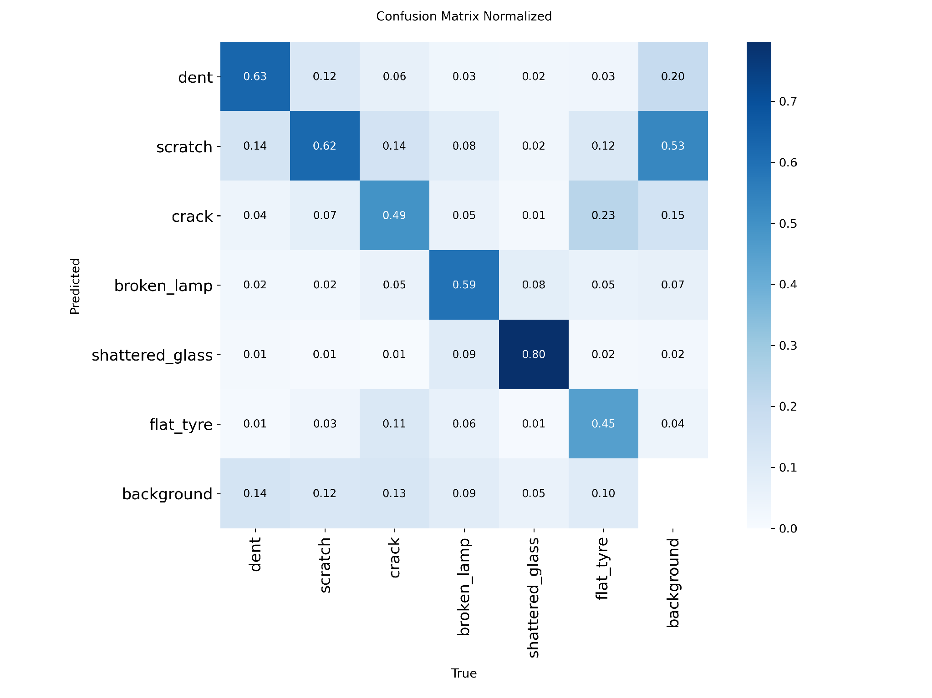
09 · ERROR ANALYSIS
The Confusion Matrix, Read Closely
THE STANDOUT NUMBER
scratch has a 0.53 predicted-as-background rate — by far the largest miss rate of any class (dent 0.20, crack 0.15, broken_lamp 0.07, shattered_glass 0.02, flat_tyre 0.04). Over half of true scratches are missed outright, not misclassified as another damage type.
DIAGONAL ACCURACY BY CLASS
Class | Correct | → Background
shattered_glass | 0.80 | 0.02
dent | 0.63 | 0.20
scratch | 0.62 | 0.53
broken_lamp | 0.59 | 0.07
crack | 0.49 | 0.15
flat_tyre | 0.45 | 0.04
Multimodal Damage Assessment for Insurance Claims · Milestone 5
9

Slide 11
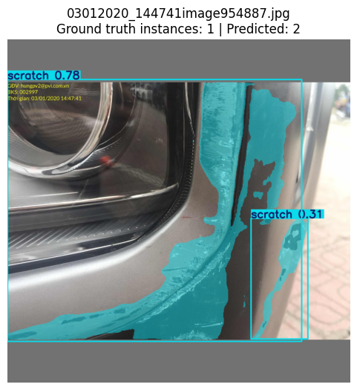
10 · ERROR ANALYSIS
A Concrete Failure Case, and Why It Happens
ROOT-CAUSE READING
shattered_glass and broken_lamp are visually distinct — sharp contrast, unusual reflectivity — and substantially outperform dent, scratch, and crack, which are subtle, low-contrast, and can resemble ordinary body-panel shadows or reflections.
This gap persisted unchanged across the Baseline, Extended, and Tuned checkpoints — three different training configurations, one consistent pattern, now confirmed on the held-out test split too. That consistency points to a property of the damage types themselves, not a fixable training artifact.
Addressing it would more likely require higher input resolution or targeted additional data for the weak classes than further hyperparameter tuning (Section 12).
A single continuous scratch, one ground-truth instance, split into two separate predictions (0.78 and 0.31 confidence) — over-segmentation on a low-contrast, elongated damage region.
Multimodal Damage Assessment for Insurance Claims · Milestone 5
10

Slide 12
11 · LIMITATIONS
What This Evaluation Does Not Yet Cover
Ablation study pending
Robustness gap found
Test-split evaluation, confusion matrix, and robustness checks are now complete — but the augmentation on/off ablation isolating degrees=5.5's individual contribution has not yet been run.
Under synthetic brightness increase, 3 of 5 sampled images produced zero detections outright — the model's most fragile tested condition. Blur and darkening were comparatively better tolerated.
Bias and ethics: not formally assessed — no metadata (make, colour, severity) exists to check uneven performance across sub-populations. The known weakest classes (dent/scratch/crack) becoming false negatives in production would under-assess the most common real damage types — a risk for whatever human-review process the deployed system uses.
Multimodal Damage Assessment for Insurance Claims · Milestone 5
11

Slide 13
12 · POSSIBLE IMPROVEMENTS
The Concrete Next Steps
1
Run the augmentation ablation
2
Reconcile the two tracks
Isolate degrees=5.5's individual contribution from the lr0 fix — the one piece of the tuned config not yet independently verified.
A direct, same-split comparison would clarify whether domain pretraining (CarDD) or the lr0 fix is the larger lever — or whether combining both wins outright.
3
Targeted data for weak classes
4
Higher input resolution
Diverse dent/scratch/crack examples, not more volume — matches Milestone 4's identical finding that augmentation and reweighting alone didn't close this gap.
imgsz=1280 to preserve fine detail relevant to thin scratches and cracks, trading inference speed for detail.
5
Harden against bright conditions
6
External benchmark comparison
4 of 5 sampled images failed outright under brightness increase — worth targeted brightness augmentation or an exposure pre-check in production.
Compare against the published CarDD paper's per-class AP figures, as Milestone 4 did, now that test-split numbers exist.
Multimodal Damage Assessment for Insurance Claims · Milestone 5
12

Slide 14
13 · SUMMARY AND NEXT STEPS
What's Ready, What Isn't
READY
NOT YET READY
A Tuned checkpoint that outperforms Baseline on every held-out test-split metric, with the improvement traced to a specific, disclosed configuration fix.
The augmentation ablation (isolating degrees=5.5 from the lr0 fix) has not been run — the tuned config's two changes are not yet separately attributed.
A corroborated headline finding: the dent/scratch/crack weakness reproduces independently across two differently-pretrained tracks (this one and Milestone 4's).
The brightness-sensitivity failure mode found in robustness testing has not been mitigated or further investigated — flagged, not yet addressed.
Test-split evaluation, confusion matrix, and robustness checks are complete — including a specific, quantified failure mode (brightness sensitivity) worth acting on.
Multimodal Damage Assessment for Insurance Claims · Milestone 5
13

Slide 15
Thank You
Questions and Discussion
GitHub: HiveCase/Group-1-DS-and-AI-Lab-Project Notebook: Milestone 5 evaluation notebook (test-split evaluation complete) Course: DS and AI Lab · May 2026 · Group 1 · IIT Madras

