Slide 1
DATA SCIENCE & AI LAB · MAY 2026 · GROUP 1
Multimodal Damage Assessment
for Insurance Claims
MILESTONE 2: DATASET PREPARATION
Satyajeet Kumar
Anuj Gautam
Pranab Kumar Manna
Venkata Siva Kamal Guddanti

Slide 2
01 · INTRODUCTION
From Milestone 1 to a Training-Ready Dataset
Milestone 1 defined a multi-agent RAG system that reads damage photos and policy PDFs, detects and classifies damage, retrieves relevant policy clauses, and drafts a preliminary claim report with a LangGraph orchestrator routing each claim across four specialist agents and escalating low-confidence cases to human review.
FOUR-AGENT ORCHESTRATION
Damage Agent
YOLO detection of 6 damage classes
MILESTONE 2 OBJECTIVES
Severity Agent
1
Dataset verification & download
Bounding-box area-ratio scoring
Identify provenance, confirm licensing, download every dataset each agent needs.
Policy Agent
2
Vision data preparation
RAG over synthetic policy corpus (MCP tool)
Clean, remap, dedupe, augment and split VehiDE into training-ready artefacts.
3
Policy corpus construction
Report Agent
Author, chunk, embed and index a synthetic policy corpus for the Policy Agent.
LLM-based preliminary claim report
Low-confidence outputs escalate to a human review queue.
Milestone 2 · Dataset Preparation · Group 1
2

Slide 3
02 · DATASET IDENTIFICATION
Six Datasets, Four Agents
Dataset | Feeds | Role | Status
VehiDE (primary) | Damage + Severity | 6-class YOLO fine-tuning & severity calibration | Ready
CarDD | Damage | Pixel-level segmentation masks | Pending access
Car Damage Severity | Severity | Human-labelled Minor/Moderate/Severe ground truth | Ready
COCO Car Damage | Damage (comparison) | Architecture sanity-check | Ready
Synthetic policy PDFs | Policy Agent | RAG retrieval corpus | Ready
Synthetic incident descriptions | Report + Eval | Ground-truth incident/report pairs | Ready
VehiDE is the largest publicly available annotated vehicle-damage dataset (13,945 images, 36,081 raw instances), selected as the primary training source. CarDD and the Severity dataset will be integrated once the training on model performs poorly.
Milestone 2 · Dataset Preparation · Group 1
3

Slide 4
03 · DATASET DESCRIPTION
VehiDE: Structure & Scale
13,945
36,081
7
2.59
raw images
raw instances
native Vietnamese classes
avg. instances / image
ANNOTATION SCHEMA (VIA-format JSON)
VIETNAMESE → PROJECT CLASS MAPPING
{
"<file>.jpg": {
"regions": [
{"all_x": [...], "all_y": [...],
"class": "rach"}, ...
]
}
}
Native | Project class
tray_son (paint_scratches) | scratch
mop_lom (dents) | dent
rach (torn_body) | crack
be_den (broken_lamp) | broken_lamp
thung (puncture) | flat_tyre
vo_kinh (broken_glass) | shattered_glass
mat_bo_phan (lost_parts) | EXCLUDED
Bounding boxes are derived from each polygon's [x, y, width, height] extent.
Milestone 2 · Dataset Preparation · Group 1
4

Slide 5
04 · EXPLORATORY DATA ANALYSIS
Class Distribution & Imbalance
6.59 : 1
imbalance ratio · scratch vs. shattered_glass
scratch dominates at 44.0% of retained instances
shattered_glass is rarest at 6.7%
torn_body is termed as crack class
Mitigated via class-weighted loss & oversampling of minority classes
Milestone 2 · Dataset Preparation · Group 1
5

Slide 6
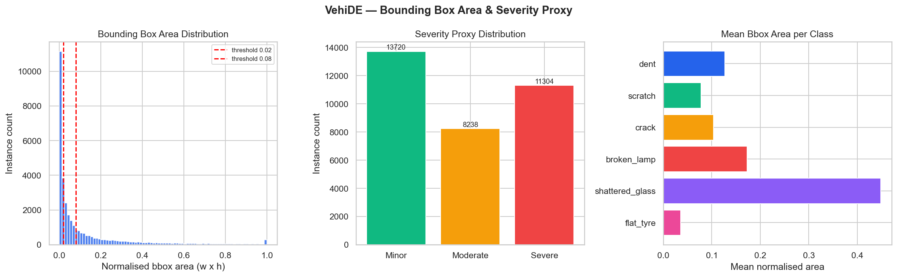
04 · EXPLORATORY DATA ANALYSIS
Bounding-Box Area & Severity Proxy
Minor
Moderate
Severe
13,720
41.3%
8,238
24.8%
11,304
34.0%
Milestone 2 · Dataset Preparation · Group 1
6

Slide 7
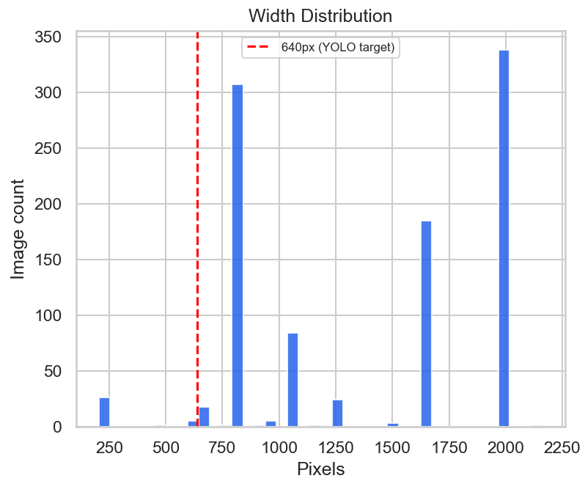
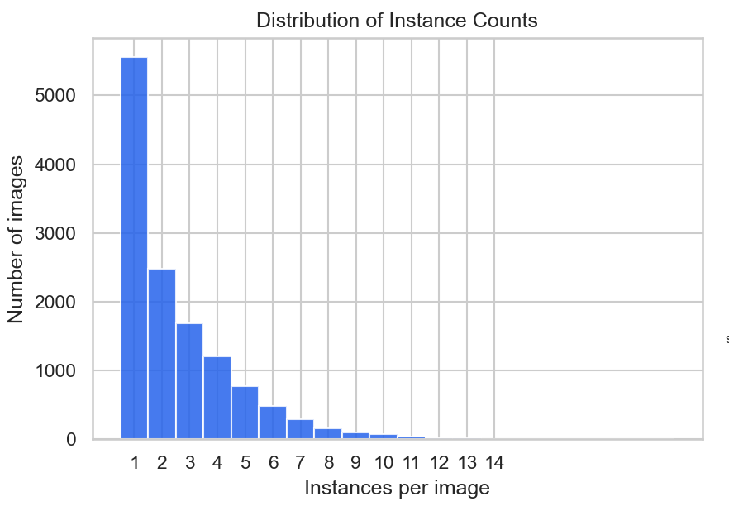
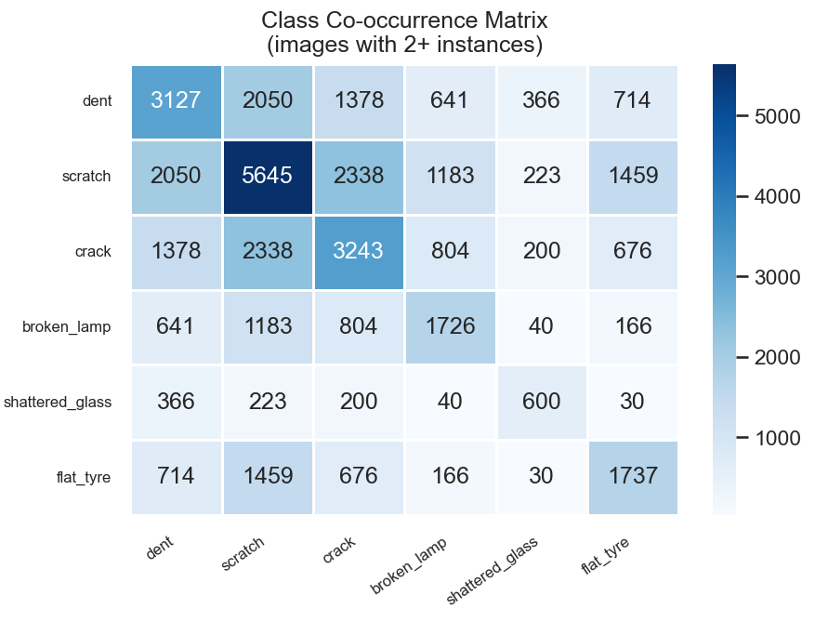
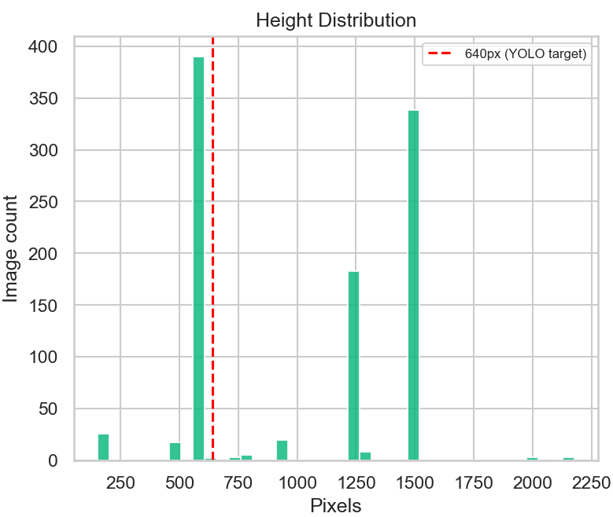
04 · EXPLORATORY DATA ANALYSIS
Multi-Instance Images & Resolution Spread
Mean 2.58 / median 2.0 instances per image (max 20) multi-label detection is the norm.
Resolutions span 204–2,164 pixels wide.
Milestone 2 · Dataset Preparation · Group 1
7

Slide 8
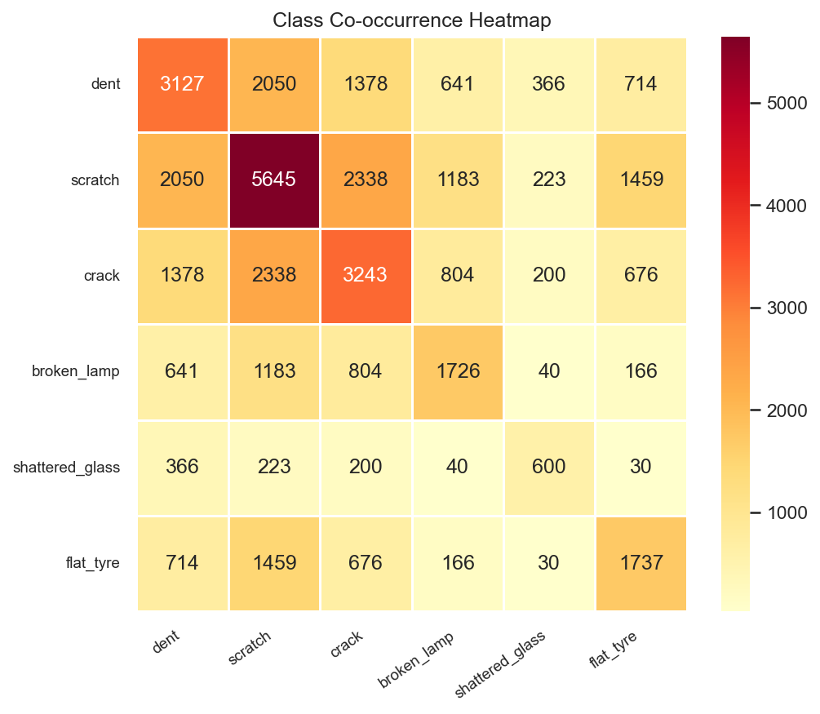
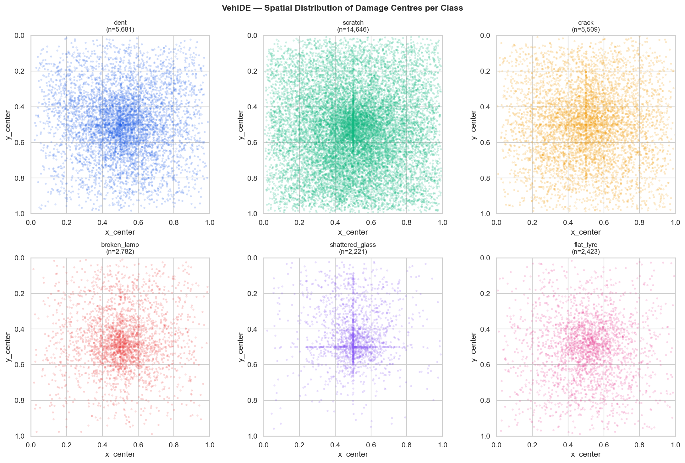
04 · EXPLORATORY DATA ANALYSIS
Where and With What Damage Appears
Milestone 2 · Dataset Preparation · Group 1
8

Slide 9
05 · DATA GOVERNANCE
Licensing, Privacy, Ethics & Reproducibility
Source & Licensing
Privacy
VehiDE (Apache-2.0), CarDD & Kaggle sets under academic/community terms. IRDAI policy PDFs used only as structural reference.
Face / license-plate detector run across all 13,655 images, 0 flagged. Detector stays in the pipeline for future additions.
Data Quality
Ethics & Bias
0 corrupt files, 0 orphan images/annotations, 1 malformed region corrected, 18 exact & 272 near-duplicates removed.
VehiDE is Southeast-Asia-sourced, Indian vehicle types & conditions may be underrepresented. Mitigated via augmentation & flagged as a domain-shift risk.
Milestone 2 · Dataset Preparation · Group 1
9

Slide 10
06 · DATA PREPROCESSING
From Raw Download to Training-Ready Images
1
2
3
4
Corrupt-file check
Class remap (7→6)
YOLO format verify
Letterbox resize
0 corrupt images found
torn_body → crack
lost_parts excluded
Polygon → [x,y,w,h] bbox, normalised
640×640, grey pad (114,114,114)
5
6
7
8
Annotation spot-check
PII detection
Deduplication
Stratified split
5% sample rendered & visually verified
Face/plate detector 0 flagged
18 exact & 272 near-duplicates removed
70 / 15 / 15 → train / val / test
Milestone 2 · Dataset Preparation · Group 1
10

Slide 11
07-08-09 · SPLITTING & AUGMENTATION
Balanced, Leakage-Checked, Training-Ready
AUGMENTATION (TRAIN-TIME ONLY)
CLASS-TARGETED WEIGHTS (cls_pw)
Horizontal flip (p=0.5)
Mosaic (4-image combine)
HSV brightness / saturation jitter
Small rotation & translation
Motion blur mobile camera shake
JPEG re-compression (quality 75)
Class | Weight
scratch | 1.0
dent | 2.6
crack | 2.7
broken_lamp | 5.3
flat_tyre | 6.0
shattered_glass | 6.6
13,655 images · 32,672 instances
70 / 15 / 15 stratified split
Milestone 2 · Dataset Preparation · Group 1
11

Slide 12
03 & 06 · POLICY DOCUMENT CORPUS
RAG Corpus for the Policy Agent
5
179
300 / 40
6
synthetic PDFs
indexed chunks
chunk size / overlap (tokens)
damage classes tagged
CHUNKS PER DAMAGE CLASS
CLAUSE TYPE DISTRIBUTION
Milestone 2 · Dataset Preparation · Group 1
12

Slide 13
10 · FINAL PREPARED DATASET
Ready for Model Training
13,655
32,672
6
179
images
retained instances
damage classes
policy chunks indexed
The data is ready for training immediately:
Train / val / test splits finalised, leakage-checked, and logged as file lists.
ChromaDB policy index (collection policy_clauses, 179 chunks) built and queryable.
CarDD segmentation augmentation & severity-proxy calibration remain open, pending data access.
Milestone 2 · Dataset Preparation · Group 1
13

Slide 14
11 · CHALLENGES ENCOUNTERED
Open Items Going Into Milestone 3
Challenge | Status / Resolution
Class imbalance | Class-weighted loss & oversampling will be applied while training
CarDD dataset access | Manual licensing form required
Geographic bias in VehiDE | SE-Asia-sourced; mitigated via augmentation, flagged as domain-shift risk
Annotation format mismatch | VehiDE (YOLO bbox) vs. CarDD (COCO polygon) conversion script drafted, will be used if CarDD dataset is used.
Milestone 2 · Dataset Preparation · Group 1
14

Slide 15
12-13 · DELIVERABLES & NEXT STEPS
What's Ready, What's Next
DELIVERABLES PRODUCED
VehiDE EDA notebook + preprocessing script
Cleaned & split image / label sets (train/val/test)
Class remap lookup & YOLO config (damage.yaml, nc=6)
Synthetic policy corpus + ChromaDB vector index (179 chunks)
COCO Car Damage EDA (complete, used for comparison)
Milestone 2 report
PLANNED FOR MILESTONE 3
Select model architecture: YOLO11m-seg vs. YOLOv8m-seg baseline
Define LangGraph orchestrator state schema & MCP tool contracts
Run YOLO baseline (50 epochs) establish mAP@50 & per-class F1
Wire up Policy Agent's FastMCP retrieval tool; run precision check
Validate Report Agent prompt template on 5 sample incident/image pairs
And if the model performs poorly, then integrate CarDD data into the training dataset.
Milestone 2 · Dataset Preparation · Group 1
15

Slide 16
Thank You
Questions & Discussion
Github: HiveCase/Group-1-DS-and-AI-Lab-Project
Course: DS & AI Lab · May 2026 · Group 1

