Slide 1
Hive Project Proof of Concept

Slide 2
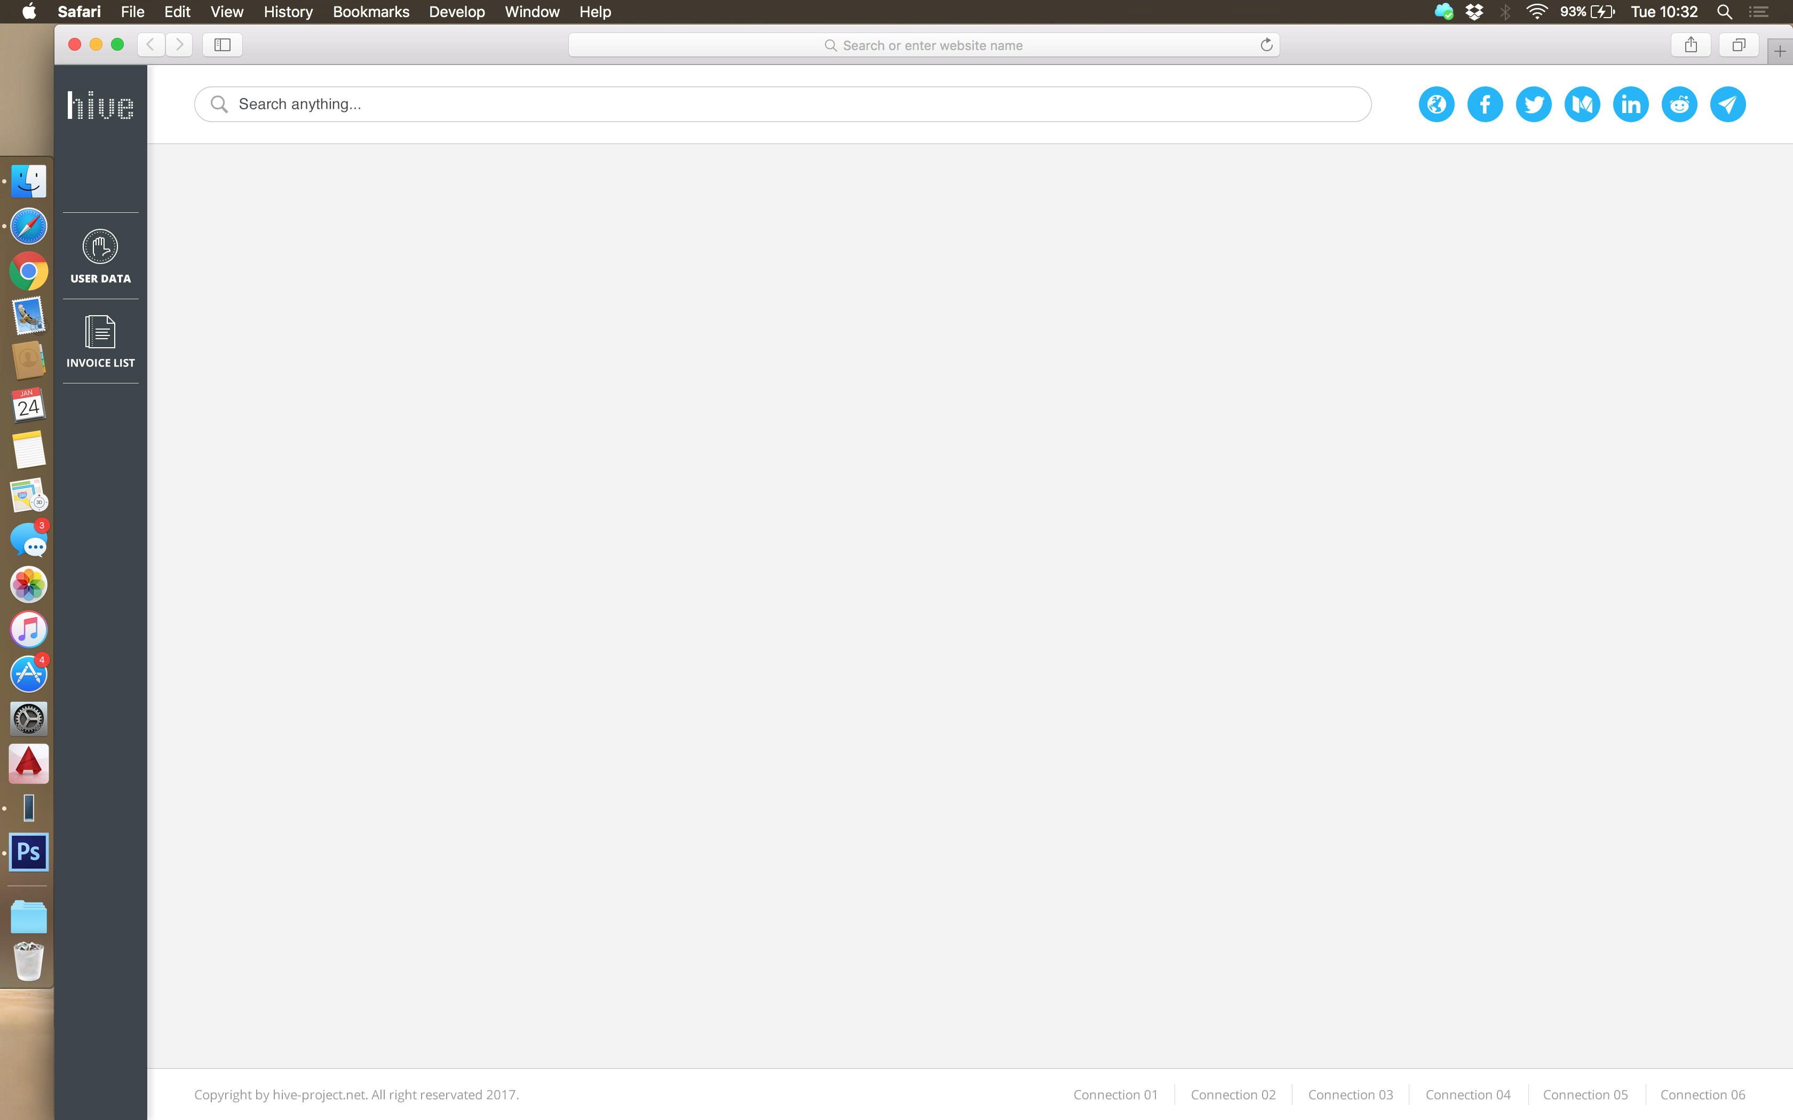
General Comments
Instead of this I will have Company and Investor menu option so
that it is clear roles that sections are playing
I am not sure what is the purpose
of this and if we need it for our demo

Slide 3
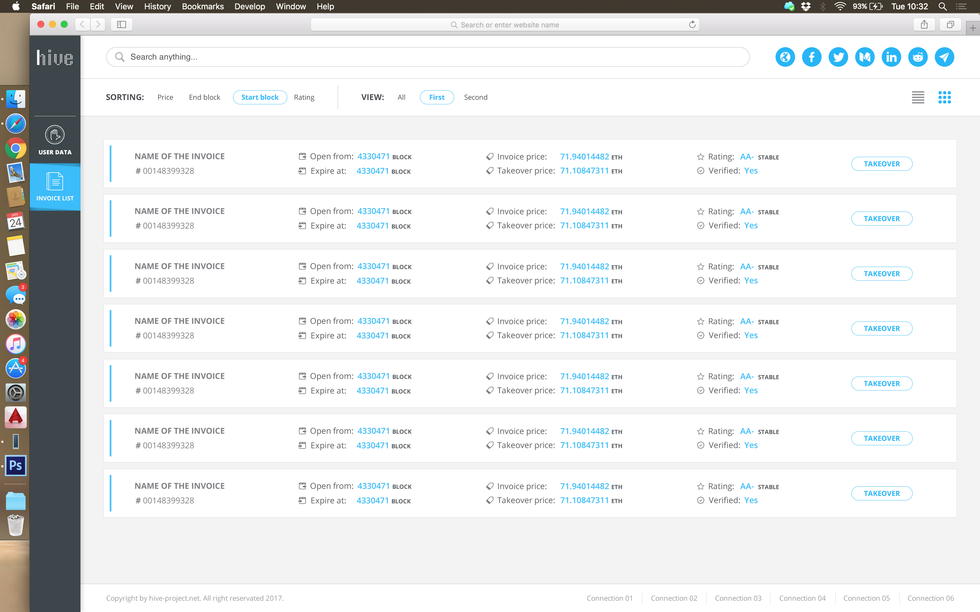
Investors View
On this page we should be able to see our investment
portfolio and closing dates for the invoices. Also as shown
List of available invoices for takeover which need to include
maturity date

Slide 4
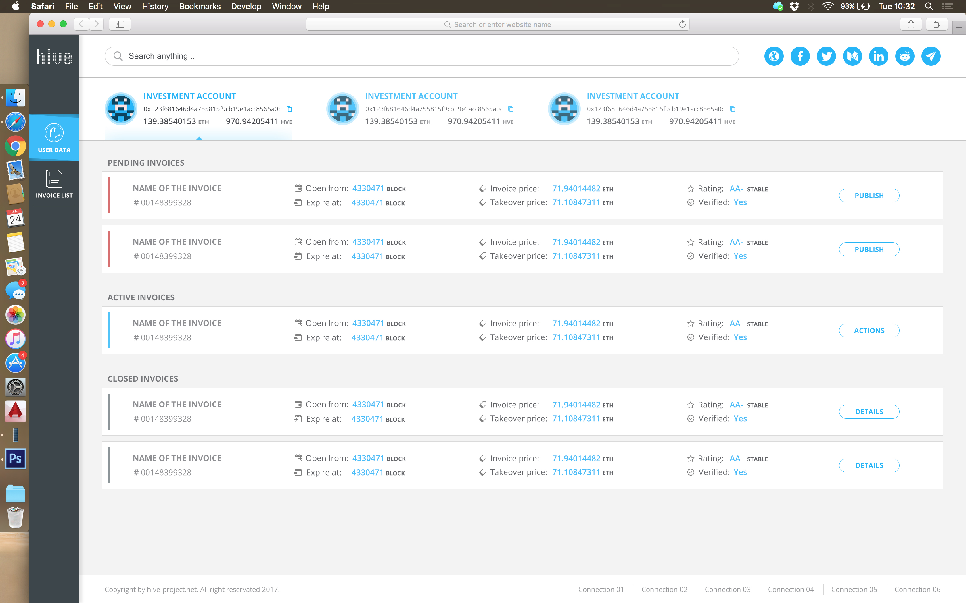
Company View
It will be great to have two tabs here:
Account Payable
Account Receivable
Account Payable are invoices that company has received
from other vendors and need to pay.
Account Receivable are invoices that company has issued to
their clients
I need your definition on Closed invoices, Active invoices and
Pending Invoices

