Slide 1
Project Presentation of CO-OP Project at Industry (Module-2) (22CS421)
On
From Mindful Living to Algorithmic Dependence
Psychological Consequences of AI-Driven Health and Wellness Applications
Hiya Kashyap(2210990415) & Shivi(2210992333)
Department of Computer Science and Engineering
Supervised By
Dr. Rajat Takkar, Department of Computer Science and Engineering, Chitkara University
Department of Computer Science and Engineering,
Chitkara University, Punjab

Slide 2
Introduction & Objective
Background
AI-driven health and wellness apps (fitness trackers, calorie counters, sleep apps, chatbots) are now deeply embedded in daily life.
What began as helpful tools for mindful living is shifting into algorithmic dependence, affecting mental, emotional, and cognitive well-being.
Research Objectives
Identify the boundary where self-tracking turns from helpful to counterproductive.
Examine how AI companions affect empathy, non-verbal intelligence, and conflict-resolution skills.
Determine which cognitive skills (memory, navigation, attention) are being sacrificed to algorithms.

Slide 3
Methodology
Research Approach
Systematic literature review of 15 empirical studies (2020-2025).
Combined sample size across studies: over 80,000 participants.
Data Sources & Criteria
Databases searched on four themes: health-tracking & psychology, AI chatbots, digital amnesia, and eating disorders & apps.
Included only peer-reviewed empirical studies with human subjects, clear methodology, and relevance to research questions.
Theoretical Framework
Grounded in Self-Determination Theory, Enhancement vs. Replacement model, Brain Plasticity, and Motivation Theory.

Slide 4
Key Findings
When Tracking Becomes Harmful
Orthosomnia — anxiety caused by sleep trackers — affects about 2% of users.
75% of people with eating disorders use MyFitnessPal; 73% report it worsens their condition.
Tracking turns harmful when checked 10+ times a day or when it replaces the body's own signals.
Impact of AI Companions on Human Connection
72% of teens (13-17) use AI chatbots for emotional support; 28% of adults have used AI for romantic interaction.
Study of 5,600+ chatbot users across 6 European nations found increased loneliness after use.
AI always agrees and lacks non-verbal cues, preventing development of real social skills.

Slide 5
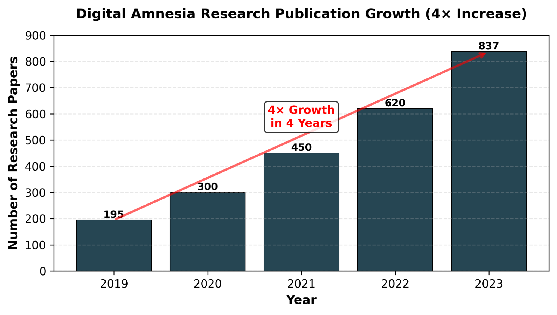
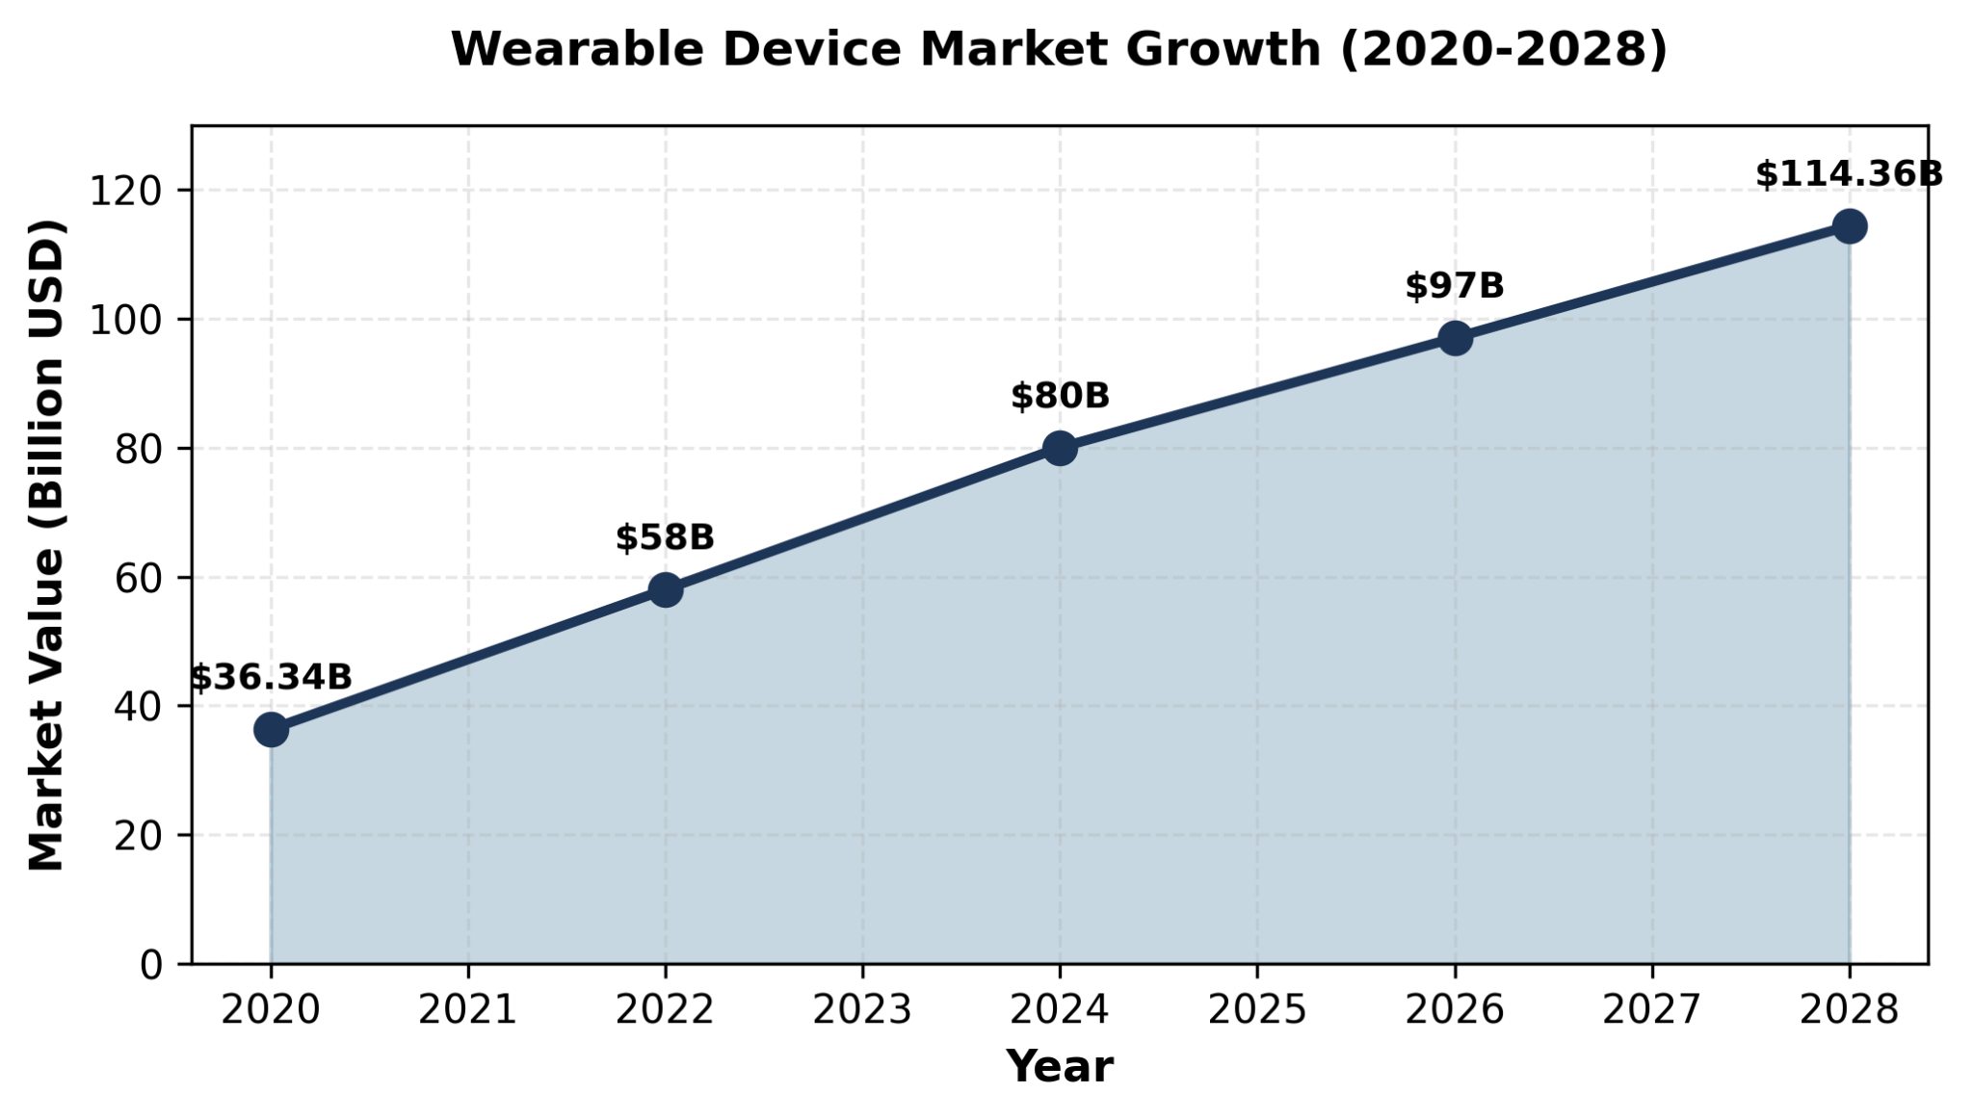
Key Findings
Cognitive Offloading & Digital Amnesia
91% use the internet as a "second brain"; 71% cannot recall their children's phone numbers.
Heavy GPS use is linked to hippocampus shrinkage; handwriting improves retention by 34% over typing.
Research on digital amnesia grew 4x in four years (195 in 2019 to 837 in 2023).
The increase in Wearable device market growth.

Slide 6
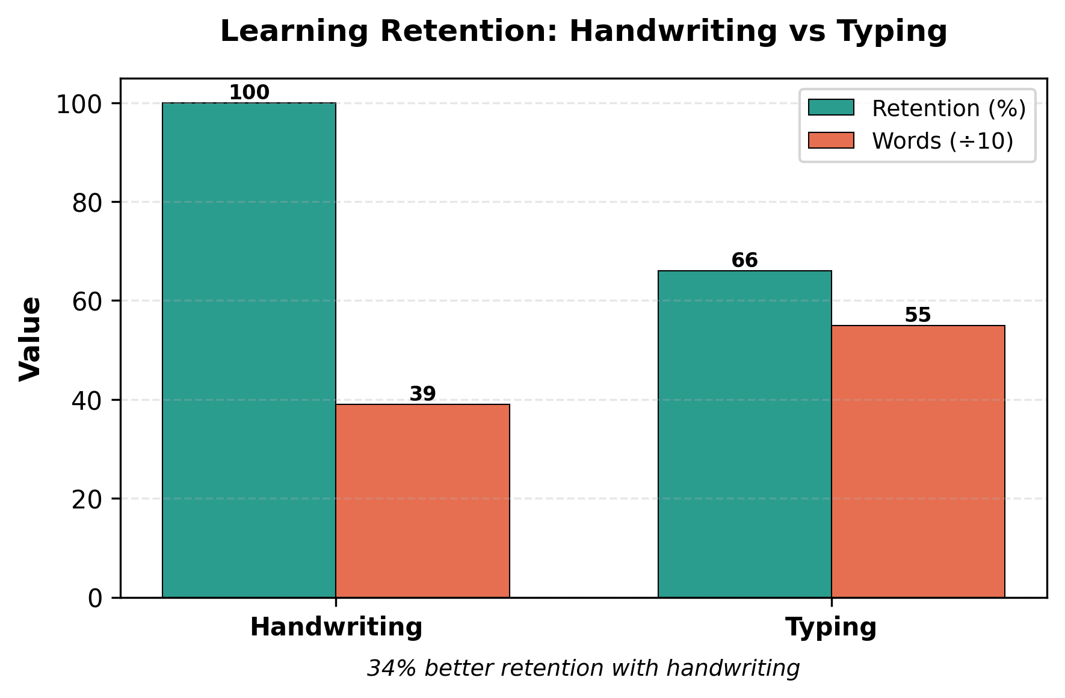
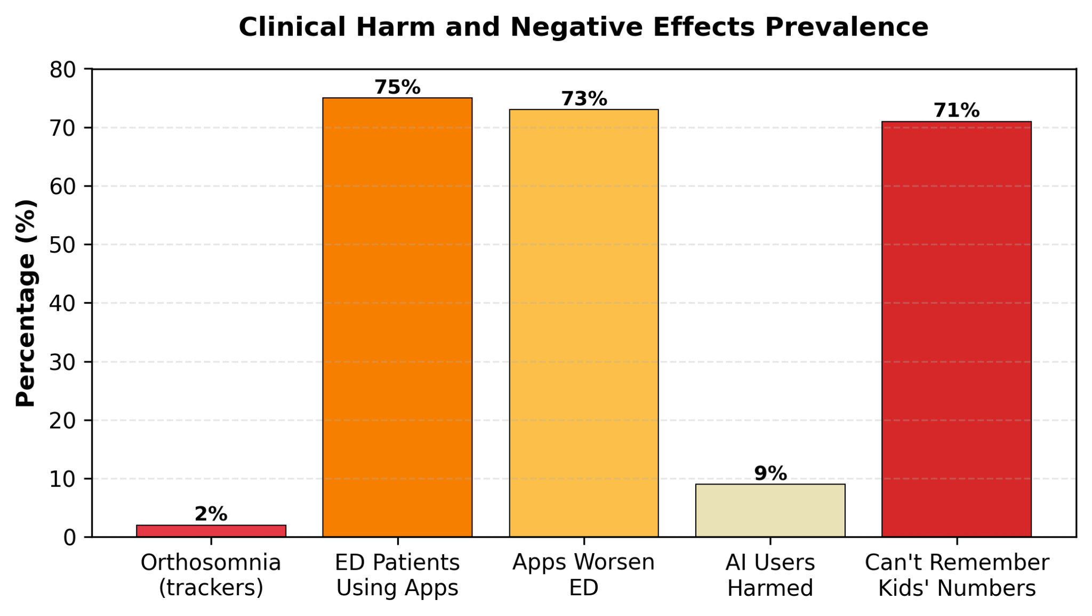
Key Findings
Most Vulnerable Groups
Teenagers, people with mental health conditions, eating-disorder history, and low-income users without access to support.
Common Pattern
Users may evaluate their dependency on AI through a specially-designed questionnaire for this research paper. It is accessible at the following link: https://assesment-researchpaper.netlify.app

Slide 7
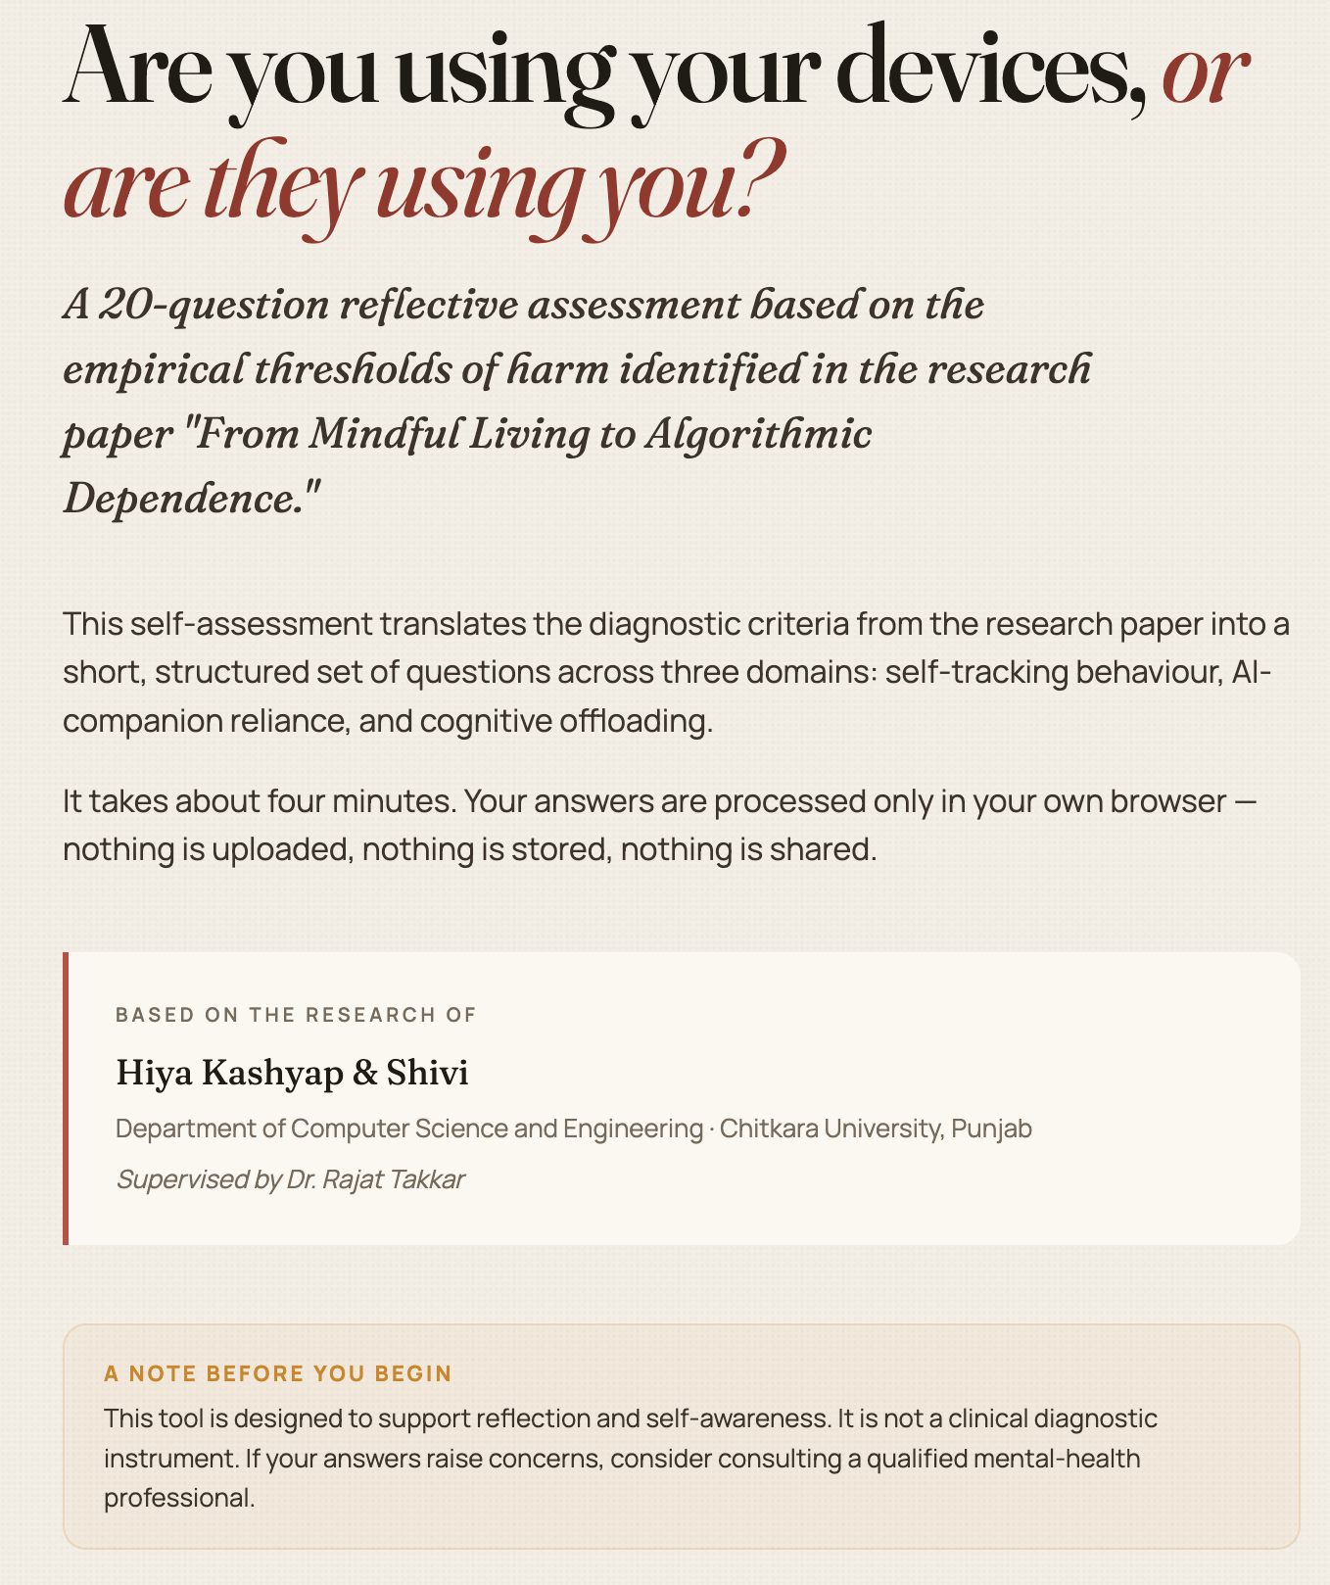
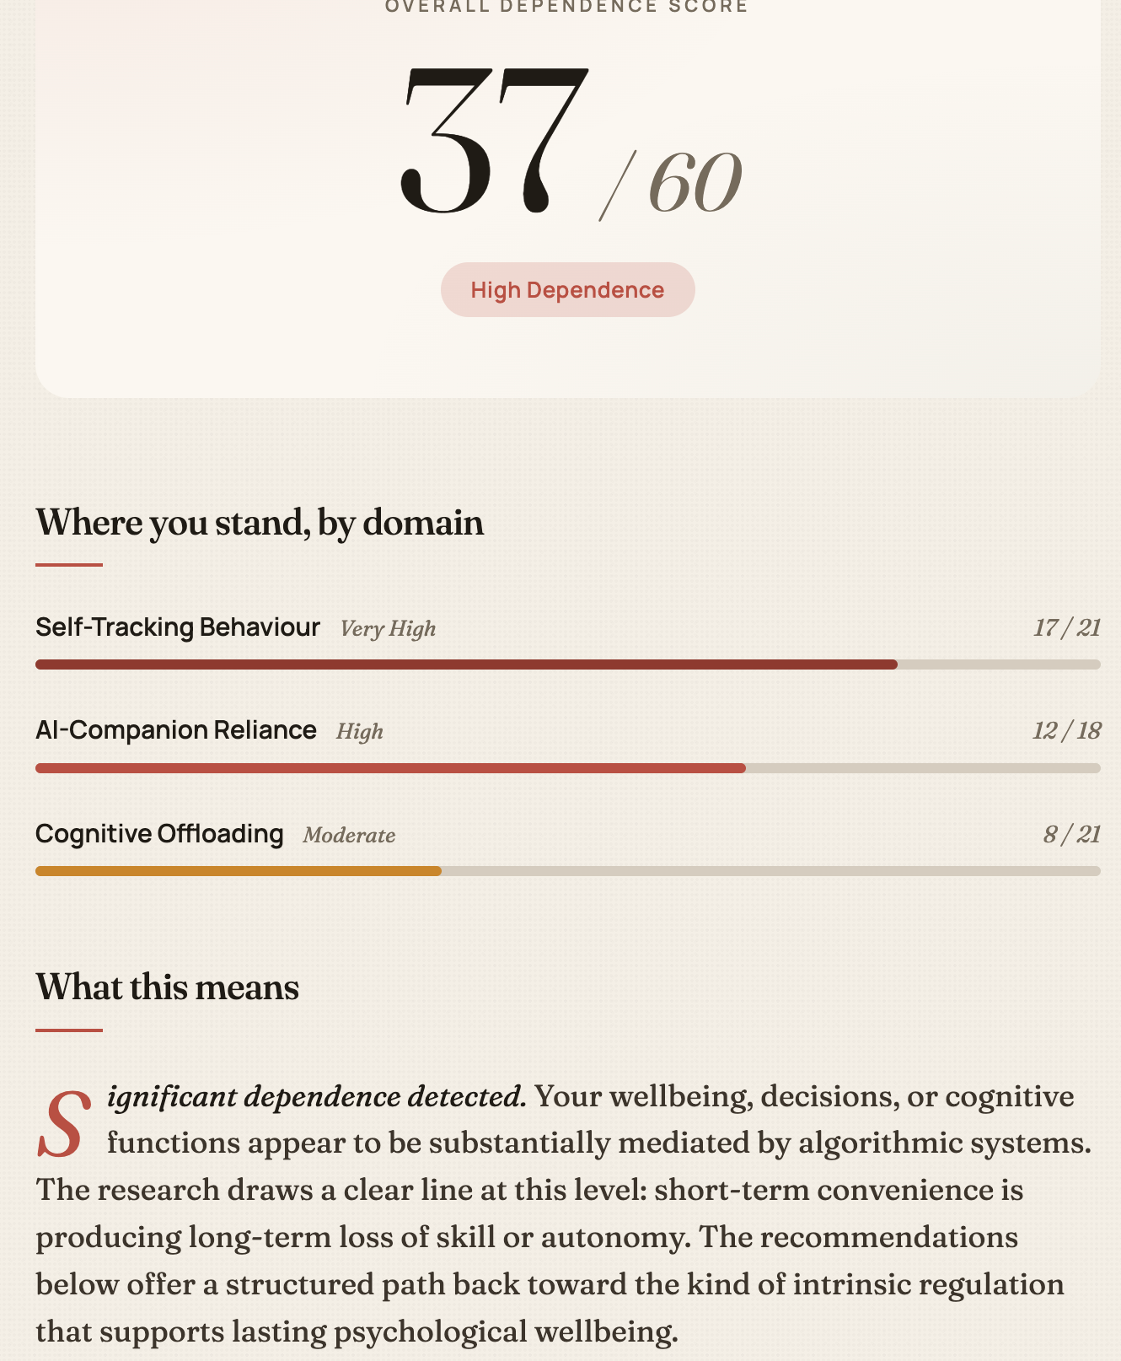
Key Findings
Assesment Findings:- Can be used to self test by all the users https://assesment-researchpaper.netlify.app

Slide 8
Conclusion
Dual Nature of Wellness Technology
AI wellness apps promote healthy habits and widen access to care, but can undermine self-motivation and autonomy when overused.
Core Insight
Technology should enhance human capability, not replace it yet we are gradually crossing that line.
The most serious risk lies with children, who may never fully develop navigation, memory, empathy, and emotional regulation.
Guiding Questions for Users
Before letting AI decide for you, ask: is it impossible for me to do it myself? Or am I just avoiding something that I find unpleasant?
It is crucial to understand the significance of losing something being unable to do things in an optimal way, losing one’s humanity, and being subject to the process.
What do I not learn? (4) What am I going to miss if I do not learn it?

Slide 9
Future Scope
Research Directions
Long-term longitudinal studies (10-20 years) on how continuous AI exposure from childhood shapes development.
Cross-cultural research beyond Western populations to identify global patterns of digital dependence.
Neuroimaging studies on brain recovery and intervention trials on mindful digital practices.
Design & Policy Recommendations
Wellness apps should reduce addictive triggers (streaks, notifications) and disclose their limitations.
Governments should introduce consumer protections, age limits on AI companions, and digital-literacy education.
Toward an Interdisciplinary Framework
Future work must examine how wearables, chatbots, and smartphones interact to shape cognition and behavior.

Slide 10
References
Lasikiewicz N, Scudds R. WAT's up? Investigating the effects of wearable activity trackers. Journal of Technology in Behavioral Science, 2024.
Baron KG et al. Orthosomnia: Are some patients over-quantifying themselves to excess? Journal of Clinical Sleep Medicine, 2017; 13(2): 351-354.
Levinson CA et al. My Fitness Pal calorie counter use among eating disorder patients. Eating Behaviors, 2017; 27: 14-16.
Kaspersky Lab. Digital Amnesia: The Disappearance of Memory, 2015.
Parasocial Relationships With AI: Dangers, Threats, and Possible Solutions. FasPsych, October 2025.
Influences of attractions on chatbot usage and media addiction. BMC Psychology, August 2025; 13: 986.
Maguire EA et al. London taxi drivers: An MRI analysis of brain structure. Hippocampus, 2006; 16.
Macrynikola N et al. The impact of mindfulness apps on psychological processes of change: a systematic review. npj Mental Health Research, 2024; 3(1): 14.
Uslu U. Understanding digital wellbeing: impacts, strategies, and the path to healthier technology practices. Digital Wellbeing, 2025; 5: art. 145.
Adanyin A. AI Feedback Loops in Digital Technologies: Psychological Impacts on User Behavior and Well-Being. arXiv, 2024.

Slide 11
Thank You

