Slide 1


Systems Inc.
R3.12 : General and Business English for Computer Science
Bachelor’s in Computer Science, Semester 3.
Alexandre MAURICE, 12th January 2023

Slide 2
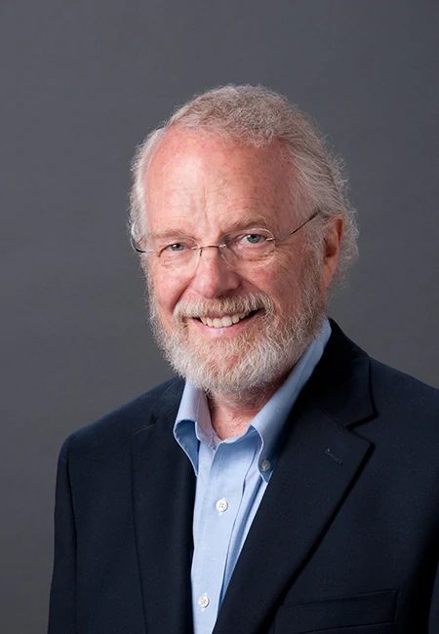
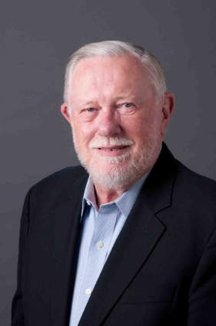



Company history
Founded in 1982
1985 : 1st version of PostScript, a programming language for digital printers
1988 : 1st version of Illustrator
1990 : 1st version of Photoshop
1993 : release of Acrobat
2013 : switching from perpetual licenses to a subscription-based model (Creative Cloud)
John Warnock
Charles Geschke

Slide 3

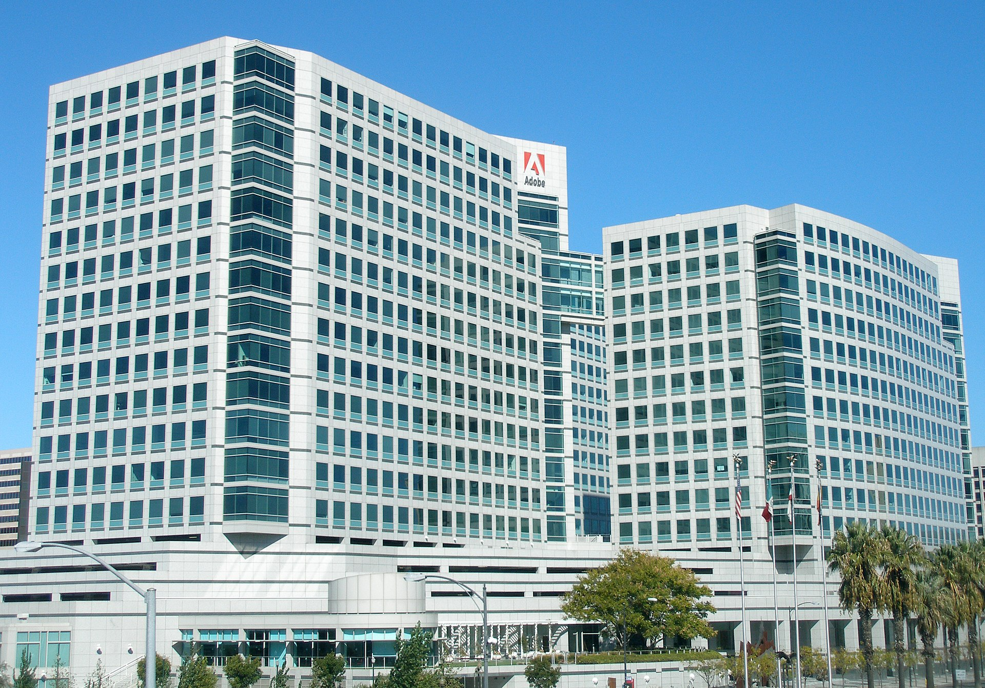


Important facts
CEO: Shantanu Narayen
Headquarters: San Jose, California, USA
Flagship products: Photoshop, Illustrator, Premiere Pro, Acrobat, Creative Cloud
Market share: Adobe's Creative Cloud product alone had a 41% market share as of 2020
International influence: Adobe products are used globally, and the company operates in over 180 countries.

Slide 4
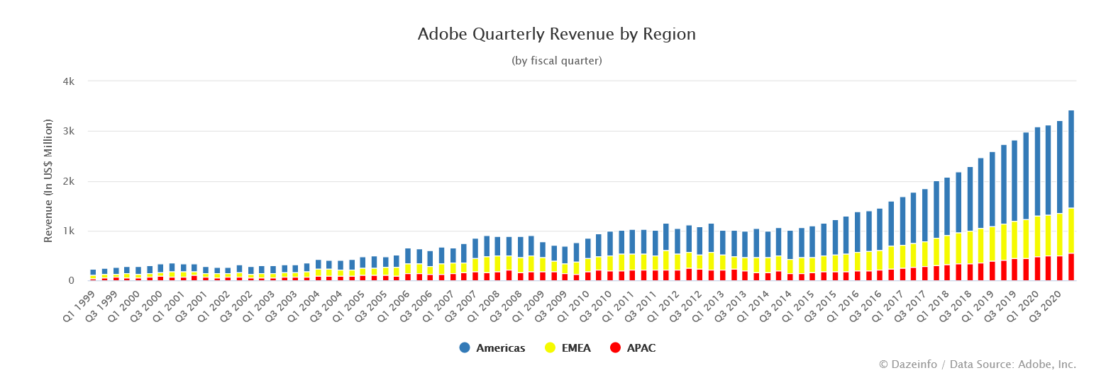
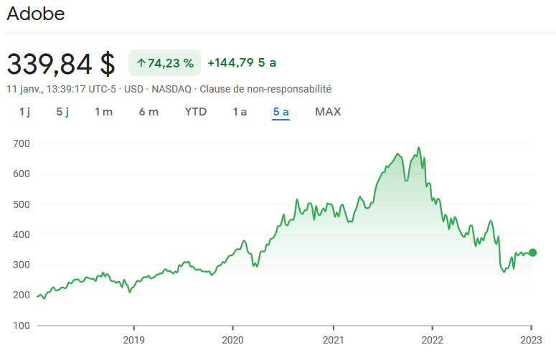
Important figures

Slide 5
Conclusion
A well-established company
A strong portfolio of products
A successful track record of adapting to changes in the market and embracing new technology

