Slide 1
HW-6
Responses & Summary

Slide 2
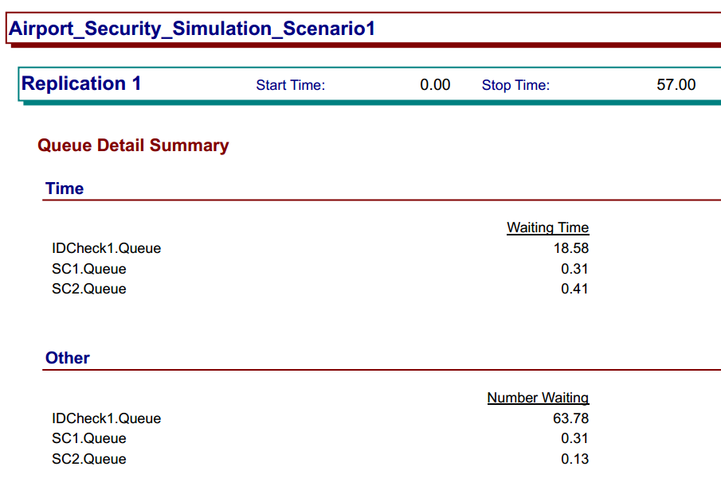
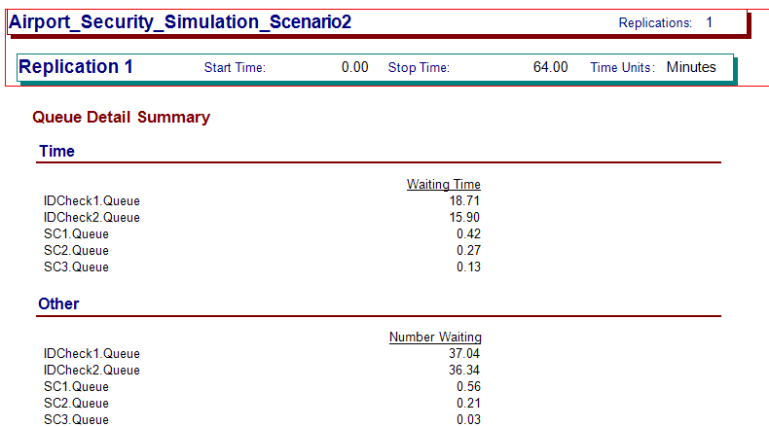
Question 13.2
2-way method used for 1st scenario to decide the queue
Scenario 1:
1 Server checking ID and Passports
2 Queue’s for security clearance
In this case the wait time was >15mins
N-way method used for making decision to assign the ID checker and Queues
Scenario 2:
2 Server checking ID and Passports
3 Queue’s for security clearance
In this case the average wait time was > 15mins
Complete Repository available on GitHub:
https://github.com/Hizzyth/GTX_Introduction-to-Analytics-Modelling

Slide 3
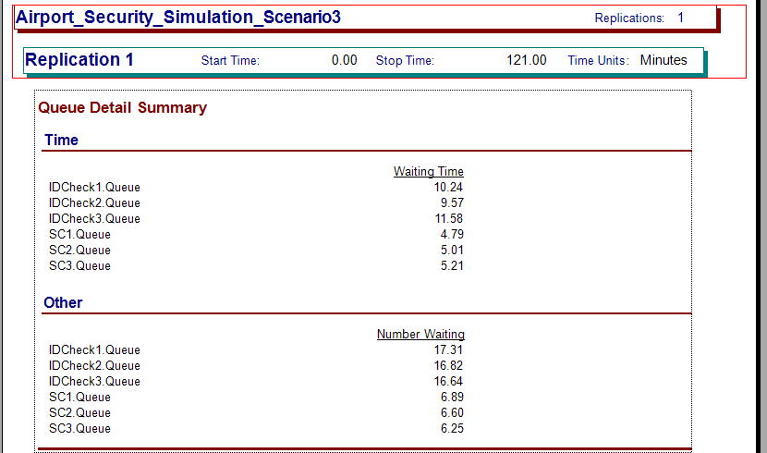
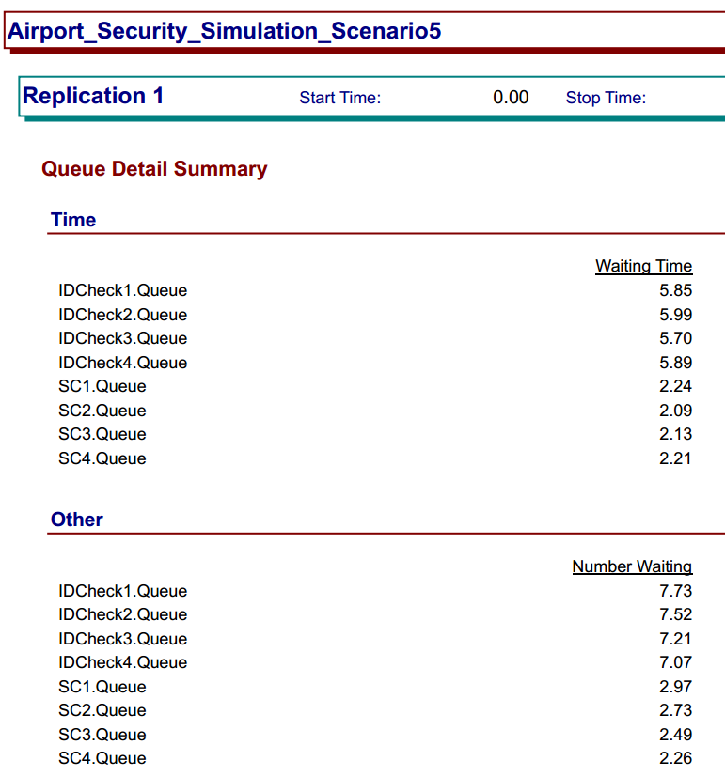
Question 13.2
Scenario 3:
3 Server checking ID and Passports
3 Queue’s for security clearance
In this case the wait time was < 15mins
Scenario 5: (Extreme Case)
4 Server checking ID and Passports
4 Queue’s for security clearance
In this case the average wait time was < 15mins
I explored this option just to see how much difference it makes
Complete Repository available on GitHub:
https://github.com/Hizzyth/GTX_Introduction-to-Analytics-Modelling

Slide 4
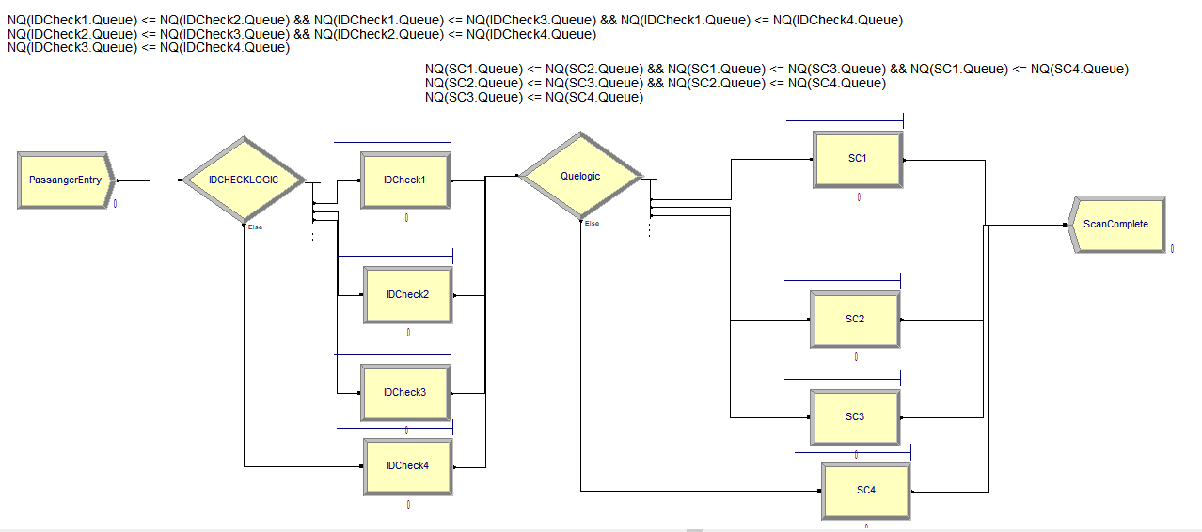
Question 13.2
Complete Repository available on GitHub:
https://github.com/Hizzyth/GTX_Introduction-to-Analytics-Modelling

Slide 5
Question 14.1
Conclusions:
Model accuracy improves with clean data, apart from that all other methods provide the accuracy in very close range (92.8-95.7%)
Mode approach is not very accurate as it assigns all missing values to be 1, whereas with every other method the values were varying above 1
With perturbation some negative values were introduced, those had to set to 1 (minimum in the acceptable range of 1~9)
Complete Repository available on GitHub:
https://github.com/Hizzyth/GTX_Introduction-to-Analytics-Modelling

Slide 6
QUESTION 15.1 : Optimization
Question: Describe a situation or problem from your job, everyday life, current events, etc., for which optimization would be appropriate. What data would you need?
Answer:
Optimization model will be applicable to travel planning. To determine which local attractions/activities to cover during trip.
Variables | Constraints | Objective Function
Time spent on each attraction/activity | Number of days | Experience Quality (Function of time and money spent)
Cost of activity/admission for attraction | Total Budget for Trip
Average waiting time for admission (if applicable)

