Slide 1
PRODUCT OVERVIEW, TECHNICAL ARCHITECTURE & STRATEGIC ROADMAP
THE GRDX
F1 Prediction & Community Platform
The problem → The product → How it works → How it is built → How it protects data → Where it is going → What it looks like.
THE PRODUCT
Motorsport Engagement
Turn every Grand Prix weekend into an interactive fan experience with session-aware predictions.
ARCHITECTURE
Lightweight & Serverless
React 19 + TypeScript SPA on GitHub Pages Edge CDN backed by Google Apps Script V8.
DATA INTEGRITY
Structured Cloud Records
15 relational worksheets on Google Sheets with LockService mutex & CacheService RAM caching.
PRODUCT VISION
Community & Future Scale
Three-phase expansion from core prediction reliability to rich analytics and social leagues.
THE GRDX PRESENTATION | 12 COMPREHENSIVE SLIDES | LIGHT PROFESSIONAL EXECUTIVE THEME
Notes:
Welcome to THE GRDX presentation. This deck tells the complete story of the platform: the problem it solves, how it works, how it is built, how it protects data, where it is headed, and what it looks like in live production.

Slide 2
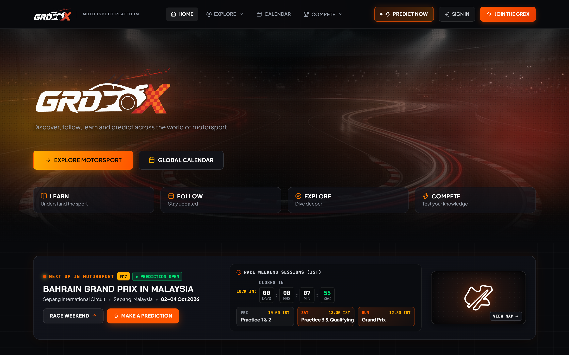
PRODUCT INTRODUCTION & OVERVIEW
Slide 1 — Introduction: What Is THE GRDX?
A motorsport-focused platform where Formula 1 fans make race predictions, follow race weekends, and compete with the community.
THE PROBLEM IT SOLVES
LIVE PLATFORM PREVIEW
F1 fans often follow races through disparate, fragmented sources and share predictions informally across group chats or social media threads.
There is no dedicated, focused digital home that combines structured session-by-session predictions, live schedule countdowns, verified official results, and competitive community leaderboards in one cohesive experience.
WHAT THE GRDX IS & TARGET AUDIENCE
• Motorsport Prediction Platform: Structured prediction rounds for Practice, Qualifying, Sprint, and Grand Prix.
• Target Audience: Formula 1 fans, race-weekend prediction enthusiasts, and motorsport communities.
• Core Aim: Make following F1 interactive by giving fans a measurable way to predict outcomes and track accuracy.
• Vision: Build a focused digital home for F1 prediction, learning, and competitive community engagement.
💡 KEY PRODUCT MESSAGE
“Turn every Grand Prix weekend into an interactive experience.”
Note: Present the problem and vision as the platform's intended purpose, rather than claiming market-wide results or user impact that hasn't been measured.
THE GRDX — F1 Prediction & Community Platform | Product, Architecture & Roadmap Presentation
Slide 1 of 12
Notes:
THE GRDX provides a motorsport-focused prediction and community experience. F1 fans often follow races through separate sources and discuss predictions informally. THE GRDX brings prediction participation, results, and competitive engagement into one dedicated experience.
Key message: Turn every Grand Prix weekend into an interactive experience.

Slide 3
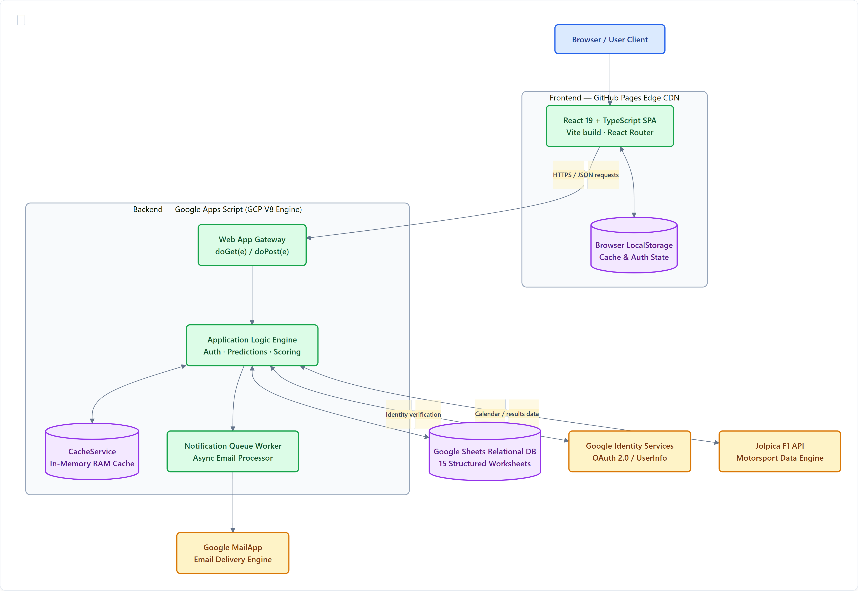
SYSTEM ARCHITECTURE | C4 CONTAINER TOPOLOGY
Slide 2 — System Architecture at a Glance
A lightweight web platform connects the user experience to server-side business logic, structured application data, and external services.
C4 CONTAINER DIAGRAM: CORE ARCHITECTURE
ARCHITECTURAL TIERS & DATA FLOW
• User Experience Layer (Frontend): React 19 + TypeScript Single Page App (SPA) hosted on GitHub Pages Edge CDN. Provides instant client-side navigation via React Router 7 and persistent local caching.
• Application Logic Engine (Backend): Google Apps Script running on Google Cloud Platform's V8 serverless runtime. Processes incoming HTTPS GET/POST JSON requests via doGet(e) and doPost(e) gateways.
• Persistent Cloud Database (Data Tier): Google Sheets relational cloud database comprising 15 structured worksheets, providing automated version history, zero hosting cost, and direct data inspectability.
• External Services & Integrations: Google Identity Services for cryptographic OAuth 2.0 user verification, Jolpica F1 API for motorsport telemetry, and Google MailApp for async transactional emails.
💡 CORE ARCHITECTURAL PRINCIPLE
A lightweight web platform connects the user experience to server-side business logic, structured application data, and external services without needing expensive traditional database or application servers.
THE GRDX — F1 Prediction & Community Platform | Product, Architecture & Roadmap Presentation
Slide 2 of 12
Notes:
“The frontend is a static web application, while the backend runs in Apps Script. Google Sheets provides the main persistent data store, avoiding the need to operate a conventional application server and database server.”
Key message: A lightweight web platform connects the user experience to server-side business logic, structured application data, and external services.

Slide 4
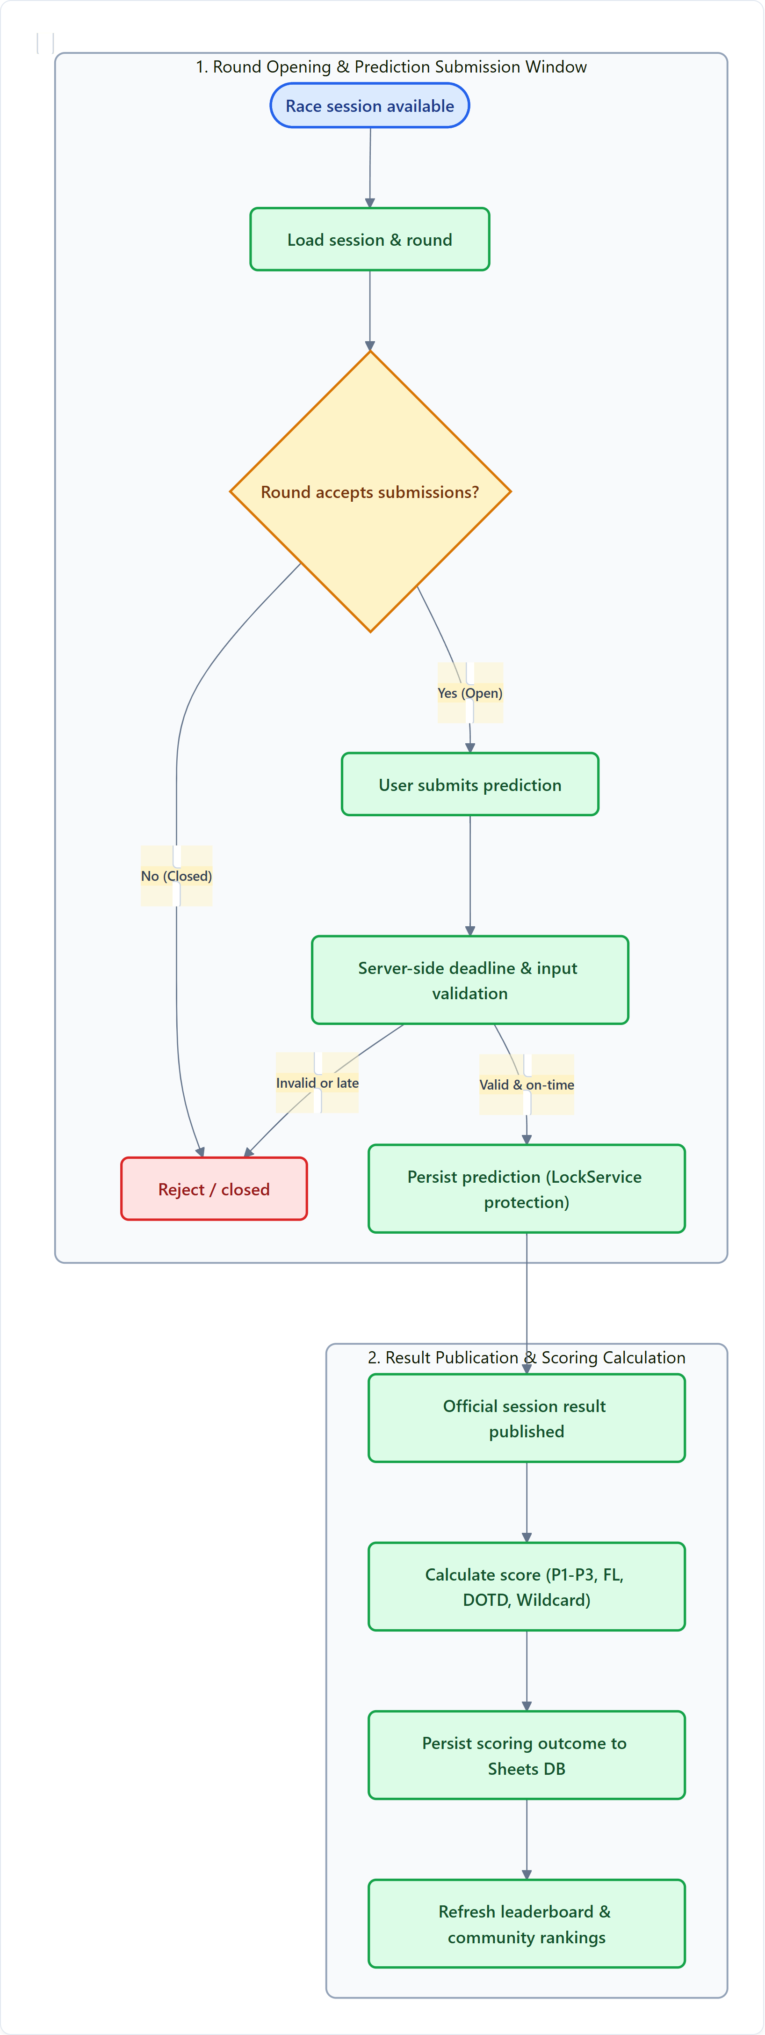
USER JOURNEY & CORE WORKFLOW
Slide 3 — Core Workflow: Race Weekend and Predictions
Predictions are organized around real race sessions rather than being isolated, free-form entries.
PREDICTION LIFECYCLE WORKFLOW
STEP-BY-STEP PREDICTION LIFECYCLE
1. Race Calendar & Session Discovery: Users browse official Grand Prix schedules with local timezone-adjusted countdowns for Practice, Qualifying, Sprint, and Race sessions.
2. Prediction Round Activation: Session-specific prediction rounds open for submissions with dedicated deadlines and custom track metadata.
3. Ballot Entry & Selection: Users enter predicted podium finishers (P1, P2, P3), Fastest Lap, Driver of the Day, and session wildcard challenges.
4. Server-Side Validation: Backend enforces strict validation: driver combination validity, input sanitization, and atomic deadline checks (5 min before session start).
5. Atomic Persistence: Verified submissions are locked and written to Google Sheets via LockService mutex to prevent race conditions.
6. Official Result Scoring: Official FIA session results are ingested; automated scoring engine calculates points and refreshes community leaderboards.
💡 KEY WORKFLOW INSIGHT
Predictions are organized around real motorsport sessions rather than being isolated entries. Strict server-side deadlines ensure competitive integrity across global timezones.
THE GRDX — F1 Prediction & Community Platform | Product, Architecture & Roadmap Presentation
Slide 3 of 12
Notes:
Predictions are organized around race sessions rather than being isolated, free-form entries. Once a submission is accepted, the scoring process compares it with the official result and produces the points used in the leaderboard.

Slide 5
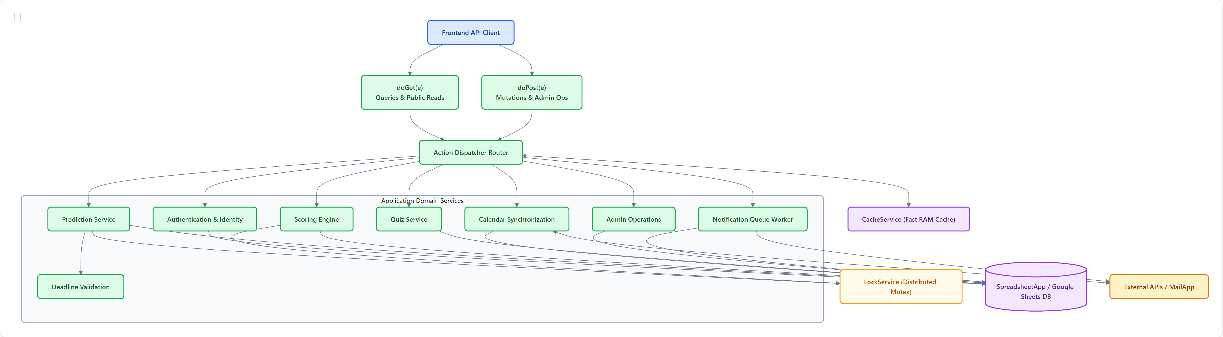
BACKEND & CLOUD PERSISTENCE | GOOGLE APPS SCRIPT & SHEETS
Slide 4 — Backend and Data Architecture
The backend coordinates business rules, data persistence, and processing across the platform.
BACKEND REQUEST ROUTING & APPLICATION SERVICES TOPOLOGY
SERVERLESS REQUEST GATEWAY & DOMAIN SERVICES
15-WORKSHEET RELATIONAL DATA MODEL
• Unified Request Dispatcher: doGet(e) processes high-speed read queries; doPost(e) routes JSON mutations to domain action handlers.
• Specialized Domain Services: Dedicated modules for Identity, Prediction Validation, Scoring Engine, Calendar Sync, and Quiz Management.
• LockService Mutex Protection: Distributed script lock (10s timeout) prevents write collisions during high-traffic cutoff windows.
• Relational Entity Hierarchy: Users connect to Predictions, Scores, Achievements, QuizAttempts, and NotificationQueue.
• Race & Prediction Entities: RaceWeekends and Sessions schedule PredictionRounds; rounds record Predictions, official Results, and Scores.
• Integrity Enforcement: Google Sheets acts as persistent storage; foreign-key constraints and unique lookups are strictly maintained in application code.
THE GRDX — F1 Prediction & Community Platform | Product, Architecture & Roadmap Presentation
Slide 4 of 12
Notes:
“The backend coordinates business rules, data persistence, and processing across the platform. The backend is organized around an action-dispatch pattern rather than separate microservices. Its services execute inside the same Apps Script project.”

Slide 6
COMPETITIVE SCORING MODEL
Slide 5 — Scoring and Competitive Workflow
How predictions become points: rewarding pinpoint accuracy, podium coverage, and session bonuses.
OFFICIAL DOCUMENTED SCORING MODEL
COMPETITIVE PROGRESSION & ENGINE RULES
Prediction Outcome | Points | Evaluation Criteria
Exact P1 Winner | 15 pts | Selected driver finishes in 1st position
Exact P2 Runner-Up | 10 pts | Selected driver finishes in 2nd position
Exact P3 Third Place | 10 pts | Selected driver finishes in 3rd position
Podium Driver (Wrong Position) | 5 pts | Driver finishes on podium but different spot
Perfect 1–2–3 Podium Bonus | +10 pts | Exact P1, P2, and P3 predicted simultaneously
Fastest Lap (FL) | 10 pts | Selected driver records official race fastest lap
Driver of the Day (DOTD) | 10 pts | Selected driver wins official broadcast fan vote
Wildcard Session Challenge | 15 pts | Correct prediction on session-specific wildcard
• Measurable Competition: Turns individual Grand Prix predictions into a competitive community leaderboard updated after every session.
• Tiered Bonus System: Balanced weighting rewards exact position insight while giving partial credit for podium presence and race-day feats.
• Automated Ingestion: Official results feed the scoring process automatically; scores aggregate into seasonal championship totals.
• Achievement Milestones: Special achievements and badges unlocked based on prediction streaks, perfect podiums, and trivia accuracy.
💡 SCORING INTEGRITY CHECKPOINT
Treat these as documented scoring values subject to backend/Code.gs verification. Server-side idempotency keys prevent duplicate scoring calculation rows upon multiple result sync events.
THE GRDX — F1 Prediction & Community Platform | Product, Architecture & Roadmap Presentation
Slide 5 of 12
Notes:
“The scoring system turns individual race predictions into a measurable competitive experience. A prediction is tied to a specific session and round. Once a submission is accepted, the scoring process compares it with the official result and produces the points used in the leaderboard.”

Slide 7
PRODUCT CAPABILITIES & FEATURE MAP
Slide 6 — Features and Platform Capabilities
THE GRDX combines race information, prediction, competition, and engagement in one focused experience.
RACE WEEKEND
• Session Schedules & Clocks: Practice, Qualifying, Sprint, and Grand Prix local time countdowns.
• Dynamic Circuit Visuals: Authentic SVG track layouts with sector and DRS zone info.
• Session Round Activation: Prediction rounds tied to specific weekend sessions.
• Telemetry & Context: Weather forecasts, historical circuit winners, and track length.
COMPETITION
• Prediction Form Engine: Intuitive ballot for podium picks, fastest lap, and DOTD.
• Automated Point Tallies: Transparent rule-based scoring calculated instantly.
• Live Community Leaderboards: Global rankings, seasonal ladders, and event standings.
• Achievement Badges: Unlockable trophies celebrating milestones and streaks.
LEARNING & ENGAGEMENT
• Motorsport Trivia Engine: Categorized F1 quizzes testing technical and historical trivia.
• Difficulty Tiers: Rookie, Enthusiast, and Strategist difficulty levels.
• Championship Exploration: Circuit guides and junior feeder championship overviews.
• Universal Search (Ctrl+K): Quick search modal across circuits, drivers, and rounds.
PERSONAL EXPERIENCE
• User Profiles & Avatars: Personalized fan profiles displaying rank and trophies.
• Participation History: Review past submitted ballots and point breakdowns.
• Transactional Notifications: Email confirmations and race result point summaries.
• Notification Preferences: Configurable reminder alerts for upcoming session cutoffs.
💡 PLATFORM FEATURE SCOPE
THE GRDX combines race information, prediction, competition, and engagement in one focused experience. All features depicted above represent implemented functionality in the active repository.
THE GRDX — F1 Prediction & Community Platform | Product, Architecture & Roadmap Presentation
Slide 6 of 12
Notes:
“THE GRDX combines race information, prediction, competition, and engagement in one focused experience. Organizing capabilities into four clear groups helps users understand the full breadth of the product.”

Slide 8
TECHNOLOGY & ENGINEERING STACK
Slide 7 — Technology Stack
Built with a lightweight, serverless-oriented stack combining modern web frameworks and managed Google services.
LAYERED TECHNOLOGY ARCHITECTURE
ARCHITECTURAL RATIONALE
Layer | Technologies | Role & Responsibility
Frontend Layer | React 19, TypeScript, Vite, React Router 7 | User interface, client navigation, state contexts, and fast build tooling.
Backend Layer | Google Apps Script V8 Serverless Engine | doGet/doPost API request gateway and application domain logic.
Data Layer | Google Sheets, CacheService, LocalStorage | 15 structured relational sheets, in-memory RAM cache, and browser cache.
Integrations Layer | Google GIS, Jolpica F1 API, Google MailApp | Cryptographic token auth, motorsport telemetry, and transactional HTML email.
Hosting & Delivery | GitHub Pages Edge CDN, GitHub Actions | Global edge static distribution and automated deploy.yml CI/CD workflows.
• Zero Infrastructure Cost: Static edge frontend combined with serverless Google backend eliminates cloud compute and database hosting expenses.
• Rapid Development: Google Sheets provides transparent inspectability without requiring dedicated database management interfaces.
• Type-Safe Frontend: React 19 + TypeScript catches contract violations at compile time before deployment.
💡 ACCURACY & SERVERLESS NOTE
Do not describe this as a generic serverless architecture without qualification: the backend runs specifically inside Google Apps Script V8, with execution limits (6 min timeout, daily email quotas).
THE GRDX — F1 Prediction & Community Platform | Product, Architecture & Roadmap Presentation
Slide 7 of 12
Notes:
“The platform uses familiar web technologies and managed Google services to keep infrastructure relatively lightweight. The backend runs specifically on Google Apps Script rather than conventional Node or container servers.”

Slide 9
PRODUCT DIFFERENTIATION & VALUE PROPOSITION
Slide 8 — What Makes THE GRDX Different?
Beyond a basic prediction website: making F1 prediction structured, immersive, and community-oriented.
F1-Focused Experience
Designed specifically around Formula 1 race weekends, rather than being a generic betting or sports skin.
Session-Aware Predictions
Predictions are organized by relevant sessions (Practice, Sprint, Quali, GP) with individual deadlines.
Circuit-Centered Identity
Dynamic circuit SVG assets and track-specific telemetry connect prediction choices directly to real circuits.
Competitive Progression
Rule-based scoring, global leaderboards, and tiered achievements give users measurable seasonal progression.
Multiple Engagement Modes
Fans engage across predictions, motorsport trivia quizzes, and championship research in one platform.
Community-First Direction
Built to foster friendly rivalry and shared excitement among friends and online motorsport communities.
💡 PRODUCT POSITIONING NOTE
The goal is to make F1 prediction more structured, immersive, and community-oriented. Avoid claiming these capabilities are unique across the entire market unless comparative empirical research supports it.
THE GRDX — F1 Prediction & Community Platform | Product, Architecture & Roadmap Presentation
Slide 8 of 12
Notes:
“The goal is to make F1 prediction more structured, immersive, and community-oriented. We focus on session awareness, circuit identity, and community competition rather than generic odds or gambling.”

Slide 10
STRATEGIC ROADMAP & PRODUCT VISION
Slide 9 — Product Vision and Future Roadmap
Build a reliable prediction platform first, deepen user engagement next, and expand into a richer F1 community experience over time.
PHASE 1 — FOUNDATION
Reliability & Core Experience (In Progress)
• End-to-End Verification: Verify prediction submission, deadline locks, and scoring.
• Resilient Fallbacks: Improve handling of unavailable upstream APIs and stale data.
• Calendar Consistency: Strengthen sync across race sessions, results, and boards.
• Multi-Device UX: Refine responsive desktop and mobile experiences.
PHASE 2 — ENGAGEMENT
Community & Competition (Planned)
• Tiered Achievements: Season-long progression milestones and badge showcases.
• Expanded Quiz Engine: Deeper trivia categories and interactive knowledge activities.
• Smart Notifications: User-configurable race-weekend alerts and result digests.
• Private Community Leagues: Custom leagues for friends and motorsport clubs.
PHASE 3 — LONG-TERM VISION
Complete Community Hub (Proposed)
• Race & Circuit Analytics: Rich telemetry, sector trends, and circuit insights.
• Predictive Accuracy Insights: Historical user performance metrics and prediction analytics.
• Social Participation Tools: Live race-weekend discussion and community reactions.
• High-Scale Architecture: Evaluate caching and indexing as community grows.
THE GRDX — F1 Prediction & Community Platform | Product, Architecture & Roadmap Presentation
Slide 9 of 12
Notes:
“Build a reliable prediction platform first, deepen user engagement next, and expand into a richer F1 community experience over time. Each roadmap item is realistically categorized as in-progress, planned, or proposed.”

Slide 11
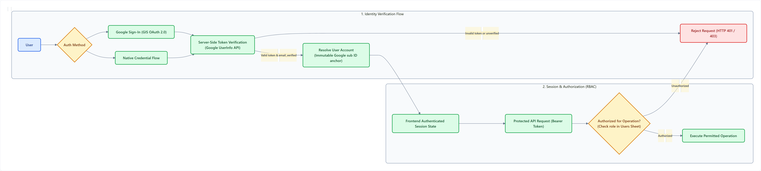
SECURITY & TRUST CONTROLS
Slide 10 — Security, Privacy, and Data Integrity
Security depends on backend enforcement and data-integrity controls, not just the authentication interface.
SECURITY & INTEGRITY FLOWCHART
ZERO-TRUST AUTHENTICATION
• Server Verification: Token validated via Google UserInfo API.
• Immutable sub Anchor: Account bound to Google Subject ID.
ROLE-BASED ACCESS CONTROL
• Server-Side Roles: Privileged actions require verified 'admin' role.
• Operation Validation: Admin tools enforce server checks on every call.
PREDICTION INTEGRITY
• Server-Clock Deadlines: Submissions cutoff 5 min prior to session.
• LockService Mutex: Serializes writes to eliminate race conditions.
DATA PRIVACY & NOTIFICATIONS
• Token Redaction: Auth secrets omitted from public endpoints.
• Idempotent Worker: Deduplication checks prevent duplicate emails.
THE GRDX — F1 Prediction & Community Platform | Product, Architecture & Roadmap Presentation
Slide 10 of 12
Notes:
“Security depends on backend enforcement and data-integrity controls, not just the authentication interface. We enforce token verification, role checks, and deadline enforcement on the server.”

Slide 12
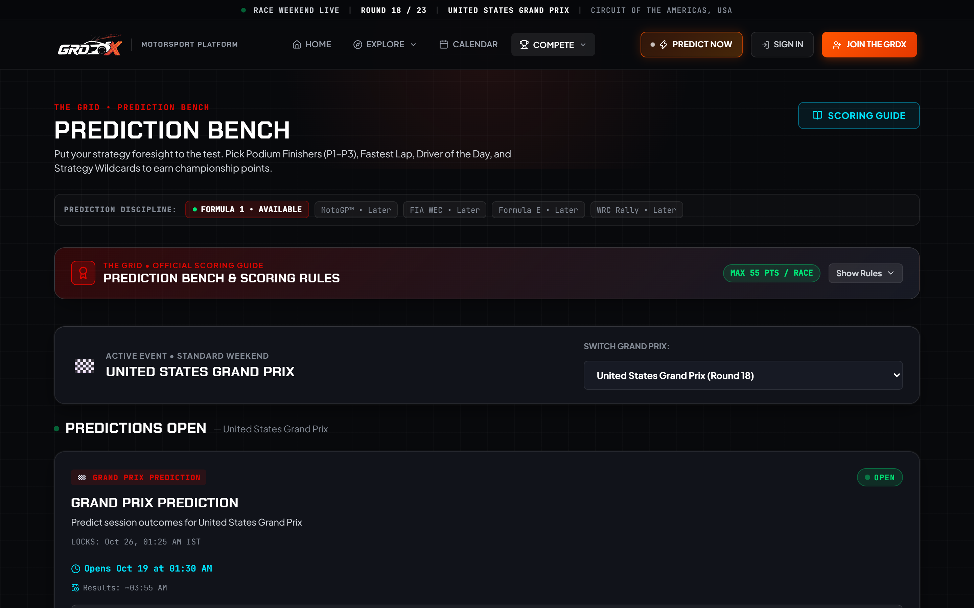
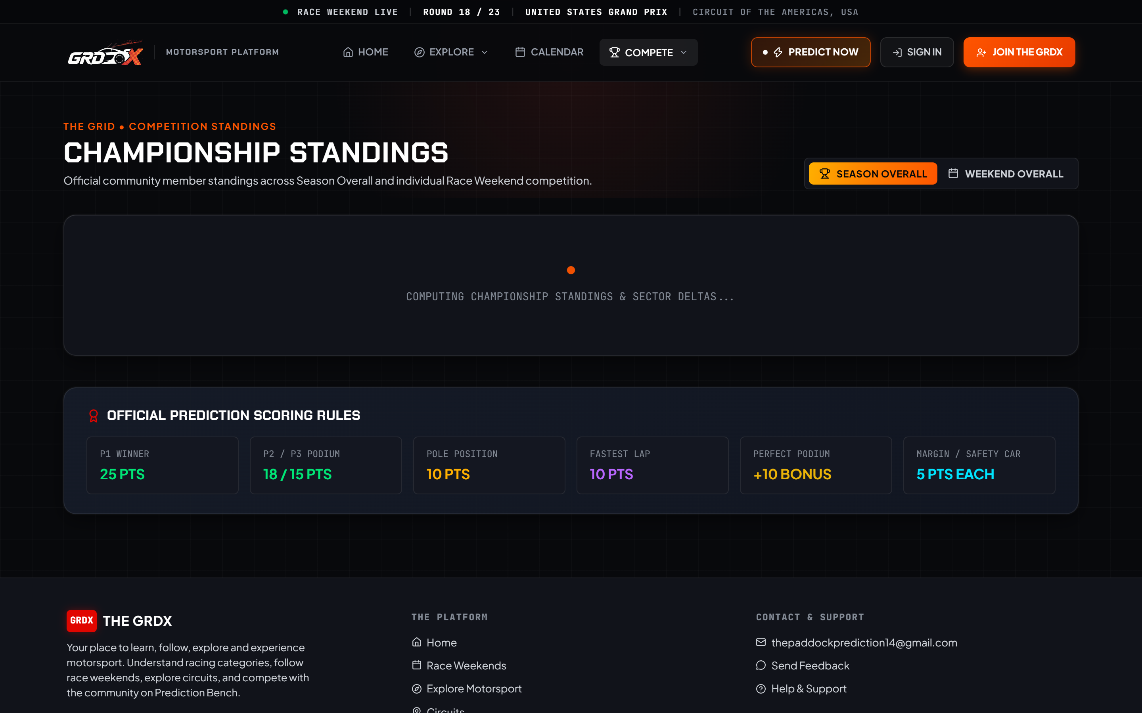
PRODUCT SHOWCASE | USER EXPERIENCE
Slide 11 — Product Showcase: Desktop Experience
Demonstrating how the underlying architecture translates into a usable, cohesive, and modern web application.
DESKTOP HOMEPAGE & HERO DASHBOARD
PREDICTIONS HUB INTERFACE
COMMUNITY LEADERBOARD & STANDINGS
THE GRDX — F1 Prediction & Community Platform | Product, Architecture & Roadmap Presentation
Slide 11 of 12
Notes:
“Actual production screenshots of the running desktop application: The left shows the main dashboard and session countdown; the top-right shows the Prediction Hub; the bottom-right shows the live community leaderboard.”

Slide 13
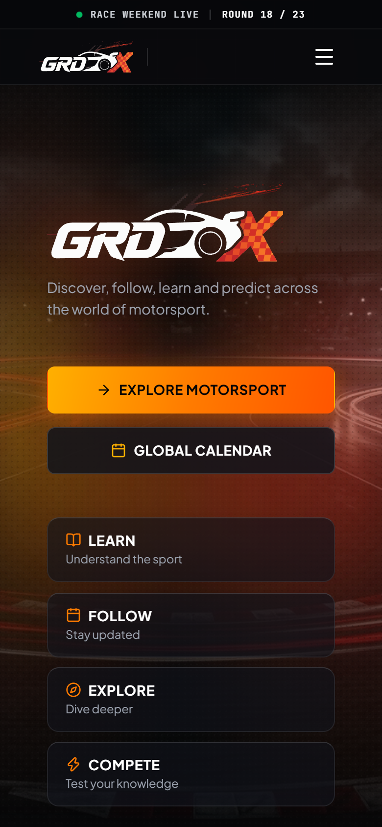
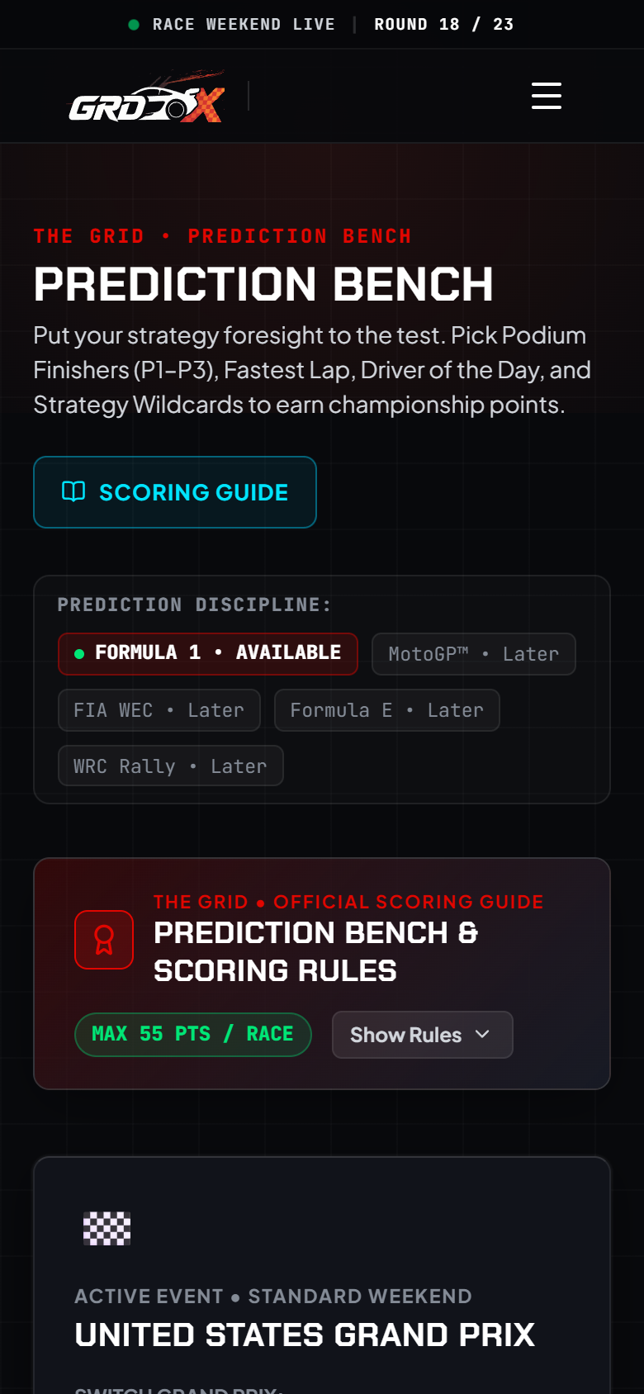
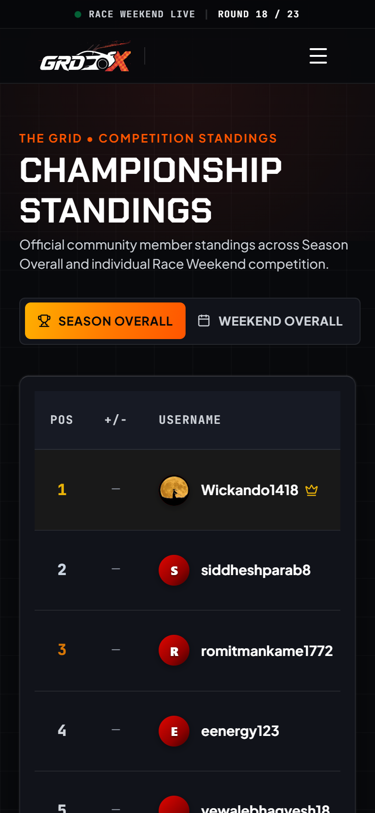
PRODUCT SHOWCASE | RESPONSIVE MOBILE EXPERIENCE
Slide 12 — Product Showcase: Mobile Experience
Demonstrating how users access the prediction experience and key platform features on mobile screens.
MOBILE HOMEPAGE & COUNTDOWN
MOBILE PREDICTION HUB
MOBILE LEADERBOARD
Responsive dashboard with race countdown & quick links.
Touch-friendly prediction rounds and driver selectors.
Fast-loading community rankings and user points tally.
THE GRDX — F1 Prediction & Community Platform | Product, Architecture & Roadmap Presentation
Slide 12 of 12
Notes:
“Demonstrate how users can access the prediction experience and key platform features on smaller screens. Actual mobile screenshots show responsive touch-friendly navigation, quick ballot entry, and leaderboard rankings.”

