Slide 1
TECHNICAL ARCHITECTURE BLUEPRINT | PRODUCTION SPECIFICATION V2
THE GRDX
Complete Technical Architecture Presentation
Comprehensive C4 architectural model, container topology, domain services, relational data model, and production engineering considerations for the next-generation motorsport prediction platform.
FRONTEND TIER
React 19 + TypeScript SPA
Vite build engine, React Router 7, Vanilla CSS design system, hosted on GitHub Pages Edge CDN.
BACKEND ENGINE
Google Apps Script V8
doGet/doPost API gateway, LockService distributed mutex, CacheService RAM cache, and business services.
PERSISTENT STORE
Google Sheets Cloud DB
15 structured worksheets, relational abstraction, automated version history, and audit logs.
ASYNC WORKERS
Decoupled Notification Engine
Time-driven queue processor, idempotency verification, exponential retries, and Google MailApp delivery.
THE GRDX TECHNICAL DECK | 10 ARCHITECTURE BLUEPRINT SLIDES | CONFIDENTIAL & PROPRIETARY
Notes:
Welcome to THE GRDX Technical Architecture presentation. This deck presents the complete architecture blueprint following the C4 model, domain workflows, relational data modeling on Google Sheets, and engineering trade-offs.

Slide 2
ARCHITECTURE ROADMAP & BLUEPRINT OVERVIEW
Deck Structure & Presentation Agenda
Ten-slide architecture narrative covering system topology, component architecture, data model, and engineering trade-offs.
Slide 1
System Context (C4 Level 1)
System boundary, community members, administrators, and external integrations (GIS, Jolpica, MailApp).
Slide 6
Prediction Lifecycle & Scoring Engine
End-to-end race round submission, server-side deadline checks, official result ingestion, and points calculation.
Slide 2
Container Architecture (C4 Level 2)
Major executable units, static edge hosting, serverless GCP V8 backend, and persistent data stores.
Slide 7
Authentication, Authorization & Integrity
Zero-trust Google GIS token verification, immutable Google 'sub' anchor, and server-side RBAC.
Slide 3
Frontend Component Architecture (C4 Level 3)
React Router navigation, AuthContext/AppContext, modular feature UI, and API facade with cache/fallback.
Slide 8
Asynchronous Notification Architecture
Decoupled NotificationQueue, scheduled background triggers, LockService mutex, and MailApp delivery.
Slide 4
Backend Component Architecture (C4 Level 3)
Apps Script doGet/doPost action dispatcher, domain services, LockService mutex, and spreadsheet persistence.
Slide 9
CI/CD, Hosting & Deployment
GitHub Actions build pipeline, dynamic circuit generation, Vite bundling, and independent Apps Script releases.
Slide 5
Data Model & Entity Relationships (ERD)
15-worksheet relational abstraction, user identity mapping, prediction rounds, and scoring tables.
Slide 10
Reliability, Quotas & Trade-offs
Apps Script quotas, execution timeouts, Google Sheets write contention, and production hardening.
THE GRDX — Motorsport Prediction & Community Platform | Technical Architecture Specification
Slide Overview of 10
Notes:
Recommended presentation sequence: Slides 1-4 establish what the system is and how it is structured. Slides 5-8 cover data schemas and business workflows. Slides 9-10 cover deployment processes and engineering trade-offs.

Slide 3
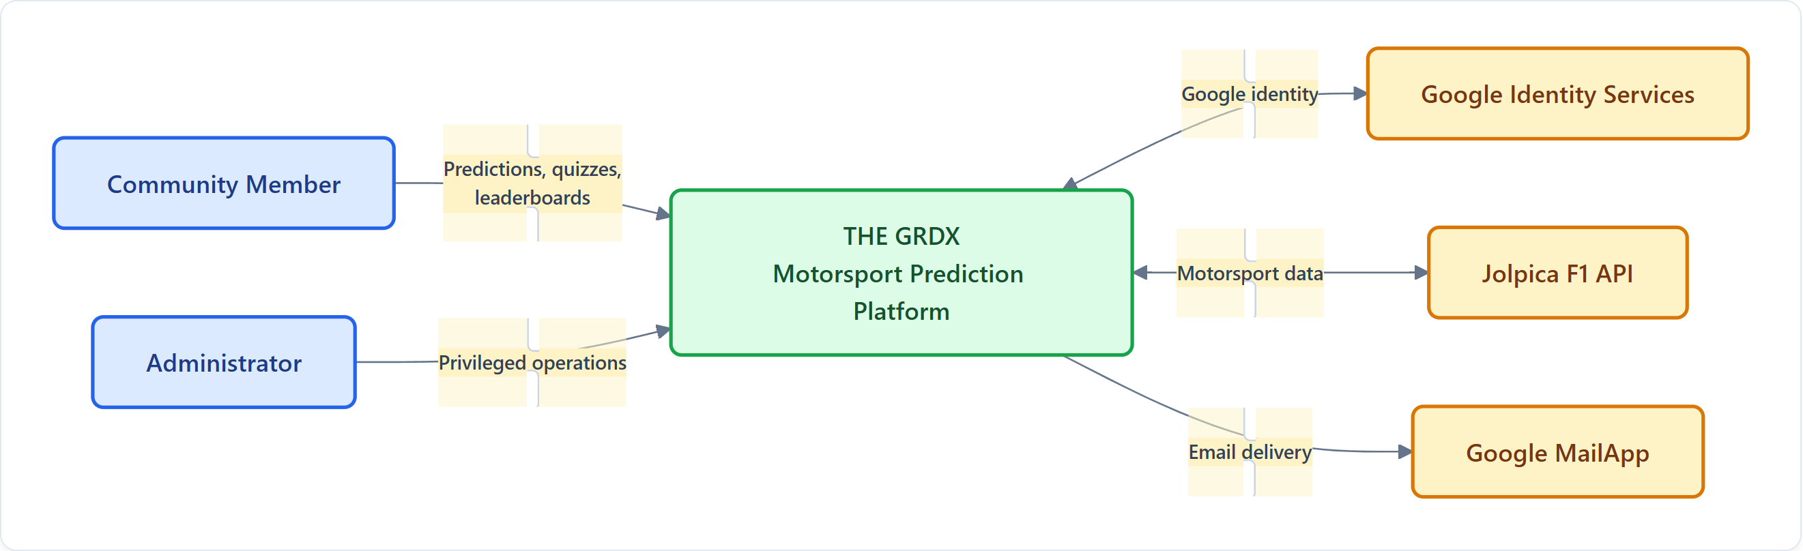
C4 ARCHITECTURE MODEL | LEVEL 1: CONTEXT
Slide 1 — System Context (C4 Level 1)
Purpose: Establish the system boundary and show the people and external services interacting with THE GRDX.
SYSTEM CONTEXT TOPOLOGY DIAGRAM
PLATFORM BOUNDARY & CAPABILITIES
• Race-Weekend Predictions: Session-specific prediction rounds (Practice, Quali, Sprint, GP).
• Automated Scoring & Boards: Rule-based point tallies, live leaderboard calculations, and driver stats.
• Motorsport Quizzes & Content: Gamified trivia engine, tiered difficulty categories, and learning badges.
• User Profiles & Security: Cryptographic Google OAuth identity, avatar customization, and settings.
• External Cloud Services: Google Identity Services (Auth), Jolpica F1 API (Data), Google MailApp (Email).
⚠️ VALIDATION CHECKPOINT
The repository documents these integrations, but confirm that each is enabled and actively used in the current production deployment before describing it as a live dependency.
THE GRDX — Motorsport Prediction & Community Platform | Technical Architecture Specification
Slide 1 of 10
Notes:
“THE GRDX provides a motorsport-focused prediction and community experience. This context view establishes the system boundary before we examine its internal architecture.”
Validation note: The repository documents these integrations, but confirm that each is enabled and actively used in the current production deployment before describing it as a live dependency.

Slide 4
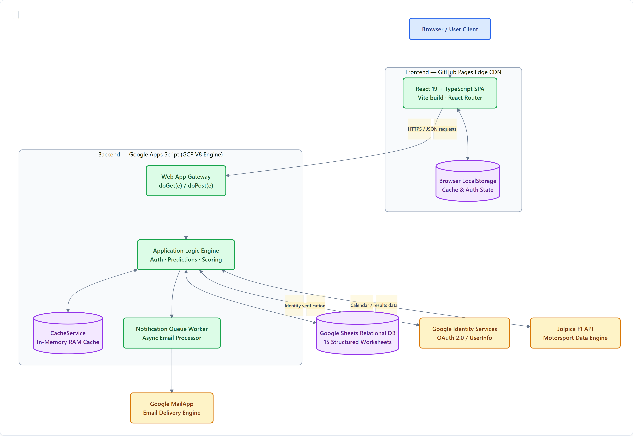
C4 ARCHITECTURE MODEL | LEVEL 2: CONTAINERS
Slide 2 — Container Architecture (C4 Level 2)
Purpose: Show the major executable units, hosting locations, and data stores.
CONTAINER & RUNTIME TOPOLOGY
CONTAINER TECHNOLOGY SUMMARY
Container | Technology | Responsibility
Frontend | React 19, TypeScript, Vite | UI, navigation, client cache, and user interactions.
Backend | Google Apps Script V8 | doGet/doPost API gateway and application business logic.
Persistent Store | Google Sheets (15 Worksheets) | Structured application records and versioned database.
Browser Storage | LocalStorage | Client-side persistence, session tokens, and cached state.
Backend Cache | CacheService (In-Memory RAM) | Temporary cached calendar responses and speedups.
External Services | GIS, Jolpica F1, MailApp | OAuth identity, motorsport calendar, and email dispatch.
⚠️ VALIDATION CHECKPOINT
The exact request paths and whether every API action reaches the live backend must be checked against the frontend API client. The repository includes mock-data fallback behavior.
THE GRDX — Motorsport Prediction & Community Platform | Technical Architecture Specification
Slide 2 of 10
Notes:
“The frontend is a static web application, while the backend runs in Apps Script. Google Sheets provides the main persistent data store, avoiding the need to operate a conventional application server and database server.”
Validation note: The exact request paths and whether every API action reaches the live backend must be checked against the frontend API client. The repository includes mock-data fallback behavior.

Slide 5
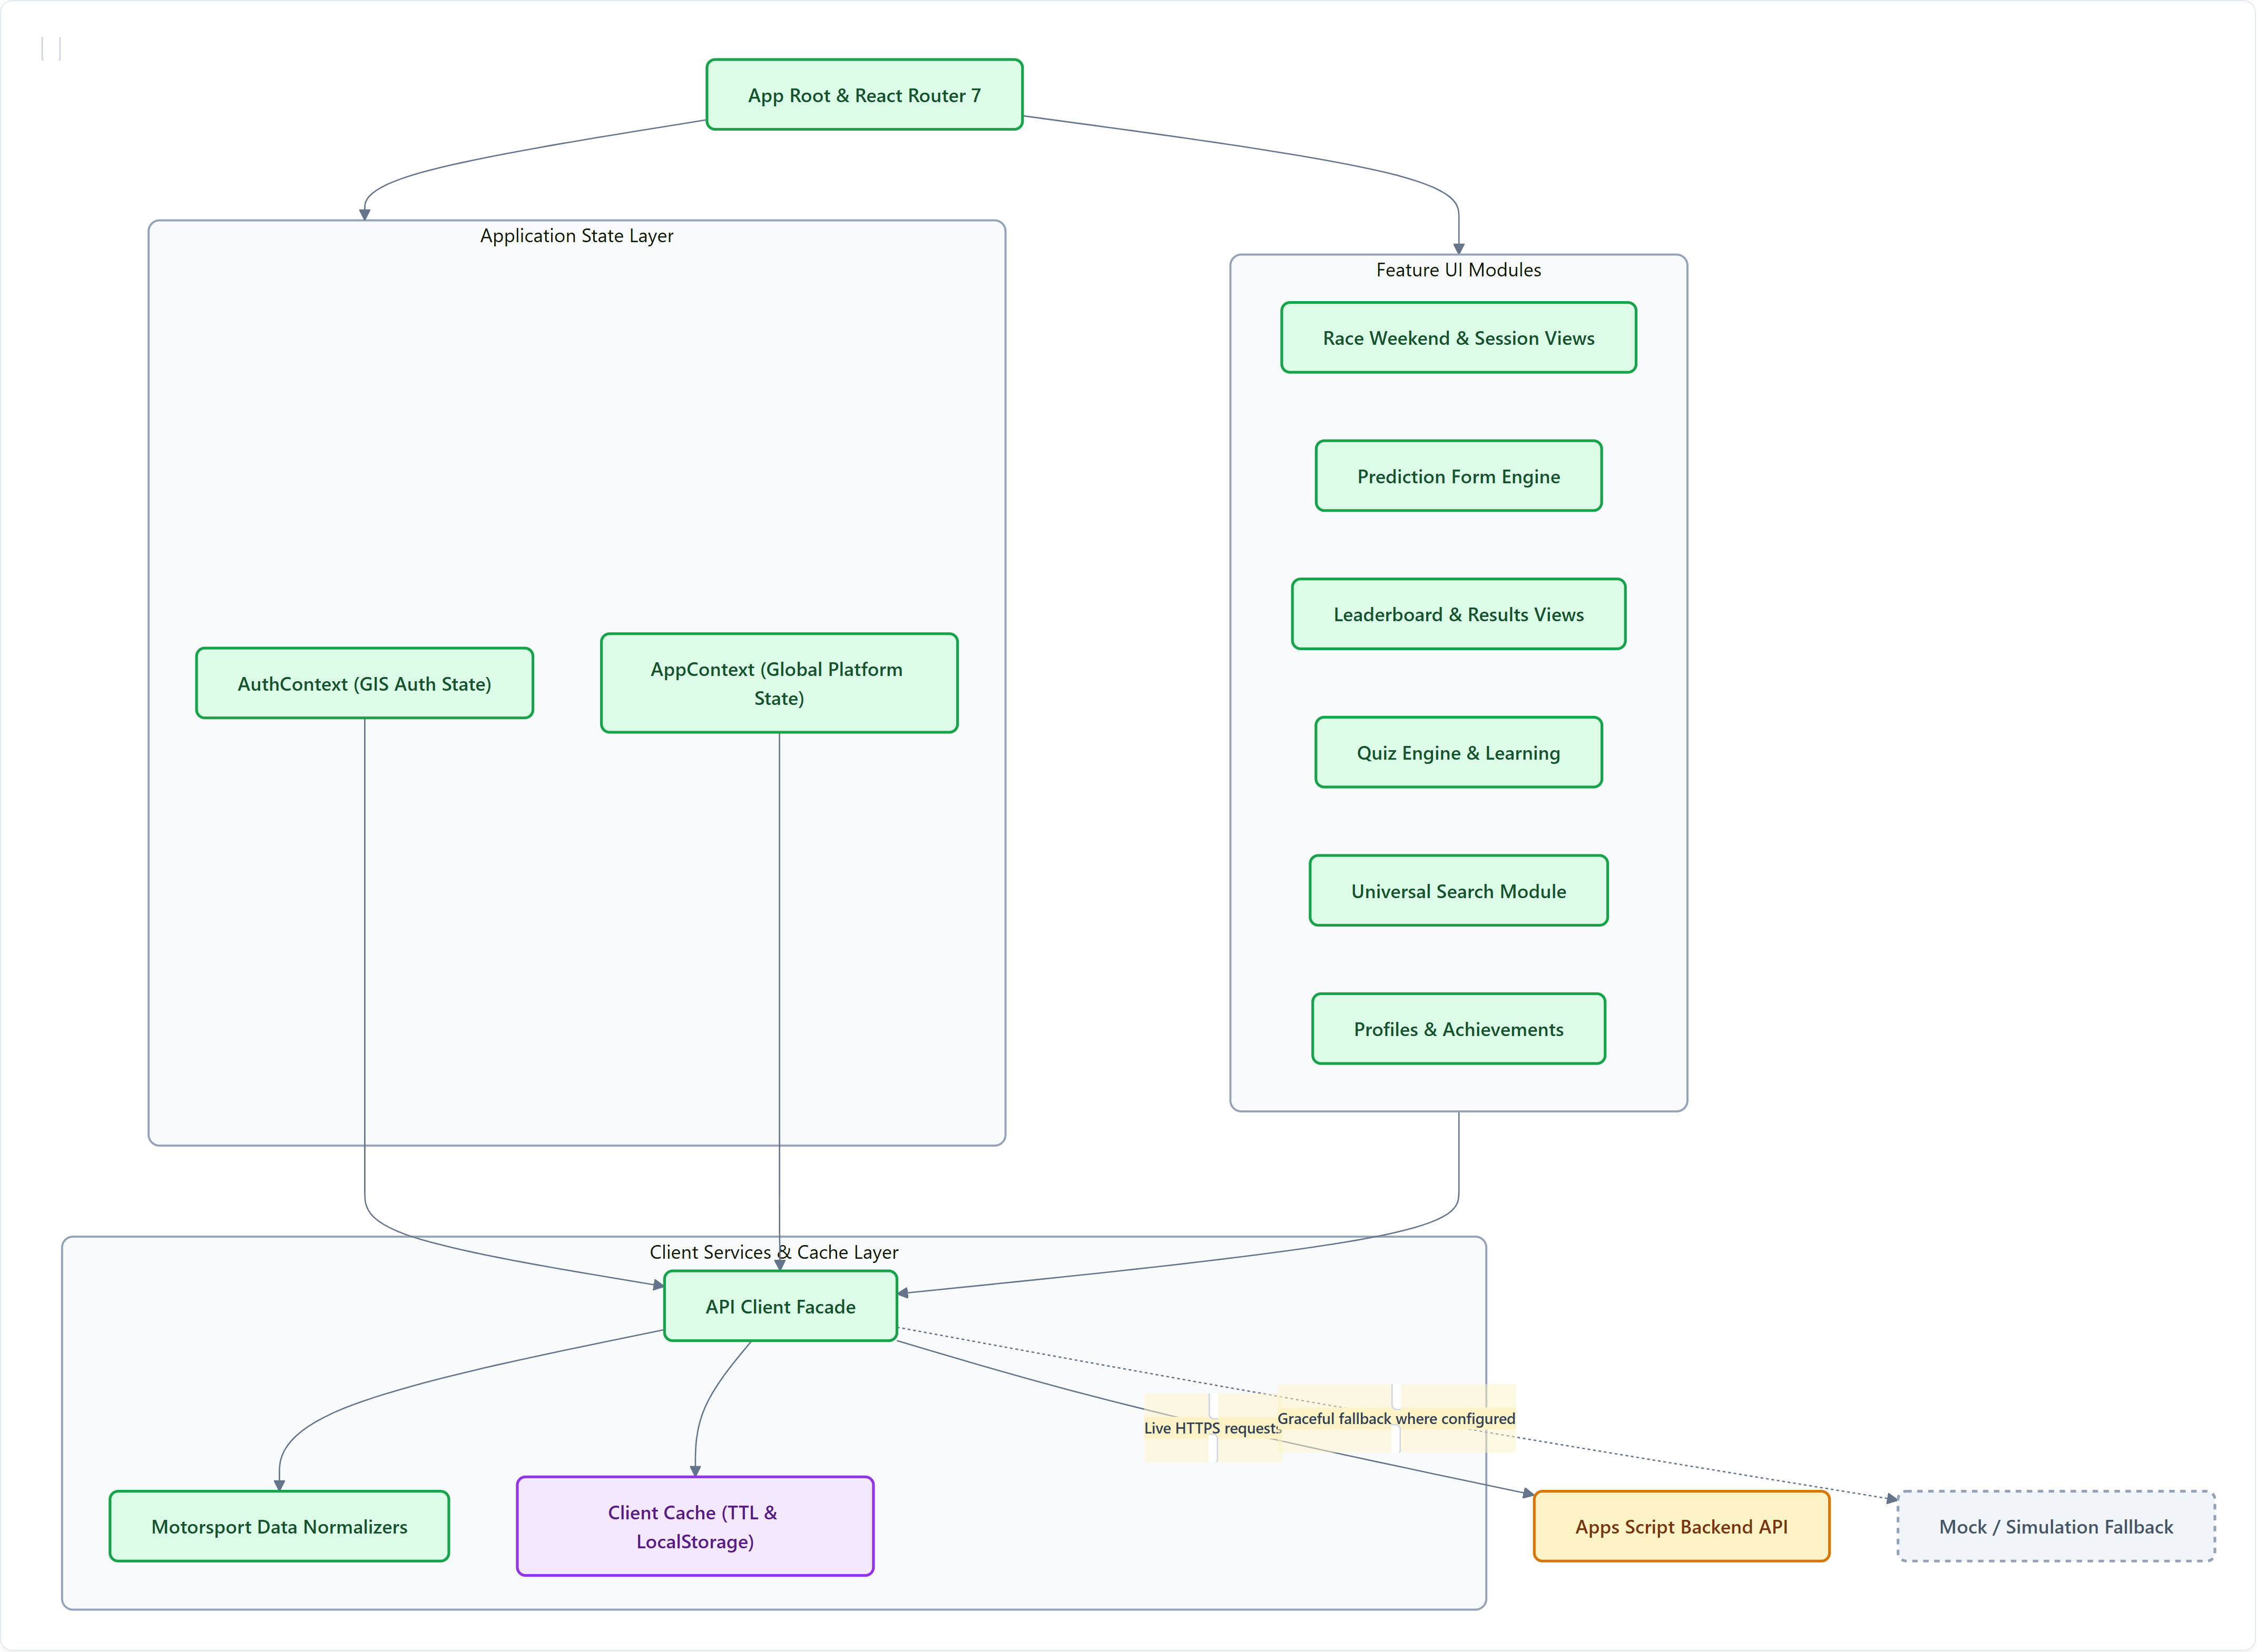
C4 ARCHITECTURE MODEL | LEVEL 3: FRONTEND
Slide 3 — Frontend Component Architecture (C4 Level 3)
Purpose: Explain how the frontend separates navigation, state, API communication, and feature modules.
FRONTEND COMPONENT INTERACTION MAP
MODULAR FRONTEND ARCHITECTURE
• Client-Side Routing (React Router 7): Declarative SPA route tree for predictions, leaderboards, quizzes, search, profiles, and administration.
• Application State Management: AuthContext encapsulates Google Identity tokens & profile state; AppContext coordinates active rounds and global notifications.
• Feature UI Modules: Self-contained feature views for race calendar sessions, interactive prediction entry, live scoreboards, and trivia quizzes.
• API Client Facade (`apiClient.ts`): Centralizes frontend-to-backend communication, manages HTTP timeouts, and attaches bearer authorization.
• Motorsport Normalization & Cache: Transforms third-party Jolpica payloads into normalized UI models with localStorage TTL caching.
• Graceful Mock Fallback Engine: Transparently serves local fixtures during offline development or backend API rate limiting.
⚠️ VALIDATION CHECKPOINT
Treat these as architectural groupings, not necessarily the exact names of every component file. Confirm the actual imports and call relationships before drawing fine-grained module dependencies.
THE GRDX — Motorsport Prediction & Community Platform | Technical Architecture Specification
Slide 3 of 10
Notes:
“The frontend is organized around feature UI, shared context, and a client-service layer. This separation keeps UI components from needing to manage every backend detail themselves.”
Validation note: Treat these as architectural groupings, not necessarily the exact names of every component file. Confirm the actual imports and call relationships before drawing fine-grained module dependencies.

Slide 6
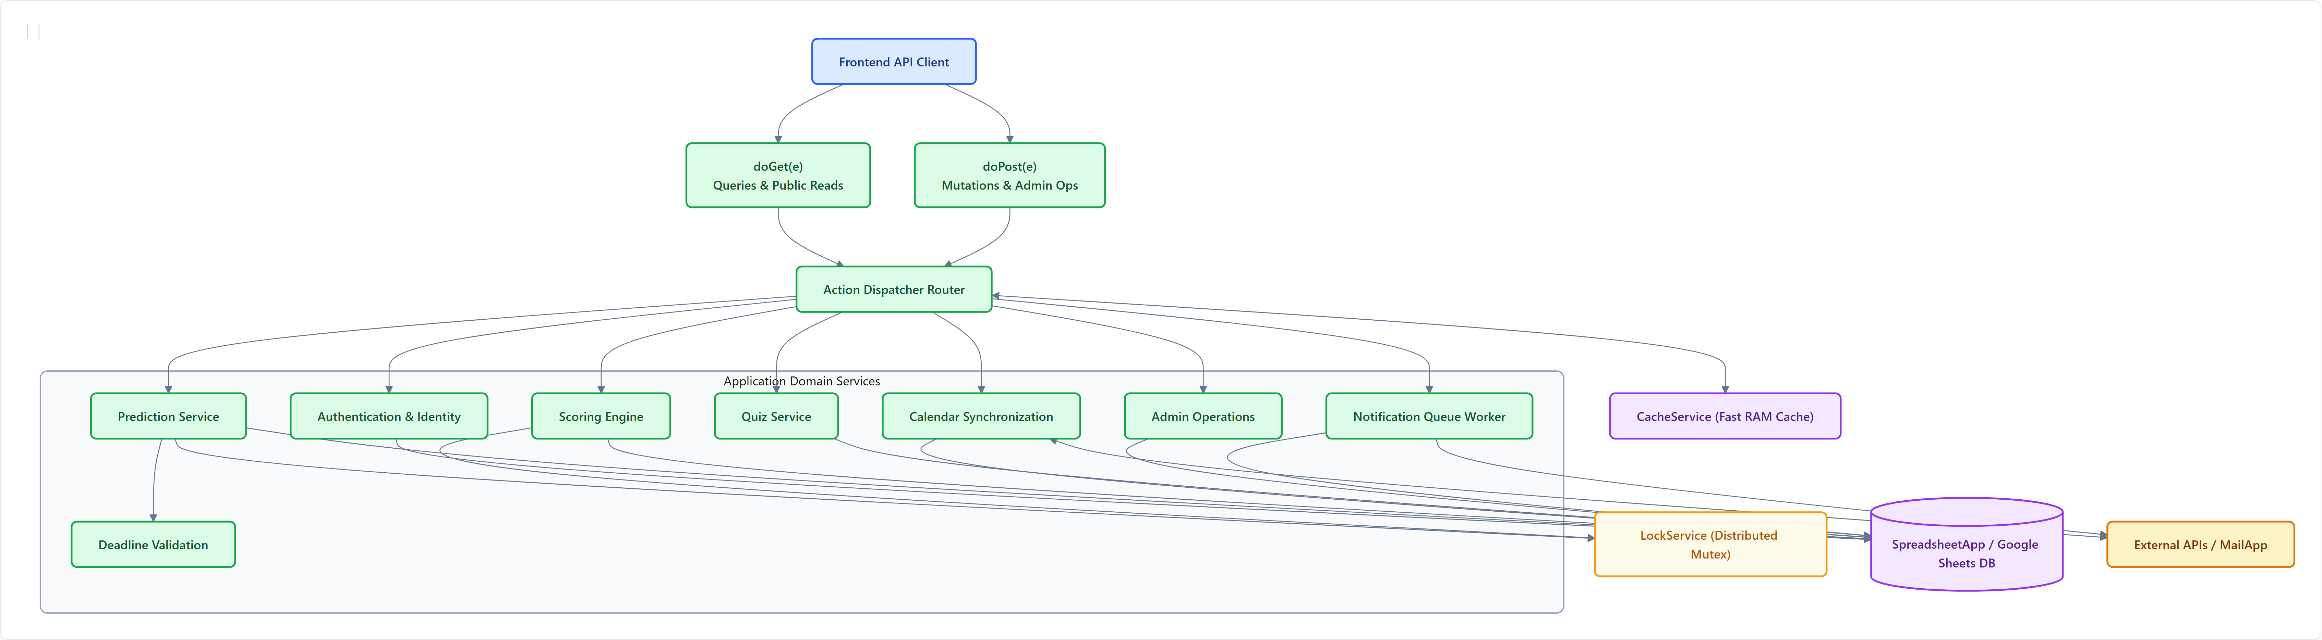
C4 ARCHITECTURE MODEL | LEVEL 3: BACKEND
Slide 4 — Backend Component Architecture (C4 Level 3)
Purpose: Show how API requests enter the backend and reach application services and storage.
BACKEND REQUEST ROUTING & APPLICATION SERVICES ARCHITECTURE
GATEWAY & DOMAIN SERVICES
DATA INTEGRITY & CONCURRENCY
⚠️ VALIDATION CHECKPOINT
This is a conceptual component map. In the final version, remove any arrow or component that cannot be traced to an actual handler or function in backend/Code.gs.
Apps Script executes in a single-threaded serverless instance per request; LockService is essential for multi-user integrity.
• API Gateway: doGet(e) handles public queries; doPost(e) handles mutations.
• Action Dispatcher: Single-point router delegating requests by action param.
• Authentication Service: Validates Google GIS OAuth tokens with Google UserInfo API.
• Quiz & Calendar Services: Syncs F1 schedule and serves categorized trivia questions.
• Deadline Validation: Enforces session cutoffs (5 min prior to session start).
• Scoring Engine: Compares user picks against official FIA race results.
• LockService Mutex: Serializes concurrent mutations to prevent race conditions.
• SpreadsheetApp Persistence: Structured worksheet read/write via Apps Script V8.
THE GRDX — Motorsport Prediction & Community Platform | Technical Architecture Specification
Slide 4 of 10
Notes:
“The backend is organized around an action-dispatch pattern rather than a set of separately deployed microservices. Its services execute inside the same Apps Script project.”
Validation note: This is a conceptual component map. In the final version, remove any arrow or component that cannot be traced to an actual handler or function in backend/Code.gs.

Slide 7
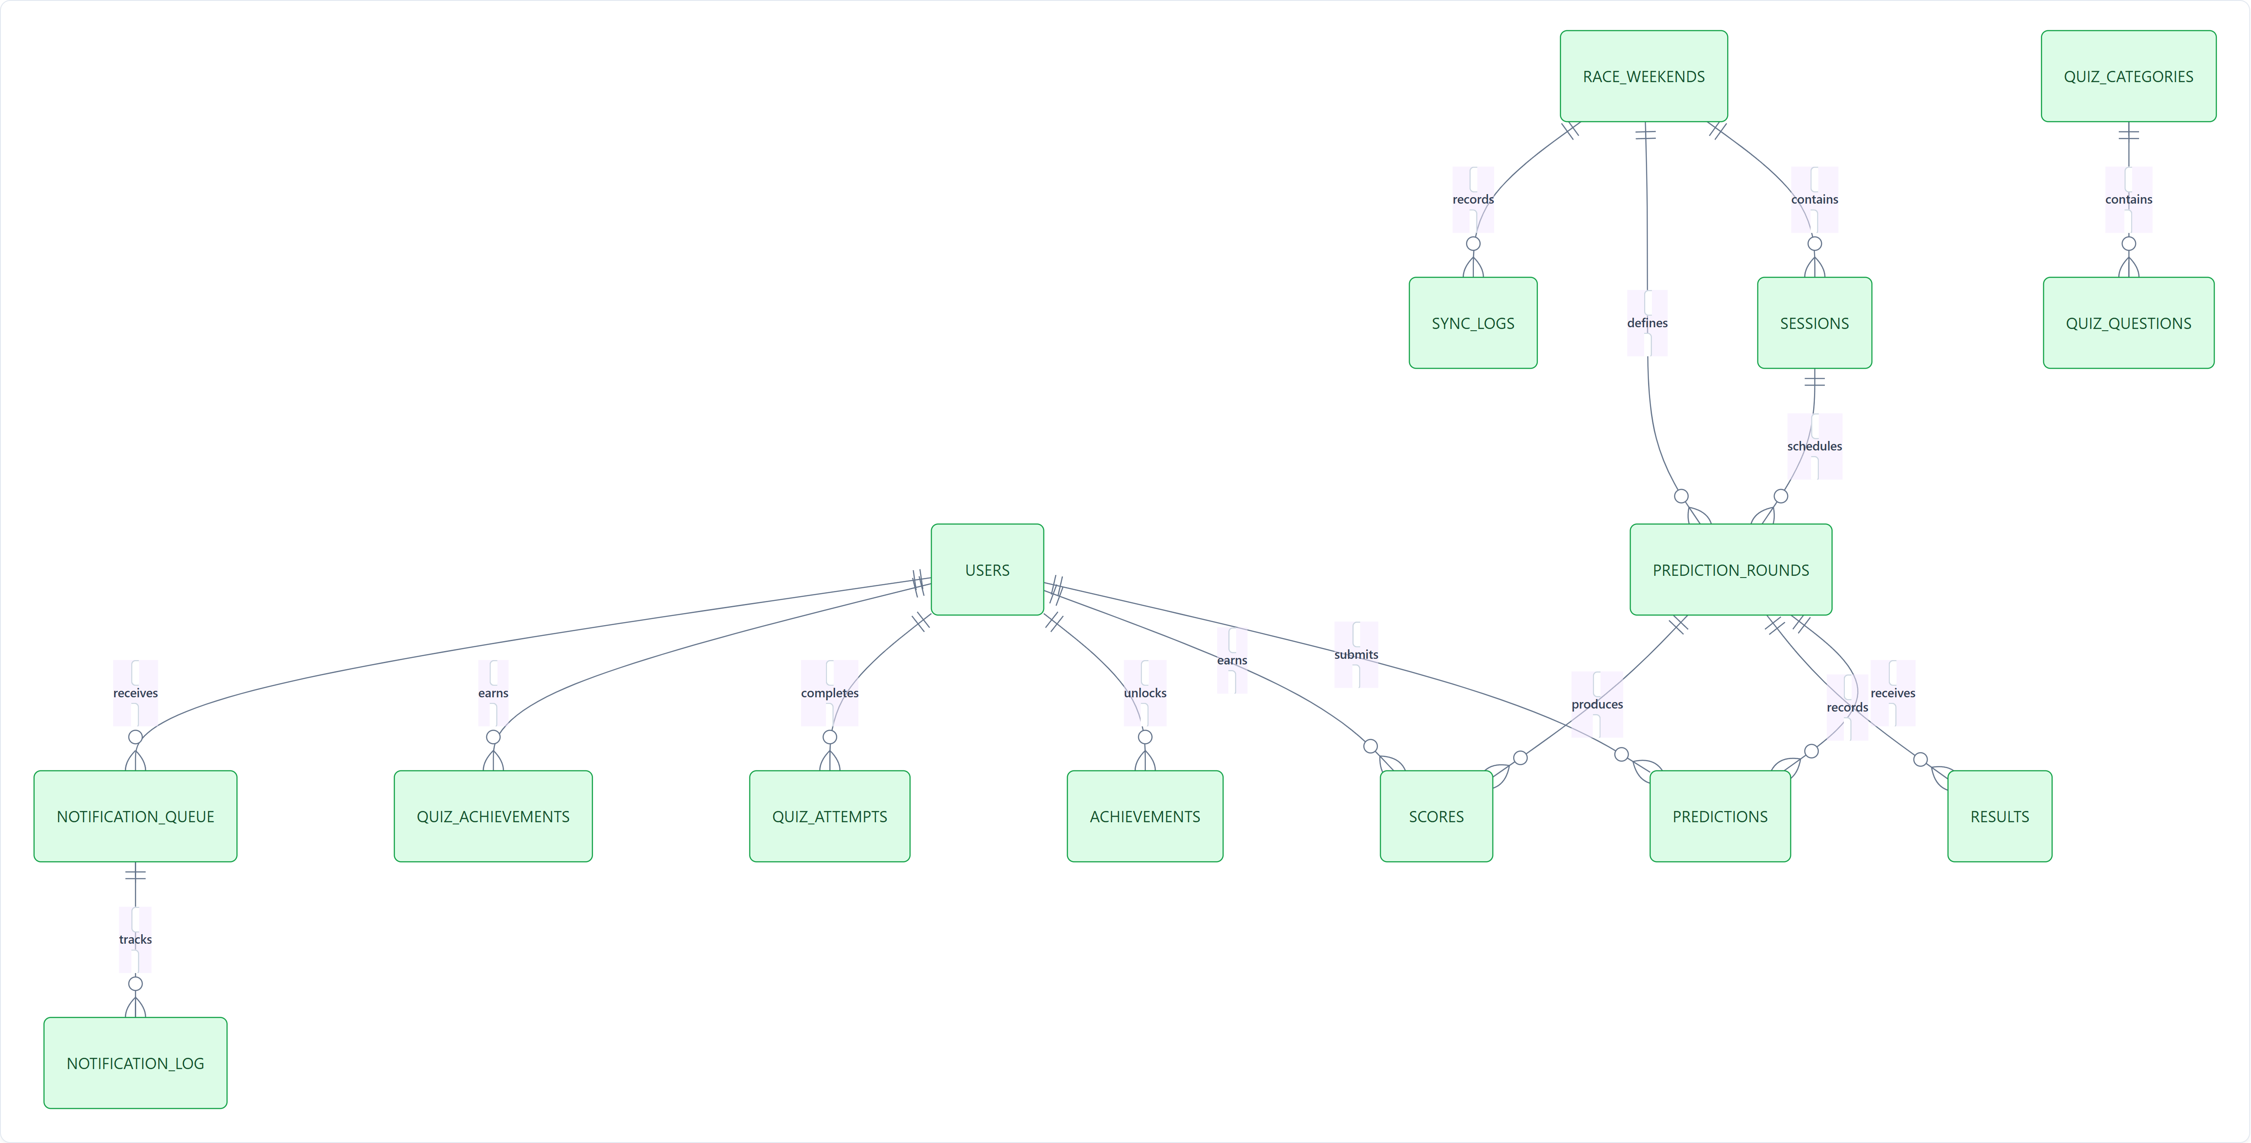
DATA ARCHITECTURE | RELATIONAL SCHEMA & GOOGLE SHEETS DB
Slide 5 — Data Model and Entity Relationship Diagram
Purpose: Explain how users, race weekends, predictions, results, and scores relate across 15 worksheets.
15-WORKSHEET ENTITY RELATIONSHIP MODEL
WORKSHEET ENTITIES & RELATIONSHIPS
• Users (Identity Anchor): Anchored by googleSubjectId (sub); maps to prediction submissions, total score aggregates, badges, and quiz attempts.
• RaceWeekends & Sessions: Motorsport calendar hierarchy defining Grand Prix rounds, practice, sprint, and main race sessions.
• PredictionRounds & Predictions: Binds active prediction opportunities to user picks and submission timestamps.
• Results & Scores: Official FIA session outcomes mapped to computed points, powering event and seasonal leaderboards.
• QuizCategories & Questions: Trivia question bank with difficulty tiers, completion logs, and quiz badges.
• NotificationQueue & Log: Asynchronous email task queue with delivery timestamps and retry counters.
⚠️ IMPORTANT ARCHITECTURE CHECKPOINT
This is a conceptual ERD based on relationships described in docs/ARCHITECTURE.md. Google Sheets does not enforce relational foreign keys like a conventional SQL database. All referential integrity, uniqueness rules, and UUID lookups are enforced in application code. Verify exact sheet names against backend/SetupSheet.gs.
THE GRDX — Motorsport Prediction & Community Platform | Technical Architecture Specification
Slide 5 of 10
Notes:
“The data model separates identity, race structure, prediction submissions, official results, scoring, and engagement features. This makes the business relationships easier to reason about even though the persistence layer is Google Sheets.”
Important: This is a conceptual ERD based on relationships described in docs/ARCHITECTURE.md. Verify the real worksheet names, key columns, uniqueness rules, and lookup logic in the code.

Slide 8
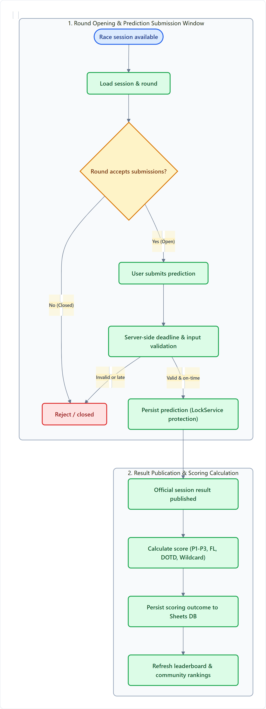
CORE BUSINESS WORKFLOWS | PREDICTION ENGINE
Slide 6 — Prediction Lifecycle and Scoring Engine
Purpose: Demonstrate the core business workflow, from opening a prediction round through calculating a user's score.
PREDICTION LIFECYCLE WORKFLOW
OFFICIAL DOCUMENTED SCORING MODEL
Prediction Outcome | Points | Evaluation Criteria
Exact P1 Winner | 15 pts | Selected driver finishes in 1st position
Exact P2 Runner-Up | 10 pts | Selected driver finishes in 2nd position
Exact P3 Third Place | 10 pts | Selected driver finishes in 3rd position
Podium Driver (Wrong Position) | 5 pts | Driver finishes on podium (top 3) but wrong spot
Perfect 1–2–3 Podium Bonus | +10 pts | Exact P1, P2, and P3 predicted simultaneously
Fastest Lap (FL) | 10 pts | Selected driver records official race fastest lap
Driver of the Day (DOTD) | 10 pts | Selected driver wins official fan voting
Wildcard Session Challenge | 15 pts | Correct prediction on session-specific wildcard question
⚠️ BUSINESS RULES & VALIDATION CHECKPOINT
• Session Deadlines: Rounds close 5 minutes prior to official session start; strictly validated on the server.
• Concurrency: LockService serializes simultaneous submissions during high-traffic cutoff windows.
• Ingestion & Idempotency: Official race results trigger batch scoring; verify duplicate-scoring protections in backend/Code.gs.
THE GRDX — Motorsport Prediction & Community Platform | Technical Architecture Specification
Slide 6 of 10
Notes:
“A prediction is tied to a specific session and round. Once a submission is accepted, the scoring process compares it with the official result and produces the points used in the leaderboard.”
Validation note: Confirm the precise deadline calculation, update behavior for existing predictions, result-ingestion mechanism, and duplicate-scoring protection against the implementation.

Slide 9
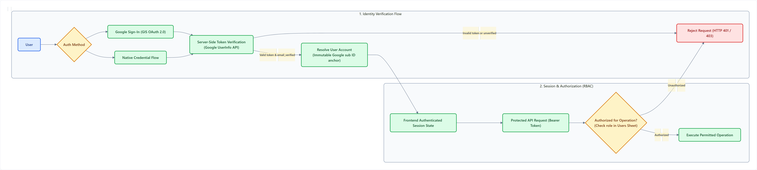
SECURITY ARCHITECTURE | ZERO-TRUST IDENTITY & ACCESS CONTROL
Slide 7 — Authentication, Authorization, and Data Integrity
Purpose: Explain how identity, privileged access, and prediction integrity are handled.
AUTHENTICATION & AUTHORIZATION WORKFLOW
IDENTITY & ACCOUNT ANCHORING
AUTHORIZATION & DATA INTEGRITY
⚠️ SECURITY VALIDATION CHECKPOINT
The repository describes both Google authentication and native credential-related flows. Do not label the system passwordless or Google-only without resolving that distinction in the actual implementation.
Also verify which API operations enforce roles server-side and ensure sensitive account tokens are redacted from public leaderboard responses.
• Zero-Trust Verification: Browser identity claims are never trusted; backend verifies token directly with Google UserInfo API.
• Immutable Google 'sub' Anchor: User record is permanently keyed to Google Subject ID, preventing account hijacking or duplicate profiles.
• Session State & Tokens: Client maintains authenticated state via short-lived bearer tokens and encrypted local session cache.
• Server-Side RBAC: Privileged operations (calendar sync, score overrides, admin tools) require verified 'admin' role in Users table.
• Server Deadline Enforcement: Submission timestamp verified against session cutoff on Apps Script server; ignores client clock.
• Distributed Mutex (LockService): 10-second script lock prevents race conditions during user registration and high-concurrency writes.
THE GRDX — Motorsport Prediction & Community Platform | Technical Architecture Specification
Slide 7 of 10
Notes:
“Security is not just a login screen. The backend must independently validate the caller, enforce permissions, and protect sensitive updates even if a client request is modified.”
Validation note: The repository describes both Google authentication and native credential-related flows. Do not label the system passwordless or Google-only without resolving that distinction in the actual implementation.

Slide 10
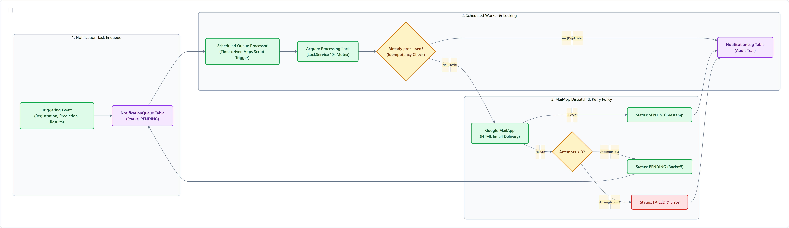
ASYNCHRONOUS WORKFLOWS | NOTIFICATION INFRASTRUCTURE
Slide 8 — Asynchronous Email Notification Architecture
Purpose: Show how email delivery can be separated from the main user-facing request via background workers.
ASYNCHRONOUS EMAIL DELIVERY PIPELINE
NOTIFICATION ARCHITECTURE & OPERATIONAL DESIGN
⚠️ NOTIFICATION VALIDATION CHECKPOINT
The architecture documentation describes a maximum of three retries and a time-driven queue processor.
Confirm those exact rules in the implementation before including the retry count in the final slide, and verify Google MailApp daily sending quotas (typically 100-1500 emails/day).
• Decoupled Task Enqueue: Triggering events (account welcome, prediction receipts, scoring summaries) write a lightweight PENDING row to NotificationQueue without blocking user response.
• Time-Driven Queue Worker: Scheduled Apps Script trigger runs periodically (every 5–10 min) executing `processNotificationQueue()` to drain pending dispatches in batches.
• Distributed Processing Lock: Worker acquires `LockService.getScriptLock()` with a 10s timeout to prevent overlapping executions from sending duplicate emails.
• Idempotency & Audit Trail: Checks NotificationLog before sending; successful dispatches transition to SENT, logging timestamps and message IDs.
• Exponential Retries & Dead-Letter: Transient failures transition to retry queue with backoff; failures exceeding 3 attempts are marked as FAILED for manual review.
THE GRDX — Motorsport Prediction & Community Platform | Technical Architecture Specification
Slide 8 of 10
Notes:
“Moving email delivery into a queue allows the platform to manage delivery independently of the original user action. Tracking and retrying failures can improve operational reliability, provided the queue's actual retry and idempotency logic is implemented correctly.”
Validation note: Confirm the exact retry count and time-driven trigger rules in the code.

Slide 11
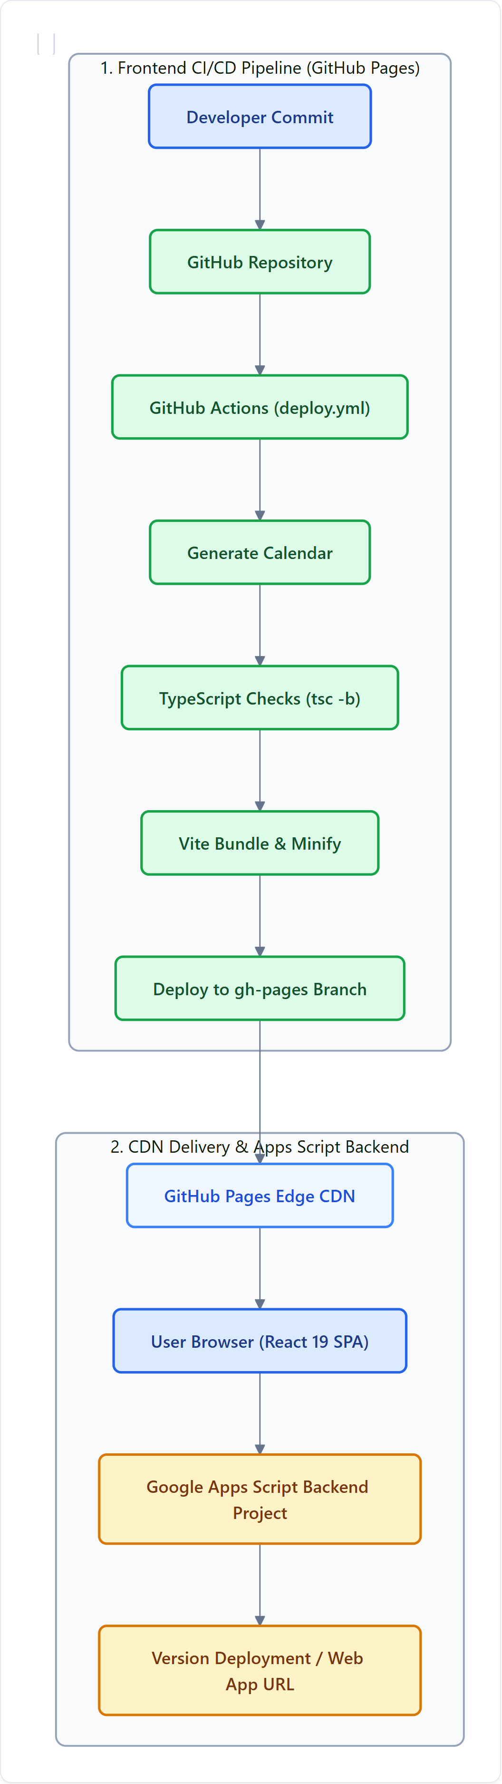
DEVOPS & INFRASTRUCTURE | DELIVERY PIPELINES
Slide 9 — CI/CD, Hosting, and Deployment
Purpose: Explain how frontend changes become a deployed website and distinguish that process from backend deployment.
CI/CD & DEPLOYMENT PIPELINE
DEPLOYMENT PIPELINES & OPERATIONAL CONCERNS
• Automated Frontend CI/CD Pipeline (GitHub Actions): Defined in `.github/workflows/deploy.yml`. Triggered automatically on push to `main` branch. Executes end-to-end static build sequence.
• Pre-Build Calendar & Circuit Generation: `npx tsx scripts/generate-calendar.ts` generates standardized race schedules and dynamic SVG circuit track layouts.
• Strict TypeScript & Vite Compilation: Runs `tsc -b` for full project type checking followed by `vite build` to generate optimized production bundles.
• Edge CDN Hosting (GitHub Pages): Pushes compiled `/dist` directory to `gh-pages` branch, serving users via GitHub Pages global CDN edge.
• Independent Backend Deployment Boundary: Apps Script backend (`backend/Code.gs`) is an independent deployment. Publishing the frontend DOES NOT automatically update or deploy the live Apps Script backend version.
• SPA Client-Side Routing Fallback: GitHub Pages requires a custom 404 redirection script (`404.html`) to preserve HTML5 client-side routes on refresh.
⚠️ DEPLOYMENT VERIFICATION CHECKPOINT
The frontend deployment pipeline and backend release process are separate. Confirm the actual workflow triggers, required checks, deployment credentials, and whether backend deployment is automated or manual before claiming end-to-end CI/CD.
A green frontend build does not prove the Apps Script endpoint is current.
THE GRDX — Motorsport Prediction & Community Platform | Technical Architecture Specification
Slide 9 of 10
Notes:
“The frontend deployment pipeline and backend release process are separate. This is important because a successful website build does not necessarily mean the Apps Script backend has been updated or configured correctly.”
Validation note: Confirm the actual workflow triggers, required checks, deployment credentials, and whether backend deployment is automated or manual before claiming end-to-end CI/CD.

Slide 12
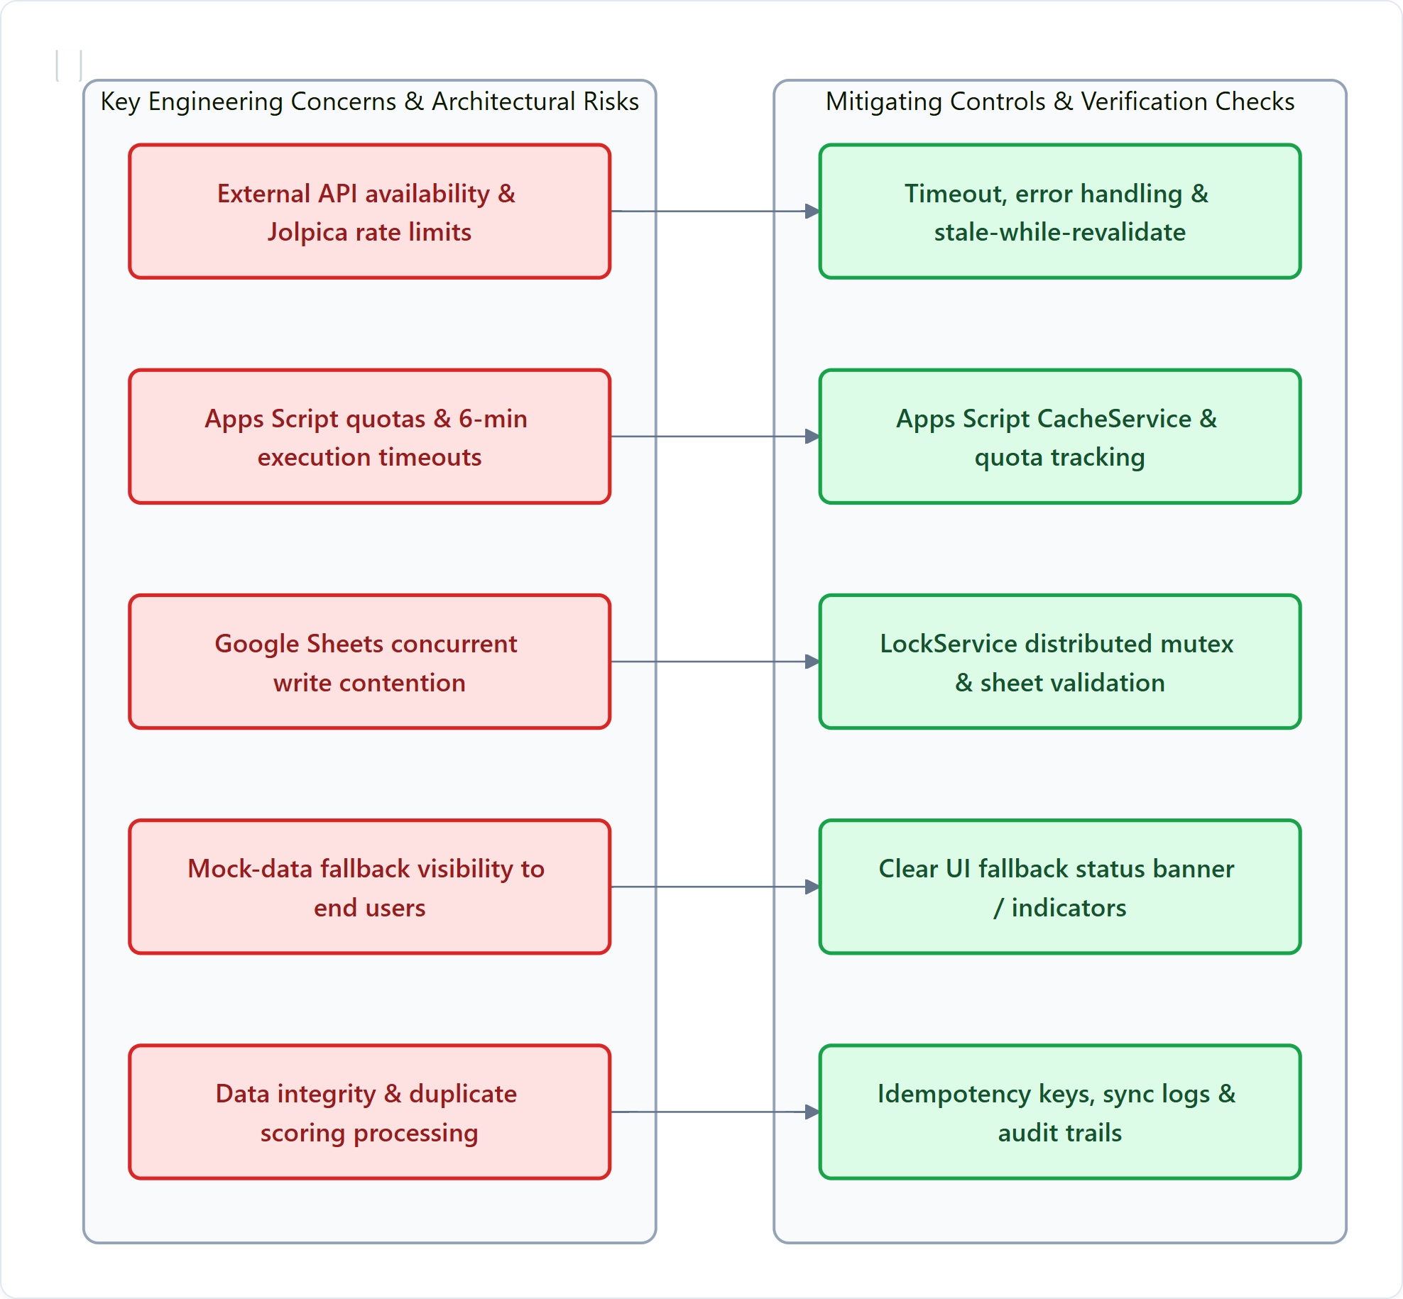
ENGINEERING DISCIPLINE | ARCHITECTURAL TRADE-OFFS
Slide 10 — Reliability, Limitations, and Engineering Considerations
Purpose: Demonstrate that you understand architectural trade-offs and operational limits, not just the feature set.
RISKS VS MITIGATING CONTROLS MAP
KEY ARCHITECTURAL TRADE-OFFS & OPERATIONAL REALITIES
Architectural Advantage | Engineering Consideration & Trade-off
Low infrastructure overhead & zero cost | Apps Script quotas apply: 6-min execution timeouts, daily email limits, and invocation caps.
Google Sheets is easy to inspect & audit | No relational foreign keys or ACID guarantees; relational integrity must be enforced in code.
Static Edge CDN frontend hosting | Frontend depends on separately configured backend Web App URL; cross-origin latency applies.
External motorsport data (Jolpica) | Upstream API outages and last-minute schedule changes affect freshness; requires client cache.
Client-side fallback capability | Users may see simulated rather than live data if fallback behavior is not clearly signaled in the UI.
⚠️ ENGINEERING CHECKLIST BEFORE PRODUCTION RELEASE
These are engineering considerations, not claims that every failure mode is already mitigated. In particular, verify:
1. Physical worksheet schema in backend/SetupSheet.gs | 2. Auth paths & server-side RBAC in backend/Code.gs
3. Mock-data fallback UI indicators | 4. Deadline & scoring rules | 5. Notification retries & deduplication.
THE GRDX — Motorsport Prediction & Community Platform | Technical Architecture Specification
Slide 10 of 10
Notes:
“THE GRDX prioritizes low-cost infrastructure and straightforward maintenance. Its reliability depends on validating data integrity, handling external failures, controlling concurrent writes, and distinguishing live data from fallback behavior.”
These are engineering considerations, not claims that every failure mode is already mitigated. Present each control as implemented only after verifying the corresponding source.

Slide 13
EXECUTIVE SUMMARY | PRODUCTION READINESS
Architectural Synthesis & Production Hardening
Summary of architectural strengths, verified operational guarantees, and recommended roadmap milestones.
CORE ARCHITECTURAL STRENGTHS
• Serverless & Zero Fixed Overhead: Static SPA on Edge CDN paired with GCP V8 Apps Script serverless backend eliminates infrastructure maintenance costs.
• Clean Separation of Concerns: Strict C4 Level 1-3 layering separates presentation, routing, state, API client facade, and business domain services.
• Cryptographic Google Identity: Passwordless authentication eliminates password leakage vulnerabilities; user account anchored to immutable Google `sub`.
• Granular Concurrency Controls: LockService distributed mutex ensures transactional write safety across high-concurrency race finish windows.
VERIFICATION & READINESS CHECKLIST
• Backend Deployment URL Alignment: Ensure Vite build environment variables point to active, versioned Apps Script Web App URL.
• Worksheet Schema Consistency: Cross-reference all 15 sheets in backend/SetupSheet.gs against backend action dispatcher column lookups.
• Server-Side Clock Enforcement: Confirm deadline checks strictly evaluate server timestamps with zero trust on client system time.
• Fallback Transparency: Ensure UI prominently displays status pills when displaying cached or mock simulation datasets.
RECOMMENDED PRODUCTION ROADMAP
• Edge Cache Layer (Cloudflare Workers): Introduce edge caching for read-heavy public endpoints (driver standings, static race calendars) to reduce Apps Script quota pressure.
• Automated Integration Testing: Expand CI/CD pipeline to execute integration test suite verifying backend API contracts before deployment.
• Granular Quota Telemetry: Add quota monitoring hooks to record daily Apps Script execution seconds and MailApp email consumption.
• Leaderboard Snapshot Generation: Pre-render static leaderboard JSON snapshots upon race scoring to serve high-traffic traffic spikes instantly.
THE GRDX — Motorsport Prediction & Community Platform | Technical Architecture Specification
Slide Summary of 10
Notes:
In conclusion, THE GRDX achieves a remarkable balance between zero-cost operational simplicity and robust architectural design. Adhering to the verification checklist and implementing edge caching will ensure seamless scale during peak motorsport race weekends.

