Slide 1
Maze Runner Game
Harrison Gilbert, Anthony Wayman

Slide 2

Introduction
Objective:
Create a functional game in Python
This Photo by Unknown Author is licensed under CC BY-SA

Slide 3
Overview
What our game will consist of:
Randomly Generated map
Timer counting down
Player “P”
Checkpoint “O”
Exit “E”

Slide 4
Technical Details
What we used:
Functions
If statements
while loops
Lists!

Slide 5
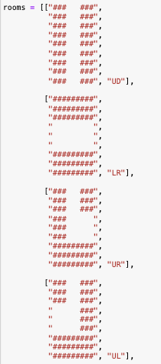
Implementation

Slide 6
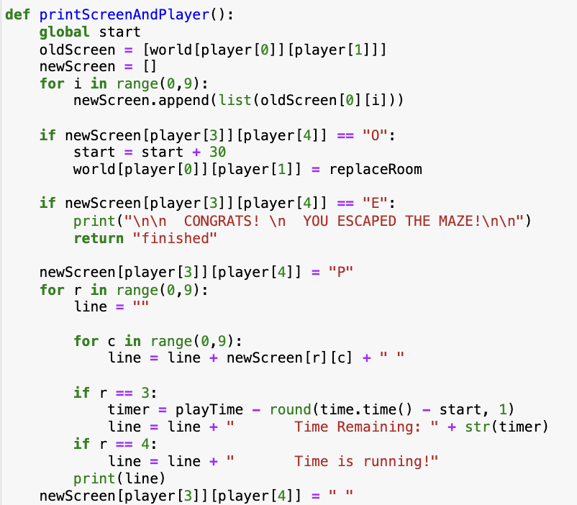
Implementation

Slide 7
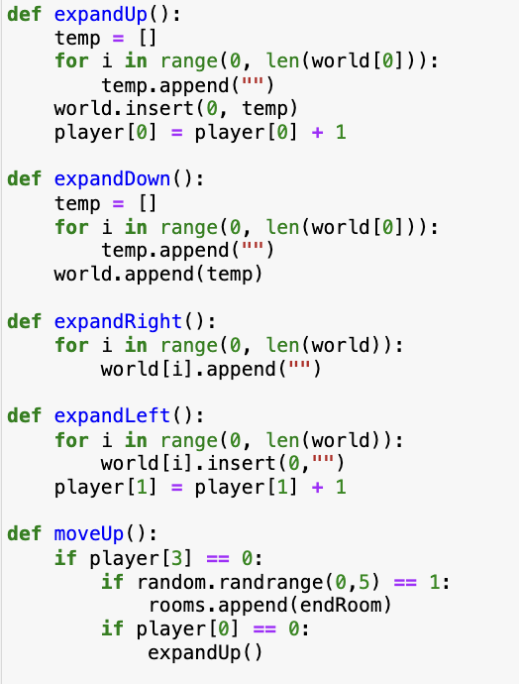
Implementation

Slide 8
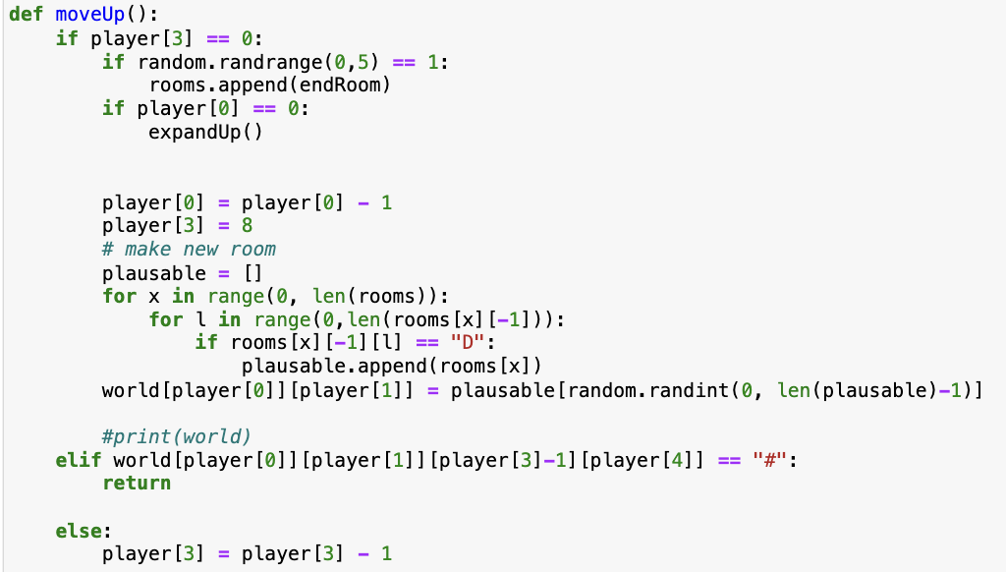
Implementation

Slide 9
Challenges/Solutions
Array ---> Lists

Slide 10
User Experience
Timer in top right
(w, a, s, d)

Slide 11
Demonstration

Slide 12
Lessons Learned

Slide 13
Thank You

