Slide 1
gh0st@wickedCrown:~$ run.sh
Pwn 0x4: Stack Buffer Overflows
Wanna.W1n: Team K – WickedCrown 0peration

Slide 2
gh0st@wickedCrown:~/Pwn_0x4$ ls -a
.
old_knowledge
canary
exercise
..
what_is_stack_ buffer_overflows
mitigation

Slide 3







gh0st@wickedCrown:~/Pwn_0x4$ cd old_knowledge
stack

Slide 4















Slide 5



















Slide 6




gh0st@wickedCrown:~/Pwn_0x4$ cd what_is_stack_buffer_overflows
1988 - Morris Worm: Stack buffer overflow was found
Now it become one of the most popular technique using in pwning

Slide 7











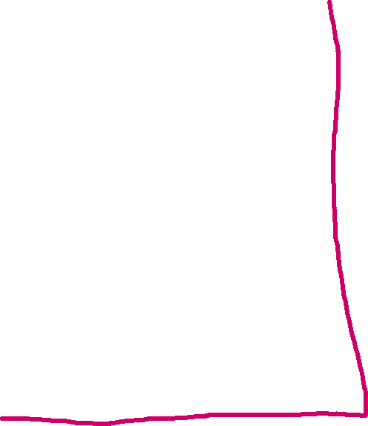




















void vuln(char *s)
{
gets(s);
}
int main()
{
char a[10];
vuln(a);
printf("output: %s", a);
return 0;
}

Slide 8






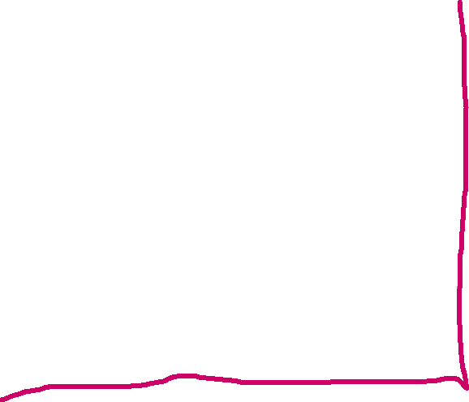

































void vuln(char *s)
{
gets(s);
}
int main()
{
char a[10];
vuln(a);
printf("output: %s", a);
return 0;
}

Slide 9

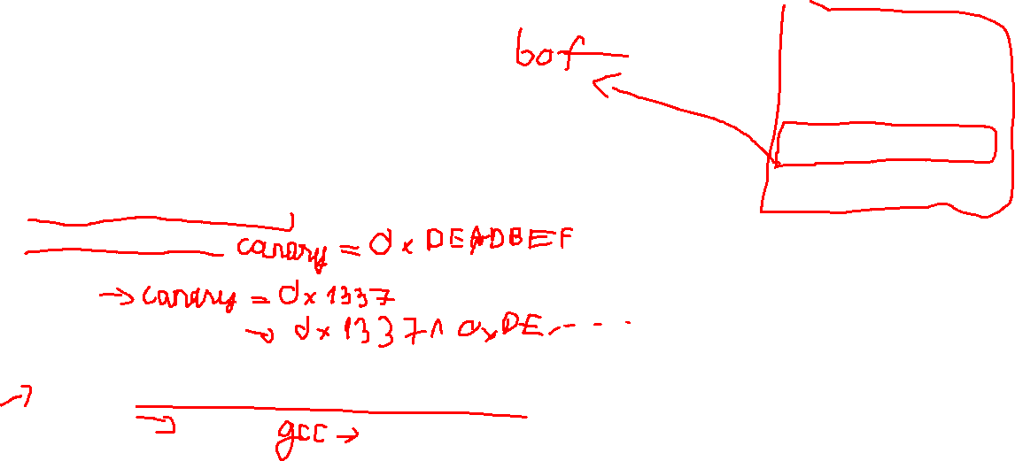
gh0st@wickedCrown:~/Pwn_0x4$ cd canary
// Hàm mã hóa và giải mã Canary
void encode_canary(unsigned long long *canary) {
*canary = (*canary) ^ 0xDEADBEEF; // Ví dụ mã hóa
}
void decode_canary(unsigned long long *canary) {
*canary = (*canary) ^ 0xDEADBEEF; // Ví dụ giải mã
}
void vuln(char *s)
{
gets(s);
}
int main()
{
unsigned long long canary = 0; // Khởi tạo giá trị Canary
// Mã hóa giá trị Canary trước khi sử dụng
encode_canary(&canary);
char a[10];
// Truyền giá trị Canary đã mã hóa vào hàm vuln
vuln(a);
// Giải mã giá trị Canary trước khi so sánh
decode_canary(&canary);
// Kiểm tra giá trị Canary sau khi hàm vuln đã thực thi
if (canary != 0) {
printf("Canary value changed! Possible buffer overflow detected.\n");
exit(1);
}
printf("output: %s", a);
return 0;
}

Slide 10
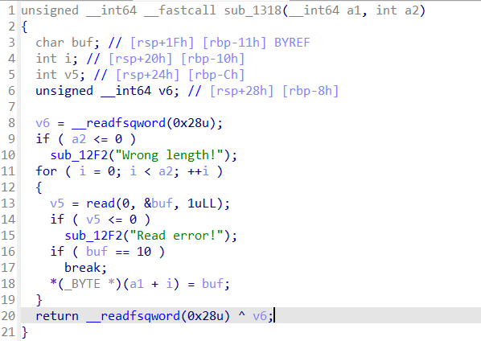
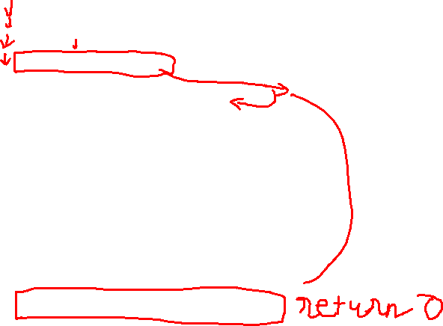
gh0st@wickedCrown:~/Pwn_0x4$ cd canary

Slide 11




How to bypass canary?
There are two ways to bypass canary
Leaking canary
Bruteforce canary

Slide 12















Leaking the canary
#include <stdio.h>
#include <stdlib.h>
int vuln() {
char buffer[64];
puts("Leak me");
read(0, buffer, 0x200);
printf("%s \n",buffer);
return 0;
}
int main() {
vuln();
return 0;
}
void win() {
puts("You won!");
}

Slide 13











gh0st@wickedCrown:~/Pwn_0x4$ cd mitigation
#include <stdio.h>
#include <stdlib.h>
int vuln() {
char buffer[64];
puts("Leak me");
read(0, buffer, 0x200);
printf("%s \n",buffer);
return 0;
}
int main() {
vuln();
return 0;
}
void win() {
puts("You won!");
}

Slide 14














gh0st@wickedCrown:~/Pwn_0x4$ cd exercise

