Slide 1
TITLE HERE (ALL CAPS)
NAME OF MEMBERS

Slide 2
Revision and Minutes

Slide 3
Encode your finding here. Based on the minutes

Slide 4




The Team (-ZPPSU)
MONKEY D. LUFFY
MONKEY D. ENEFTY
MONKEY D. ASTRON
MONKEY D. YOUNG
System Analyst
UI/UX Designer
Lead Technical
Documenter

Slide 5
Chapter 1

Slide 6
Introduction
Summarize
Inputs by bullets

Slide 7
Purpose and Description
Summarize
Inputs by bullets

Slide 8
Objectives and Specific Objectives
Summarize
Inputs by bullets

Slide 9
Methodology

Slide 10
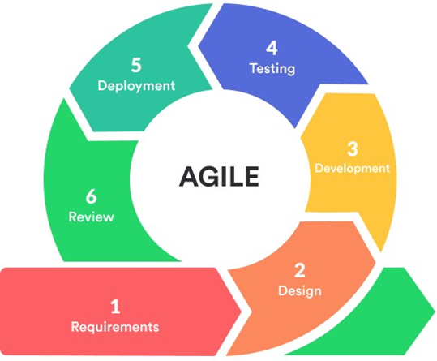
Six (6) Phases of AGILE Methodology
Phase 1: Requirements
The first step is to gather the requirements from the stakeholders. This includes understanding the needs of employers, job seekers, and other stakeholders.
Phase 2: Design
Develop a design and prototype of the system. This includes determining the features, user interface, and other elements of the system.
Phase 3: Development
Develop the job portal system according to the design and prototype.
Phase 4: Testing
Test the system for any bugs and deploy it for use.
Phase 5: Deployment
The system has been deployed by its supporters after being developed and tested successfully.
Phase 6: Review
Throughout this time, the developer keeps track of the system's performance and tests it. The system will be improved using the client's feedback. In order to make the system easily maintainable and upgradeable, the replies from this phase will be assessed and analyzed. The cycle continues until the supporters are happy with the advancement and idea.

Slide 11
Results and Discussion

Slide 12
Data Gathering
Summarize
Inputs by bullets
Show image on next slide

Slide 13
Analyze Data
Summarize
Inputs by bullets
Show image on next slide

Slide 14
System Designing and Prototype
Summarize
Inputs by bullets
Show image on next slide. Must be step by step

Slide 15
Developed a Portal/System
Summarize
Inputs by bullets
Show image on next slide. Must be step by step

Slide 16
Testing and Evaluation
Summarize
Inputs by bullets
Show image/Tables on next slide.

Slide 17
System Presentation

Slide 18
Conclusion and Recommendation

Slide 19
Conclusion
Summarize
Inputs by bullets

Slide 20
Recommendation
Summarize
Inputs by bullets

Slide 21
The Team (ZCJP-ZPPSU)
MONKEY D. LUFFY
MONKEY D. ENEFTY
MONKEY D. ASTRON
MONKEY D. YOUNG
System Analyst
UI/UX Designer
Lead Technical
Documenter

Slide 22
Thank you!

