Slide 1
NETWORK DESIGN PROPOSAL
For Zamboanga Puericulture
Center
Presented by:
ALIM, AL-KHAZRI
RAMILLANO, INCENT
PAGOTAISIDRO, MARCOJEAN

Slide 2
Introduction
Background
• Rapid ICT advancement makes networking essential for organizations
• Zamboanga Puericulture Center provides:
- Integrated health care services
- Educational programs
- Socio-economic services
Current Challenges
• Slow data transfer
• Limited communication channels
• Inefficient information management

Slide 3
Problem Statement & Objectives
Problem Statement
Existing network infrastructure limitations hinder:
• Productivity
• Service delivery quality
• Inter-department collaboration
Research Objectives
• Design scalable miniature office network
• Implement tree topology matching organizational structure
• Enhance security and data management
• Support four main departments

Slide 4
Related Literature (1/2)
Network Design Principles
• Scalability, reliability, cost-efficiency, security (Tanenbaum & Wetherall, 2011)
• Structured networks reduce communication bottlenecks (Kurose & Ross, 2017)
Health Institution Requirements
• Secure data transmission for sensitive records
• Firewalls, access control, segmentation (Smith, 2019)
• LAN benefits: document sharing, centralized storage (Bautista, 2018)

Slide 5
Related Literature (2/2)
Research Approach
1. Needs Analysis
2. Topology Selection
3. Device Planning
4. IP Addressing Scheme
5. Router Configuration
6. Switch Configuration
7. Diagram Creation

Slide 6
Methodology Overview
Research Approach
1. Needs Analysis
2. Topology Selection
3. Device Planning
4. IP Addressing Scheme
5. Router Configuration
6. Switch Configuration
7. Diagram Creation

Slide 7
Needs Analysis
Department Requirements
• School Department: Education and training
• Admin Department: General operations
• Hospital/Health: Medical services
• Human Resources: Employee records
Resource Allocation
• Dedicated switch per department
• PCs and shared printers
• Centralized management

Slide 8
Topology Selection
Why Tree Topology?
✓ Matches organizational hierarchy
✓ Supports semi-independent departments
✓ Easy expansion capabilities
✓ Centralized control through router
✓ Efficient traffic management
Network Structure
Router → 4 Department Switches → Multiple PCs

Slide 9
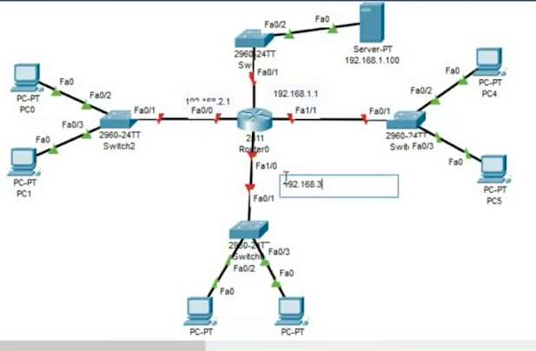
Network Design Diagram
Topology Layout:
• Central Router (Root)
• 4 Department Switches (Branches)
• Multiple PCs per department
• Cat6 Ethernet connections
• Optional patch panels

Slide 10
IP Addressing Scheme
Department Subnets
• Admin: 192.168.10.0/24
• HR: 192.168.20.0/24
• School: 192.168.30.0/24
• Hospital: 192.168.40.0/24
Benefits:
• Conflict prevention
• VLAN-like segmentation
• Organized network management

Slide 11
Device Configuration
Router Setup
• DHCP services
• Inter-department routing
• Firewall security
• NAT for internet sharing
Switch Configuration
• Department segmentation
• Port security
• MAC address filtering
• Traffic management

Slide 12
Security Implementation
Security Measures
• WPA3/WPA2 wireless protection
• Password-protected shared folders
• Router firewall activation
• Department-based access control
• Broadcast traffic reduction
Data Protection
• Sensitive health records secured
• Role-based permissions
• Network segmentation

Slide 13
Results & Implementation
Successful Implementation
✓ Stable connectivity across all departments
✓ Efficient inter-department communication
✓ Minimal latency in data transmission
✓ Reliable file sharing capabilities
✓ Internet access for all workstations
Connectivity Test Results
• All PCs successfully connected
• Stable uplinks maintained
• Department communication functional

Slide 14
Network Performance
Key Achievements
• Organized data flow
• Improved coordination
• Scalable infrastructure
• Secure data transmission
• Efficient resource sharing
Operational Benefits
• Faster information exchange
• Enhanced administrative processes
• Better collaboration
• Reliable service delivery

Slide 15
Conclusion
Research Summary
• Tree topology successfully implemented
• Department segmentation achieved
• Security requirements met
• Scalable design demonstrated
Value Proposition
• Supports organizational mission
• Enhances daily operations
• Provides foundation for future expansion
• Meets academic requirements

