Slide 1

[PROGRAM TITLE] [YEAR] · [REVIEW TYPE]
[DOMAIN]
>
Accenture Strategy & Consulting
Copyright © 2026 Accenture. All rights reserved.
Notes:
Good morning everyone. I'm Yuvraj Singh,. I'll walk you through my work across two projects covering what I built, how I worked with the team to shape it, and what's next.

Slide 2
01
About Me
Background
02
Project Overview
Client context & key workstreams
03
Key Work & Deliverables
Agenda
Core outputs and artefacts
04
Contributions Beyond Scope
New requirements and scaled delivery
05
Impact & Growth Trajectory
Journey in a nutshell
06
Learnings & Capabilities Built
Skills strengthened through delivery
>
2
Copyright © 2026 Accenture. All rights reserved.
Notes:
The flow for this presentation looks like this first I will give a brief about the project, why it matters

Slide 3

01
About Me
Background and journey leading into this internship
>
Copyright © 2026 Accenture. All rights reserved.

Slide 4
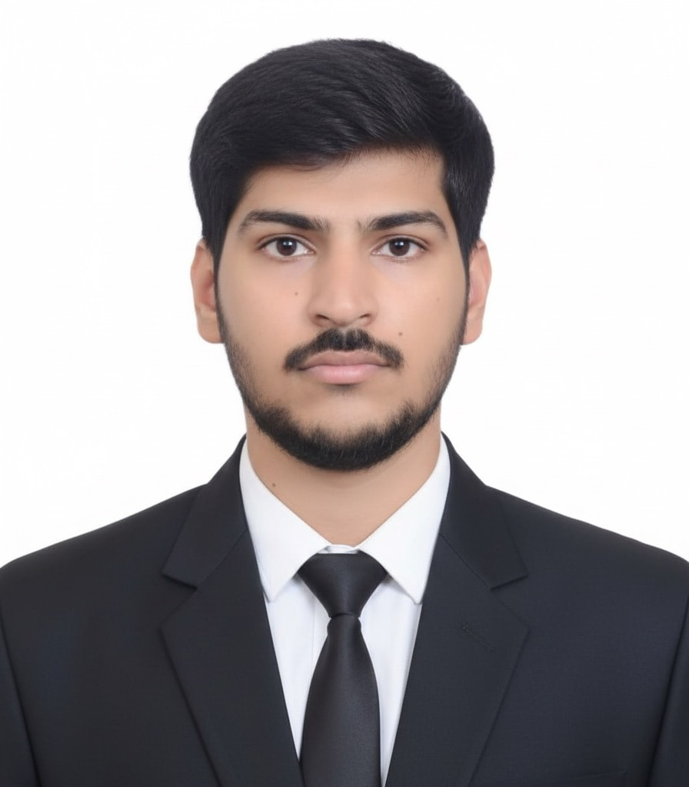
About Me
[Your Name]
[Photo]
[Institution] | [Degree, Years]
Education
[Previous Degree]
[Previous Institution, Years] | [Honours/Notes]
Work Experience
Research
[Previous Role]
[Research Title / Topic]
[Previous Company]
[Lab / Group / Advisor]
[Brief description of your previous work: scope, contributions, technical skills used, and impact created. Keep to 3-4 lines.]
[Brief description of your research: focus area, methodology, key contributions, publications, and outcomes. Keep it to 3-4 lines.]
[Capability 1] · [Capability 2] · [Capability 3] · [Capability 4] · [Capability 5] · [Capability 6]
Highlights: [Award/Recognition 1] · [Award/Recognition 2] · [Award/Recognition 3]
Domains: [Domain 1] · [Domain 2] · [Domain 3] · [Domain 4] · [Domain 5]
>
Copyright © 2026 Accenture. All rights reserved.
Notes:
A bit about me I come from an Electrical Engineering foundation and before IIM Bangalore, I spent over 2 years at Landis+Gyr as a Firmware Engineer, working on smart meter firmware firmware ensuring integration between firmaware and hardware

Slide 5
02
Project Overview
Client context and key workstreams across both engagements
>
Copyright © 2026 Accenture. All rights reserved.
Notes:
Let me now walk through the scope and technical approach.

Slide 6
Engagements at a Glance
External Project
Internal Project
⚙
[Project 1 Name]
⚡
[Project 2 Name]
[One-line description of project 1: client context, your scope, and what you contributed.]
[One-line description of project 2: client context, your scope, and what you contributed.]
KEY DELIVERABLES
KEY DELIVERABLES
⬢ [Project 1 deliverable 1 — short description of output and impact]
⬢ [Project 1 deliverable 2 — short description of output and impact]
⬢ [Project 1 deliverable 3 — short description of output and impact]
⬢ [Project 2 deliverable 1 — short description of output and impact]
⬢ [Project 2 deliverable 2 — short description of output and impact]
⬢ AI Agent for post-event DR analysis — load curves, anomaly detection & performance dashboards
👤 PM: [PM Name]
👤 MD: [MD Name]
👤 PM: [PM Name]
👤 MD: [MD Name]
>
Copyright © 2026 Accenture. All rights reserved.
Notes:
I'm working on two projects — an internal Demand Response accelerator under PM Tushar, and an external ERP Transformation engagement under Sreeneeth Sreevilasan.

Slide 7
03
Key Work & Deliverables
Core outputs and artefacts produced through delivery
>
Copyright © 2026 Accenture. All rights reserved.
Notes:
Let me now walk through the deliverables and progress to date.

Slide 8





[Key Deliverable / Workstream Title]
[One-line subtitle: what this deliverable did and its impact]
[Component 1 / Phase 1 Name]
[Component 2 / Phase 2 Name]
[Brief description of what was built / the approach taken in this component]
[Sub-point 1]
[Sub-point 2]
[Sub-point 3]
[Sub-point 4]
[Feature 1]
[Brief description of feature 1 and its value]
[Feature 2]
[Brief description of feature 2 and its value]
[Feature 3]
[Brief description of feature 3 and its value]
Evolution: [Evolution / progression statement: how the work moved from v1 to v2, what improved, and why it matters.]
>
5
Copyright © 2026 Accenture. All rights reserved.
Notes:
In context of designing tools that can help with the workflows I built two agentic tools 1st one is a Copilot Agent I designed — I configured it with CCS knowledge from the project SharePoint, enabling it to ingest JIRA requirements and generate structured test scripts in a standardized Excel format. This was shared with the team early for adoption and iterated based on feedback.
Building on that, I developed a more robust Claude-powered workflow as the second version. This tool ingests JIRA requirements, Oracle CCS user guides, and configuration workbooks, then generates test scripts directly in Excel — with full test cases, execution steps, this helps the team member to shift their effort from building these scenarios from scratch to just reviewing output and giving feedback and making it even better

Slide 9
[Key Deliverable / Workstream Title]
[One-line subtitle describing the deliverable and its impact on the client/team]
[Step 1 Name]
[Step 2 Name]
[Step 3 Name]
[Step 4 Name]
[Brief description of step 1 — what happens here]
[Brief description of step 2 — what happens here]
[Brief description of step 3 — what happens here]
[Brief description of step 4 — what happens here]
Impact
[Impact 1]
[Impact 2]
[Impact 3]
[Impact 4]
Coverage areas
[Coverage area 1]
[Coverage area 2]
[Coverage area 3]
[Coverage area 4]
◆ Shaped through collaboration with requirements, design, and review teams — improving functional discussions and reducing repeated clarification cycles
>
8
Copyright © 2026 Accenture. All rights reserved.
Notes:
Moving ahead I have started working on this Config Design Accelerator for the Collections module. This tool is designed to reduce the ambiguity, rework, and repeated clarification cycles in designing from requirements to product templates
It works in four steps. It first captures client inputs across collections, severance, and payoff workflows. It then surfaces the right Oracle CCS design questions early — reducing interpretation effort and misalignment. It converts those inputs into reusable Oracle CCS-native configuration templates or give detailed what needs to be custom built

Slide 10
Key Deliverables — Progress to Date
[Subtitle: brief description of the deliverables shown below]
WEEK 1
WEEK 2
1
2
3
4
[Deliverable 2 Title]
[Brief description of what was built and its purpose]
[Deliverable 1 Title]
[Brief description of what was built and its purpose]
[Deliverable 3 Title]
[Brief description of what was built and its purpose]
[Deliverable 4 Title]
[Brief description of what was built and its purpose]
WEEK 4
WEEK 3
8
7
5
[Deliverable 7 Title]
[Deliverable 7 description — what was built and its purpose]
[Deliverable 6 Title]
[Brief description of what was built and its purpose]
[Deliverable 5 Title]
[Brief description of what was built and its purpose]
>
6
Copyright © 2026 Accenture. All rights reserved.
Notes:
Across four weeks, I have built and structured these core deliverables for this accelerator.. Started with understanding the AMI landscape for demand response program and iteratively other outputs are built and obviously these are not built in isolation but a result of consistent connects with Project manger and implementation team

Slide 11
04
Contributions Beyond Scope
New requirements taken on and scaled delivery beyond original scope
>
Copyright © 2026 Accenture. All rights reserved.
Notes:
Starting with the project context

Slide 12

[Contribution Beyond Scope — Title]
[Subtitle: brief description of the additional work taken on and why it matters]
[Initiative / Workstream Name]
Target Outcomes
[Key capability / deliverable 1]
[Key capability / deliverable 2]
[Key capability / deliverable 3]
[Key capability / deliverable 4]
[Key capability / deliverable 5]
01 [Outcome 1]
[Outcome 1 description]
02 [Outcome 2]
[Outcome 2 description]
03 [Outcome 3]
[Outcome 3 description]
Collaboration: [Closing note: collaboration approach, team interactions, or the way this contribution was delivered.]
>
7
Copyright © 2026 Accenture. All rights reserved.
Notes:
The next phase of this project is focused the AI Agent for post-event analysis. The agent will read interval meter data from MDM to quantify actual power reductions per event, generate load curve visualizations comparing pre-event, during-event, and post-event consumption, flag anomalies in customer response patterns, and produce automated Measurement and Verification reports. Moreover I'll be supporting the implementation directly alongside the team

Slide 13
05
Impact & Growth Trajectory
Journey in a nutshell — outcomes, recognition, and progression
>
Copyright © 2026 Accenture. All rights reserved.
Notes:
Let me walk through the two main deliverables I have built.

Slide 14
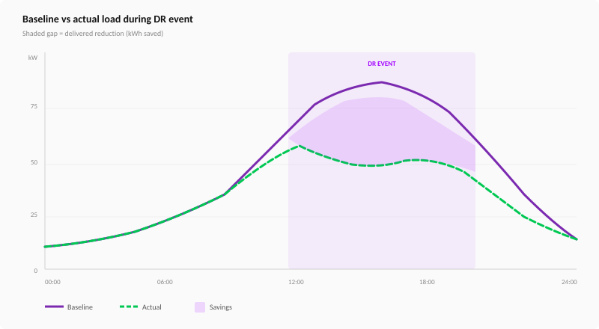
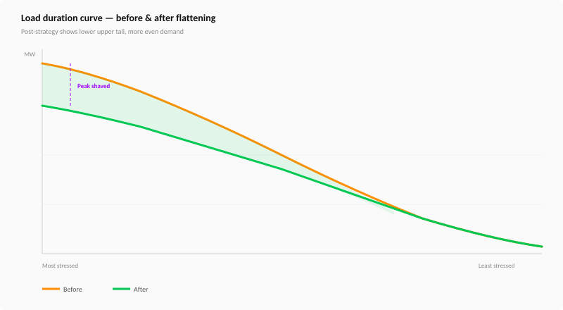
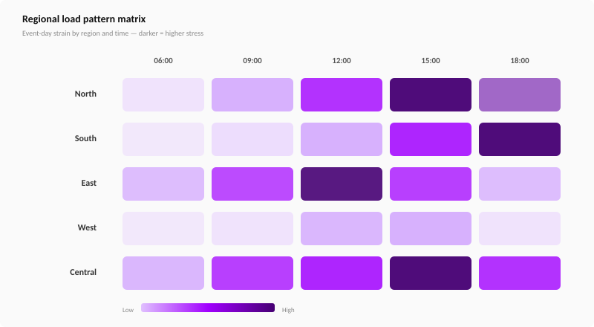
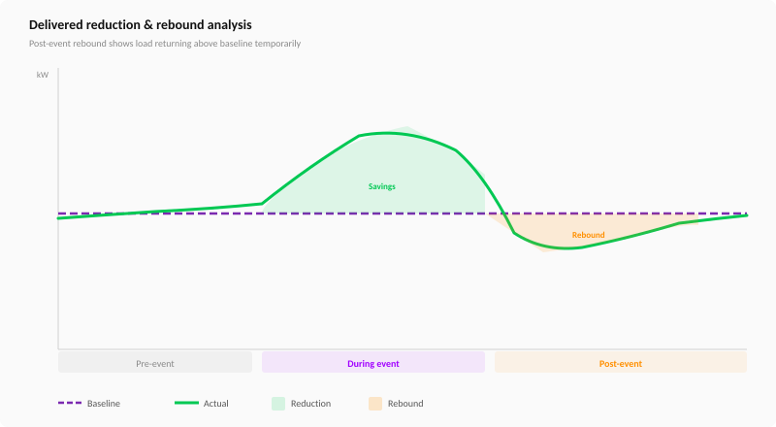
[Impact & Growth — Title]
[Subtitle: high-level framing of impact and growth over the internship]
[Impact metric / chart 1 caption]
[Impact metric / chart 2 caption]
[Impact metric / chart 3 caption]
[Impact metric / chart 4 caption]
>
8
Copyright © 2026 Accenture. All rights reserved.
Notes:
This shows the types of visual outputs the AI agent will produce. These include baseline versus actual load comparisons during DR events, load duration curves showing before and after profiles, regional load pattern matrices for geographic analysis, and rebound analysis to capture post-event consumption bounce-back.
These outputs are designed to give operations teams and program managers a clear, data-backed view of program performance both at the individual event level and across the season

Slide 15
06
Learnings & Capabilities Built
Skills strengthened through delivery and reflections from the internship
>
Copyright © 2026 Accenture. All rights reserved.
Notes:
Let me close with where things stand and what I am planning to deliver.

Slide 16



[Learnings & Capabilities — Title]
[Subtitle: how skills strengthened and what capabilities were built]
[Category 1]
[Category 2]
[Category 3]
[Category 1 Heading]
[Category 2 Heading]
[Category 3 Heading]
[Description of category 1 — the area of capability built and how]
[Description of category 2 — the area of capability built and how]
[Description of category 3 — the area of capability built and how]
[Capability 1 detail]
[Capability 2 detail]
[Capability 3 detail]
[Capability 1 detail]
[Capability 2 detail]
[Capability 1 detail]
[Capability 2 detail]
>
9
Copyright © 2026 Accenture. All rights reserved.
Notes:
To summarize progress — the domain mapping and AI tooling work is complete. I have ramped up on Oracle CCS, built both versions of the test automation tooling, and mapped the core Collections, Severance, and Payments processes end-to-end.
What is currently in progress is the template builder agent for the collections module Moving ahead the focus will be on tool adoption with dedicated demos to the team in not only using the tools but how they can build them for there custom workflows
.

Slide 17


