Slide 1
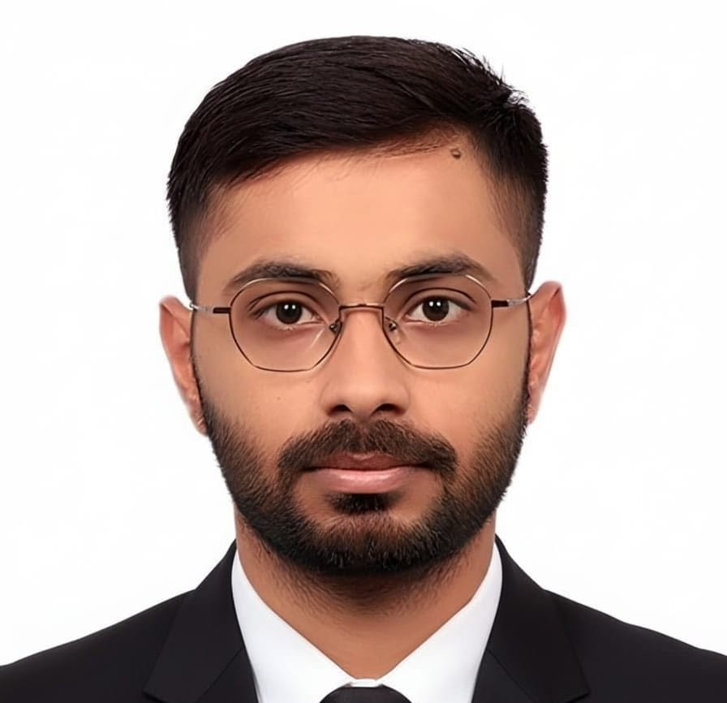
FY26 TS&T Internship - Performance Overview
[Photo]
PHOTO
Overview Summary:
Achievement:
Scope of Improvement:
Completed assigned tasks and deliverables on time with expected quality.
Learned and applied new skills, tools, or domain knowledge during the internship.
Collaborated effectively with the team and incorporated feedback into work
Build deeper technical/functional understanding to work more independently.
Improve clarity and structure in communication and status updates.
Strengthen time management and prioritization across multiple tasks.
Name: Himanshu Institute: IIM Bangalore
Worked On: Project Name: Agentic AI PDLC Transformation | Role: AI Strategy Practitioner | Manager E.ID: pulkit.j.jain
Mapped pain points across 5 archetypes & 9 lifecycle stages by attending discovery workshops, preparing questions through research & contributing to cross-archetype heatmap
Built archetype-wise process summaries with current-state assessments, alongside a differentiation matrix isolating shared vs. unique friction across tools, roles & handoffs
Identified archetype-specific AI opportunities across stages by synthesizing workshop findings, Gartner, KX client stories & defined recurring cross-archetype intervention themes
Prioritized 3 PoC candidates by value, feasibility and tooling constraints from a broader set & created the Agentic Periodic Table mapping finalized & potential AI agents across PDLC
Shaped PoC scope, positioning narratives, & solution approach for all 3 pilots, co-defined agent architectures with build paths & HITL controls in coordination with the dev team
Researched industry best practices & non-PoC AI accelerators across PDLC stages using Gartner frameworks & KX stories to inform the broader transformation strategy
Built PDLC metrics framework (40 metrics) mapped to lifecycle stages & PoCs, structured across current-state process health, PoC-impact tracking, & agentic end-state outcome layers
Designed baseline measurement protocols with computation logic & survey instruments, defined industry-standard baseline values & target-state benchmarks per metric
Contribution Agent Creation : RCA Compression Agent (Repo Link)
~85% Effort Reduction per Bug: Compresses a 30–60 min senior-engineer investigation into a 3–8 min agent run. Savings scale with adoption, per-run cost stays bounded.
5-Stage Context-Funnel Pipeline: Briefing, Investigate, Diagnose, Solve, Validate. Each agent sees only the prior stage's output, keeping reasoning focused and traceable.
Self-Verifying Fix: Applies the patch in sandbox env & runs the project's own test suite
Production-Grade Architecture: Schema-enforced agent contracts, per-agent tool limits, confidence-gated outputs, fully reproducible runs with audit logs
Skill Development:
Accenture Internal AI & Productivity Tools: Completed Agentic AI TQ, explored Copilot, Amethyst, TeSA, Case Study Navigator and QPT. Built working knowledge of Accenture's AI capabilities and internal tooling. TeSA helped navigate resources (Udacity, AI Refinery) and align with nomenclature
Anthropic Claude Courses (6 completed via Workday): Claude 101, Driving Enterprise Adoption, Agent Skills, Cowork, MCP, Subagents. Learnt Claude's entire ecosystem helping me ensure that team's PoC recommendations & Agent Architecture in PDLC track remained grounded and feasible to implement
Claude Certified Architect, Foundations (WIP): Pursuing to deepen understanding of cost-efficient agent design. Applied to scoping agent components, cost-quality tradeoffs & identifying where Agents can add value in client ecosystem
ARC/myResearch (Gartner): Extensively reviewed KX client stories on agentic AI transformation. Applied directly to PoC ideation, best AI practices, metrics definition and industry-standard benchmarking across 40 PDLC metrics
Additional Contribution Beyond Project Scope (Optional):
Document Sensitivity Classifier Agent: Designed & built an agent with permission guardrails & sharing logic that classifies documents and recommends access controls
(CGS)AI Tool Landscape: Created enterprise AI tool map for leadership evaluation
(CGS)Agentic AI PoV: Created "Why Now" narrative covering capability trajectory, governance prerequisite & investment signal on recent agentic AI developments for practitioner awareness
(CGS)Staffing Support: Vetted and collated practitioner profiles to support resource allocation

Slide 2

INTERNSHIP PROGRAM FY26 · END-REVIEW
TS&T
Accenture Strategy & Consulting
>

Slide 3

Agenda
01
About Me
02
Project Overview
Project Objective & Discovery-Led Approach
03
Work Deliverables
Key outputs from my work
04
Contributions Beyond Scope
Value delivered outside PDLC Project
>

Slide 4

01
About Me
>
4

Slide 5
About Me
Himanshu
[Photo]
IIM Bangalore | MBA(PGP), 2025-27
Education
B. Tech, Mechanical Engineering
IIT Kharagpur, 2018-22
Work Experience
Research
Sr. Data Analyst
(Published) COVID-19 Detection Using Cough Recordings
American Express [CFR(CoE) - AI Labs division]
Prof. Ram Babu Roy, IIT Kharagpur
Designed ML models and automated pipelines across 6 global markets, saving $5M+ and cutting timelines by 60%. Drove analytics for 100K+ customers, unlocking $10M+ in retention value.
Built an ML model to detect COVID-19 from cough audio, achieving 98% precision and 100% recall on asymptomatic patients. Used in few departments in AIIMS Delhi and AIIMS Bhubaneshwar.
Stakeholder Management · Data-Driven Strategy · AI/ML Solutioning · Process Optimization · Cross-functional Leadership
Highlights: Executive VP Award (AMEX '24) · Patented ML Innovation (COVID Detection) · $18M+ Value Delivered
Domains: [Domain 1] · [Domain 2] · [Domain 3] · [Domain 4] · [Domain 5]
>

Slide 6
02
Project Overview
Project Objective & Discovery-Led Approach
>
6

Slide 7

GMI PDLC Transformation | Project Scope & Approach
Project Objective
Diagnose
Map current-state PDLC across five archetypes and six lifecycle phases, surface friction through cross-archetype pattern evidence
Prioritize & Prove
Convert friction into stage-wise AI opportunities, prioritize by value and feasibility, validate through three focused PoC pilots
Measure & Scale
Define metrics framework, governance structure and phased scale-up roadmap from utility agents to orchestrated delivery
Move GMI from fragmented, tool-level AI pilots to an end-to-end AI-embedded delivery lifecycle across all five archetypes.
Unified process baseline where none existed across archetypes
AI embedded at every lifecycle stage not bolted on at one
Measurable outcomes replacing activity-based tracking
Delivery model designed for Human + Agent collaboration
Discovery Led Approach
Problem
Diagnosis
Opportunity Identification
Solution
Positioning
Measurement Design
My Key Workstreams
Map pain points across archetypes and lifecycle stages, isolate shared vs. unique friction
Define AI opportunities per archetype, build capability taxonomy, prioritize PoC candidates
Shape PoC scope and narratives, co-define architectures, package for stakeholder alignment
Build KPI framework, benchmark against industry, design baseline protocols for pilot validation

Slide 8
03
Work Deliverables
Key outputs from my work
>
8

Slide 9
Key Contributions: AI-Enabled PDLC Transformation
Contributions spanning problem framing, opportunity mapping, solution architecture & performance measurement
Problem
Diagnosis
Opportunity
Identification
Solution
Positioning
Measurement
Design
Mapped pain points across archetypes and lifecycle stages
Built archetype-wise process summaries with key takeaways
Built cross-archetype differentiation matrix to isolate unique vs. shared friction
Assessed tool landscape and adoption patterns across archetypes
Identified archetype-specific AI opportunities across lifecycle stages
Defined recurring AI opportunity themes to focus cross-archetype intervention areas
Prioritized PoC candidates based on value, feasibility & tooling constraints
Created Agentic Periodic Table spanning in-flight & future AI agents across PDLC
Shaped PoC positioning with pain points & solution approach across all PoCs
Co-defined reference architectures & HITL controls, coordinated with dev team
Defined PoC build path, agent components & expected outcomes for all PoCs
Researched non-PoC accelerators and industry best practices across PDLC
Built PDLC metrics framework mapped to lifecycle stages, PoCs & measurement types
Structured metrics across current-state, PoC-impact & agentic end-state layers
Designed baseline measurement protocols with computation logic & survey instruments
Defined industry-standard baseline values & target-state benchmarks for each metric

Slide 10

PDLC Deliverables: Week-by-Week Progress
Eight weeks of discovery, design and delivery across the GMI PDLC Transformation
1
2
3
Discovery & Scoping
PDLC landscape analysis, tool inventory, archetype identification
Workshop Analysis
Friction mapping, As-Is Pain Point extraction, archetype-based AI opportunity analysis
POC Ideation
GenAI agent prioritization, feasibility assessment
5
4
Metrics & Measurement
KPI framework, AI impact tracking, outcome mapping
Architecture & Kickoff
End-to-end POC design, dev-coordinated architecture finalization
6
7
8
Agentic Periodic Table
Agent-to-stage mapping, capability taxonomy, archetype-level recommendations
Findings & Synthesis
Cross-archetype friction patterns, archetype specific best-practice exploration
Iteration & Consolidation
Refinement based on pattern findings, deliverable wrap-up
Notes:
Across eight weeks, I built and structured these core PDLC deliverables — each week building on the last. Week 1 — Discovery: Mapped the current-state PDLC across all five archetypes and six lifecycle phases to understand where friction, duplication, and AI gaps exist. Week 2 — Workshop Analysis: Did a deep-dive into cross-archetype workshop outputs to surface handoff inefficiencies and recurring pain points across pods. Week 3 — POC Ideation: Ranked GenAI and agentic opportunities by PDLC stage, narrowing down to three high-impact PoC candidates based on feasibility and value. Week 4 — Architecture: Designed the end-to-end AI-embedded architecture spanning intake to operate, ensuring it works across all five archetypes. Week 5 — Metrics: Created a metrics framework that ties every AI investment to measurable business outcomes — not just adoption metrics but real value levers. Week 6 — Agentic Periodic Table & Recommendations: Built the agentic capability taxonomy mapping agent types to PDLC stages and delivered archetype-level recommendations for where AI fits best. Week 7 — Cross-Archetype Pattern Synthesis: Consolidated all the friction evidence and discovery insights across archetypes into a unified cross-archetype view — surfacing the recurring patterns that cut across delivery models. Week 8 — Iteration & Wrap-Up: Continued iterating on deliverables incorporating the cross-archetype findings from Week 7, refined earlier outputs, and consolidated everything. None of this was built in isolation; it was shaped through consistent connects with the PM and implementation team.

Slide 11
04
Contributions Beyond Scope
Expanding the original scope
11

Slide 12
RCA Multi-Agent System
Diagnoses bugs, proposes the fix, verifies with tests. Projected savings: ~$17K/dev projected at 500 bugs/yr
VALIDATED
Tested on complex, buggy open-source GitHub repos
OPTION 1: MANUAL
OPTION 2: VIBE CODING
OPTION 3: AGENTIC WORKFLOW
Developer alone
75 mins
Dev + Claude Code
40 mins
Purpose-built RCA multi-agent system
5 mins dev
Read bug report
5 min
Read bug report
3 min
Auto-Triggered
Engineered Context
Specialised Agents
Built-in Guardrails
Pick up the QA ticket.
Pick up the QA ticket.
Investigate codebase
Prompt & investigate
Hand bug to the agent
1 min
Hunts the cause across files.
45 min
Dev guides the AI turn by turn.
25 min
QA report dropped into the tool.
Write the fix
15 min
Agent investigates, finds root cause, fixes & tests
9 min
Makes the code change.
Write the fix
7 min
Dev refines the AI draft.
QA Bug › Investigate
Test the fix
whole repo
10 min
Diagnose
Runs tests to confirm.
Test the fix
5 min
finds root cause
Runs tests to confirm.
Finds Fix
writes code change
Verify
tests pass
Dev reviews the report
3 min
Reads findings, approves the fix.
Approve & ship
2 min
The catch: dev prompts ad-hoc, AI has no structure. On large repos it wanders and stalls.
Tests already passed in the agent run.
COST / BUG: MANUAL
COST / BUG: VIBE CODING
COST / BUG: AGENTIC
NET SAVINGS: AGENTIC
$70(IN dev)/$190(US dev)
$40(IN dev)/$105(US dev)
$7(IN dev)/$15(US dev)
$35 (IN dev)/$90(US dev)
75 mins
40 mins dev + ~$4 AI tokens
5 min dev time + ~$2 agent run
vs Vibe Coding
>
*Per-run AI costs reflect typical compute. Agent advantage compounds on large, complex codebases.

Slide 13



More Contributions & Learnings
Contributions beyond core scope spanning CGS leadership content, self-initiated AI builds & professional development
CGS Contributions
Document Sensitivity Classifier Agent
Learning and Professional Development
Reads + scans document
PII · financials · client data · audience
Claude Certified Architect, Foundations (Anthropic – waiting on results)
Reinvention with Agentic AI program (Stanford HAI self-study + hands-on workshop)
7 Anthropic courses (including Claude 101 and advanced modules)
Hands-on agent development in multiple environments (RCA system + sensitivity classifier)
AI PoV Deck: Developed a PoV on the shift from decision support to autonomous execution
Tool Landscape: Built AI Tool Landscape 1-pager for enterprise AI tools
Profile Collation: Vetted resource availability, maintained updated shortlist for leadership evaluation
Summary + clarification Qs
2-4 targeted questions to get more context
User answers
Classification Scheme
17 sensitivity sub-labels
5 Question decision tree
Permissions guide
Access control rules
External sharing logic
Guardrails
Assessment + recommendation
Option A (best fit) · Option B (alt)

Slide 14


