Slide 1
Introduction to Objects and Classes

Slide 2
Learning Outcomes
By then end of this lecture, a student will be able to:
Understand the differences between objects and classes
Create objects from classes and Interact with objects using the public methods in BlueJ.
Use parameters to pass information to methods.
Set the state of an object.

Slide 3
BlueJ Introduction
BlueJ is an Integrated development environment (IDE), which provide us many tools through one common interface:
Editor which helps by coloring reserved word, by showing matching braces and parentheses, and by indenting statement .
A simple UML(Universal Modeling Language) diagramming tool for the Visualization of class structure.
A tool for creating and testing classes.
A link to a compiler.
A debugger.

Slide 4
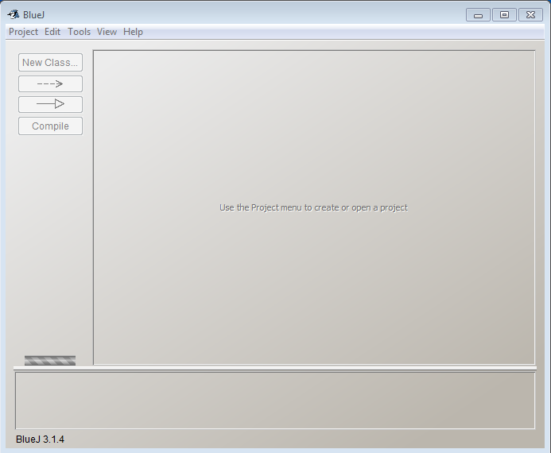

BlueJ Getting started
Start BlueJ:
Double click on the icon either from desktop or from the start menu.

Slide 5
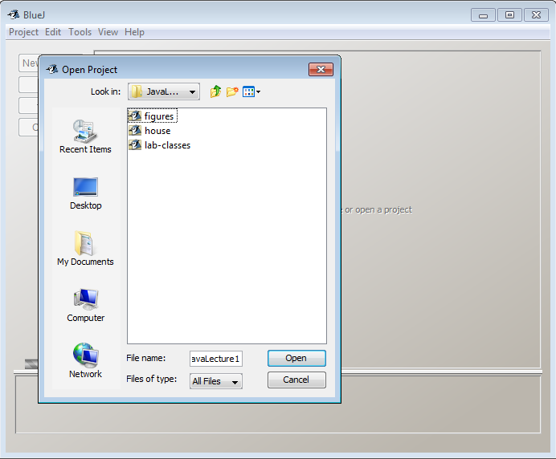
BlueJ Getting Started, Cont.
Open a project:
Select Open Project from the Project menu
In the pop-up dialog box, navigate to the folder that contains the BlueJ project you downloaded from Blackboard.

Slide 6
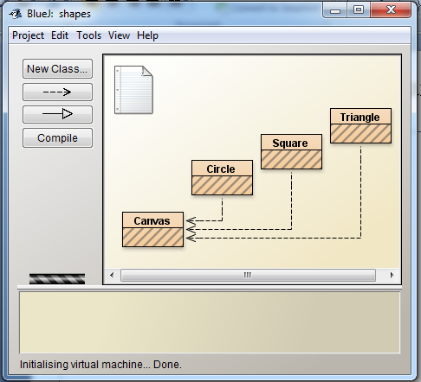
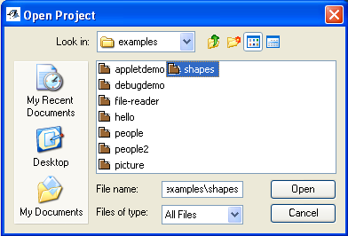
BlueJ Getting started, Cont.
Open the figures project.
Canvas, Circle, Square and Triangle are the classes in the figures project.

Slide 7
Objects and Classes, Cont.
Objects
Represent ‘thing’ from the real world
Like noun in English
automobile1, student1, shapes, etc.
Class:
Represent all objects of a kind
Template(blueprint) for creating objects
Automobile, Students, Shape, etc

Slide 8
Objects and Classes, Cont.
Objects are created from the classes.
Object is an instance of the class.
“My red car parked in my garage”
The Class describes the kind of object.
Whenever you find things having common features, you create a blue print for creating objects.
Object has an attribute (e.g. its name), it has state (the values which it knows), and behaviors (the things it can do)

Slide 9
Question 1
Which of the following are objects?
Twin-engine planes
My twin-engine plane
That twin-engine plane over there
A and B only
B and C only

Slide 10
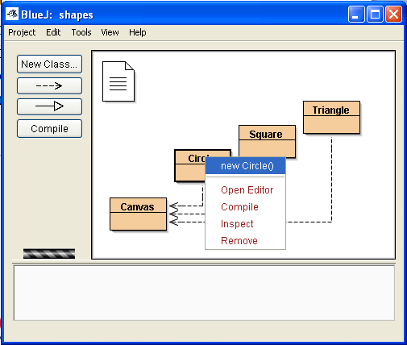
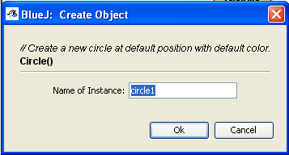
Creating Objects
Create an Object.
Right click on the Circle class and from the popup menu choose
new Circle()
You can leave the default name of the instance or give it a name.
Click “Ok”

Slide 11
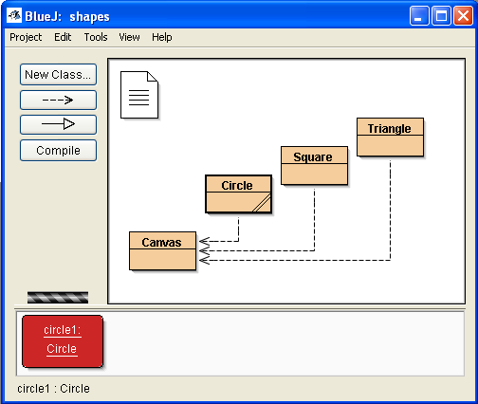
Creating Object, Cont.
Naming Convention.
Name of classes starts with capital letters(Circle)
Name of objects starts with the lower case (circle1).

Slide 12
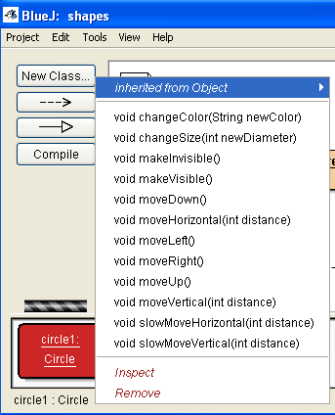
Calling Methods
Calling methods.
Right-click on circle object(not the class), circle1.
You can see the list of methods.
We can communicate with objects by invoking or calling methods.
Methods performs an action

Slide 13
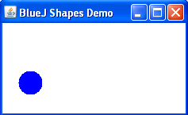
Calling Methods, Cont.
From the popup menu , choose makeVisible() this will draw a circle in a separate window .
Invoke moveLeft() couple of times.
Invoke moveUp() couple of times.

Slide 14
Question 2
slowMoveHorizontal is a,
Method
Object
Behavior
A and B
A and C

Slide 15
Question 3
Which of the following are behaviors of a twin-engine plane?
Land
Turn
Fly
All of the above
None of the above

Slide 16
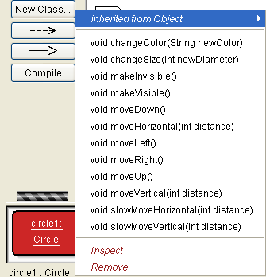
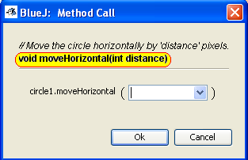
Parameters
Invoke MoveHorizontal method .
Methods require more information to execute.
The additional value(s) that some methods require are called parameter(s).
Methods can have any number of parameters.
The header of a method is called its signature.
Signature

Slide 17
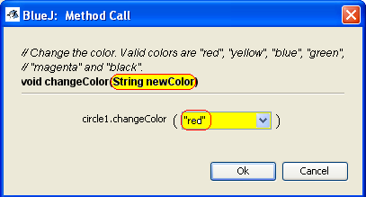
Data Types
Parameters have types.
Type defines what kinds of values a parameter can take.
The type int signifies whole(integer) numbers.
The changeColor method has a parameter of type String.
Strings are always enclosed within double quotes.
Comments are included to provide information to the reader.

Slide 18
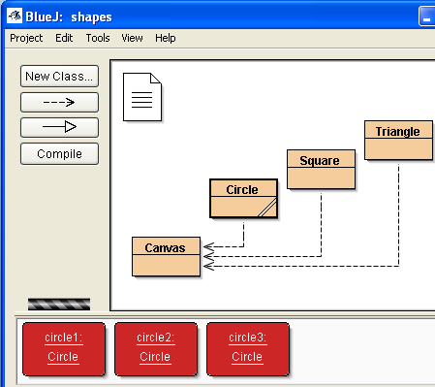
Multiple Instances
Once you have a class, You can create as many objects (instances) of that class as you like .
Each object has its own position, color, and size.
You can change an attribute of an object by calling appropriate method on that object. This will only affect the particular object.

Slide 19
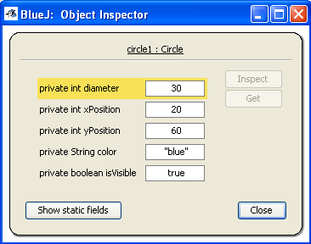
State
Attributes(fields) of the Circle class are diameter, xPosition, yPosition, color, isVisible.
Object’s state is the set of values of all attributes defining an object.
State of an object can be inspected by selecting the Inspect function from the object’s popup menu.

Slide 20
Objects
Different objects of the same class have the same:
Number of fields;
Types of fields;
Names of fields;
They all initially have the same default values.
Methods are defined in the class of the object.
So, all objects have the same set of methods.
However, methods are invoked on objects and affect only the object they are invoked on.

Slide 21
Question 4
Instances of a class share the same,
State
Attributes
Behaviors
A and B
B and C

Slide 22
In Class Exercise
Create the following image.
The circle should have diameter of 100 and remain in its default position.
The triangle has a height and width of 100.
The image should be created using a minimum number of method calls.

Slide 23
Learning Outcomes
In this lecture, you learned to:
The differences between objects and classes.
Create objects from classes.
Interact with objects using their public methods.
Use parameters to pass information to methods.
How to set the state of an object.
Declare, define, and manipulate variables of different types in Java.
Construct expressions to evaluate mathematical formulas.

