Slide 1
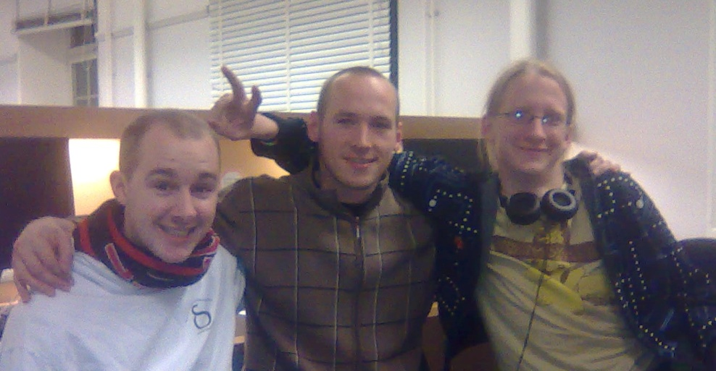
Sokoban Solver
A Push in the Right Direction

Slide 2
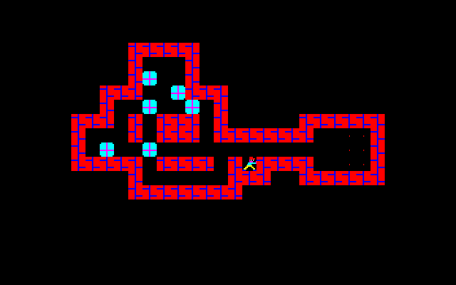
Sokoban Solver
About Sokoban
Problem
Method
Optmizations
  Repeated states
  Prioritizing states
  Assign State Cost
  Deadlocks
  Converting immovable boxes into walls
  Partial bipartite matching
  Compiler optimizations
  Tunnel warping
Result and conclusions

Slide 3
About Sokoban
By Hiroyuki Imabayashi in 1981.

Slide 4
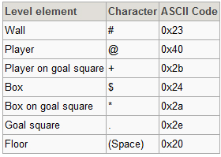

Problem

Slide 5
Method
Fetch board from server and create the level.
Create the first board state.
Create new states from the best state.
Repeat until we find a solution.
Backtrack a solution string.
Send the solution string to the server.

Slide 6
Optimizations
  Repeated states
  Prioritizing states
  Assign State Cost
  Deadlocks
  Converting boxes into walls
  Partial bipartite matching
  Compiler optimizations
  Tunnel warping

Slide 7
Repeated states
Lookups and insertions in hash set is fast.
Hash key from a set of box-positions.
Sort boxes before hashing.
(Permutations are equal.)
Player position does not effect hash-value. (Intentionally)
Finally, states are equal when boxes are equally placed and the player from one state can reach the player position in the other state.

Slide 8

Repeated states
Two different states with the same hash-value.

Slide 9
Assigning state costs
Number of pushes from a goal.
100 plus for every box not on a goal.
Backward breadth-first search.(Pull boxes)

Slide 10
Assigning state costs
##########
#-210123-#
##########
The 0 is a goal and 1,2,3 are the distance to the goal. The dashes are dead positions which cause deadlocks if any box is moved here.

Slide 11
Deadlocks
$$ ## # $$
$ $ $ # $$ $$
$$ $# #
# #########
$$ $# # $ # # .** $
## ###### #########
Examples of deadlocks. States from which no solution can be found.

Slide 12
Future Deadlock Work
Corral deadlocks.
##########
#. @ $ #
#. $ #
##########
A corral deadlock; the player cannot reach the area to the right without causing a deadlock. The boxes are dead, and the state is therefore also dead.

Slide 13
Tunnel warping
Only one box in a tunnel at most.
Implemented by discarding partial pushes in tunnels.
When a box enters a tunnel, it's pushed, either to a goal or to the end of the tunnel.

Slide 14
Converting Boxes into Walls
Converting immovable boxes on goals into walls.
Finds deadlocks where other boxes cannot find any goal anymore.
Board #35 went from hundred thousand expands into less than 100.
###### ######
.*$ #.** $
#.** $
##

Slide 15
Partial bipartite matching
Finds deadlocks where a goal can not be reached by any box.
##########
# . $ $ #
# . @ #
# #
########## “Oops!”

Slide 16
Compiler Optimizations
”-O3” flag in g++
More than twice the time to search.
Lets us pass the boards in the set which our solver finds the hardest

Slide 17
Result and Conclusions
136 test boards in 4 minute and 21 seconds.
Compiler optimizations: 19 minutes to 7 minutes.
Immovable boxes to walls: 100 000 expands to less than 100 on map 35.
Different maps have different deadlocks.
The hash set is important for avoiding loops.
The priority-queue is fundamental for the whole program.

