Slide 1


Using Python to build clean energy future
Python Workshop Meeting
Juhani Rantaniemi / 13.9.2017
Fortum solar power plant, India

Slide 2
Welcome
https://github.com/HkiPythonWorkshops/Workshops
Python Workshop Meeting
Using Python to build clean energy future – 13.9.2017:
18:00 Welcome to the Meetup / Introductions
18:10 Spring by Fortum
18:20 Code is the new fuel
18:30 Workshop 1: Data-analytics with Numpy & Pandas
19:00 Workshop 2: Solving optimization cases with PuLp
19:30 Workshop 3: Solving concurrency with Python standard libraries
20:00 Chatting & End of the event

Slide 3

GitHub: https://github.com/HkiPythonWorkshops/Workshops
Python Workshop Meeting

Slide 4





Code is the new fuel
Traditional centralized Energy Utility operations:
Investment planning Investment Operation Markets

Slide 5




Code is the new fuel
Modern distributed Energy Utility operations rely on software:
aurinkolaskuri.fortum.fi
Investment planning Investment Operation Markets

Slide 6
Workshops
Have the right libraries installed: for example pip3 install pandas / sudo pip install pandas
18:30 Workshop 1: Data-analytics with Numpy & Pandas
19:00 Workshop 2: Solving optimization cases with PuLp
19:30 Workshop 3: Solving concurrency with Python standard libraries

Slide 7
Installing PuLP
In windows
pip install pulp
(pip install xlrd)
In Linux
sudo pip install pulp
sudo pulptest
Installing instructions in detail
- https://pythonhosted.org/PuLP/main/installing_pulp_at_home.html

Slide 8
Optimization exercise
Your electricity costs have been a bit too high recently, so you want to schedule the usage of your devices according to hourly SPOT prices. Assume you have three devices: Electric vehicle battery (EV), Water heater (WH) and Electric radiator (ER) and for each device and each hour t=0,…,23 you can choose whether to charge/use it or not (1=ON,0=OFF). The devices have powers 4kW, 3kW and 2kW, respectively. Your task is to minimize SPOT costs subject to the following constraints:
The hourly total power consumption cannot exceed 8kW (or 8kWh)
EV has to be fully charged (capacity 16kWh) at 08:00 and you cannot charge it after 08:00
WH must get at least 15 kWh/day energy in total so that you can get warm water
ER can be switched OFF only 3h/day, otherwise it should be always ON

Slide 9
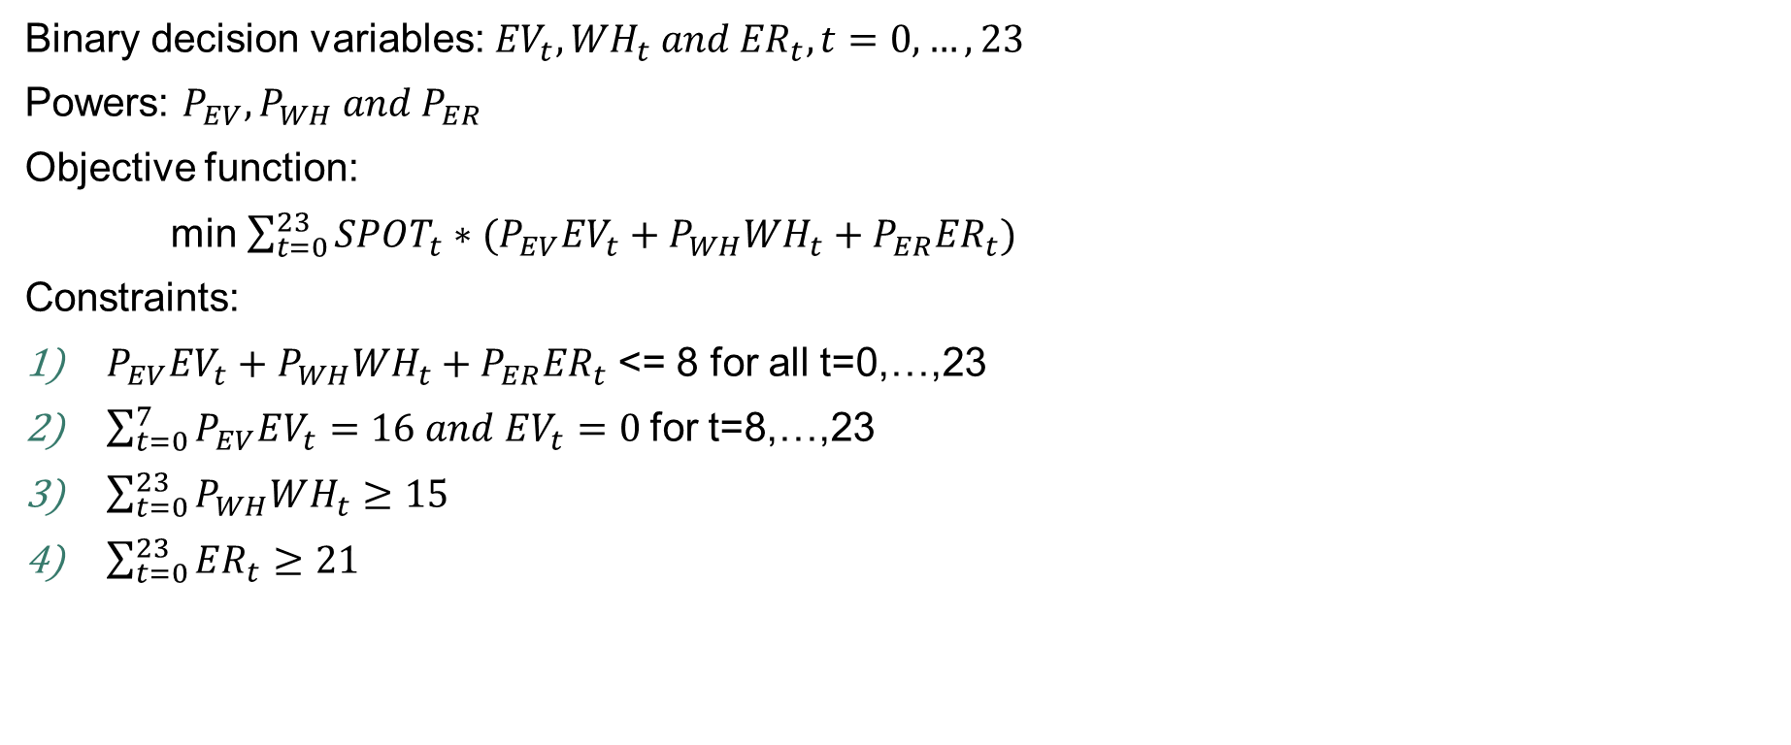
Problem Formulation
Binary decision variables: ${EV}_{t},{WH}_{t} and {ER}_{t}, t=0,…,23$
Powers: $P_{EV}, P_{WH} and P_{ER}$
Objective function:
min $\sum_{t=0}^{23}{SPOT_{t}∗(P_{EV}{EV}_{t}+P_{WH}{WH}_{t}+P_{ER}{ER}_{t})}$
Constraints:
$P_{EV}{EV}_{t}+P_{WH}{WH}_{t}+P_{ER}{ER}_{t}$ <= 8 for all t=0,…,23
$\sum_{t=0}^{7}{P_{EV}EV_{t}=16 and EV_{t}=0 }$for t=8,…,23
$\sum_{t=0}^{23}{P_{WH}WH_{t}≥15}$
$\sum_{t=0}^{23}{ER_{t}≥21}$

