Slide 1
HVCS
HomeCare Verification and Compliance System
A Django web application for managing home care visits, GPS check-in verification and regulatory compliance.
Django
PostgreSQL
GitHub
Render
11-Slide Project Presentation
1

Slide 2
Problem & Solution
❌ The Problem
✅ The Solution
▸
Paper-based visit records
▸
Digital visit records in one place
▸
No proof caregivers attended
▸
GPS-verified caregiver check-in
→
▸
Missing documentation unnoticed
▸
Automatic compliance alerts
▸
No central compliance view
▸
Real-time manager dashboard
▸
Audit reports done manually
▸
One-click audit report export
HVCS — HomeCare Verification and Compliance System
2

Slide 3
Project Overview
What HVCS does and who uses it
🔐 Admin
🩺 Caregiver
📊 Manager
▸
Manage clients
▸
View daily visits
▸
Compliance scores
▸
Manage caregivers
▸
GPS check-in
▸
View alerts
▸
Schedule visits
▸
Submit visit notes
▸
Generate reports
▸
View dashboard
▸
View care plans
▸
Export to CSV
HVCS — HomeCare Verification and Compliance System
3

Slide 4
User Stories
What each role needs — written from the user's perspective
🔐 Admin
🩺 Caregiver
📊 Manager
As an Admin I want to add and manage client records so that caregivers know who they are visiting.
As a Caregiver I want to see my visits for the day so that I know where to go and when.
As a Manager I want to see compliance scores per caregiver so that I can identify who needs support.
As an Admin I want to schedule visits and assign caregivers so that all clients receive care on time.
As a Caregiver I want to GPS check in at a client's home so that my attendance is verified.
As a Manager I want alerts for missing documentation so that nothing falls through the cracks.
As an Admin I want to see today's visits on a dashboard so that I can monitor progress at a glance.
As a Caregiver I want to submit visit notes after each visit so that care records are kept up to date.
As a Manager I want to export an audit report so that I can submit evidence to regulators.
HVCS — HomeCare Verification and Compliance System
4

Slide 5
Features — Must, Should, Could, Won't (MoSCoW)
Must Have
Should Have
Could Have
Won't Have
• User login & roles
• GPS check-in
• CSV export
• Mobile app
• Client CRUD
• Compliance dashboard
• Search & filter
• Email alerts
• Caregiver CRUD
• Auto alerts
• Visit history
• 2FA login
• Visit scheduling
• Admin overview
• Compliance scores
• Training module
• Visit notes
Sprint 1–2
Sprint 3
Sprint 4
Future
HVCS — HomeCare Verification and Compliance System
5

Slide 6
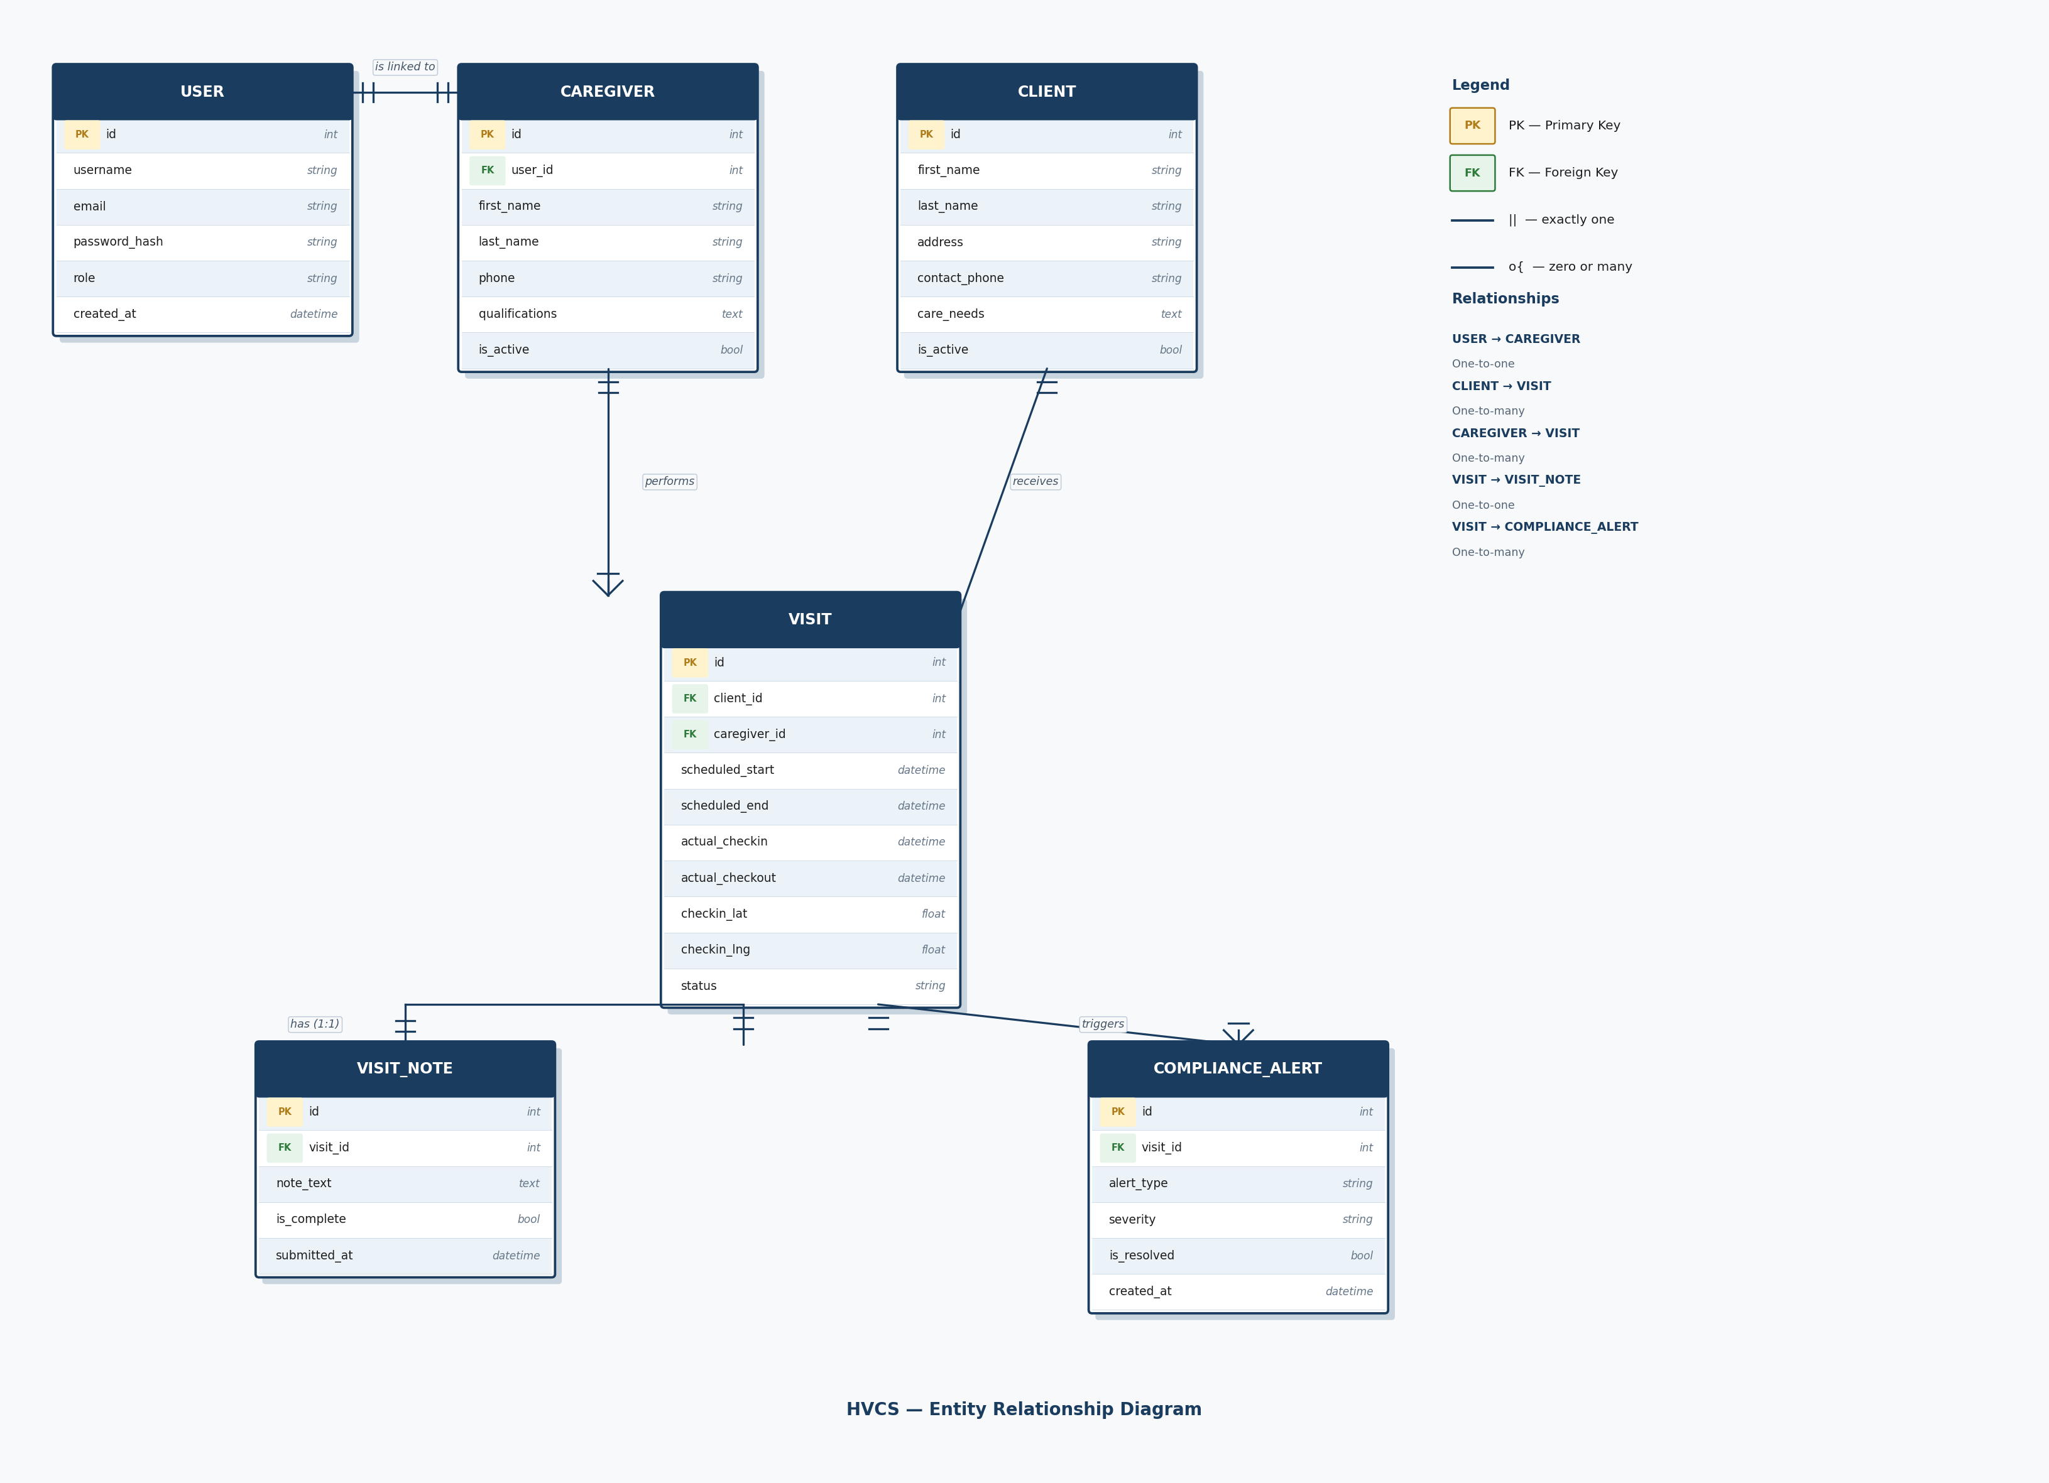
Entity Relationship Diagram (ERD)
Six database tables and how they connect
Key relationships
USER → CAREGIVER
1-to-1
CLIENT → VISIT
1-to-many
CAREGIVER → VISIT
1-to-many
VISIT → VISIT_NOTE
1-to-1
VISIT → ALERT
1-to-many
HVCS — HomeCare Verification and Compliance System
6

Slide 7
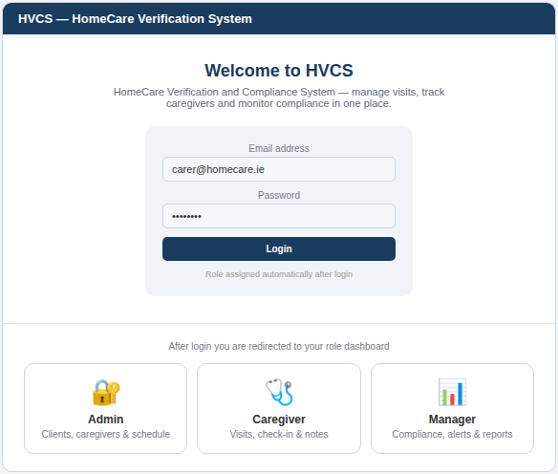
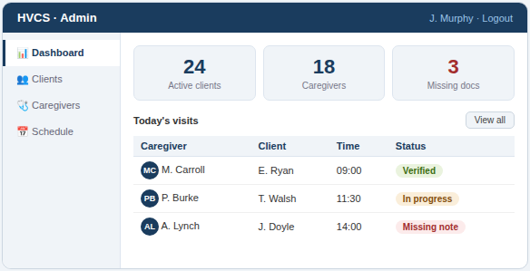
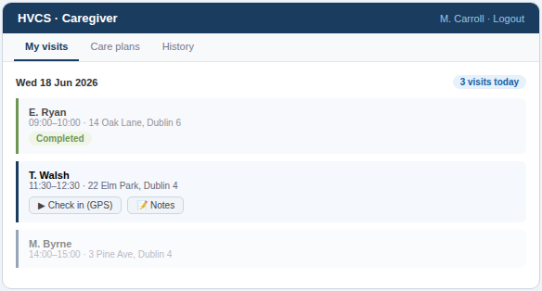
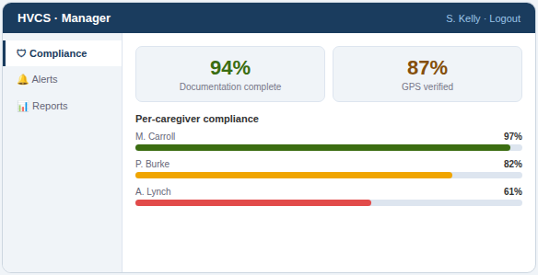
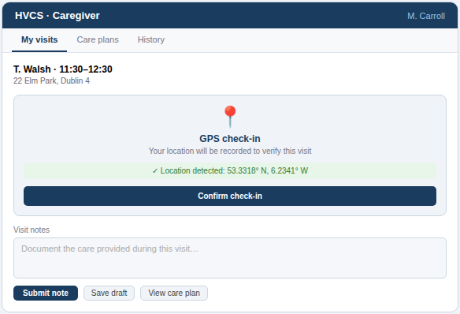
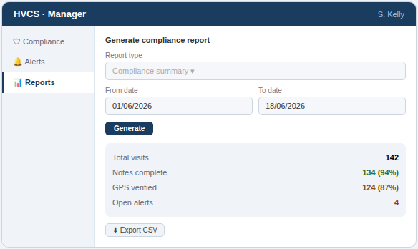
Wireframes — Key Screens
Landing / login
Admin dashboard
Caregiver visits
Compliance dashboard
GPS check-in
Manager reports
HVCS — HomeCare Verification and Compliance System
7

Slide 8
Technology Stack
🐍 Django
🐘 PostgreSQL
🎨 HTML / CSS
Python web framework — handles routing, models, views and templates
Production database hosted on Render — replaces SQLite for deployment
Django templates for all screens — responsive layout, no extra framework
🐙 GitHub
☁️ Render
Version control with feature branching — main → develop → feature/*
Cloud hosting for the web app and the PostgreSQL database
HVCS — HomeCare Verification and Compliance System
8

Slide 9
Sprint Plan — Agile Development
Sprint 1
Sprint 2
Sprint 3
Review
Foundation
Visit Flow
Compliance
Testing
▸
GitHub repo & Django setup
▸
Visit scheduling
▸
Compliance dashboard
▸
End-to-end testing
▸
Authentication & user roles
▸
GPS check-in & notes
▸
Auto alerts
▸
Bug fixes
▸
Client & caregiver CRUD
▸
Admin dashboard
▸
CSV report export
▸
Final Render deploy ✓
▸
Deploy to Render ✓
▸
Deploy to Render ✓
▸
Deploy to Render ✓
▸
Project submission
HVCS — HomeCare Verification and Compliance System
9

Slide 10
Version Control & Deployment
GitHub branching strategy and Render database
🐙 GitHub
☁️ Render — Auto Deploy
main ← production only
Continuous Deployment (CD)
develop ← tested features
1. Code on laptop
feature/authentication
2. git push → feature branch
feature/client-management
3. Pull Request → merge to main
feature/gps
4. Render detects main changed
feature/compliance
5. Auto-deploys instantly ✓
✓ No manual deployment needed — ever
HVCS — HomeCare Verification and Compliance System
10

Slide 11
Project Summary
HVCS — HomeCare Verification and Compliance System
3
15
6
User roles
Features planned
Database tables
13
4
12
App screens
Sprints
Weeks to build
Built with Django · PostgreSQL · GitHub · Render
11

