Slide 1
CSIS 402
Computer Organization and System Programming
Winter 2026
Tutorial #7
Intel 80x86 microprocessor
Assembly Instructions

Slide 2
Intel 8086 Assembly Directives
Directives are words that give directions/instructions to the assembler about how it should translate the assembly language instructions into machine code.
Segment definition
.data
Marks the beginning of the data segment
It written in the code before declaring any data
.code
Marks the beginning of the code segment
It written in the code before writing any instructions
.stack
Marks the beginning of the stack segment

Slide 3
Intel 8086 Assembly Directives
Directives are words that give directions/instructions to the assembler about how it should translate the assembly language instructions into machine code.
Org 100H:
ORG means origin. It is an assembler directive that tells the assembler what offset to assume for the code or data that follows.

Slide 4
Intel 8086 Assembly Directives
Data directives
DB → defines byte
EX: label_name DB 12H
DW → defines word
EX: label_name DW 1122H
DD → defines double word
EX: label_name DD 11223344H
DB | DW | DD | DQ | DT
1 Byte | 2 Bytes | 4 Bytes | 8 Bytes | 10 Bytes

Slide 5
Intel 8086 Assembly Directives
Data directives
DQ → defines quadword
EX: label_name DQ 1122334455667788H
DT → defines ten bytes
EX: label_name DT 112233445566778899AAH
DB | DW | DD | DQ | DT
1 Byte | 2 Bytes | 4 Bytes | 8 Bytes | 10 Bytes

Slide 6
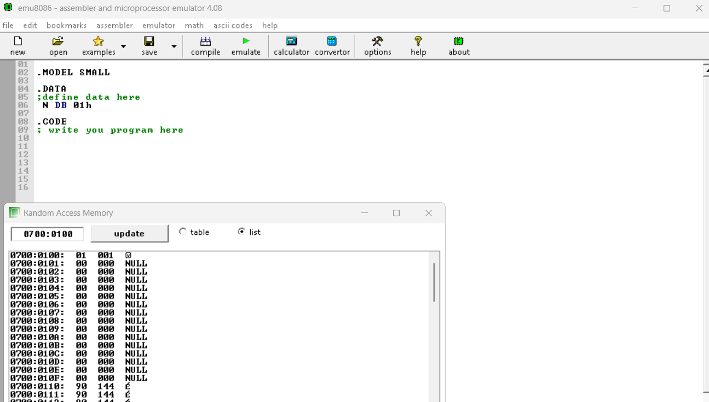
Example
Data directives
DB | DW | DD | DQ | DT
1 Byte | 2 Bytes | 4 Bytes | 8 Bytes | 10 Bytes

Slide 7
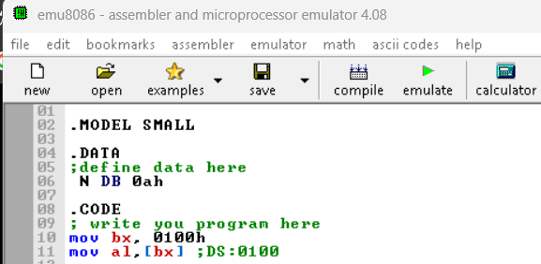
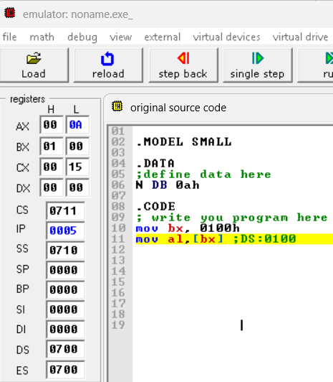
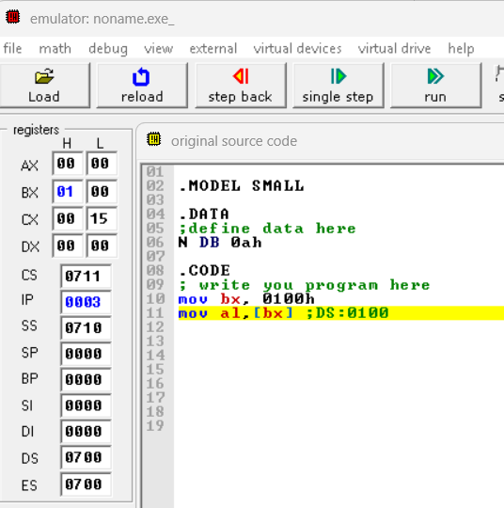
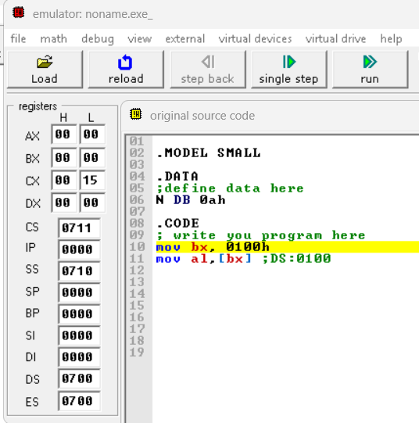
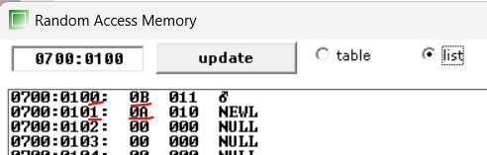
Example
Data directives
DB | DW | DD | DQ | DT
1 Byte | 2 Bytes | 4 Bytes | 8 Bytes | 10 Bytes

Slide 8
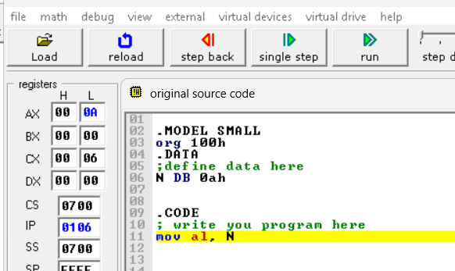
Example
Data directives
DB | DW | DD | DQ | DT
1 Byte | 2 Bytes | 4 Bytes | 8 Bytes | 10 Bytes

Slide 9
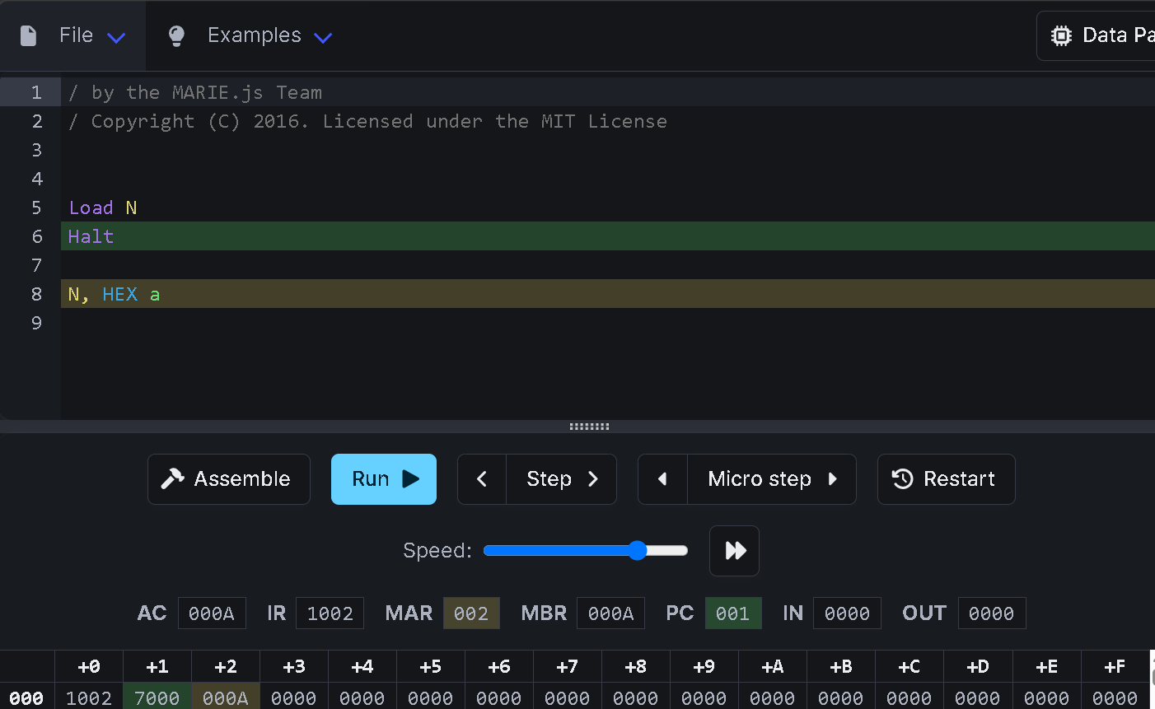
Example
Data directives

Slide 10
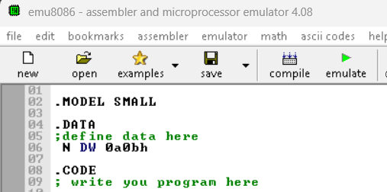
Example
Data directives
DB | DW | DD | DQ | DT
1 Byte | 2 Bytes | 4 Bytes | 8 Bytes | 10 Bytes
Little Endian

Slide 11
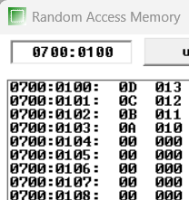
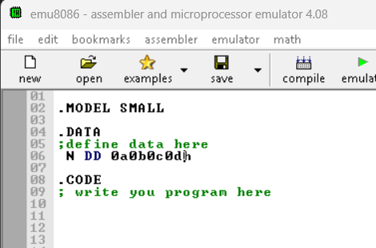
Example
Data directives
DB | DW | DD | DQ | DT
1 Byte | 2 Bytes | 4 Bytes | 8 Bytes | 10 Bytes
Little Endian

Slide 12
Remember….MOV Instruction
It copies the contents of the source into the destination
Format : MOV BX,AX

Slide 13
A Simple Program
.data
DATA1 DB 25H
DATA2 DB 32H
.code
MOV AL,DATA1
MOV AH,DATA2
ret
AH
AL
32
25

Slide 14
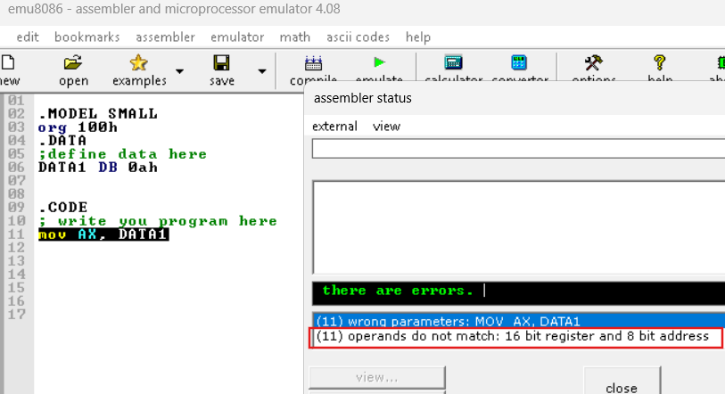
A Simple Program
.data
DATA1 DB 25H
DATA2 DB 32H
.code
MOV AX, DATA1
ret

Slide 15
ADD Instruction
ADD instruction add the source and destination operands and put the result in the destination.
Format: ADD destination, Source
Addition can be 8- and 16- Bits.
Addition can be performed as follows
Destination = Destination + Source
Add a register content to a register
Add immediate(number) to a register
MOV AL,25H
MOV BL,34H
ADD AL,BL
MOV DH,25H
ADD DH,34H
AL = AL + BL
DH = 25H + 34H

Slide 16
ADD Instruction
ADD instruction add the source and destination operands and put the result in the destination.
Format: ADD destination, Source
Addition can be 8- and 16- Bits.
Addition can be performed as follows
Destination = Destination + Source
Add a memory content to a register
Add a memory content (direct memory access) to a register
MOV AL,25H
MOV BX,100H ;address
ADD AL,[BX]
MOV DH,25H
ADD DH,[100H]
AL = AL + MEM[BX]
DH = 25H + MEM[100H]

Slide 17
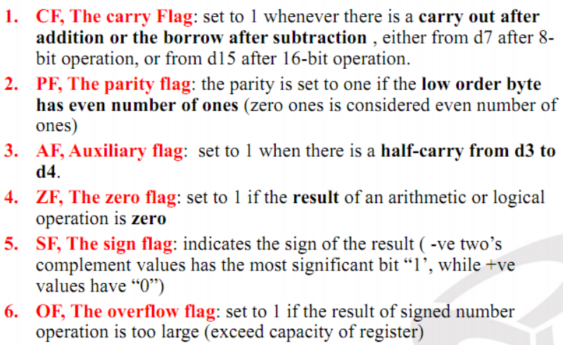
8086 Assembly instructions
ADD destination, source
The status of CF, ZF, SF, AF, OF,
and PF are affected.
Example_1
MOV BH,45H \\BH=45H
ADD BH,4FH \\ BH=94H (45H+4FH = 94H)
0
1
(69)45H → 0100 0101
+
(79)4FH→ 0100 1111
(-108)94H → 1001 0100
( 148)
CF = 0
AF = 1
SF = 1
PF = 0
ZF = 0
OF = 1

Slide 18
8086 Assembly instructions
ADD destination, source
The status of CF, ZF, SF, AF, OF,
and PF are affected.
Example_2
MOV DX,126FH \\DX=126FH
ADD DX,3465H
\\ DX=46D4H (126FH+3465H = 46D4H)
126F → 0001 0010 0110 1111
+
3465 → 0011 0100 0110 0101
0100 0110 1101 0100
CF = 0
AF = 1
SF = 0
ZF = 0
PF = 1
Notes:
AF: This flag is used in BCD (Binary-coded Decimal) operations

Slide 19
8086 Assembly instructions (The Overflow Flag (OF))
ADD destination, source
The Overflow Flag (OF) is set when the result of a signed arithmetic operation cannot be represented within the available bit width.

Slide 20
8086 Assembly instructions (The Overflow Flag (OF))
ADD destination, source
Addition (ADD): Overflow occurs when adding two numbers with the same sign produces a result with the opposite sign.
  Positive + Positive = Negative → OF = 1
    MOV AL, 7FH ; +127
    ADD AL, 01H ; +127 + 1 = +128
    ; AL = 80H (-128), OF = 1
  Negative + Negative = Positive → OF = 1

Slide 21
8086 Assembly instructions (The Overflow Flag (OF))
SUB destination, source
Subtraction(SUB): Subtraction overflow occurs when the operands have opposite signs and the result’s sign differs from the destination’s original sign.
  Positive − Negative = Negative → OF = 1
  Negative − Positive = Positive → OF = 1
    MOV AL, 80H ; -128
    SUB AL, 01H ; -128 - 1 = -129 (FF7FH)
    ; AL = 7FH (+127), OF = 1

Slide 22
8086 Assembly instructions (The Carry Flag (CF))
ADD destination, source
CF (Carry Flag): Indicates an unsigned carry out of the most significant bit during addition, or a borrow during subtraction.
Addition (ADD):
    MOV AL, FFH ; 255 unsinged
    ADD AL, 01H ; 255 + 1 = 0
    ; AL = 0, CF = 1
11111111
+ 00000001
------------------
1 00000000
^
Carry out

Slide 23
8086 Assembly instructions (The Carry Flag (CF))
SUB destination, source
CF (Carry Flag): Indicates an unsigned carry out of the most significant bit during addition, or a borrow during subtraction.
Subtraction (SUB):
    MOV AL, 00H ; 0
    SUB AL, 01H ; 0 - 1 = FFh(255)(Unsigned)
    ; AL = FFh, CF = 1
00000000 (0)
- 00000001 (1)
----------
1 11111111
↑
Borrow out (CF = 1)

Slide 24
8086 Assembly instructions
Unsigned Addition/Subtraction.
The status of CF, ZF are very important to monitor.
A special attention must be given to the carry flag (CF)

Slide 25
8086 Assembly instructions
Signed Addition/Subtraction.
The status of OF, ZF, SF are very important to monitor.
A special attention must be given to the overflow flag (OF)

Slide 26
8086 Assembly instructions
HOW to judge that an overflow has occurred ?
If there is a carry from d6 to d7 OR no carry from d7 out (8-bit operation) or the opposite
If there is a carry from d14 to d15 OR no carry from d15 out (16-bit operation) or the opposite
If both carries occur, or none of them occur → no overflow occurs
Example_1
MOV AL,+66 \\AL= +66
MOV CL, +69 \\ CL = +69
ADD CL, AL \\ CL=CL+AL = 87h (-121)
1
CF = 0
+66 → 0100 0010
+
+69 → 0100 0101
1000 0111
SF = 1
OF = 1
ZF = 0
OF = carry into the sign bit XOR carry out of the sign bit

Slide 27
8086 Assembly instructions
Example_2
MOV AL, -12 \\AL= -12
MOV CL, +18 \\ CL = +18
ADD CL, AL \\ CL=CL+AL = +6
+12 → 0000 1100
1111 0011
1+
1
1
1
1
0
1
0
0
1
1
-12 → 1111 0100
+
+18 → 0001 0010
1 0000 0110
OF = 0
There is a carry from d6 to d7 AND a carry from d7 out
SF = 0
ZF = 0

Slide 28
ADD with Carry “ADC”
Adds the destination operand (first operand), the source operand (second operand), and the carry (CF) flag and stores the result in the destination operand.
The state of the CF flag represents a carry from a previous addition.
Destination = Destination + Source + Carry Flag

Slide 29
ADD with Carry “ADC”
Adds the destination operand (first operand), the source operand (second operand), and the carry (CF) flag and stores the result in the destination operand.
The state of the CF flag represents a carry from a previous addition.
MOV AL, 01H
MOV BL, 0FFH
MOV CL, 00H
ADD AL, BL ; 01H + FFH = 100H
; AL = 00H, CF = 1
ADC CL, 00H ; 00H + 00H + CF = 01H
; CL = 01H, CF = 0
CL = CL + 00H + Carry Flag

Slide 30
SUB Instruction
SUB instruction subtracts the source operand from the destination operand and stores the result in the destination.
Format: SUB dest, source
the six arithmetic status flags are affected by the subtract instruction, like addition
dest = dest - source

Slide 31
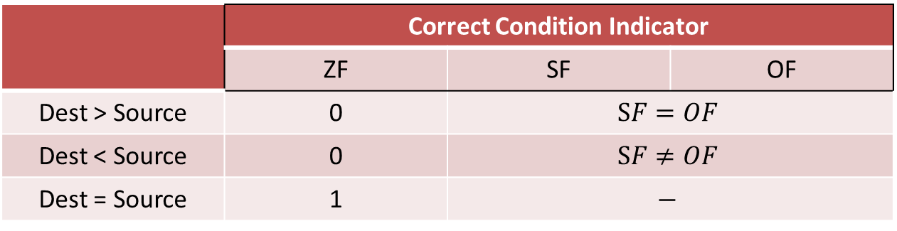
CMP Instruction
It compares two operands of the same size.
The source and destination operands are not changed.
The comparison is performed by subtracting the source operand from the destination operand.
Format: CMP dest, source
Sets flags as if SUB dest, source
Signed Numbers
 | Correct Condition Indicator
 | ZF | SF | OF
Dest > Source | 0 | $$SF=OF$$
Dest < Source | 0 | $$SF≠OF$$
Dest = Source | 1 | $$−$$

Slide 32
CMP Instruction
It compares two operands of the same size.
The source and destination operands are not changed.
The comparison is performed by subtracting the source operand from the destination operand.
Format: CMP dest, source
Sets flags as if SUB dest, source
Signed Numbers
 | Correct Condition Indicator
 | ZF | SF | OF
Dest > Source | 0 | $$SF=OF$$
Dest < Source | 0 | $$SF≠OF$$
Dest = Source | 1 | $$−$$
mov al, 120
mov bl, 119
cmp al, bl ;120 – 119 = 1 (ZF = 0, SF = 0, OF = 0)

Slide 33
CMP Instruction
It compares two operands of the same size.
The source and destination operands are not changed.
The comparison is performed by subtracting the source operand from the destination operand.
Format: CMP dest, source
Sets flags as if SUB dest, source
Signed Numbers
 | Correct Condition Indicator
 | ZF | SF | OF
Dest > Source | 0 | $$SF=OF$$
Dest < Source | 0 | $$SF≠OF$$
Dest = Source | 1 | $$−$$
mov al, 127
mov bl, -1
cmp al, bl ; 127 - (-1) = 128; 8-bit result = 80h (-128)
;(ZF = 0, SF = 1, OF = 1)

Slide 34
CMP Instruction
It compares two operands of the same size.
The source and destination operands are not changed.
The comparison is performed by subtracting the source operand from the destination operand.
Format: CMP dest, source
Sets flags as if SUB dest, source
Signed Numbers
 | Correct Condition Indicator
 | ZF | SF | OF
Dest > Source | 0 | $$SF=OF$$
Dest < Source | 0 | $$SF≠OF$$
Dest = Source | 1 | $$−$$
mov al, 5
mov bl, 10
cmp al, bl ;5 – 10 = -5 (ZF = 0, SF = 1, OF = 0)

Slide 35
CMP Instruction
It compares two operands of the same size.
The source and destination operands are not changed.
The comparison is performed by subtracting the source operand from the destination operand.
Format: CMP dest, source
Sets flags as if SUB dest, source
Signed Numbers
 | Correct Condition Indicator
 | ZF | SF | OF
Dest > Source | 0 | $$SF=OF$$
Dest < Source | 0 | $$SF≠OF$$
Dest = Source | 1 | $$−$$
mov al, -128
mov bl, 1
cmp al, bl ;-128 - 1 = -129; 8-bit result = 7Fh (+127)
;(ZF = 0, SF = 0, OF = 1)

Slide 36
CMP Instruction
It compares two operands of the same size.
The source and destination operands are not changed.
The comparison is performed by subtracting the source operand from the destination operand.
Format: CMP dest, source
Sets flags as if SUB dest, source
Signed Numbers
 | Correct Condition Indicator
 | ZF | SF | OF
Dest > Source | 0 | $$SF=OF$$
Dest < Source | 0 | $$SF≠OF$$
Dest = Source | 1 | $$−$$
mov al, 5
mov bl, 5
cmp al, bl ;5 – 5 = 0 (ZF = 1)

Slide 37
CMP Instruction
It compares two operands of the same size.
The source and destination operands are not changed.
The comparison is performed by subtracting the source operand from the destination operand.
Format: CMP dest, source
Sets flags as if SUB dest, source
Unsigned Numbers
 | Correct Condition Indicator
 | ZF | CF
Dest > Source | 0 | 0
Dest < Source | 0 | 1
Dest = Source | 1 | 0

Slide 38
DEC Instruction
Subtracts 1 from the destination operand
Format: DEC dest
All flags are affected by the DEC instruction, except for CF.
CF remains unaffected after the execution of the instruction DEC
dest = dest - 1

Slide 39
INC Instruction
Adds 1 to the destination operand
Format: INC dest
All flags are affected by the INC instruction, except for CF.
CF remains unaffected after the execution of the instruction INC
dest = dest + 1

Slide 40
Write an assembly code to calculate 25H - 1
Exercise 1
.data segment
DATA1 DB 25H
.code segment
MOV AL,DATA1
DEC AL
ret
AL
25
0010 0101
37
0010 0100
36
AL
24

Slide 41
MUL Instruction
Format: MUL source

Slide 42
MUL Instruction
Format: MUL source
Which register is the destination?

Slide 43
MUL Instruction
Format: MUL source
If source is 8 bit (e.g. BL)
Source is multiplied by AL (8 bit)
Destination is AX (16 bit)
AX = AL * BL

Slide 44
MUL Instruction
Format: MUL source
If source is 16 bit (e.g. BX)
Source is multiplied by AX (16 bit)
Destination is DX:AX (32 bit)
DX:AX = AX * BX

Slide 45


MUL Instruction
Format: MUL source
MUL BL \\ AX = $BL∗AL$
MUL BX \\ $DX:AX=BX ∗AX$

Slide 46
Write an assembly code to calculate 25 H * 32 H
Exercise 2a
.data
DATA1 DB 25H
DATA2 DB 32H
.code
MOV AL,DATA1
MOV AH,DATA2
MUL AH
ret
AH
AL
32
25
50
0011 0010
0010 0101
37
0000 0111 0011 1010
1850
AH
AL
07
3A

Slide 47

Write an assembly code to calculate 3225H * 0102H
Exercise 2b
MUL BX \\ $DX:AX=BX ∗AX$
.data
DATA1 DB 25H
DATA2 DB 32H
DATA3 DW 0102H
.code
MOV AL,DATA1
MOV AH,DATA2
MOV BX,DATA3
MUL BX
ret
AH
AL
32
25
0011 0010
0010 0101
12837
BH
BL
01
02
0000 0001
0000 0010
258
00
32
89
4A
00000011 00101000 10001001 01001010
3311946
DH
DL
AH
AL
00
32
89
4A

Slide 48
DIV Instruction
Divides either the value stored inside AX by the source operand. (when the source operand is 8-bits)
OR the value stored in DX:AX by the source operand.
(when the source operand is 16-bits)
Format: DIV source
Quotient @ AX
DIV BX \\ $\frac{DX:AX}{BX}$
Remainder @ DX
Quotient @ AL
DIV BL \\ $\frac{AX}{BL}$
Remainder @ AH

Slide 49
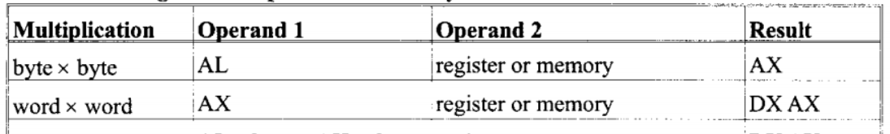

Exercise 3 – Complete the following
MUL BX \\ $DX:AX=BX ∗AX$
In unsigned multiplication of a byte in DATA1 with a byte in AL, the product will be placed in register(s) __________.
In unsigned multiplication of AX with BX, the product is placed in register(s)
__________.
In unsigned multiplication of CL with a byte in AL, the product is placed in register(s)
__________.
AX
DX & AX
AX

Slide 50
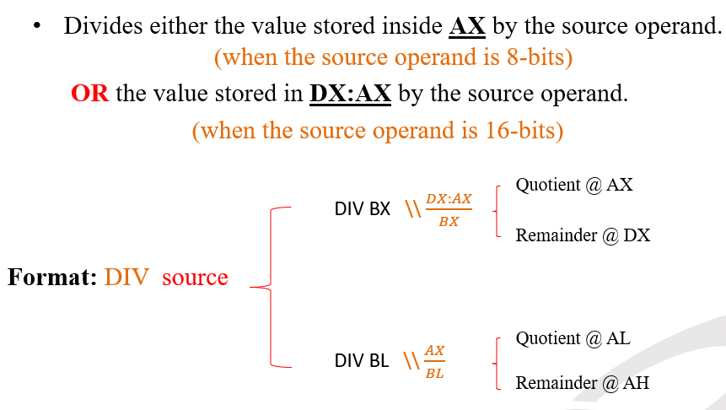
Exercise 3 – Complete the following (Cont’d)
4. In unsigned division of a byte in AL by a byte in DH, the quotient will be placed
in __________ and the remainder in __________.
5. In unsigned division of a word in AX by a word in DATA1, the quotient will be
placed in __________ and the remainder in __________.
AL
AH
AX
DX

Slide 51
Exercise 3 – Complete the following (Cont’d)
6. In unsigned division of a word in AX by a byte in DATA2, the quotient will be
placed in __________ and the remainder in __________.
7. In unsigned division of a doubleword in DX:AX by a word in CX, the quotient
will be placed in __________ and the remainder in __________.
AL
AH
AX
DX

Slide 52
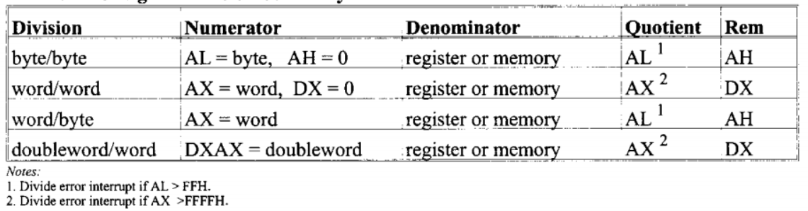
Exercise 3 – Complete the following (Cont’d)

Slide 53
Logic Instructions
NOT (Logical NOT)
Format: NOT dest
OR (Logical OR)
Format: OR dest,source
AND (Logical AND)
Format: AND dest,source
dest = 1’s complement of dest
dest = dest OR source
dest = dest AND source

Slide 54
Write an assembly code to calculate 25H OR 32H
Exercise 4
.data
DATA1 DB 25H
DATA2 DB 32H
.code
MOV AL,DATA1
MOV AH,DATA2
OR AH,AL
ret
AH
AL
32
25
0011 0010
0010 0101
0011 0010
OR
0010 0101
---------------------
0011 0111
AH
AL
37
25

Slide 55
NEG vs NOT Instructions
The NOT instruction 1’s complements a number.
The NEG (negate) instruction 2’s complements a number
Example:
MOV AX, 01010010B ; AX = 0000 0000 0101 0010
; AX = 0052H
NOT AX ; Invert all bits
; AX = 1111 1111 1010 1101
; AX = FFADH
NEG AX ; NOT(AX) + 1
; AX = 0000 0000 0101 0011
; AX = 0053H

Slide 56
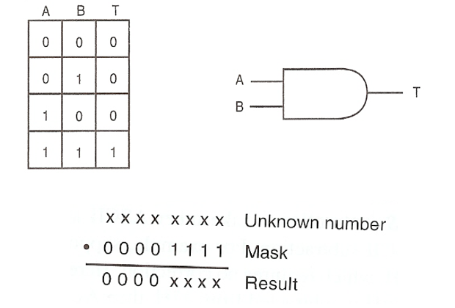
AND Instruction
The AND instruction performs logical multiplication

Slide 57
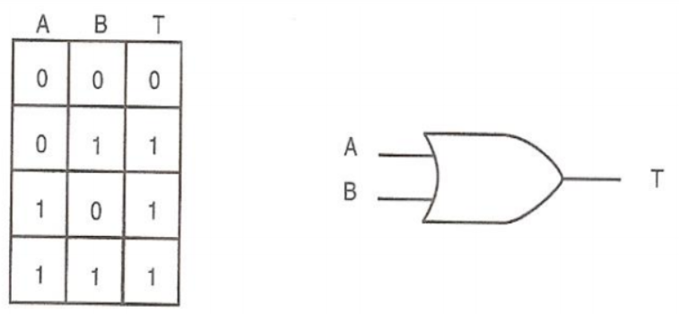
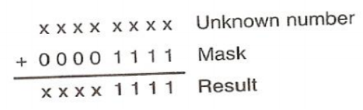
OR Instruction
The OR instruction generates the logical sum

Slide 58
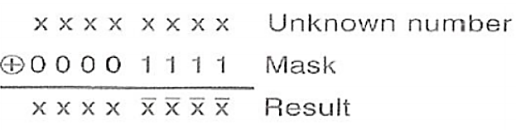
Exclusive OR
It performs the XOR Instruction

Slide 59
Questions ?!

