Slide 1
Project Introduction

Slide 2
Outline
Project Description
  AES Encryption
Emulator 8086

Slide 3

Cryptography and Security
It is the study of encrypting and decrypting data to prevent unauthorized access. It is used to safeguard company secrets, secure classified information, and sensitive information from fraudulent activity, among other things.
Crypto means hidden and Graphy means writing

Slide 4
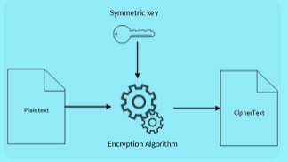
Encryption Algorithms
Encryption categories:
  Symmetric Key Cryptography (Secret key)
  Asymmetric Key Cryptography (Public key)
In secret key encryption, a single shared key is used to encrypt and decrypt the message
In public-key encryption, different two keys are used, both related to each other by a complex mathematical process.
Therefore, we can say that encryption and decryption take more time in public-key encryption.

Slide 5
Symmetric Key Cryptography
Advanced Encryption Standard (AES)
  AES is a block cypher
  The key size can be 128/192/256 bits
  Encrypts data in blocks of 128 bits each
  Is a symmetric block cyber i.e. uses the same key for encryption & decryption.
Note: AES performs operations on bytes of data rather than in bits. Since the block size is 128 bits, the cypher processes 128 bits (or 16 bytes) of the input data at a time.
The number of rounds depends on the key length as follows:
  128 bit key – 10 rounds
  192 bit key – 12 rounds
  256 bit key – 14 rounds

Slide 6
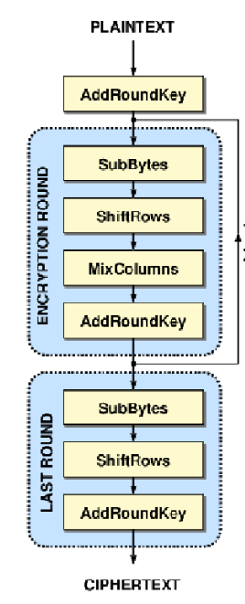
Advanced Encryption Standard
The encryption process will contain 10 rounds
All the rounds are identical except last round where the Mix Columns is not preformed.
Rounds consists of:
  Sub Bytes
  Shift Rows
  Mix Columns
  Add Round Key
A good description for the standard is shown in this flash video:
https://formaestudio.com/rijndaelinspector/archivos/Rijndael_Animation_v4_eng-html5.html

Slide 7
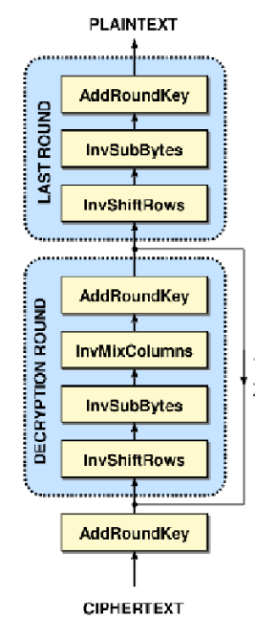
Advanced Encryption Standard
The decryption process will contain 10 rounds
Same key is used in both operations
Rounds consists of:
  Inverse Sub Bytes
  Inverse Shift Rows
  Inverse Mix Columns
  Add Round Key

Slide 8
Project Deadlines
Teams Submission (Deadline: Saturday 7/11/2026):
  Groups of 2, should be submitted on Google form.
Milestone 1 (Deadline: Saturday 28/11/2026):
  Use Macros to implement SubBytes() and ShiftRows() modules, all work on 128 bits.
  Use Macros to implement one cycle of MixColumns() and AddRoundKey() modules, all work on 128 bits.
  For the AddRoundkey module consider the used key of FFFFFFFFFFFFFFFF.

