Slide 1
Performance Management
System (PMS)
End-to-End Employee & Branch Performance Tracking
A comprehensive digital platform for goal alignment, performance monitoring,
evaluation, and data-driven decision making across all organizational levels.
Banking Sector | Confidential

Slide 2
Agenda
01
System Overview
What PMS is and why it matters
02
User Roles & Org Structure
Who uses the system and how access is controlled
03
Target Setting
Financial and non-financial goal definition
04
Performance Metrics & Pillars
Strategic alignment via OKR framework
05
Real-time Dashboard
My Dashboard & Team Dashboard
06
Evaluation & Scoring
How performance is assessed and scored
07
Feedback Management
Two-way communication between managers and staff
08
Reporting & Analytics
Exportable data-driven insights
09
Key Benefits
Business value delivered by PMS
Performance Management System (PMS)

Slide 3
System Overview – What is PMS?
The Performance Management System (PMS) is a digital platform built for the banking sector that enables the organization to:
📌 Set, track, and manage financial and non-financial performance targets at every level
📊 Monitor real-time progress of employees, branches, and districts against set goals
🎯 Align individual and team objectives with the bank's strategic pillars
✅ Conduct structured performance evaluations with weighted scoring
💬 Enable continuous two-way feedback between supervisors and staff
📋 Generate detailed, exportable reports for informed decision-making
💡 PMS connects individual employee performance to the bank's overall strategic goals through a fully digital, data-driven platform.
Performance Management System (PMS)

Slide 4
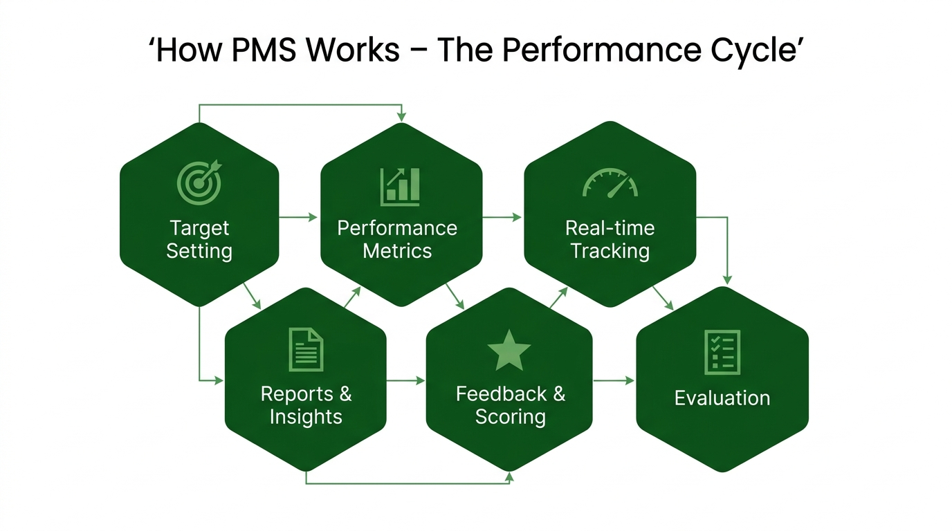
The PMS Performance Cycle
Performance Management System (PMS)

Slide 5
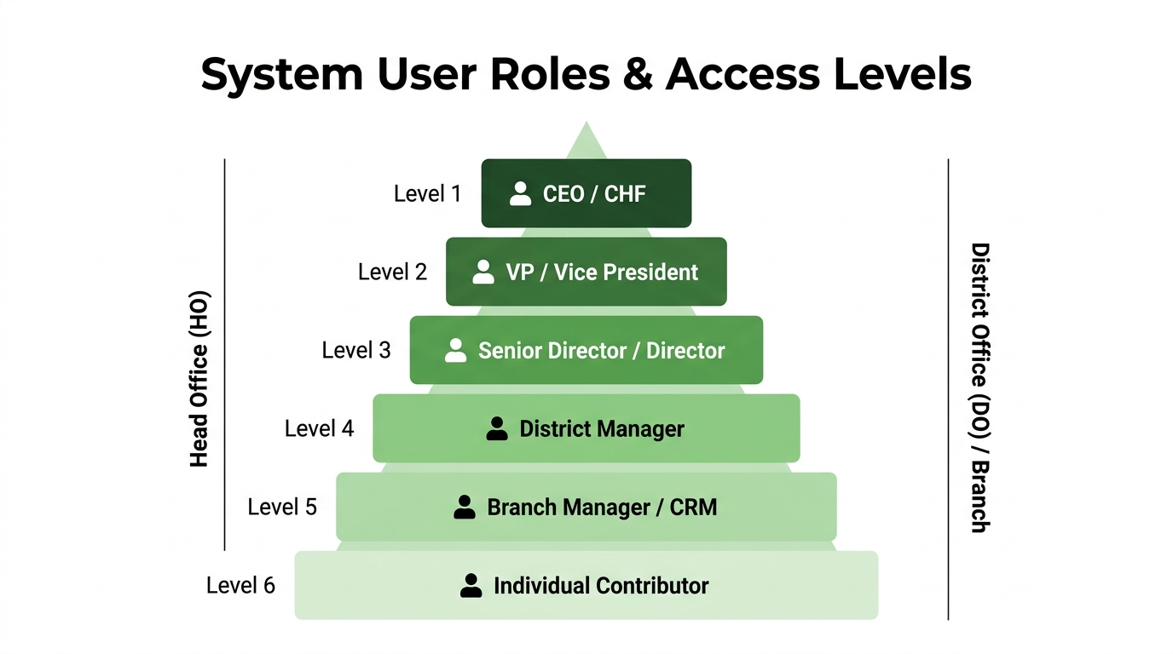
User Roles & Organizational Access
Access is role-based:
Admin
Full system configuration, user management, data upload
CEO / CHF
Executive-level view of all performance metrics
VP / Director
Departmental targets, team performance overview
District Manager
District-wide target tracking and team evaluation
Branch Manager/CRM
Branch-level goal setting, team scoring, and feedback
Individual
Personal dashboard, self-reporting, own score & feedback
Performance Management System (PMS)

Slide 6
Module 1 – Target Setting
Managers and supervisors define financial and non-financial targets for their teams and branches.
🏦 Local Account Mapping
📍 District Mapping
Map customer deposit accounts to employees/branches for performance tracking
Map accounts and targets to district-level managers
💱 FCY Account Mapping
📈 Financial Target
Track foreign currency account targets by employee or unit
Set deposit, loan, and FCY monetary targets per employee
💰 FCY Generation
📊 Non-Financial Target
Monitor foreign currency generation performance vs targets
Set operational KPIs: new accounts, card activation, digital transactions
🏧 Loan Account Mapping
⚙️ Bulk Metric Upload
Loan portfolio targets mapped to responsible employees
Admins can bulk-upload performance data from CBS systems
Performance Management System (PMS)

Slide 7
Module 2 – Strategic Pillars & Performance Metrics
PMS uses an OKR-inspired framework to align every employee's work to the bank's strategic direction.
🏛️ Strategic Pillars
Top-level themes that define the bank's strategic direction
(e.g., Financial Growth, Customer Experience, Compliance)
▼
🎯 Objectives
Specific, measurable goals under each pillar
Assigned by title/grade with weighted importance
▼
📊 Performance Metrics
Quantifiable KPIs linked to each objective
Includes: formula, unit, evaluation frequency, and weight
Performance Management System (PMS)

Slide 8
Module 3 – Real-time Dashboards
👤 My Dashboard
👥 Team Dashboard
✦ Personal performance score (0–100%) visualized as a radial gauge
✦ Manager's view of all direct and indirect reports
✦ Live actual vs. expected comparison for each metric
✦ Each team member shown with their overall performance score
✦ Bar chart showing achievement across all KPIs
✦ Progress bars per metric for quick comparison
✦ Pie chart distribution of performance by metric type
✦ Priority status: highlights employees with missing priorities
✦ Self-reported data entry for eligible metrics
✦ Sortable by position level (CEO → Individual)
✦ Color-coded status: 🟢 On Track / 🟡 At Risk / 🔴 Below Target
✦ Drill-down into any employee's detailed metric breakdown
Performance Management System (PMS)

Slide 9
Module 4 – Performance Evaluation & Scoring
Structured, periodic evaluation ensures accurate and fair performance assessment.
1
Metric Evaluation
Each performance metric is evaluated with a recorded value. Evaluations are linked to the responsible evaluator.
2
Weight-Based Scoring
Every metric carries a pre-defined weight. The final score is a weighted average across all active metrics.
3
System vs. Self Input
Some metrics are auto-calculated from CBS data; others allow supervised self-reporting with evaluator confirmation.
4
Team Score View
Managers view aggregated scores for all team members, enabling fair comparison and coaching decisions.
5
My Score View
Employees see their own weighted score, trend, and performance rating against targets.
Performance Management System (PMS)

Slide 10
Module 5 – Feedback Management
PMS provides a structured, two-way communication channel between supervisors and their direct reports.
👔 Supervisor / Manager
👤 Employee
→ Sends feedback messages to team members
→ Receives feedback notifications
→ Views all feedback history per employee
→ Views all feedback received
⇆
→ Replies to employee-initiated feedback
→ Sends replies and requests clarification
Two-way
Channel
→ Provides coaching notes and performance context
→ Accesses historical feedback in My Feedback section
Performance Management System (PMS)

Slide 11
Module 6 – Reports & Analytics
PMS offers a suite of management reports, all exportable to Excel, for monitoring and audit purposes.
📋 User Targets Report
🏦 Account Mapping Report
Shows all financial and non-financial targets per user. Filterable by name, position, and period.
Lists account-to-employee mappings by district. Exportable per district for audit and review.
📈 Financial Achievement Report
💱 FCY Deposit Report
Compares actual financial performance to targets (deposit, FCY, loan). Shows variance.
Tracks foreign currency deposit activity and achievement vs. targets by branch and employee.
⭐ Evaluation Result Report
📊 Raw Evaluation Report
End-of-period evaluation scores per employee. Shows metric-level details and weighted scores.
Detailed evaluation data for administrative use, supporting payroll and HR decisions.
Performance Management System (PMS)

Slide 12
System Administration & Configuration
Administrators maintain full control over the system's structure, users, and data.
👥 User Management
⚙️ General Configurations
Create, update, and deactivate user accounts. Assign roles, positions, organizations, and processes.
System-wide settings including fiscal year parameters, metric formulas, and thresholds.
🔄 User Transfer
🗺️ Area Manager Mapping
Seamlessly reassign employees between branches, districts, or teams without data loss.
Map area managers to their supervised branches and regions for accurate hierarchy-based reporting.
🗂️ Employee Master
📤 Metric Upload
Manage the employee master database synced with the bank's core HR systems.
Bulk-upload actual performance data (e.g., from CBS exports) to auto-populate metric actuals.
🌐 Hierarchy Configuration
Define organizational reporting hierarchy, processes, and sub-processes.
Performance Management System (PMS)

Slide 13
Key Business Metrics Tracked by PMS
💰 Financial KPIs
📊 Non-Financial KPIs
✔ Local Deposit Mobilization
✔ New Account Opening
✔ Foreign Currency (FCY) Generation
✔ Active Card Users
✔ Digital Transaction Volume (ATM, Mobile)
✔ Loan Portfolio Achievement
✔ Merchant & Agent Recruitment
✔ Cash Collection Performance
✔ EEU Transaction Activity
✔ CRM / Michu Loan Collection
✔ POS Deployment
✔ Compliance Rate
✔ Audit Report Quality
Performance Management System (PMS)

Slide 14
Key Business Benefits
🎯 Strategic Alignment
⚡ Real-time Visibility
Links every employee's daily KPIs to the bank's strategic pillars and annual objectives
Managers and executives see live performance data without waiting for period-end reports
⚖️ Fair & Transparent Scoring
📉 Early Risk Detection
Weighted, formula-based scoring eliminates subjectivity and ensures evaluations are consistent
Color-coded dashboards flag underperforming employees or branches before year-end
💬 Continuous Feedback
🗃️ Audit-ready Reporting
Structured feedback loop improves manager-staff communication and employee development
All data is exportable with full traceability, supporting HR, payroll, and compliance audits
🔒 Role-based Security
🔗 CBS Integration
Each user sees only the data relevant to their level, ensuring data privacy and confidentiality
Auto-pulls actual performance data from the Core Banking System, reducing manual entry errors
Performance Management System (PMS)

Slide 15
Thank You
Performance Management System (PMS)
Empowering data-driven performance culture across every level of the bank.
Questions & Discussion

