Slide 1
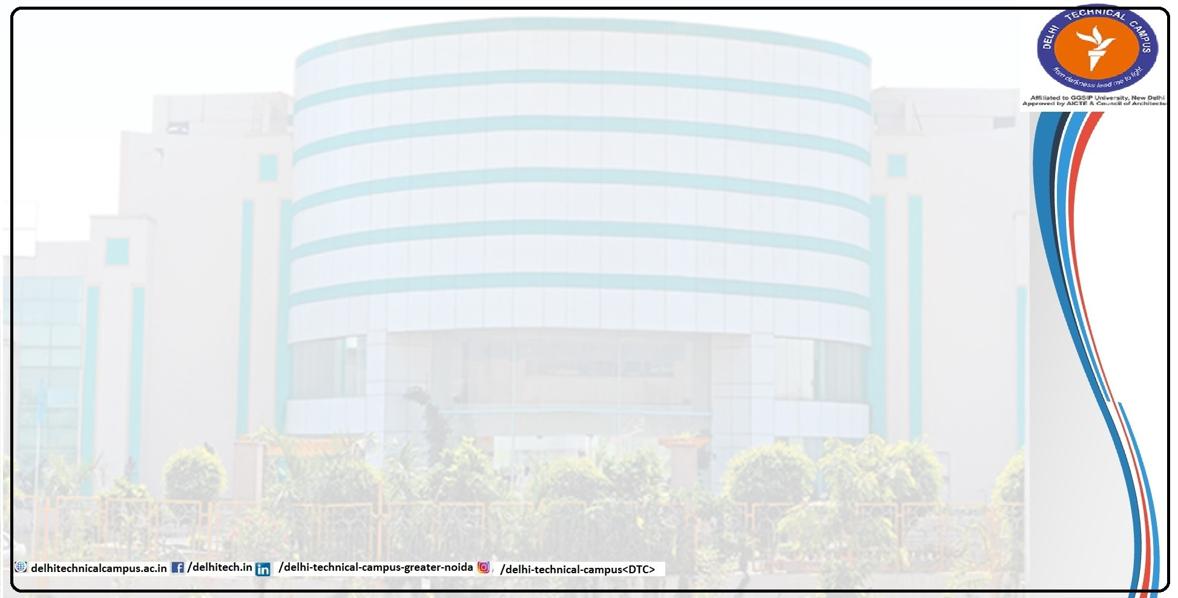
DEVELOPING AN INTELLIGENT
RAG-DRIVEN ARCHITECTURE
FOR ASTRONOMICAL STAR CATALOGS
Presented By
Amit Kumar
Roll No: 14618002722
Under Guidance of
Dr. Madhumita Mahapatra
Professor, CSE
Session 2025-2026 (Even SEM)

Slide 2
Content
1. Introduction
2. Problem Definition
3. Feasibility Study
4. Need and Significance
5. Objectives
6. Literature Survey
7. Design Analysis / Diagrams
8. Proposed Methodology in Brief
9. Hardware and Software Requirements
10. Running Project and Implementation
11. Screen shots
12. Scope of the Project
13. Conclusion and Future Work
14. References

Slide 3
Introduction
Petabyte-scale sky surveys such as Gaia and Vera C. Rubin have made astronomy a data-rich science with billions of stellar records.
Researchers still work across siloed systems, switching manually between ADQL/SQL-based catalog search and keyword-based literature search.
Retrieval-Augmented Generation (RAG) can unify these workflows by grounding large language models in astronomical catalogs and research papers.
The proposed system acts as an intelligent co-pilot capable of natural-language querying, ADQL execution, and multi-step reasoning.
Key data sources: Gaia DR3, SIMBAD, curated ArXiv astrophysics papers, and Astropy-powered analysis tools.

Slide 4
Problem Definition
No unified interface exists for querying SIMBAD, Gaia, and ArXiv together in one research workflow.
Students and early-career researchers face a technical barrier because ADQL/SQL tooling is rigid and difficult to learn.
Standard semantic chunking misses the geometric and spatial relationships needed for cone searches and astronomical reasoning.
Traditional RAG pipelines struggle with relational and multi-hop reasoning across observations, papers, and catalog entities.
Current systems lack agentic capabilities for planning research steps, selecting tools, and verifying answers against source data.

Slide 5
Feasibility Study
Technical Feasibility
LangChain and LlamaIndex support agentic orchestration.
Astropy and astroquery support Gaia and SIMBAD integration.
Neo4j and PostgreSQL with Q3C provide graph and spatial indexing at scale.
Economic / Operational Feasibility
Open-source models and public datasets keep the solution cost-effective and practical for academic deployment.
A web-based modular architecture supports incremental rollout from core search to full agentic features.
Schedule Feasibility
Month 1: literature review and connectors; Month 2: ingestion and indexing; Month 3: graph and agentic core; Month 4: integration and evaluation.

Slide 6
Need and Significance
Modern astroinformatics produces data volumes too large for manual exploration, making intelligent retrieval essential.
For researchers: the system creates a unified data-to-discovery interface that links catalogs and literature in one workflow.
For education: students can work in plain English instead of depending on advanced ADQL or scripting expertise.
For the field: the project combines SQL precision, vector semantics, and graph logic into a scientific AI methodology.
As a future-facing contribution, the architecture aligns with Reasoning Language Models that actively navigate data environments.

Slide 7
Objectives
1. Build a multi-modal ingestion engine for FITS/CSV catalogs, ArXiv PDFs, and observational metadata.
2. Create a hybrid indexing system using dense vectors, BM25 keyword retrieval, and Q3C spatial indexing.
3. Construct a knowledge graph linking stars, papers, catalogs, and cross-matched entities.
4. Develop an agentic reasoning core for query decomposition, tool selection, and execution.
5. Enable code execution with Astropy and Pandas for on-the-fly analysis and plotting.
6. Add a verification and synthesis layer that checks answers against catalog values and produces cited responses.
7. Evaluate the system with astronomy-adapted RAG benchmarks and retrieval metrics.

Slide 8
Literature Survey
Lewis et al. established the foundational RAG framework for grounding LLMs in external knowledge bases.
Gao et al. organized RAG systems into a progression from naive to advanced, modular, and agentic architectures.
Edelman et al. introduced GraphRAG to capture relational structure that vector-only retrieval often misses.
Prior star-catalog work shows the shift from positional lists to multidimensional databases with Q3C-style spatial indexing.
Recent Reasoning Language Model work highlights iterative tool use and deliberate search strategies for complex tasks.
Proposed improvements: agentic tool use, hybrid indexing, graph-enhanced reasoning, and Astropy-driven interaction with astronomy data.

Slide 9
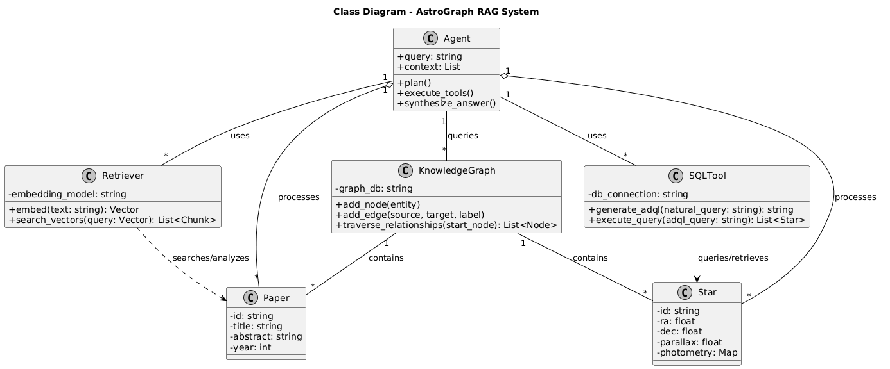
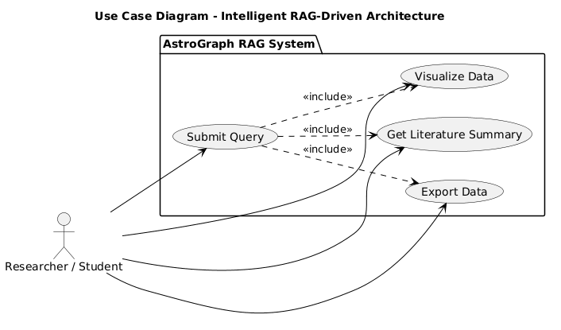
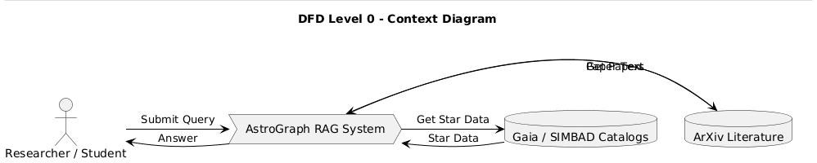
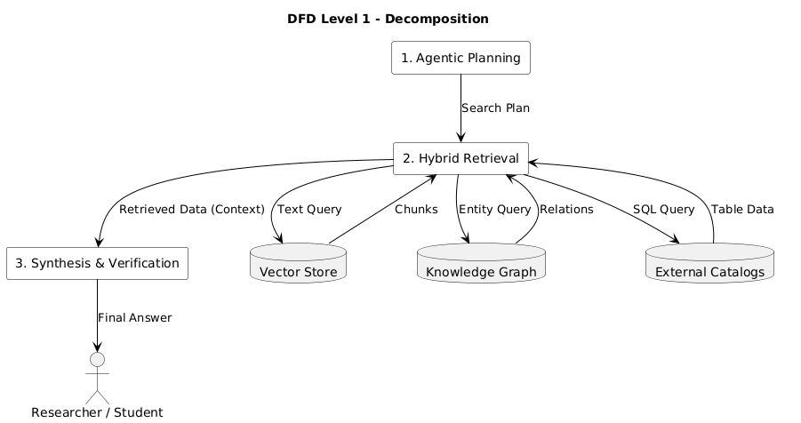
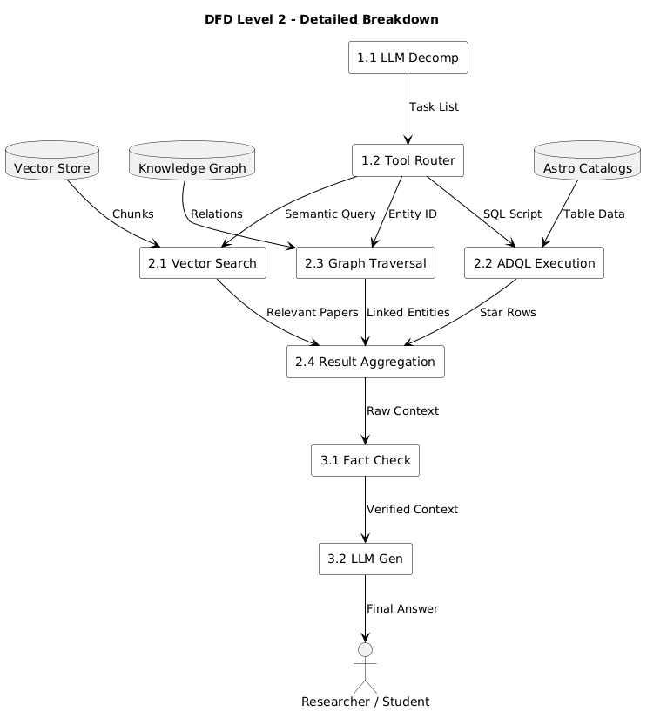
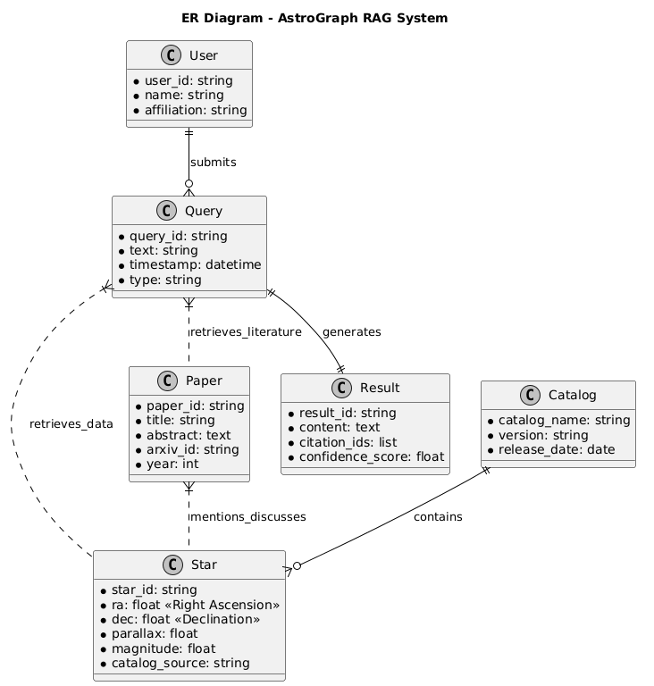
Design Analysis / Diagrams
Class Diagram
Use Case Diagram
DFD Level 0
DFD Level 1
DFD Level 2
E-R Diagram

Slide 10
Proposed Methodology in Brief
M1: Multi-Modal Ingestion Engine for FITS/CSV files, ArXiv PDFs, and entity extraction.
M2: Hybrid Indexing System combining dense vectors, BM25 retrieval, and Q3C spatial indexing.
M3: Knowledge Graph Constructor with nodes such as stars, papers, and catalogs, plus cross-reference edges.
M4: Agentic Reasoning Core for query planning, tool routing, and execution.
M5: Verification and Synthesis Layer for hallucination checking and citation generation.
Non-functional goals: ADQL/SQL latency below 3 seconds, precise cone-search accuracy, and a student-friendly natural-language UI.

Slide 11
Hardware and Software Requirements
Hardware Requirements
• Server RAM: 16 GB minimum for vector database operations.
• GPU: NVIDIA T4 optional for local LLM hosting and experimentation.
• Storage: 500 GB SSD for Gaia catalog subsets and intermediate artifacts.
Software Requirements
• Backend: Python 3.9+ with FastAPI.
• LLM Layer: LangChain / LlamaIndex.
• Databases: Neo4j, PostgreSQL + Q3C, and Qdrant.
• Libraries: Astropy, Pandas, Matplotlib, and astroquery.

Slide 12
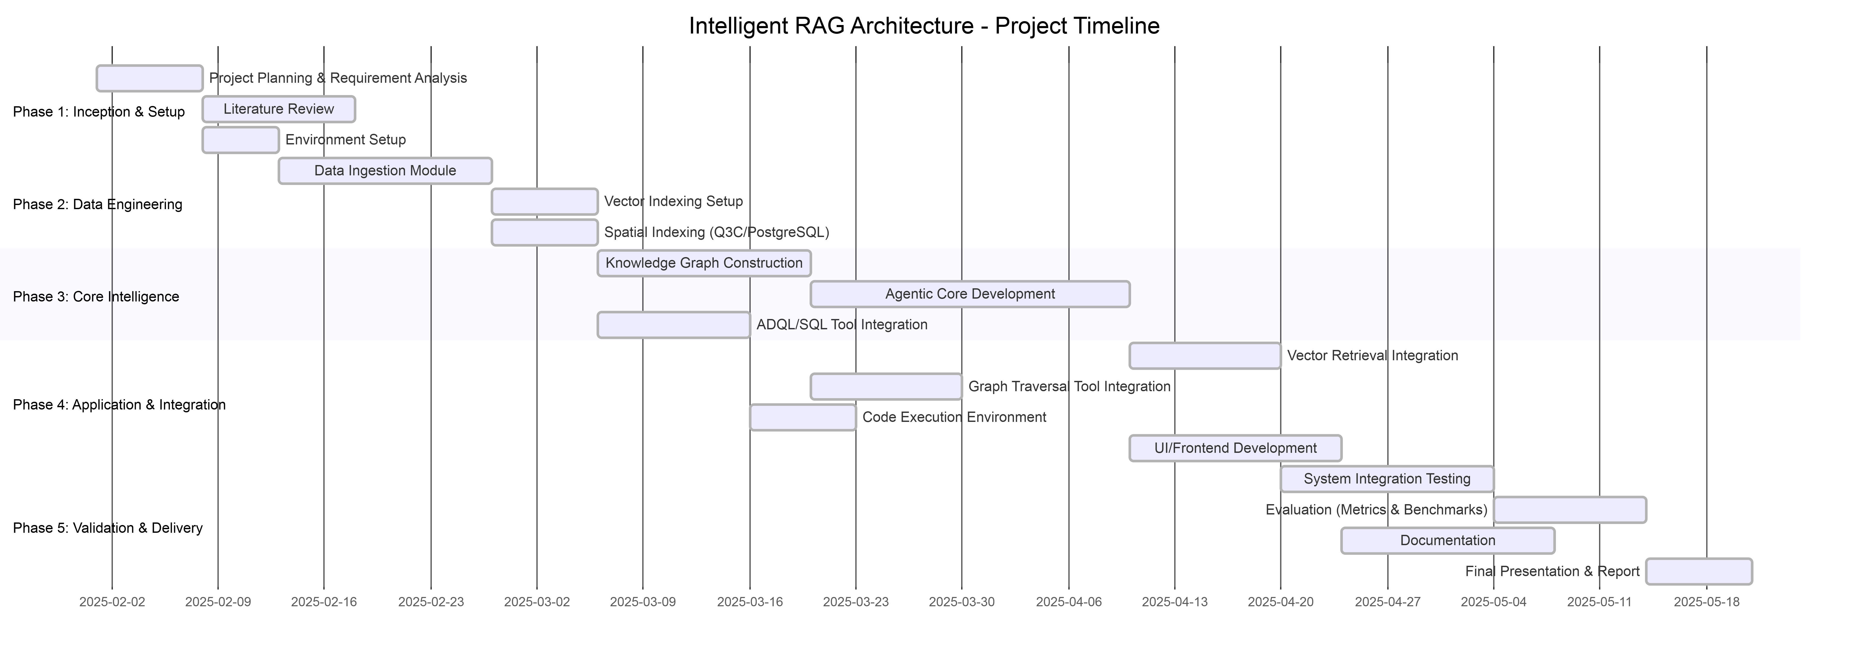
Running Project and Implementation
Current Development Status
• Data Ingestion Engine — 90%
• Vector Store Integration — 80%
• ADQL/SQL Query Generator — 60%
• Knowledge Graph (Neo4j) — 70%
• Agentic Reasoning Core — 70%
• UI / Frontend — 60%
• Minimum review milestone target: 70% complete

Slide 13
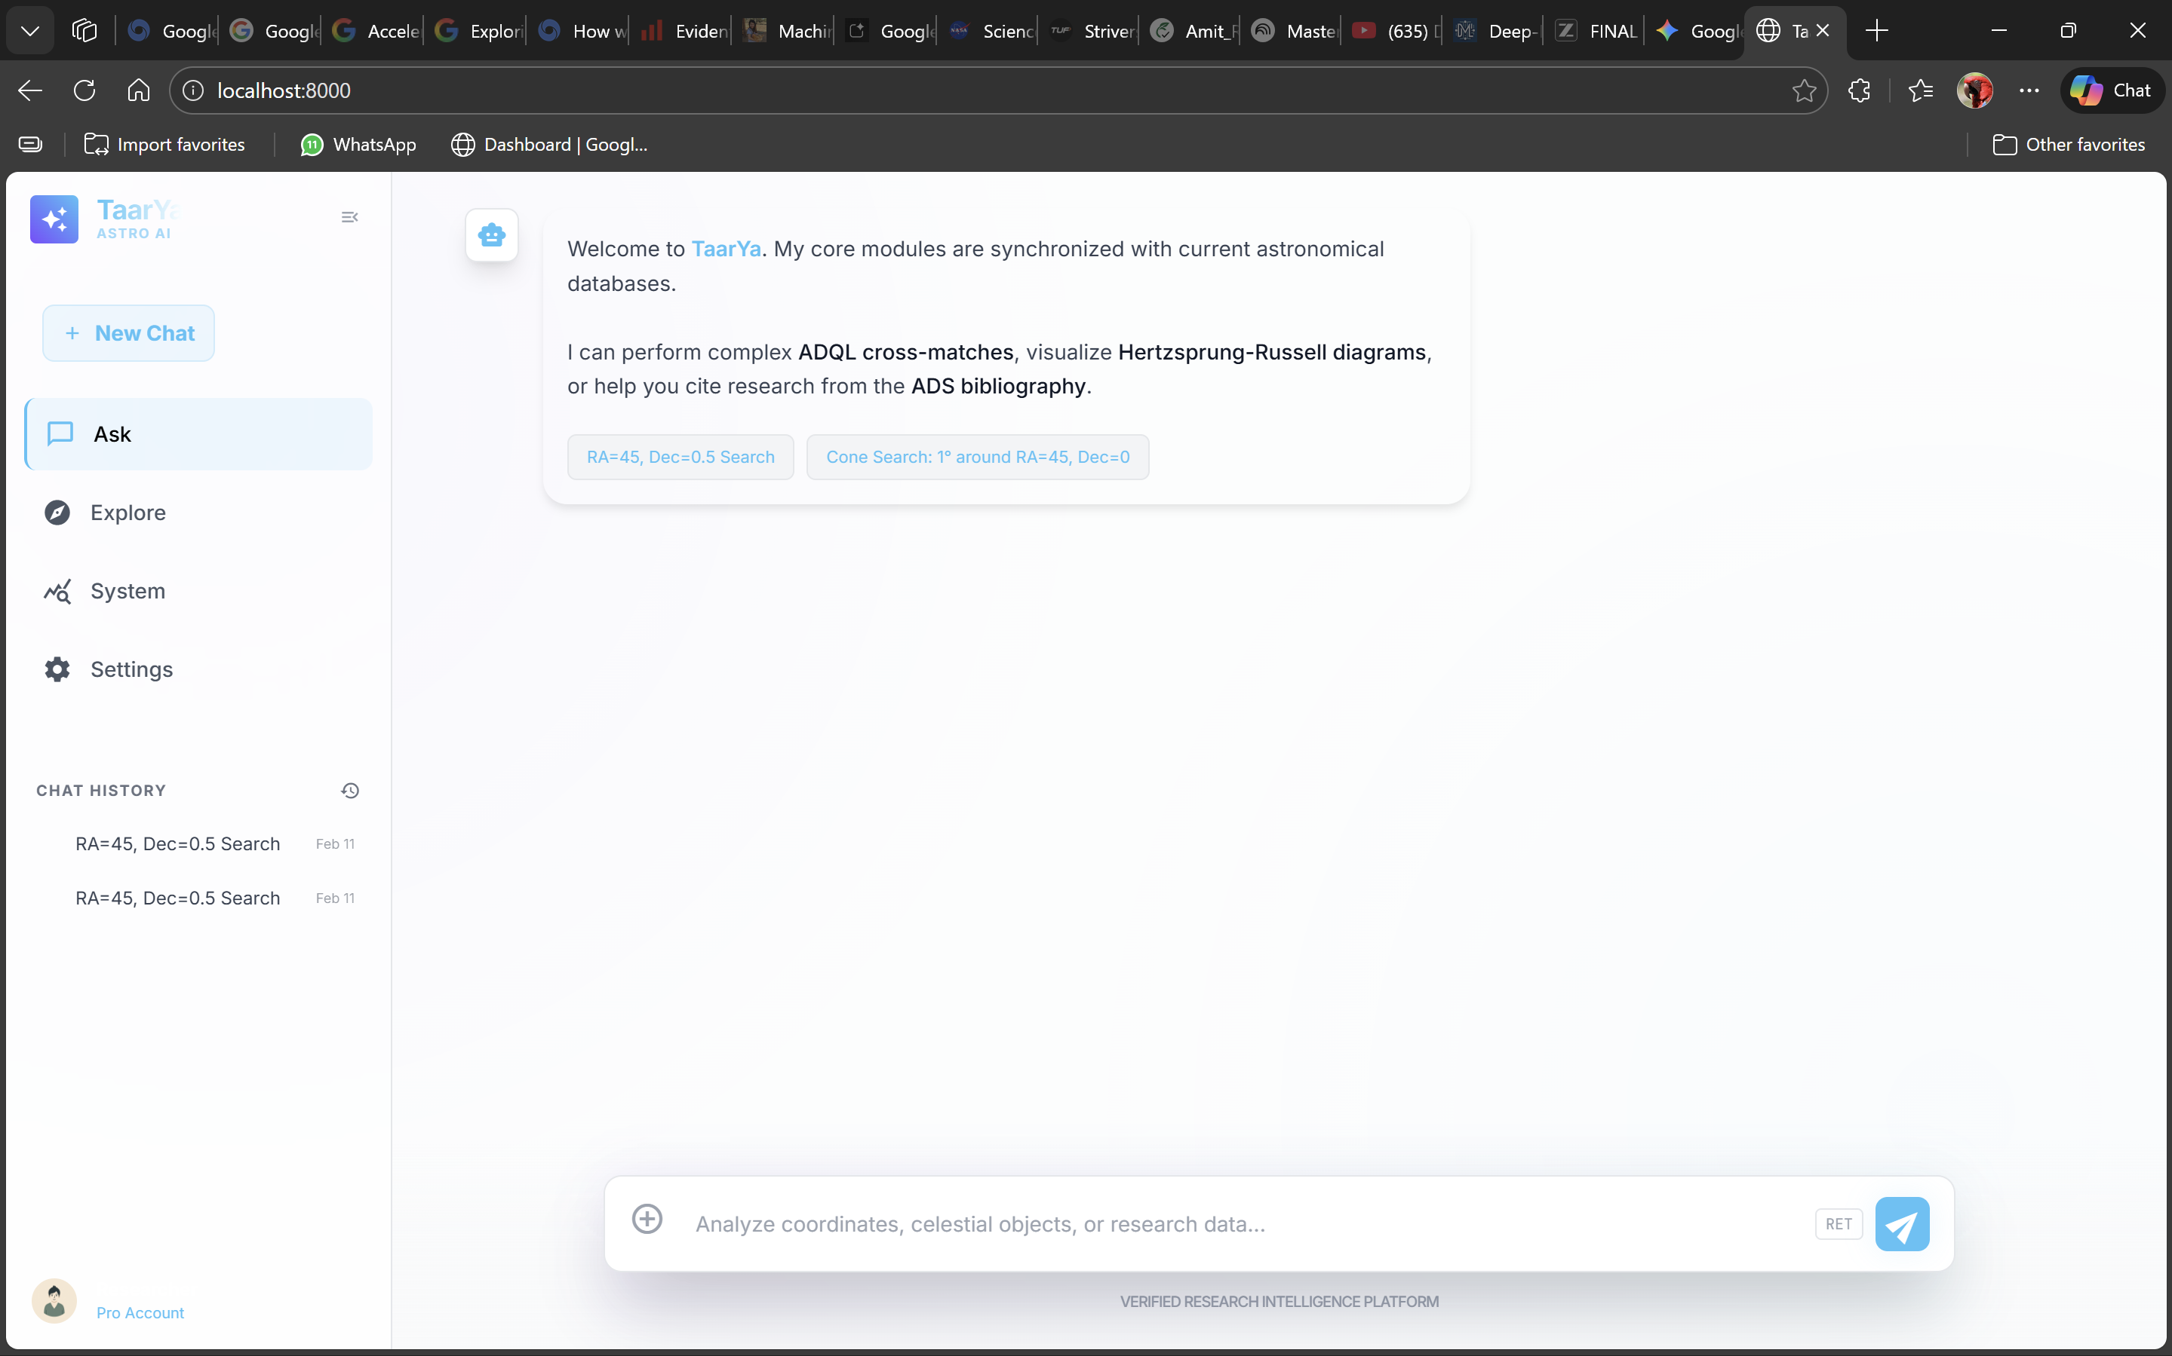
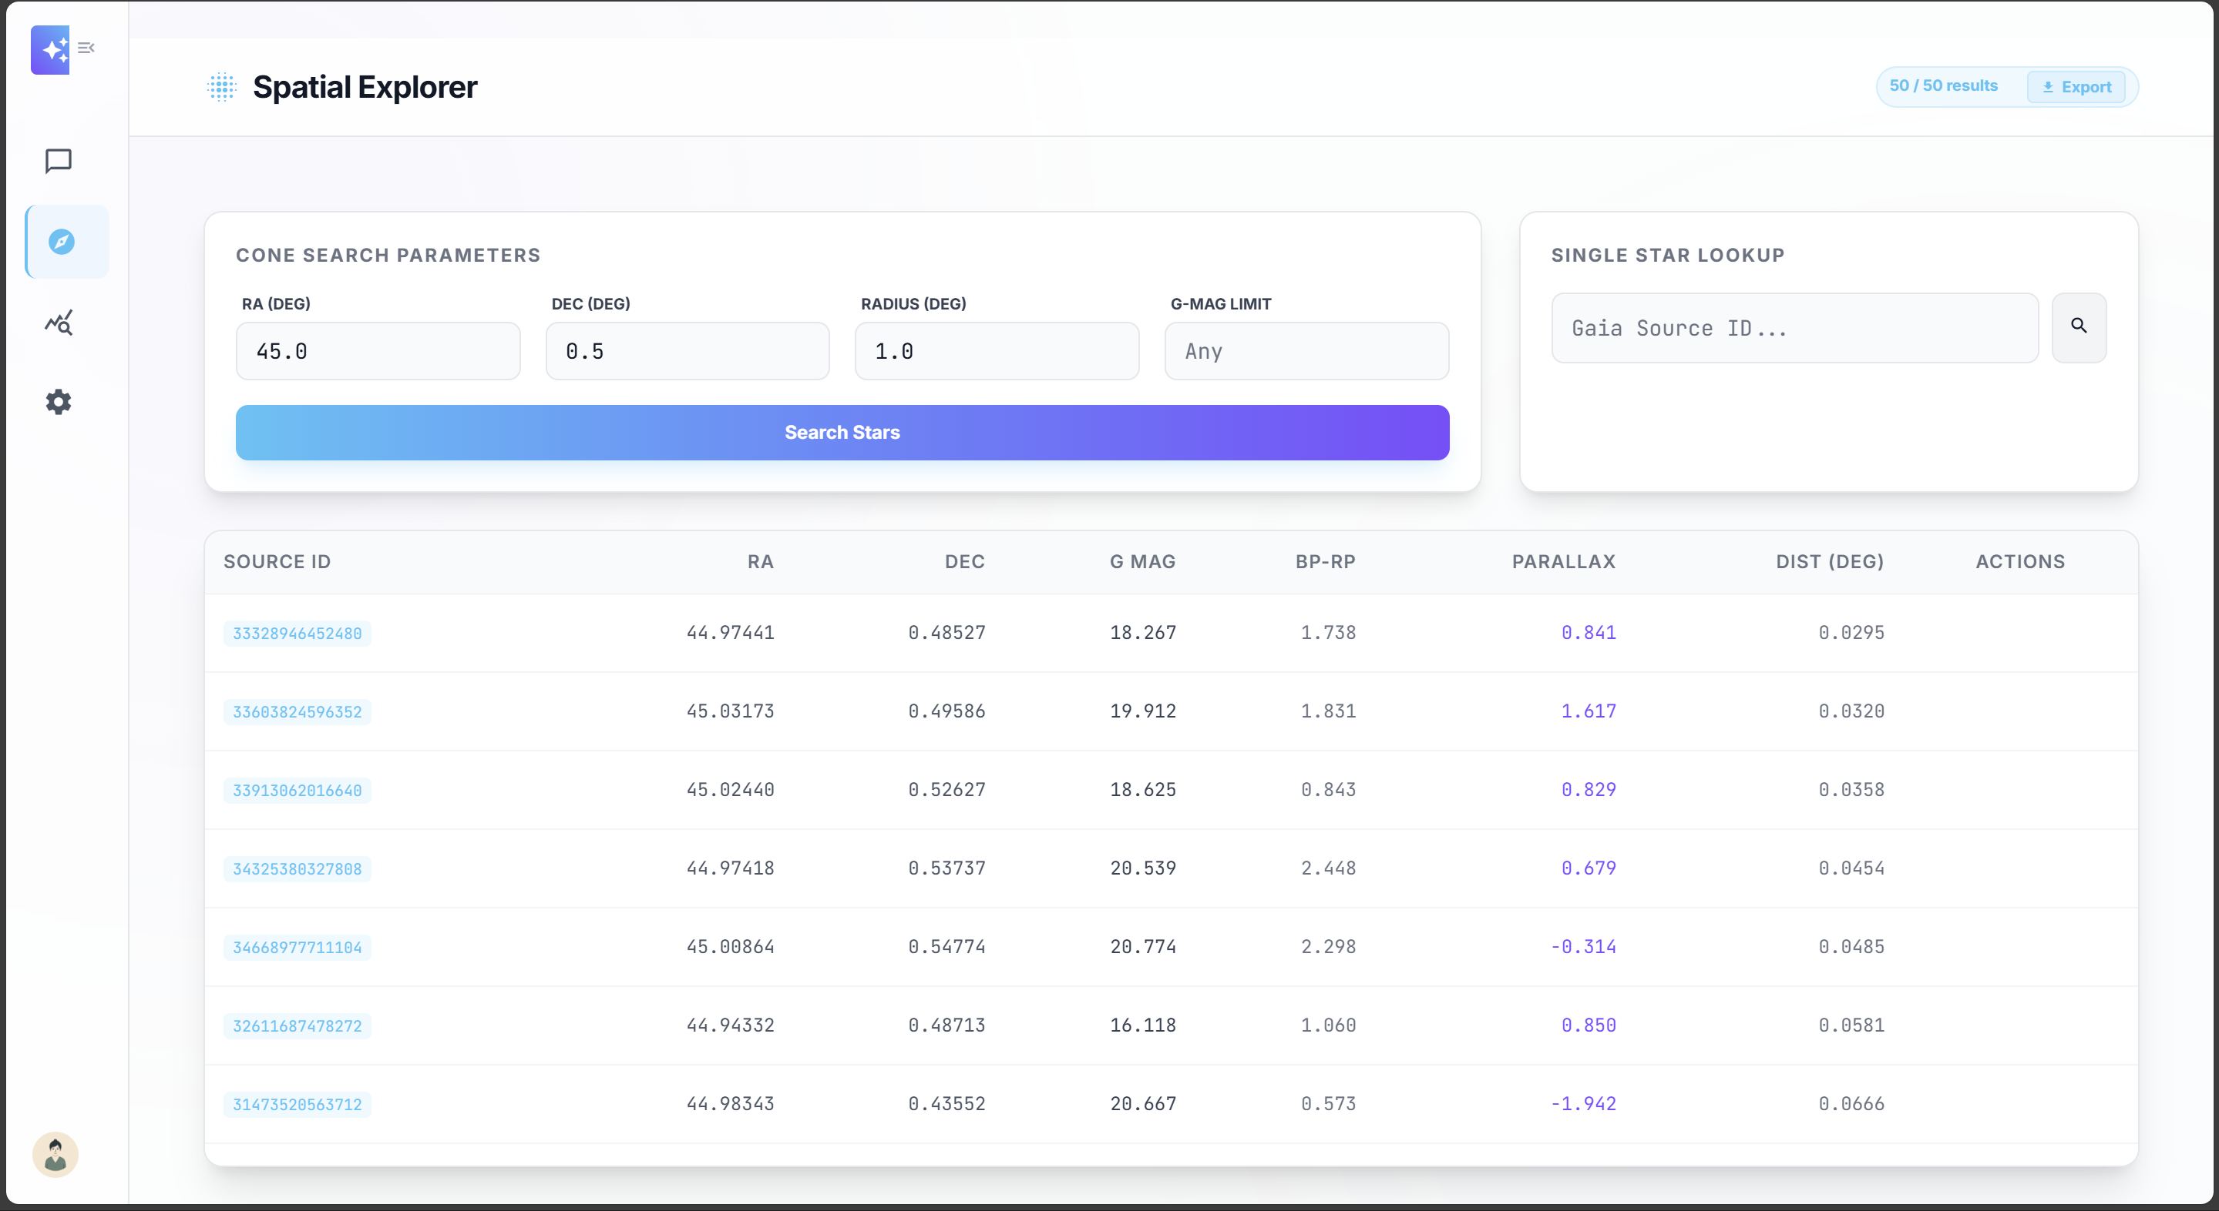
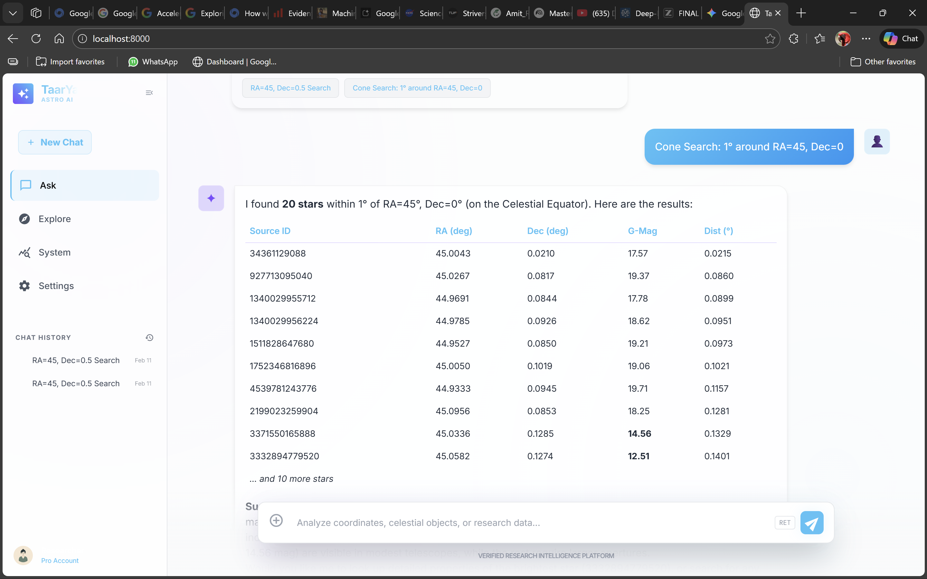
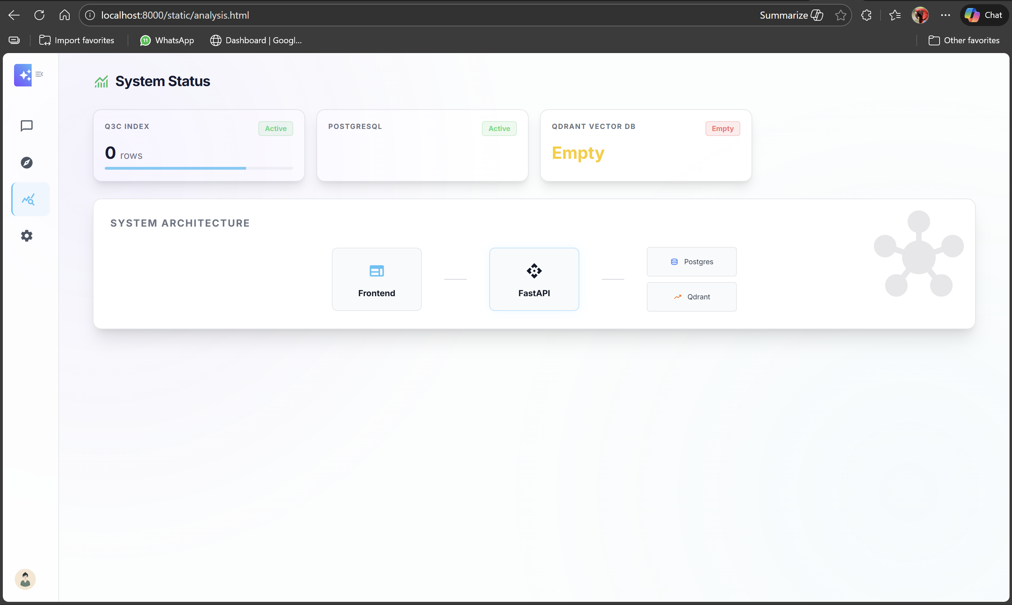
Screen shots
Chat Interface
Spatial Explorer
Query Results
System Status

Slide 14
Scope of the Project
Domain scope includes Gaia DR3 catalogs, SIMBAD records, and a curated set of astrophysics papers from ArXiv.
Functional scope covers natural-language querying, catalog lookup, literature synthesis, hybrid retrieval, graph reasoning, and result export.
Analytical scope includes spatial search, cross-referencing of catalog entities, and code-assisted statistical analysis through Astropy/Pandas.
Deployment scope is a web-based academic research assistant designed for researchers and students in astroinformatics workflows.

Slide 15
Conclusion and Future Work
The proposed RAG-driven architecture addresses a real astronomy workflow gap by unifying data retrieval, literature search, and reasoning.
A hybrid approach combining vector retrieval, spatial indexing, knowledge graphs, and agentic tool use is well-suited to star-catalog research.
Prototype progress already demonstrates strong momentum in ingestion, retrieval, graph construction, and interface development.
Future work includes completing the ADQL generation pipeline, expanding benchmark evaluation, broadening catalog coverage, and refining the end-user interface.

Slide 16
References
[1] Gao, Y., et al. Retrieval-Augmented Generation for Large Language Models: A Comprehensive Review. arXiv:2312.10997, 2024.
[2] Lewis, P., et al. Retrieval-Augmented Generation for Knowledge-Intensive NLP. NeurIPS, 2020.
[3] Edelman, G., et al. GraphRAG: Towards Graph-Based Retrieval-Augmented Generation. arXiv:2404.16130, 2024.
[4] The Digital Architecture of the Heavens: A Comprehensive Analysis of Star Catalogs. arXiv:2501.00000, 2025.
[5] A Comprehensive Report on Reasoning Language Models (RLMs). arXiv:2512.24601, 2025.
[6] Vaswani, A., et al. Attention Is All You Need. NeurIPS, 2017.
[7] Brown, T., et al. Language Models are Few-Shot Learners. NeurIPS, 2020.
[8] Koposov, S., et al. Q3C, a Quad Tree Cube. Astronomy and Computing, 2010.
[9] Gaia Collaboration. Gaia Data Release 3 Documentation.

Slide 17
THANK YOU
Amit Kumar | Roll No: 14618002722
Guide: Dr. Madhumita Mahapatra
Delhi Technical Campus, Greater Noida
Session 2025-2026

