Slide 1
DELHI TECHNICAL CAMPUS
Department of Computer Science & Engineering
Developing an Intelligent
RAG-Driven Architecture
for Astronomical Star Catalogs
MAJOR PROJECT REVIEW – I | ES-452
Submitted by Amit Kumar Roll No: 14618002722
Under the Guidance of Dr. Madhumita Mahapatra Professor, CSE
Session 2025-2026 (Even SEM)

Slide 2
Introduction
The Data Challenge
Key Data Sources
Petabyte-scale sky surveys (Gaia, Vera C. Rubin) have transformed astronomy into a data-rich science with billions of stellar objects.
Gaia DR3
Billions of stellar
astrometric records
The Fragmentation Problem
Researchers must navigate siloed systems — manually switching between ADQL/SQL for data retrieval and keyword searches for literature.
SIMBAD
RAG as the Solution
Object identifications
& cross-references
Retrieval-Augmented Generation (RAG) bridges this gap by dynamically connecting LLMs to external astronomical knowledge sources.
ArXiv
Our Vision
Curated astrophysics
research papers
An intelligent "co-pilot" for astronomers — capable of natural language queries, ADQL execution, and multi-step reasoning.
Astropy
Python astronomy
library (tool use)

Slide 3
Problem Definition
Data Silos
Lack of Relational Reasoning
01
No unified interface for complex queries across SIMBAD, Gaia, and ArXiv simultaneously. Researchers must switch tools manually.
04
Multi-hop reasoning (connecting Gaia observations to theoretical paper concepts) is beyond standard RAG pipelines.
Technical Barriers
No Agentic Capabilities
02
Students & early-career researchers lack expertise in ADQL/SQL. Existing interfaces are too rigid or too complex.
05
Current systems cannot autonomously plan research strategies, select tools, or verify results against ground-truth data.
High-Dimensional Data Challenges
03
Standard semantic chunking fails to capture geometric relationships needed for spatial queries (cone searches).

Slide 4
Feasibility Study
Technical Feasibility
Economic Feasibility
LangChain & LlamaIndex support agentic orchestration
Astropy & astroquery for Gaia/SIMBAD integration
Neo4j for Knowledge Graph at scale
Q3C extensions for PostgreSQL spherical indexing
Open-source models (Llama 3) keep costs minimal
Gaia & SIMBAD datasets are publicly accessible
High ROI for academic & research institutions
Reduces 'time-to-science' for researchers
Operational Feasibility
Schedule Feasibility
Web application accessible via standard browsers
Asynchronous jobs for heavy computation
Modular architecture for incremental deployment
Scalable from core search to full agentic features
Month 1: Literature review, env setup, data connectors
Month 2: Ingestion & Hybrid Indexing (Vector + SQL)
Month 3: Knowledge Graph & Agentic Core development
Month 4: Integration, UI development, Evaluation

Slide 5
Need and Significance
As data volumes grow exponentially, human manual analysis becomes impossible.
This project addresses critical bottlenecks in modern Astroinformatics.
🔭
🎓
📊
🤖
For Researchers
For Education
For the Field
Future Direction
Unified 'Data-to-Discovery' interface automating cross-referencing of catalogs and literature — revealing patterns hidden in the data deluge.
Democratizes complex astronomy data. Students query in plain English without needing ADQL or scripting skills.
Establishes a methodological framework combining SQL precision, Vector semantics, and Graph logic for scientific AI.
Aligns with Recursive Language Models (RLMs) — treating massive data not as passive corpus but as an active environment the AI can navigate.

Slide 6
Objectives
Multi-Modal Ingestion Engine — Parse heterogeneous sources: FITS/CSV catalogs, ArXiv PDFs, and observational metadata into a unified representation.
Hybrid Indexing System — Combine Dense Vector Retrieval, Sparse BM25 Keyword Retrieval, and Spatial Q3C Indexing for precise & fuzzy queries.
01
02
Knowledge Graph Constructor — Map entities (Stars, Galaxies, Papers) and relationships (Observation, Cross-Match, Citation) for multi-hop reasoning.
Agentic Reasoning Core — LLM controller decomposes complex queries into sub-tasks and selects appropriate tools (ADQL, Vector, Graph).
03
04
Code Execution Environment — Generate and run Astropy/Pandas code for on-the-fly analysis, plotting, and statistical calculations.
Verification & Synthesis Layer — Cross-reference LLM claims against catalog values to flag hallucinations and generate cited responses.
05
06
Rigorous Evaluation — Validate using domain-specific benchmarks (T²-RAGBench adapted for astronomy, Recall@K for spatial retrieval).
07

Slide 7
Literature Survey
Existing Theoretical & Methodological Contributions
Our Improvements
Lewis et al.
Foundational RAG framework — grounding LLMs in external knowledge bases to mitigate hallucinations.
Agentic Tool Use — dynamic tool selection
Gao et al.
Comprehensive taxonomy of RAG architectures: Naive → Advanced → Modular → Agentic systems.
Hybrid Indexing — Q3C + dense vectors
Edelman et al.
GraphRAG — graph-based retrieval capturing relational data that standard vector retrieval misses.
Graph-Enhanced Reasoning (GraphRAG)
Star Catalog Survey
Evolution of catalogs from positional lists to multidimensional databases with Q3C spatial indexing.
RLM-style data interaction via Astropy
RLM Report (2025)
Reasoning Language Models operationalizing search heuristics for iterative, deliberate reasoning.
Scope: Gaia DR3 archive • SIMBAD database • Curated ArXiv astrophysics papers

Slide 8
Proposed Methodology
Functional Requirements — 5 Core Modules
M1
M2
M3
M4
M5
Multi-Modal
Ingestion Engine
Hybrid Indexing
System
Knowledge Graph
Constructor
Agentic
Reasoning Core
Verification &
Synthesis Layer
FITS/CSV, ArXiv PDFs, entity extraction
Dense vectors + BM25 + Q3C spatial
Nodes: Stars, Papers, Catalogs
Edges: Observed, Cites, CrossMatch
Query planning, tool selection, execution
Hallucination check, citation generation
Non-Functional Requirements
Latency:
ADQL/SQL < 3 sec
Accuracy:
Cone Search 100% precise
Usability:
Natural language + UI for students

Slide 9
Hardware & Software Requirements
⚙ Hardware Requirements
💻 Software Requirements
Server RAM
Backend
16 GB minimum for Vector DB operations
Python 3.9+, FastAPI
LLM Framework
GPU
LangChain / LlamaIndex
NVIDIA T4 (optional, for local LLM hosting)
Databases
Storage
Neo4j (Graph) • PostgreSQL + Q3C
Qdrant (Vector Store)
500 GB SSD for Gaia catalog subsets
Libraries
AstroPy • Pandas • Matplotlib
astroquery

Slide 10
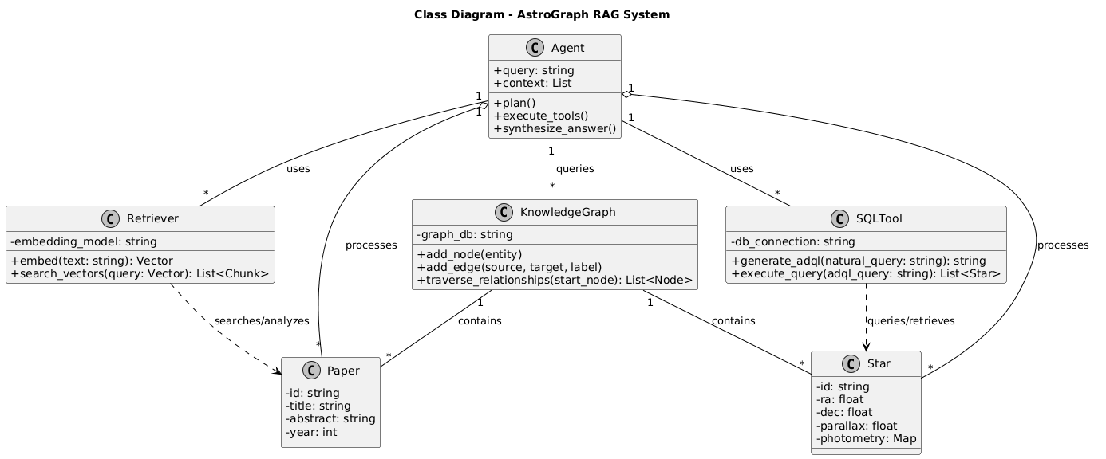
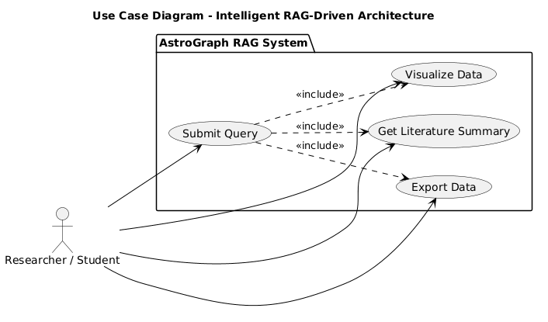
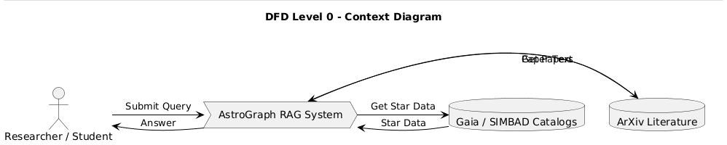
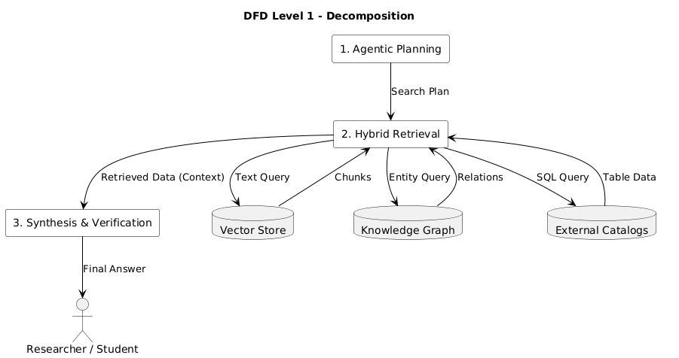
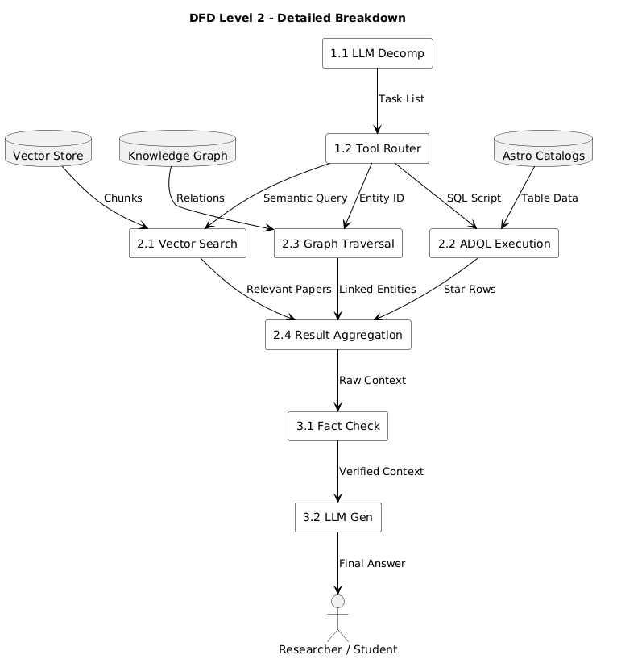
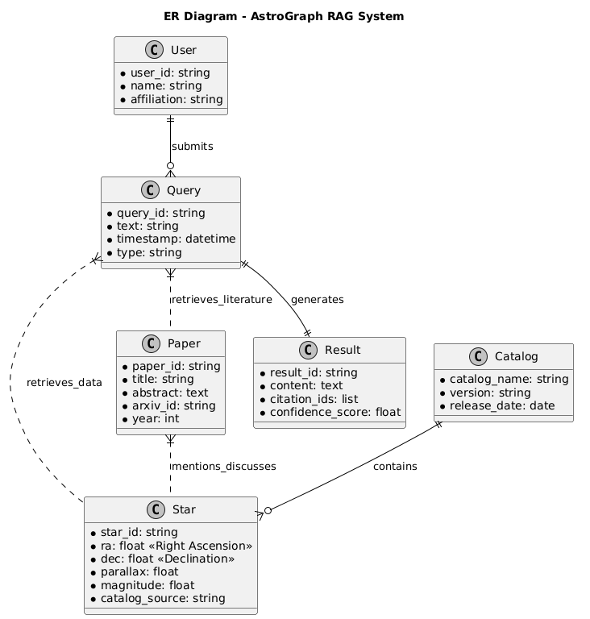
Diagrams
The following diagrams from the project synopsis are included below.
Class Diagram
Use Case Diagram
DFD Level 0
[Diagram Placeholder
— attach image here]
[Diagram Placeholder
— attach image here]
[Diagram Placeholder
— attach image here]
Agent, Retriever, KnowledgeGraph,
SQLTool, Paper, Star classes
Submit Query → Visualize Data
Get Literature Summary
Export Data
Context Diagram:
Researcher ↔ AstroGraph RAG System ↔ Gaia/SIMBAD/ArXiv
DFD Level 1
DFD Level 2
E-R Diagram
[Diagram Placeholder
— attach image here]
[Diagram Placeholder
— attach image here]
User, Query, Paper, Star, Result,
Catalog with relationships
[Diagram Placeholder
— attach image here]
Detailed: LLM Decomp → Tool Router → Vector Search / Graph Traversal / ADQL Execution → Fact Check → LLM Gen
Agentic Planning → Hybrid Retrieval (Vector Store, Knowledge Graph, External Catalogs) → Synthesis & Verification

Slide 11
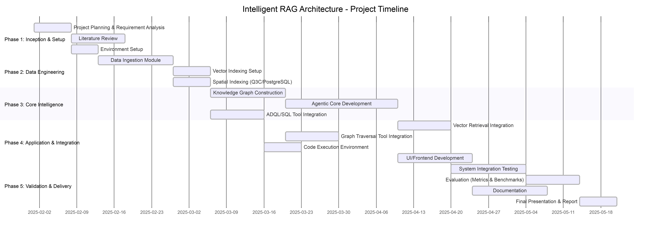
Gantt Chart — Project Timeline
Feb
Mar
Apr
May
Phase 5: Validation
Documentation
Final Presentation

Slide 12
Project Demo (Minimum 70% Complete)
Current Development Status
Data Ingestion Engine
90%
Vector Store Integration
80%
ADQL/SQL Query Generator
60%
Knowledge Graph (Neo4j)
70%
Agentic Reasoning Core
70%
UI / Frontend
60%

Slide 13
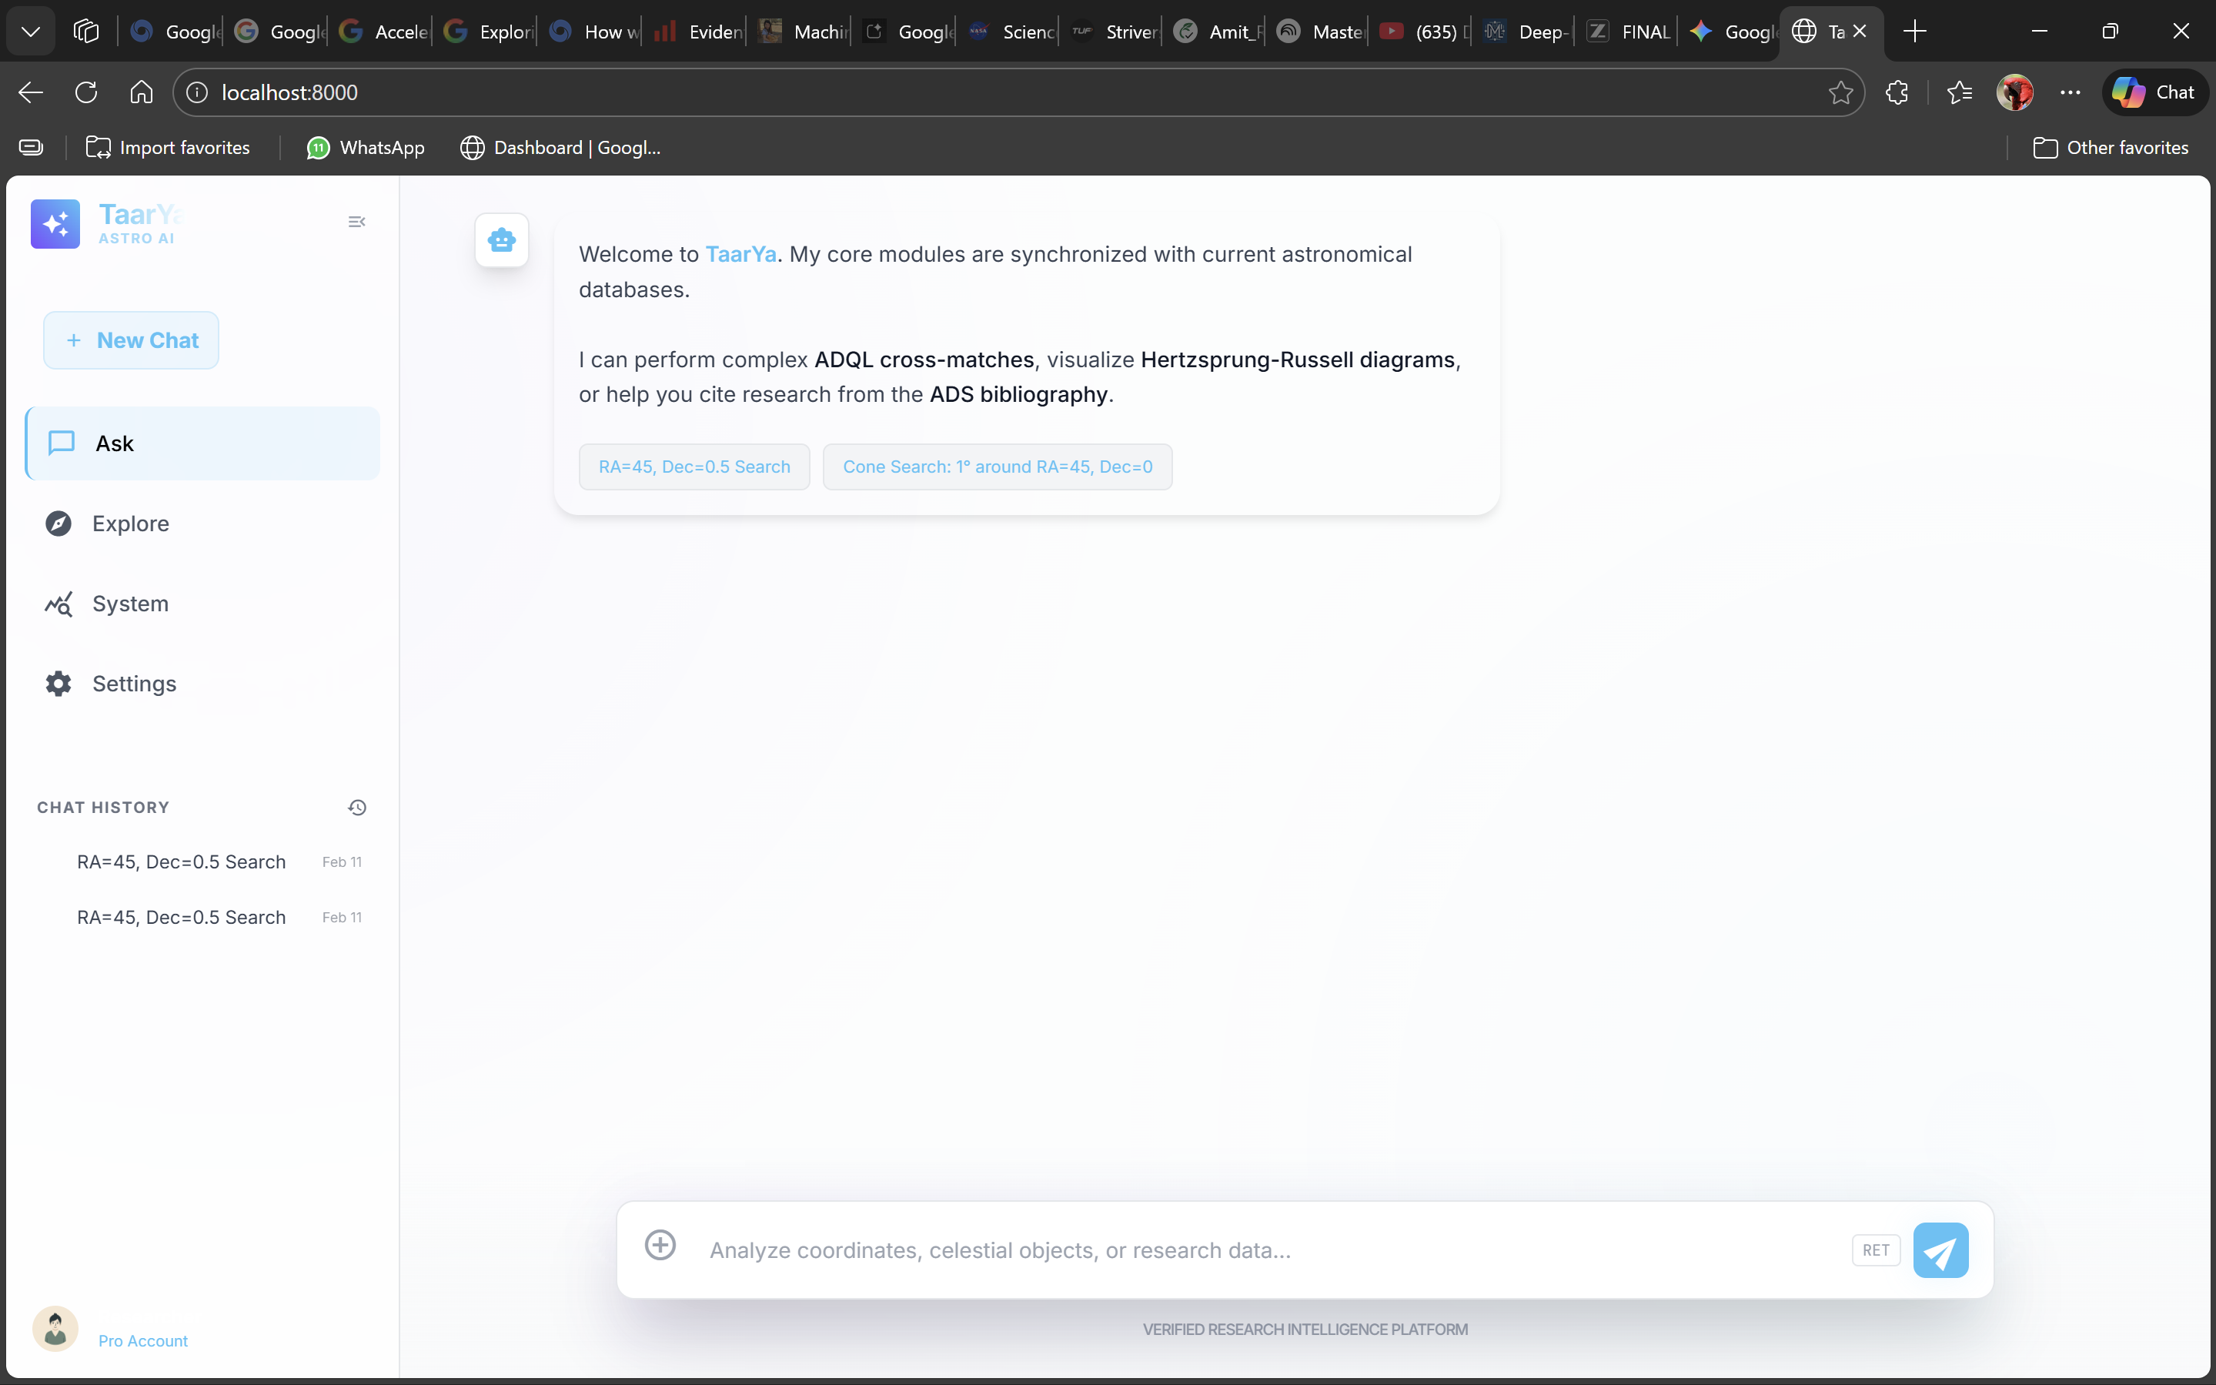
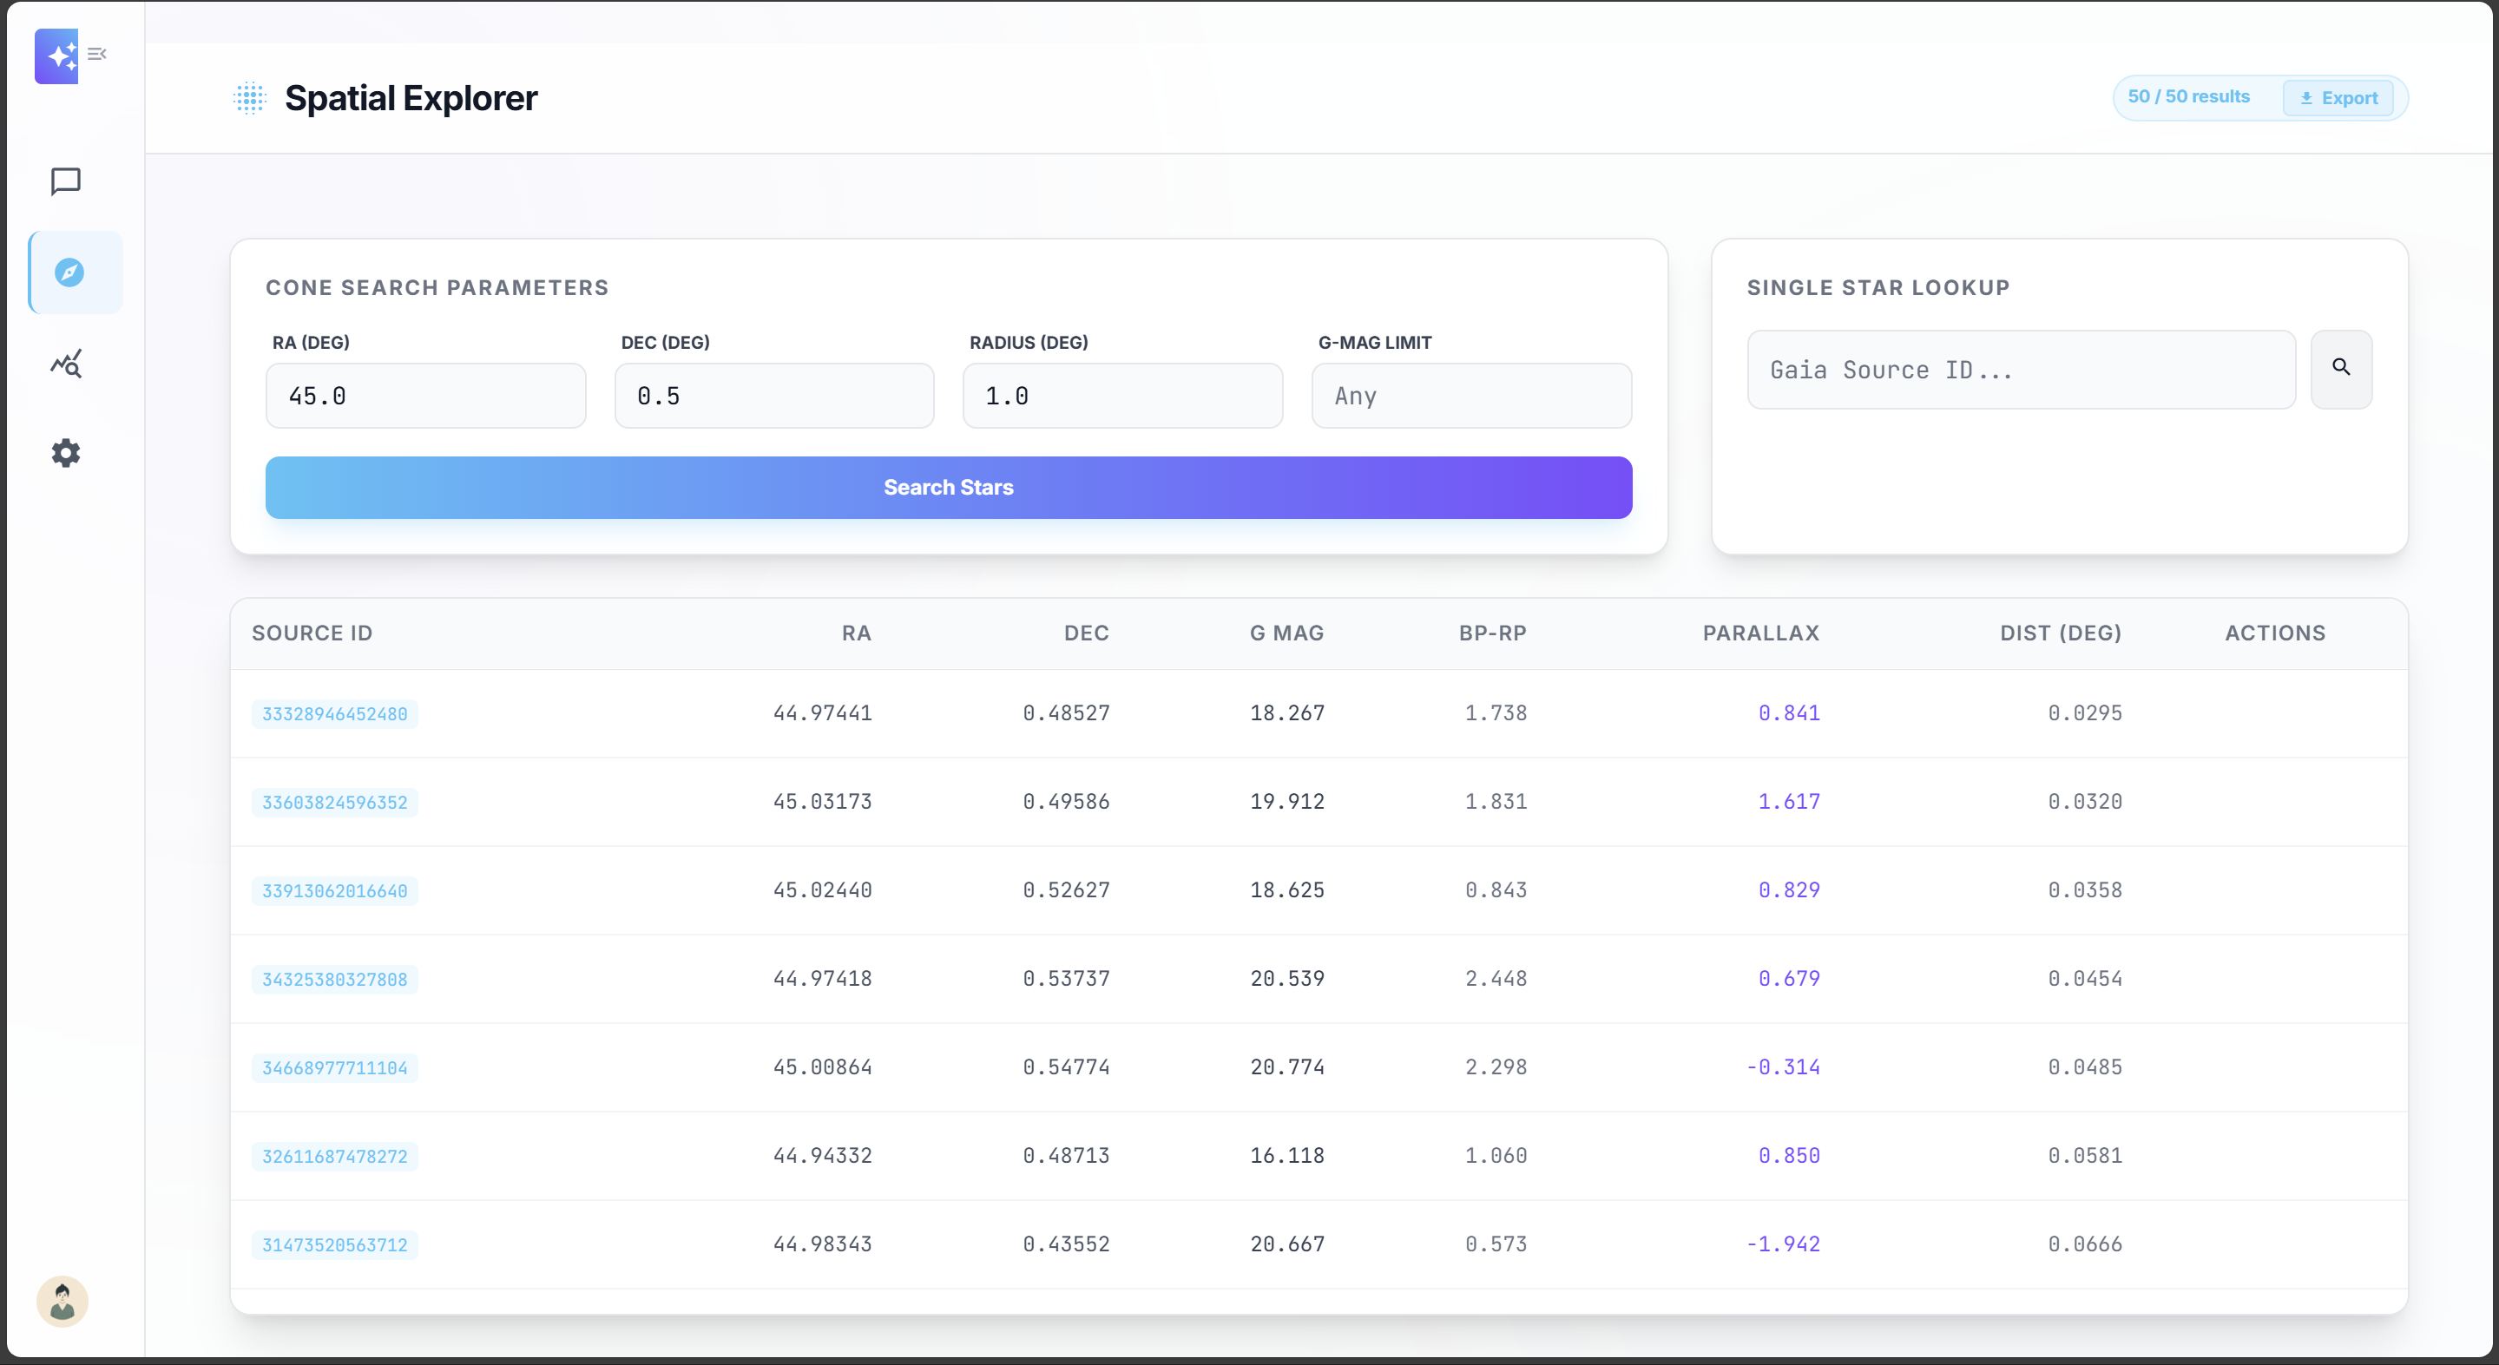
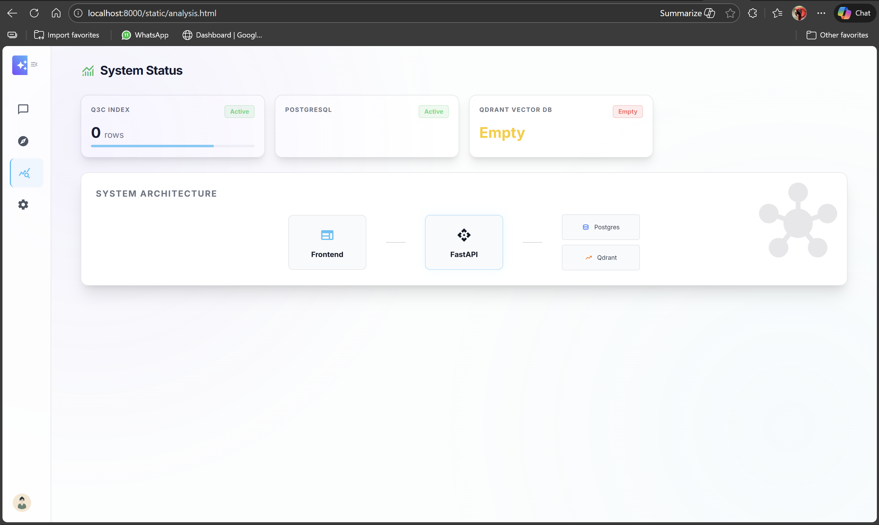
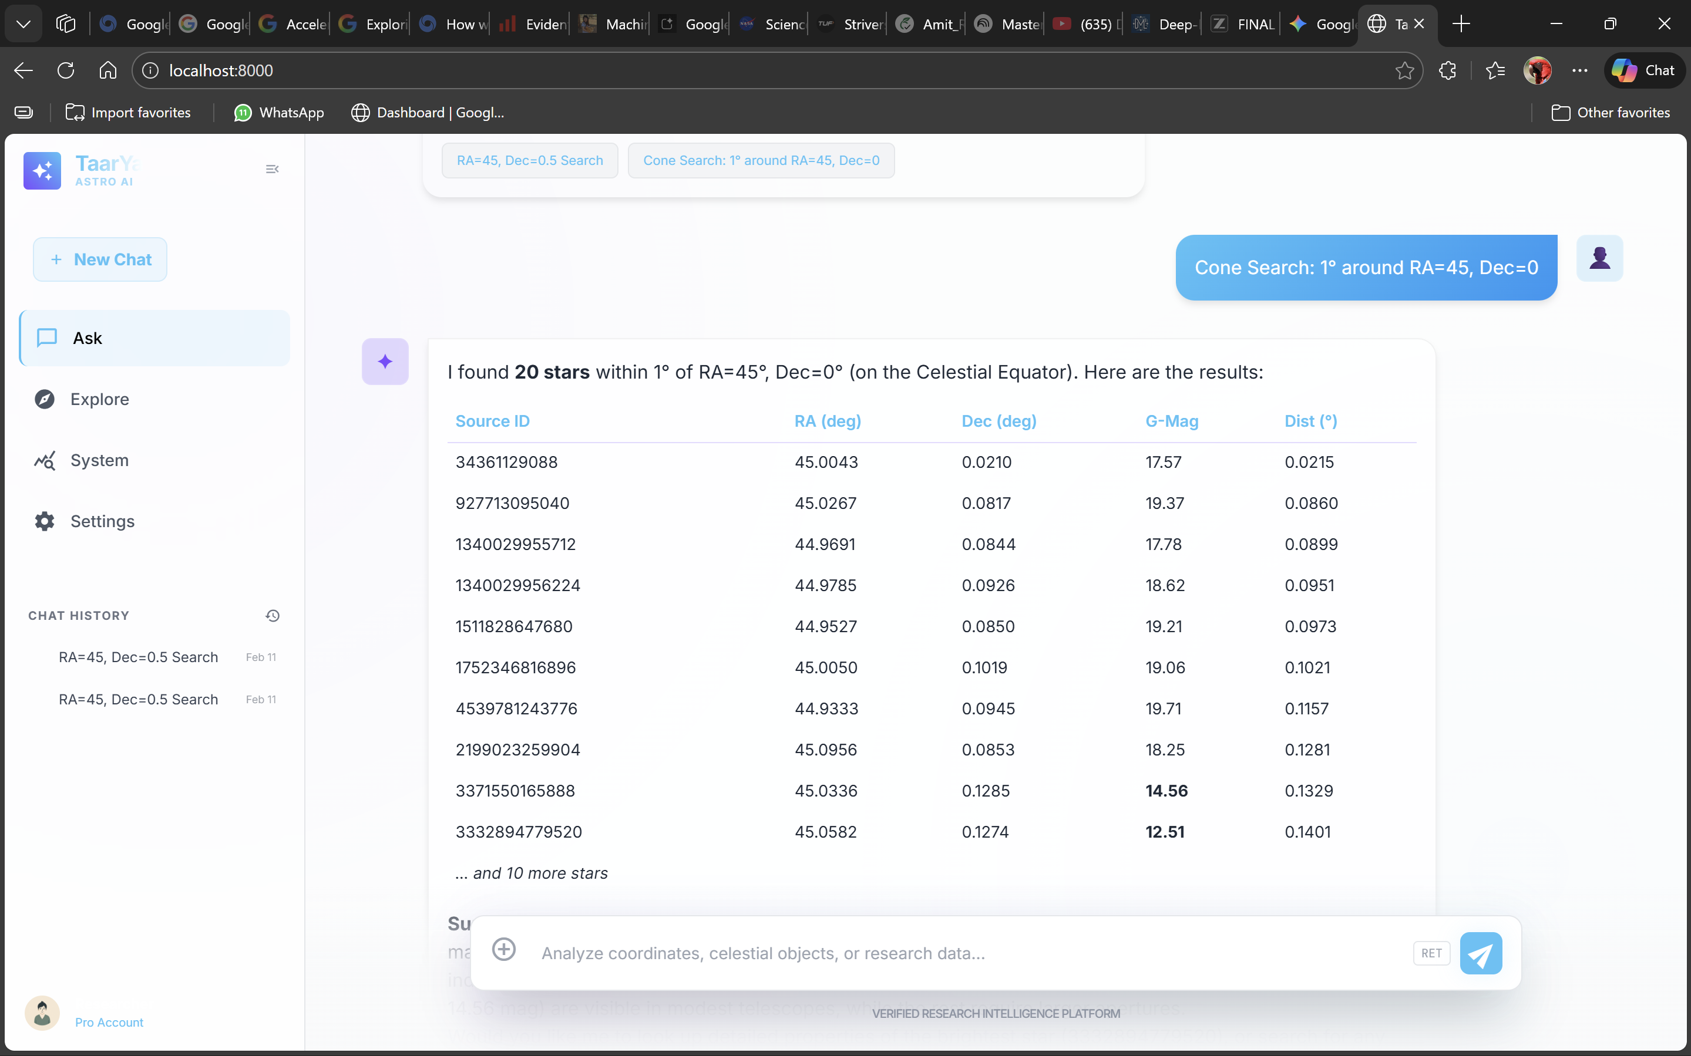

Slide 14
References
[1] Gao, Y., et al.: "Retrieval-Augmented Generation for Large Language Models: A Comprehensive Review"; arXiv:2312.10997, 2024.
[2] Lewis, P., et al.: "Retrieval-Augmented Generation for Knowledge-Intensive NLP"; NeurIPS, 2020, vol. 33, pp. 9459–9474.
[3] Edelman, G., et al.: "GraphRAG: Towards Graph-Based Retrieval-Augmented Generation"; arXiv:2404.16130, 2024.
[4] "The Digital Architecture of the Heavens: A Comprehensive Analysis of Star Catalogs…"; arXiv:2501.00000, 2025.
[5] "A Comprehensive Report on Reasoning Language Models (RLMs)"; arXiv:2512.24601, 2025.
[6] Vaswani, A., et al.: "Attention is All You Need"; NeurIPS, 2017.
[7] Brown, T., et al.: "Language Models are Few-Shot Learners"; NeurIPS, 2020.
[8] Koposov, S., et al.: "Q3C, a Quad Tree Cube"; Astronomy and Computing, 2010.
[9] Gaia Collaboration: "Gaia Data Release 3 Documentation."

Slide 15
Thank You
Amit Kumar | Roll No: 14618002722 Guide: Dr. Madhumita Mahapatra Delhi Technical Campus, Greater Noida | Session 2025-2026

