Slide 1
Personal Library Tracker
CSE 111- Database Systems
Habibatu Mboka & Neel Patel

Slide 2
System Description
User has access to GoodReads database
User can import data from GoodReads onto Personal Tracking Database
They can manually add book data if the book is not found on the GoodReads database.
User will be able to:
Save their favorite books or authors
Rate and save books they’ve read
Search or select books based upon specific attributes.
Notes:
Talk about the last point during schema slide.

Slide 3
Implementation Details
Coding Environment(s)
MySQL, Visual Studio Code.
Database:
SQLite3 implemented with Retool.

Slide 4
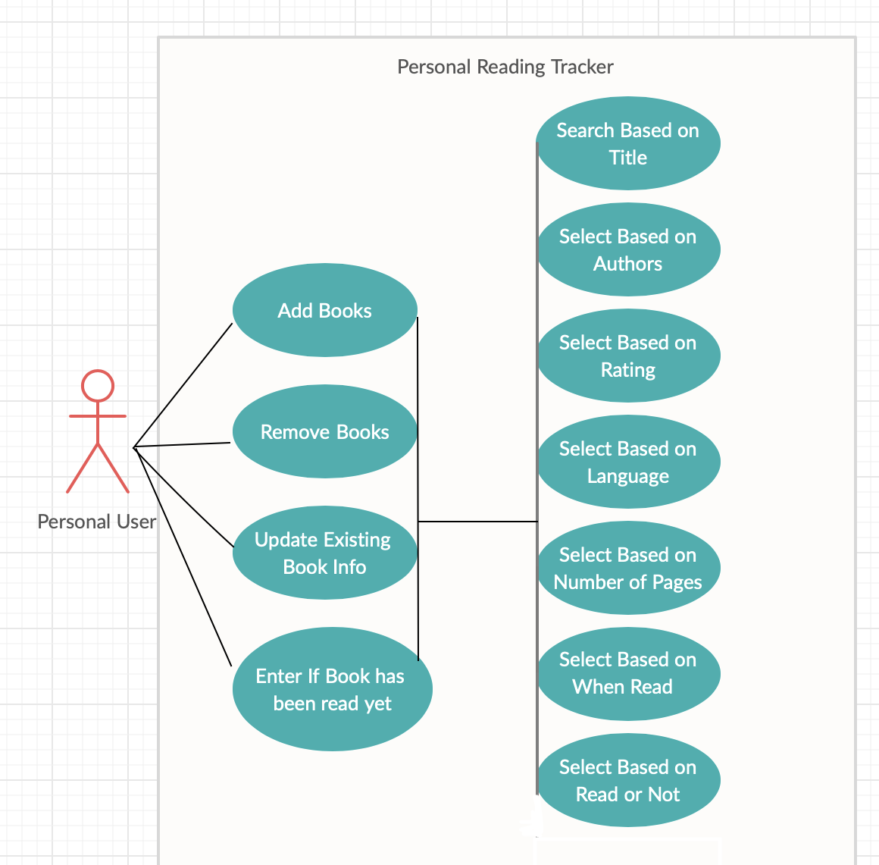
Use-Case Diagram

Slide 5
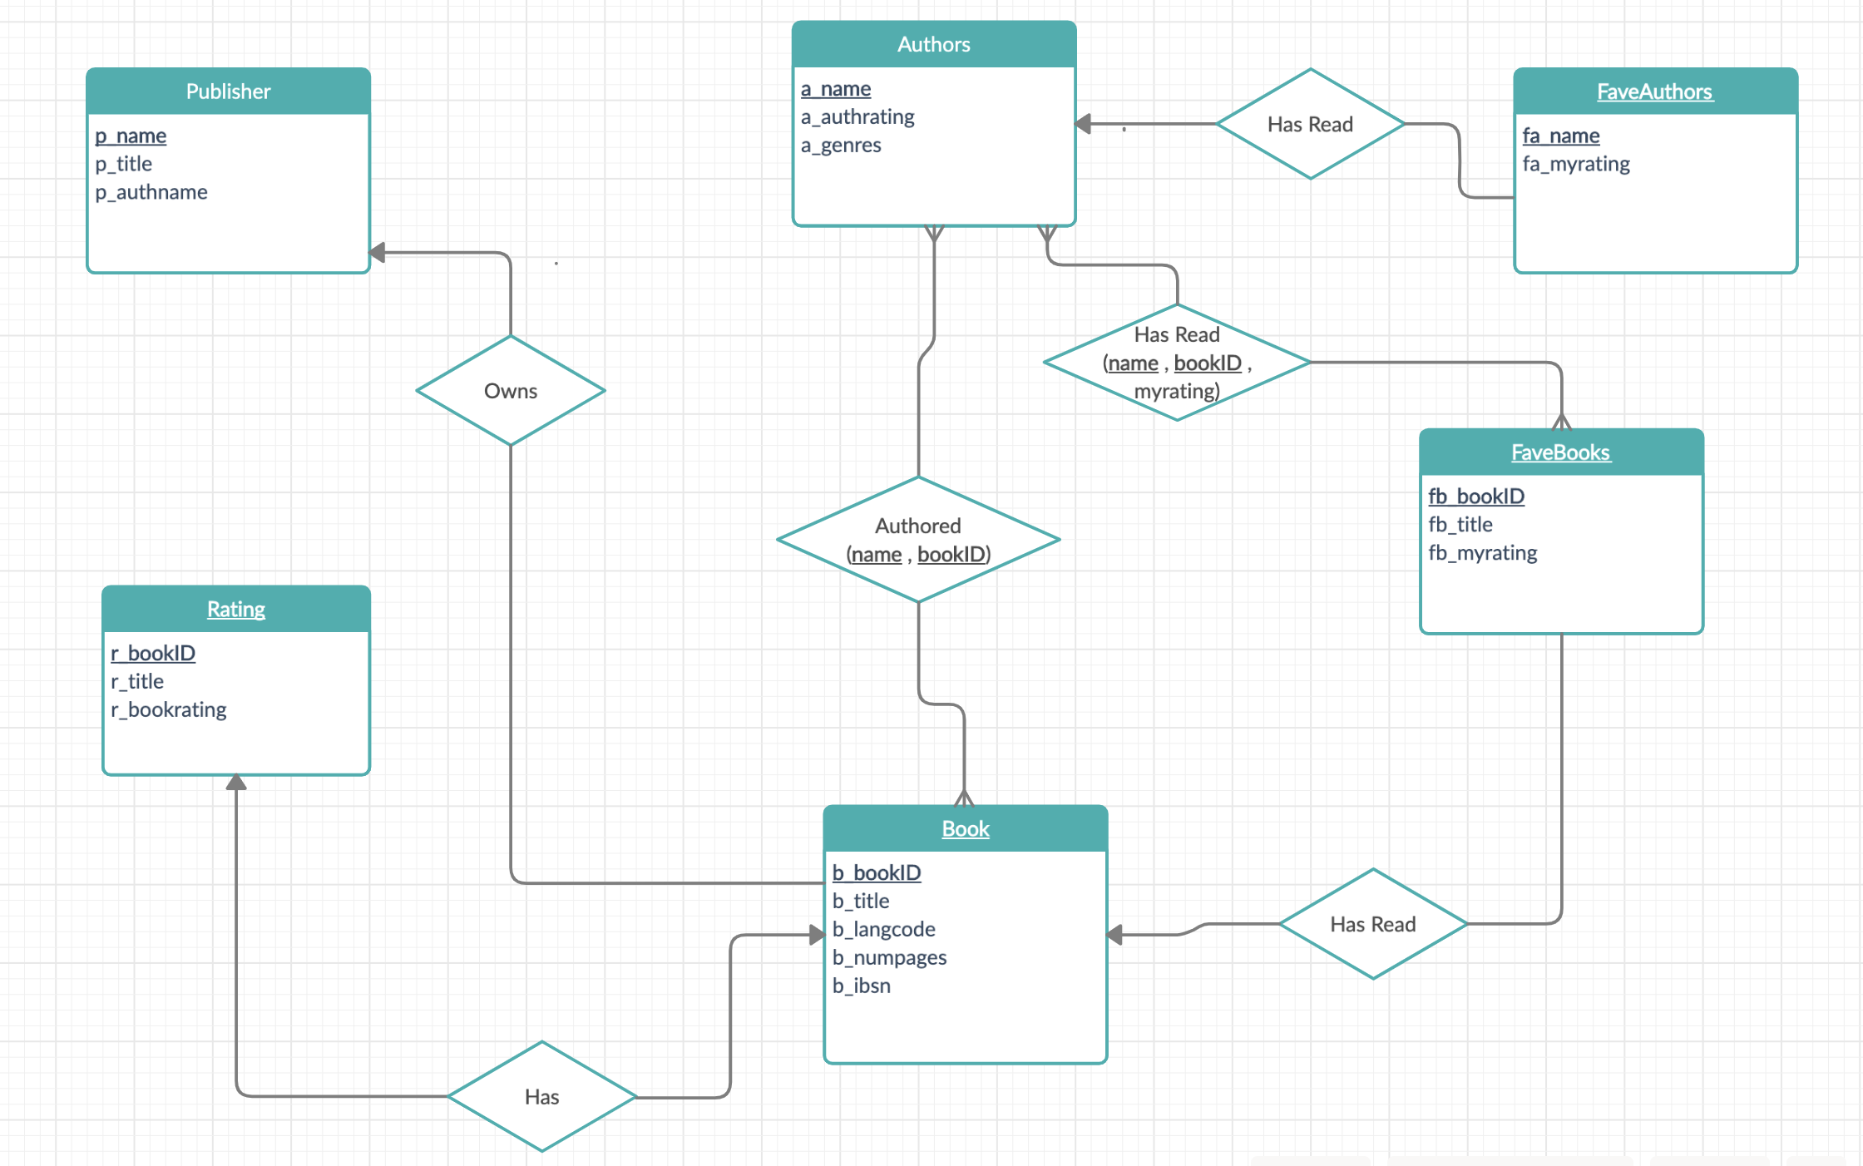
E/R Diagram

