Slide 1
Object Oriented Software development
151-35-1114

Slide 2
About The System
This system is mainly for university student to do online
course registration also for professors and register in a
university. This system will have the following features:
View All Course
Select Course
View Course Fee
View All Register Student
Select Taken Course
Create Course
Delete Course
Maintain Information

Slide 3
Why This System Necessary?? For saving time this system is necessary.
Vision
The vision of this system would be used by professors to indicate the courses they will teach, by students to select courses, and by the registrar to complete the registration process by creating courses.

Slide 4
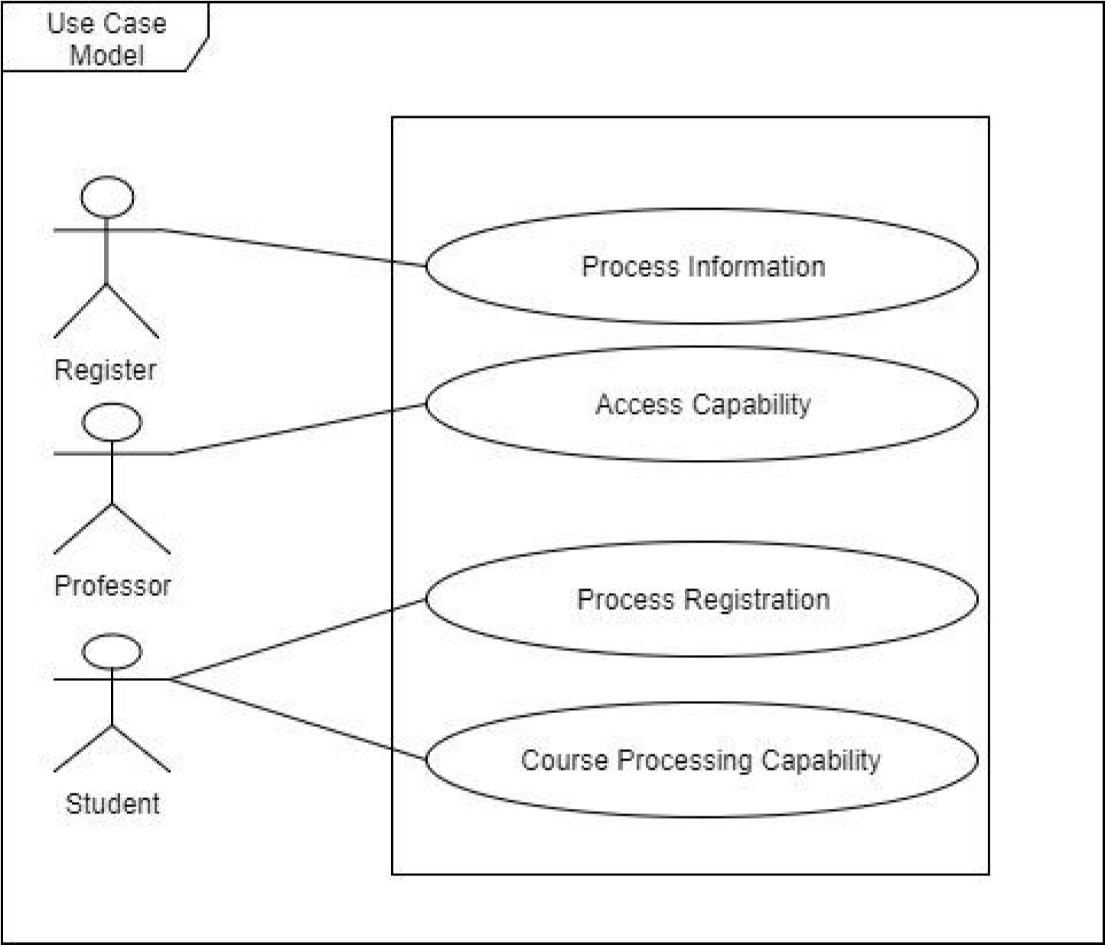
Use Case Model

Slide 5
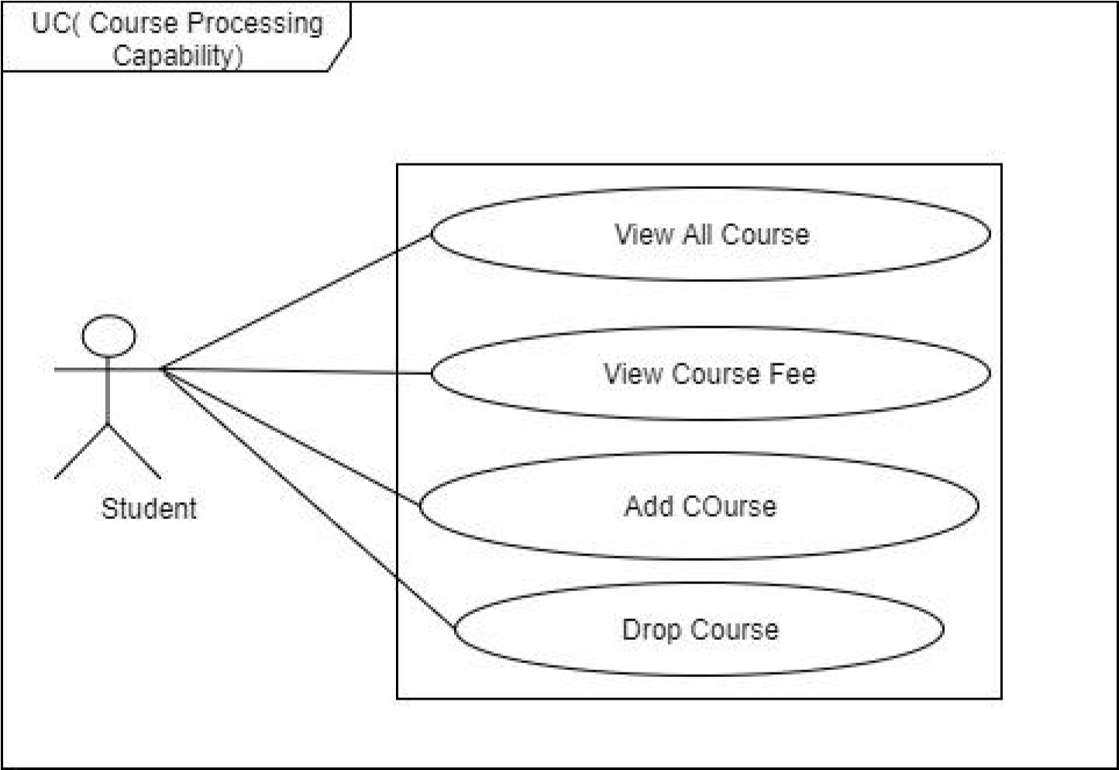
Use Case Description Brief
Course Processing Capability
Students are able to look up their course availability with course code, course fee and course schedule.

Slide 6
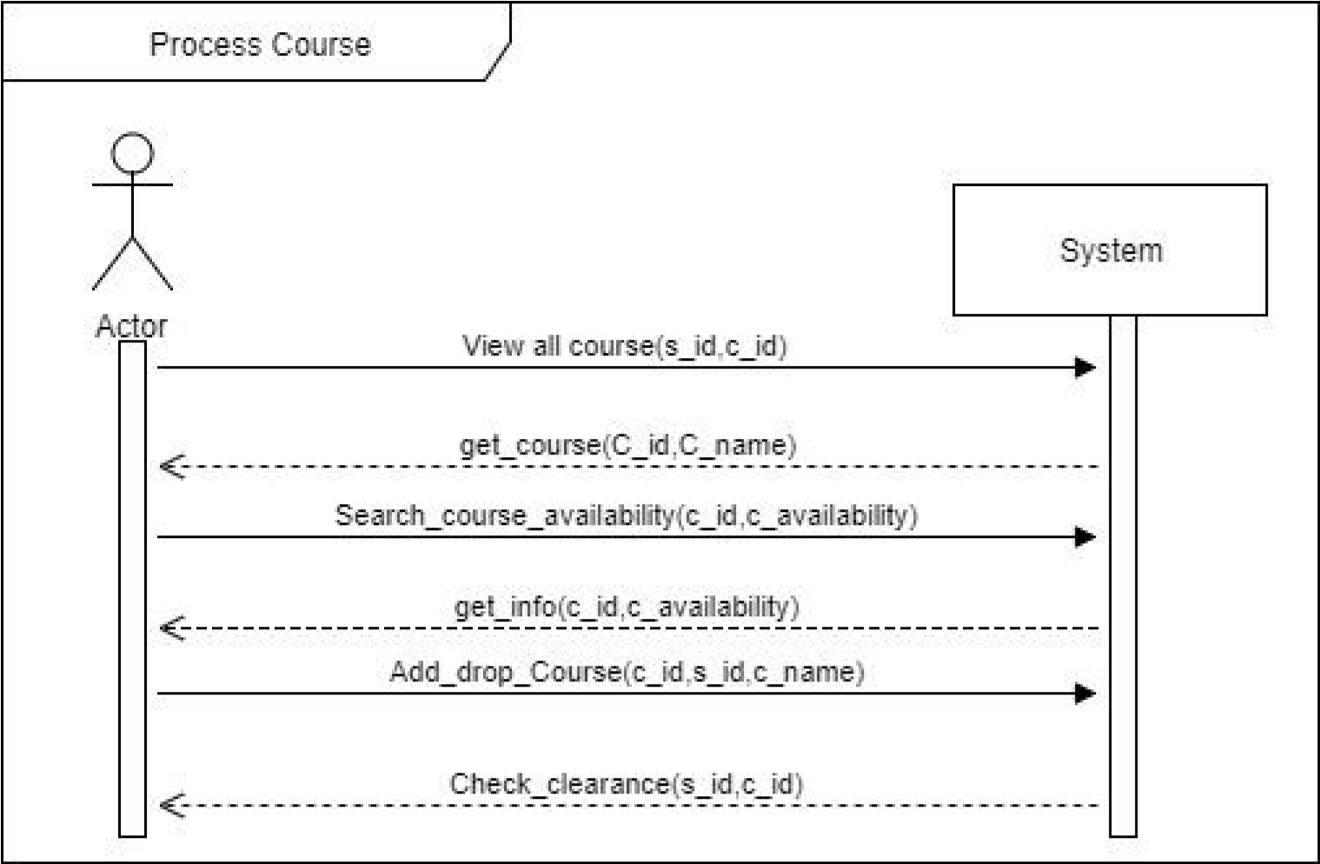
System Sequence Diagram
Process Course Success Scenario:-

Slide 7
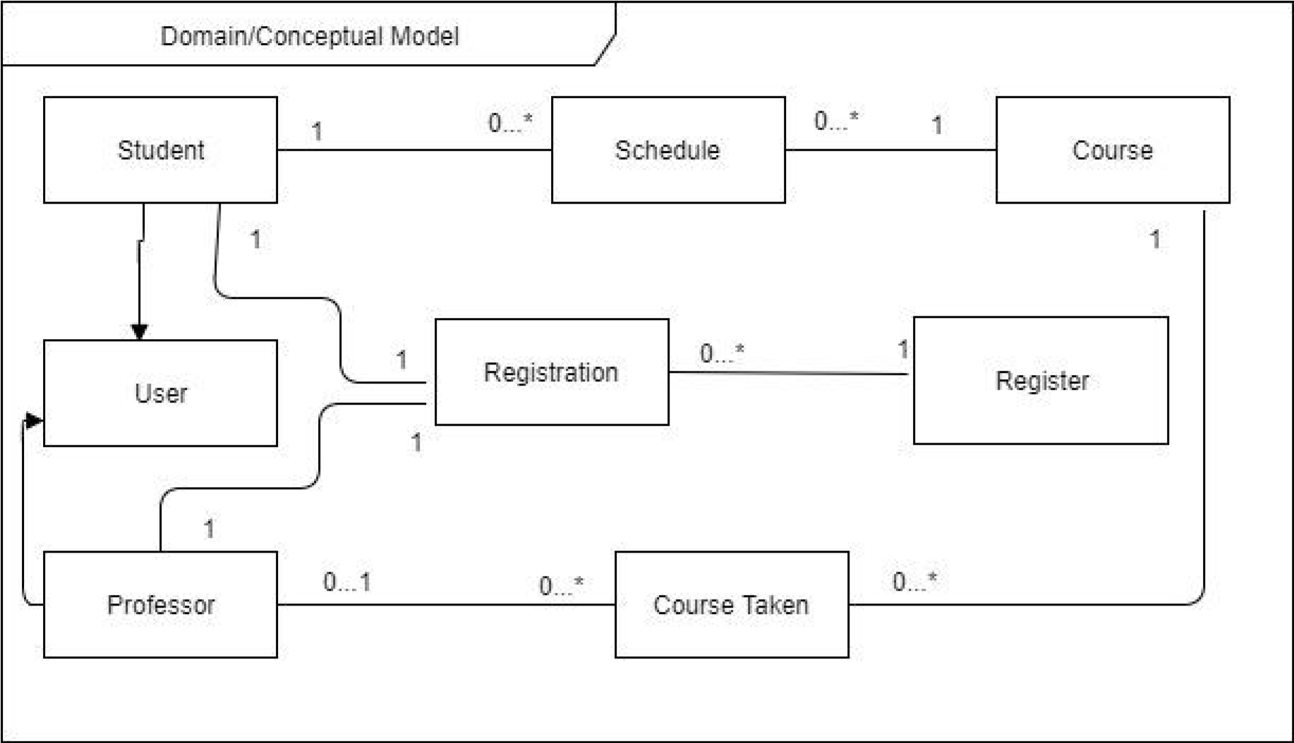
Domain Model

Slide 8
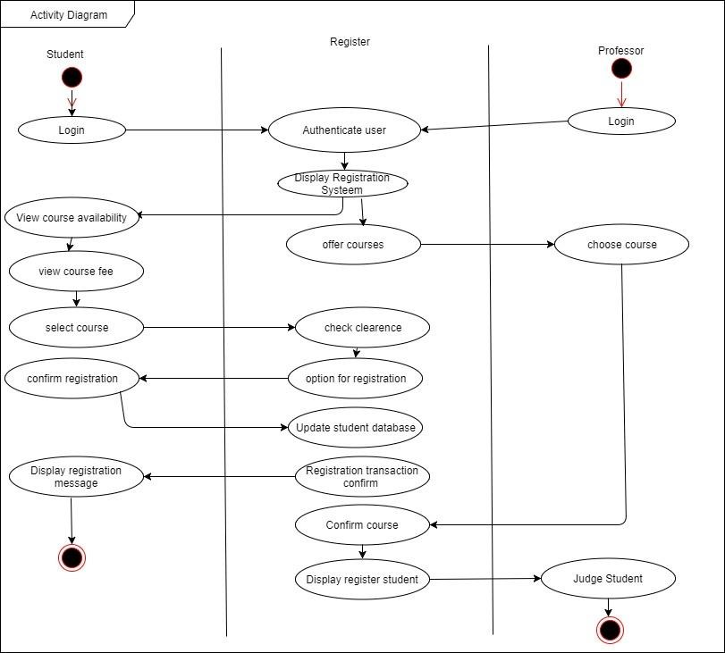
Activity Diagram

Slide 9
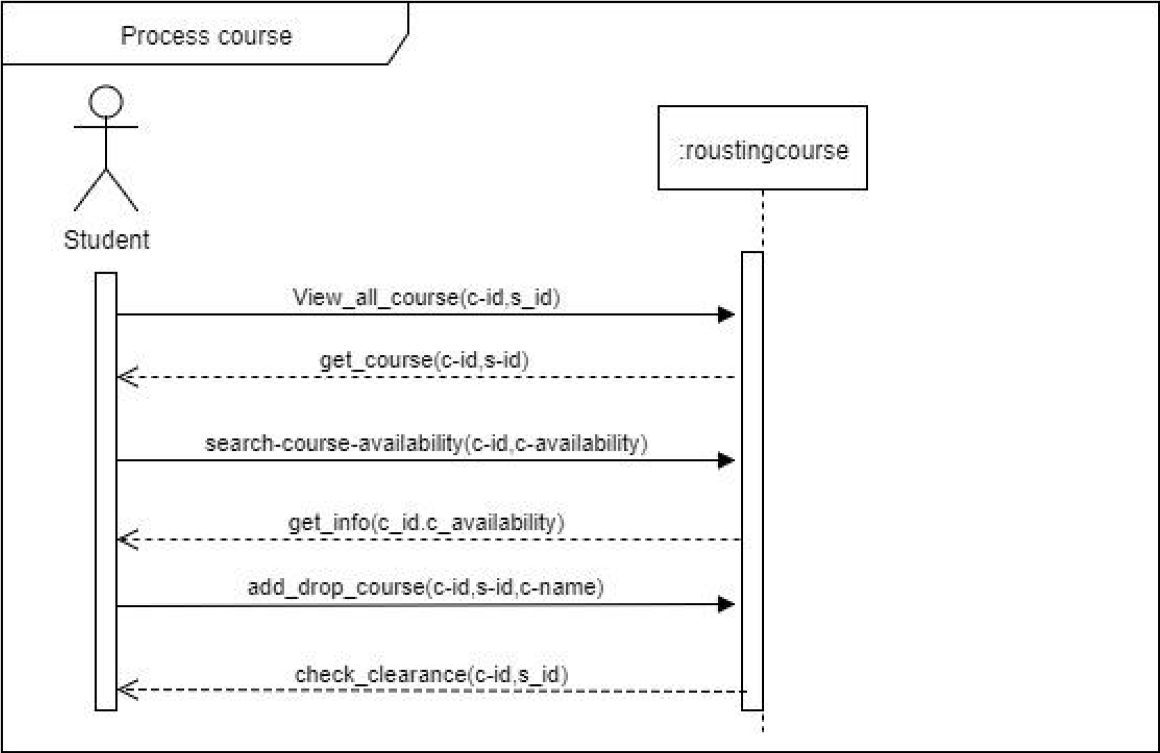
Sequence Diagram
Process Course for success scenario:-

Slide 10
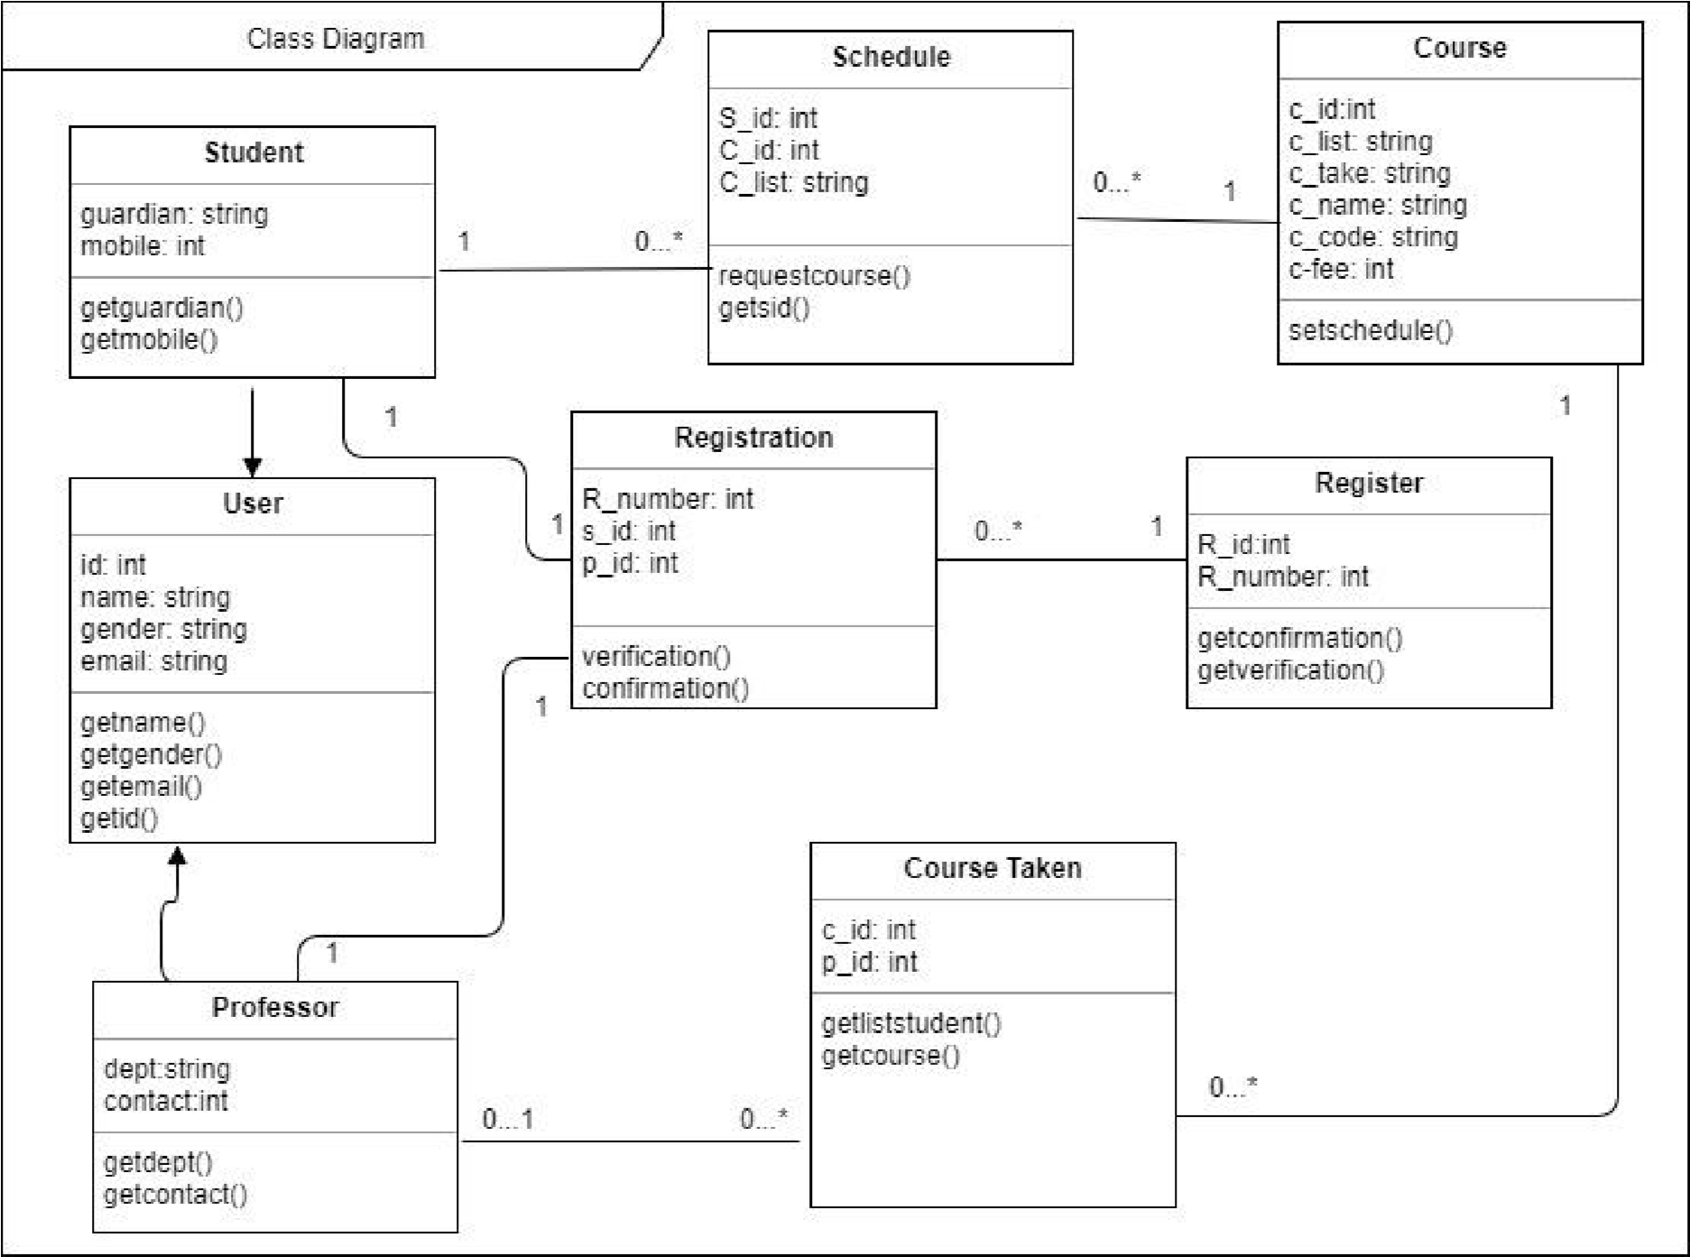
Class Diagram
Class or structural diagrams define the basic building blocks of a model.

Slide 11
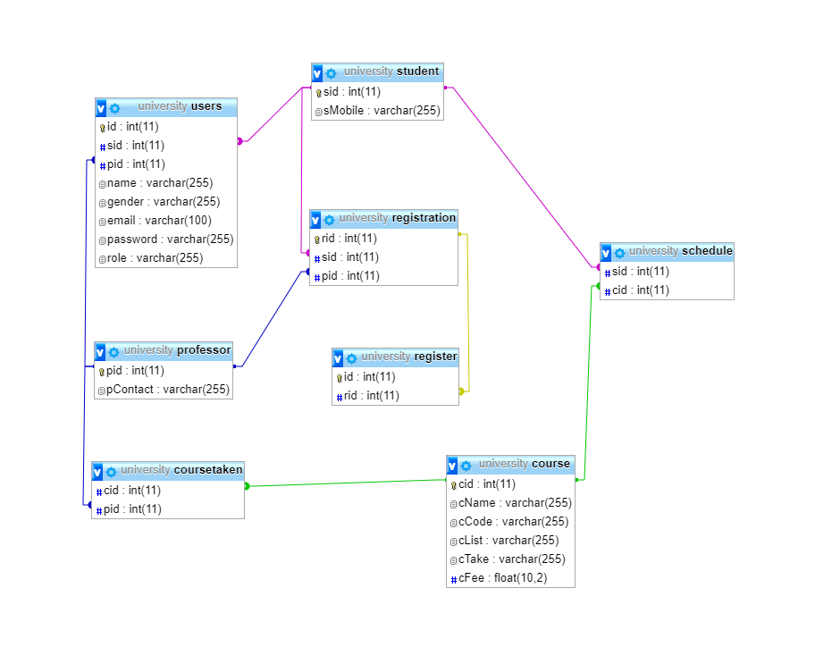
Entity Relationship Diagram
An entity-relationship model is an abstract and conceptual representation of data.

Slide 12
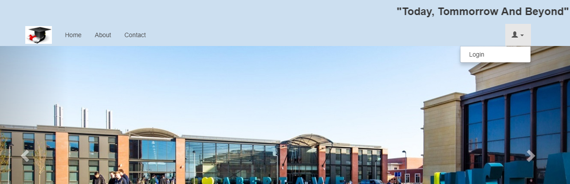
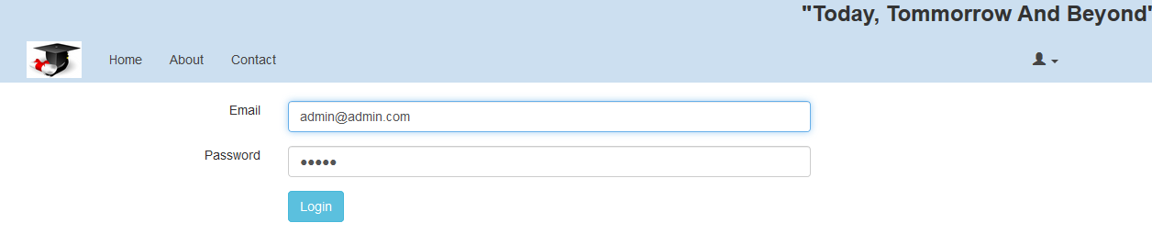

Slide 13
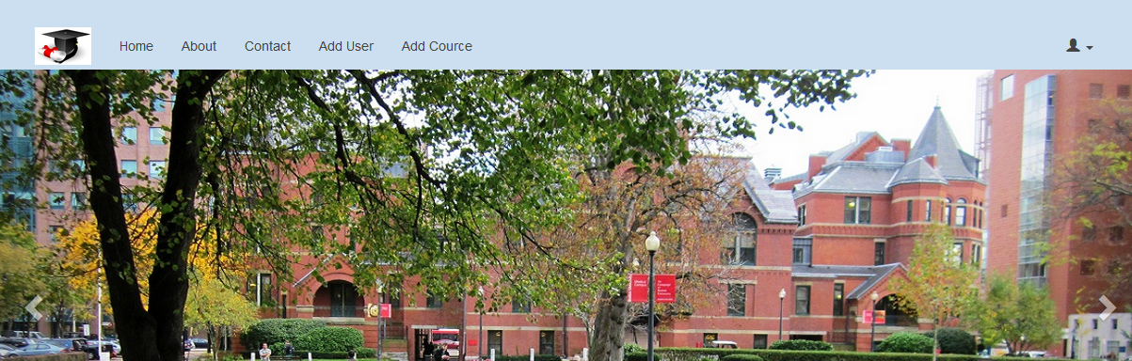
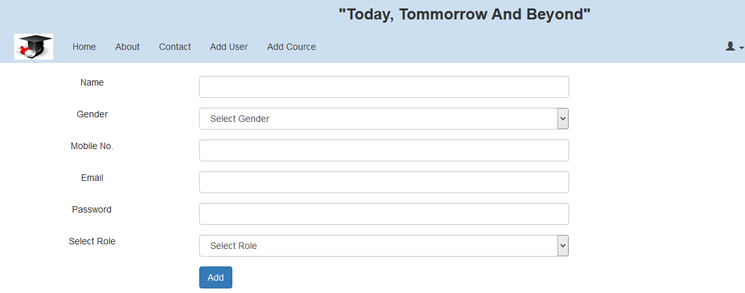
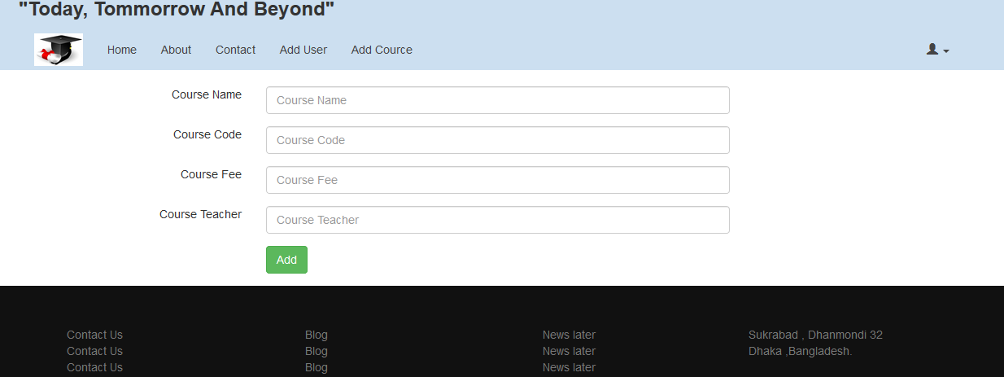
Logout

Slide 14
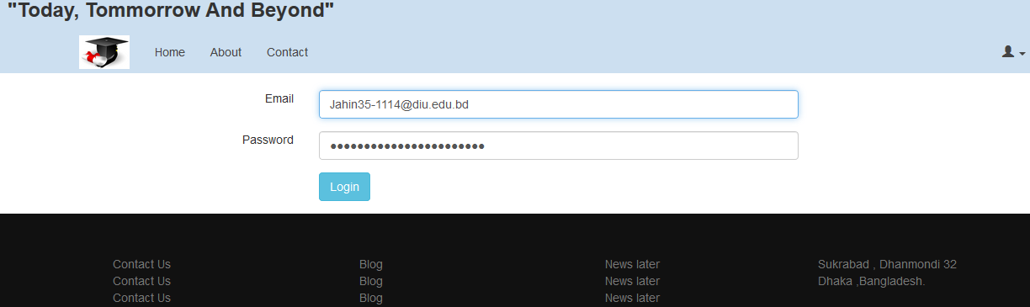


Slide 15
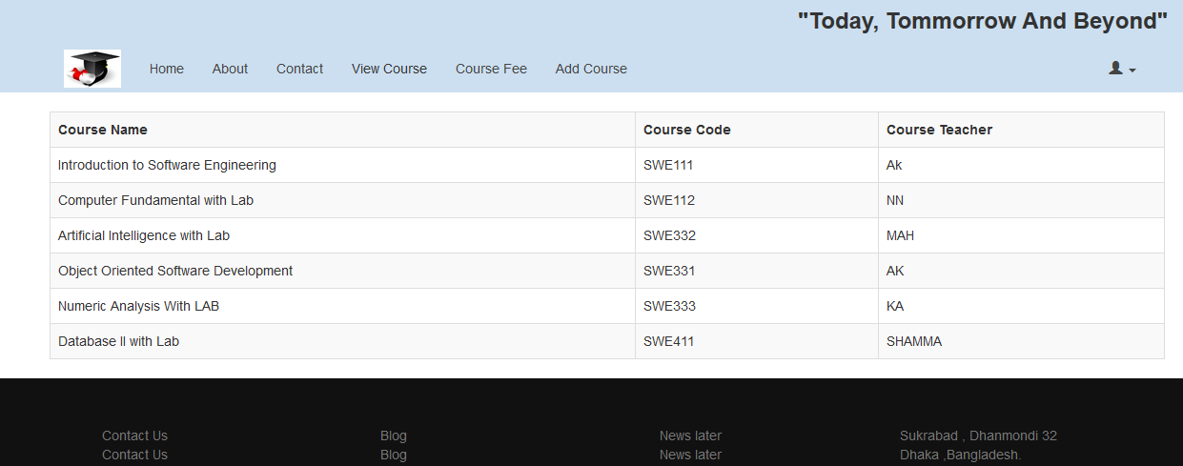
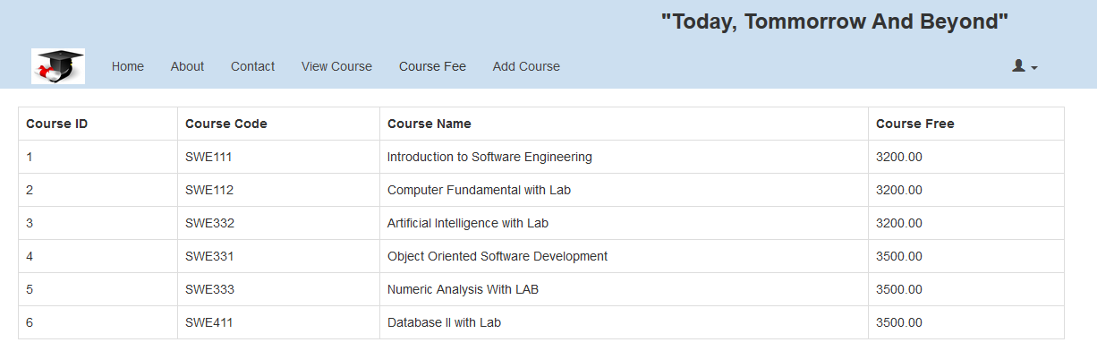

Slide 16
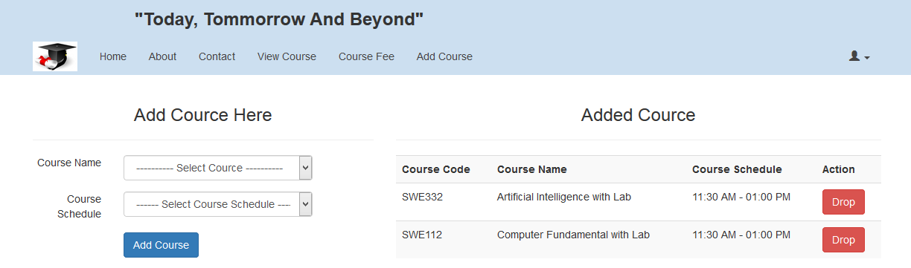
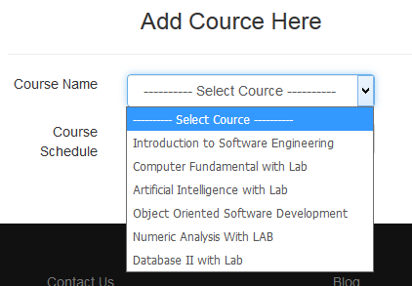
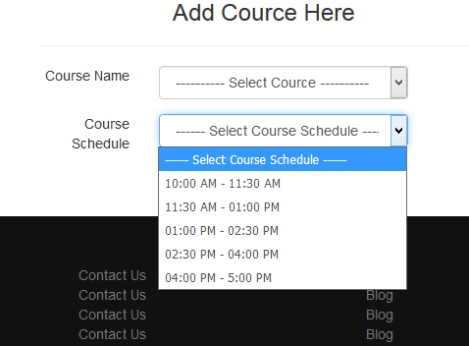

Slide 17
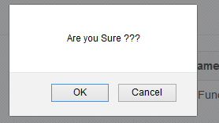
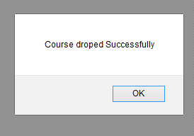
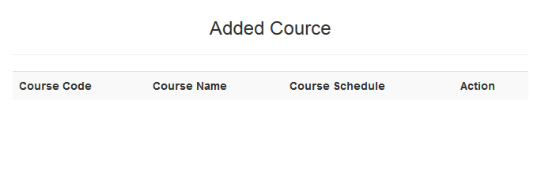

Slide 18


