Slide 1



INFORMATION CHALLENGE 2023 UMD iSCHOOL HANNAH MILILLO TEAM 23068
Redesigning the Council for the Preservation of Anthropological Records (CoPAR) Website

Slide 2
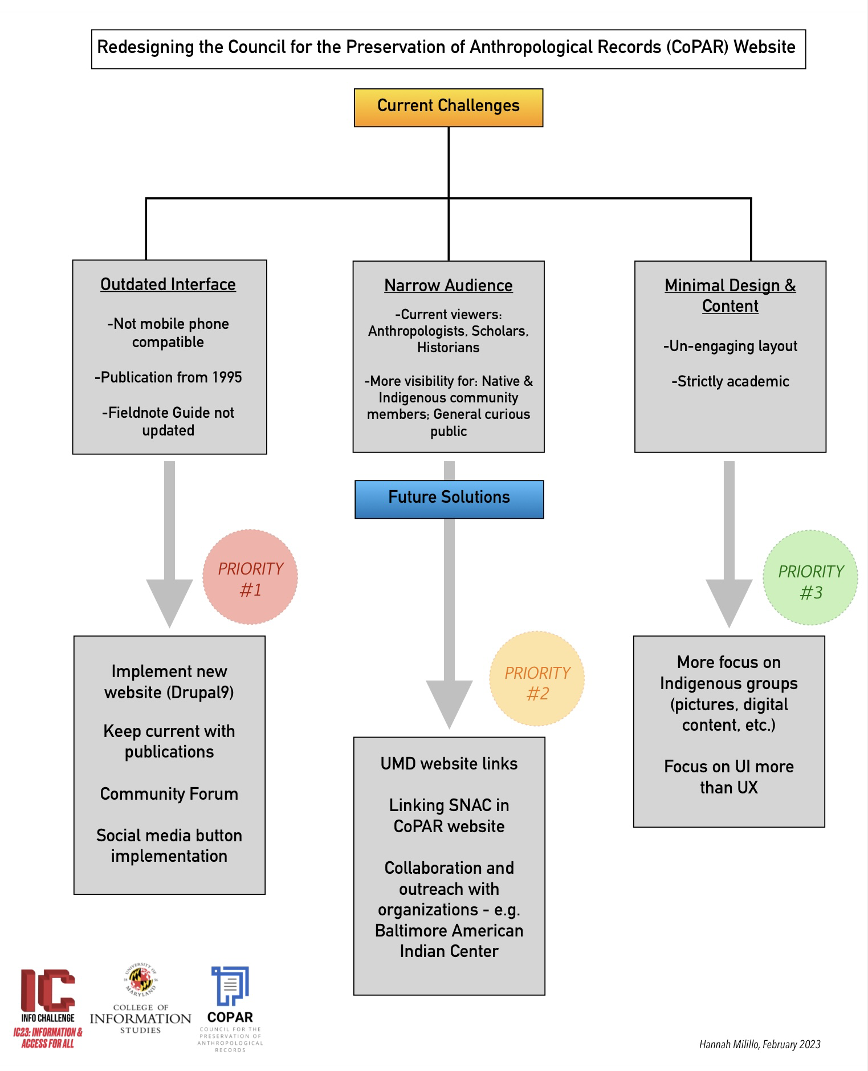

Slide 3
CoPAR Initiatives | Website Goals | Suggestions & Solutions
Foster awareness of importance of preserving anthropological records | Organization best-practices | DESIGN -Keep consistent, pleasing theme -Stay simple, yet academic
Provide technical support to archival repositories | Information Architecture | FORMAT -Convert documents (Preserving Anthro. Record & Bulletins) into PDFs -Rearrange website tabs for guidance
Provide information on records location and access | User-friendliness & visual appeal | ENGAGEMENT -Community forum -Digital media
Foster collaboration between archivists, repositories, and Native communities | Additional information | SPREAD -Outreach & collaborations -Readily available contact information -Links through UMD sites

Slide 4
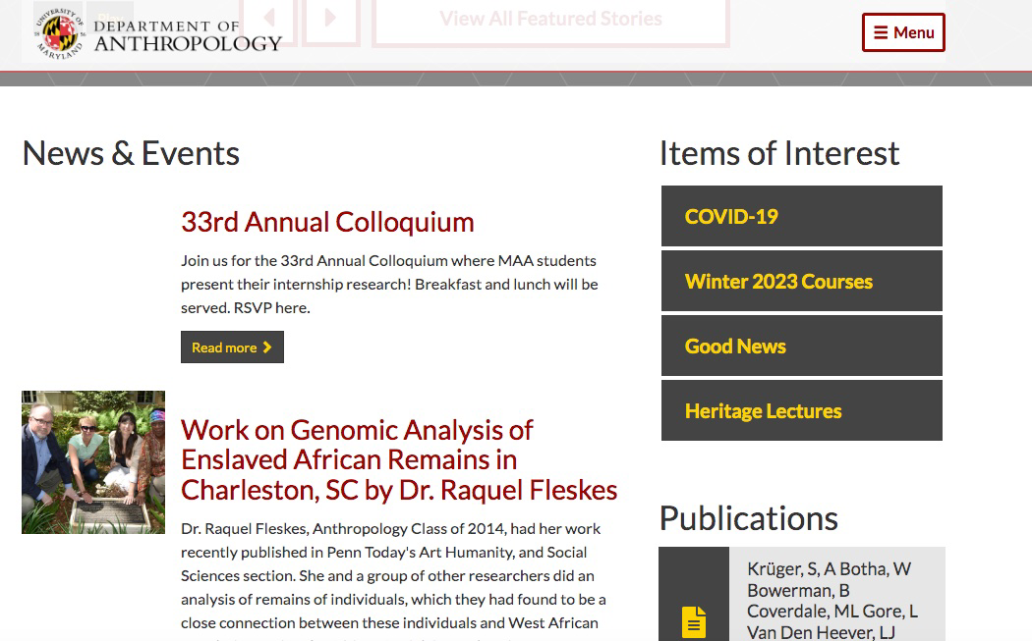
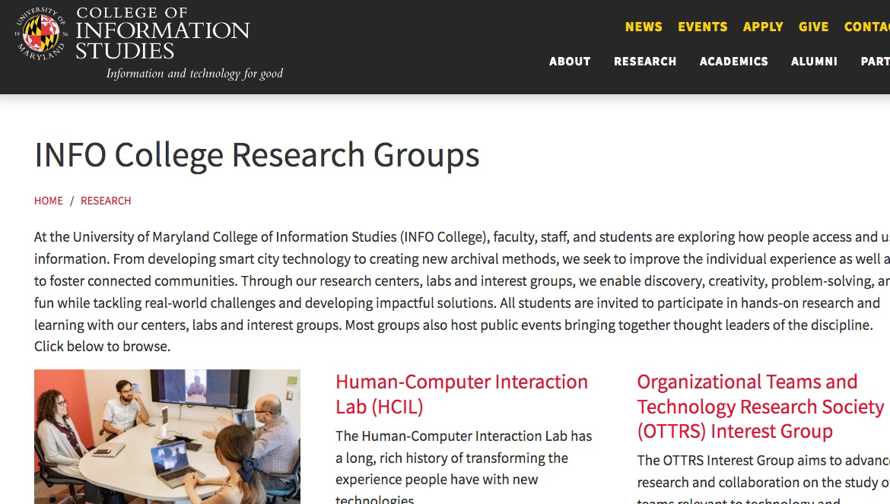
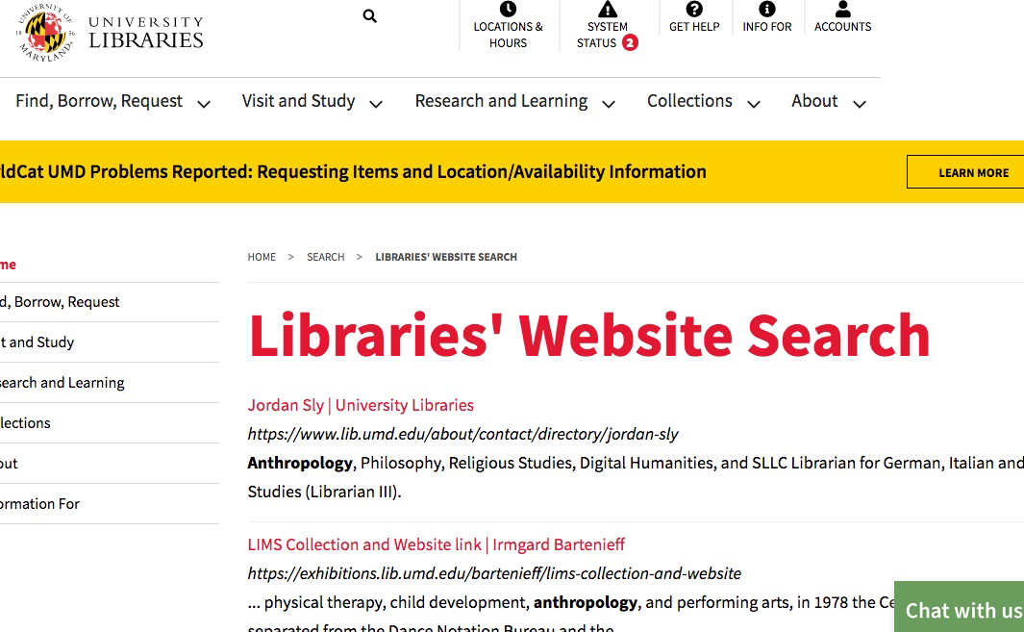
UMD Department of Anthropology
https://anth.umd.edu
UMD iSchool Research Groups or related site
https://ischool.umd.edu/research/centers-and-labs
Searching by keyword through UMD Libraries
https://www.lib.umd.edu/search/website?query=Anthropology

Slide 5

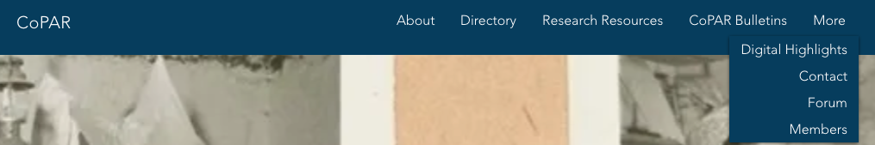
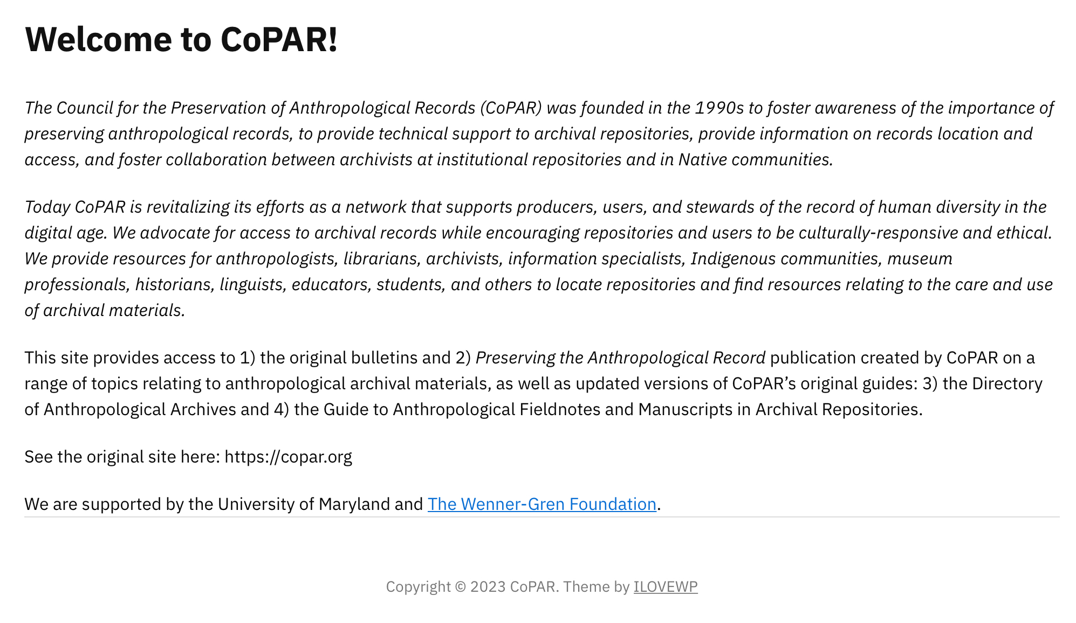
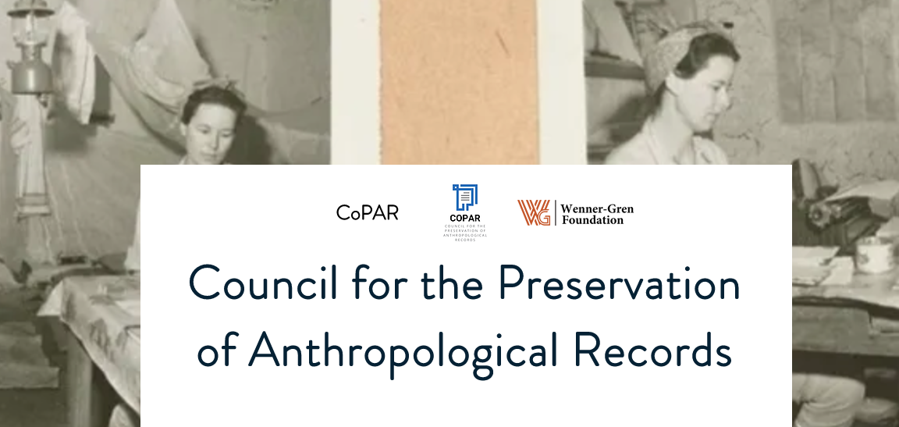
LET’S TALK DESIGN!
FORMAT
Rearrange tabs – guide people where to go
DESIGN
Engaging, visually appealing, keeps blue theme of logo

Slide 6
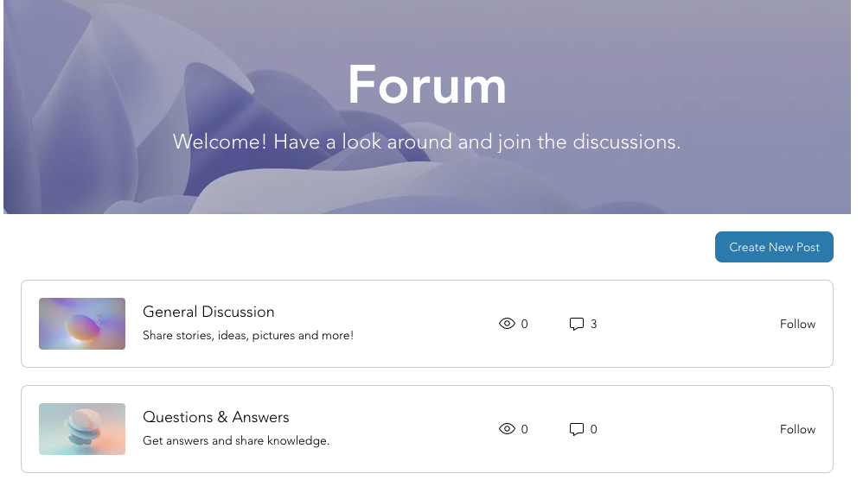
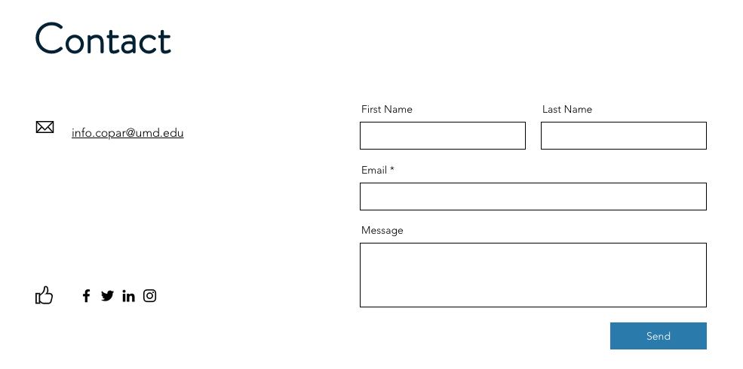
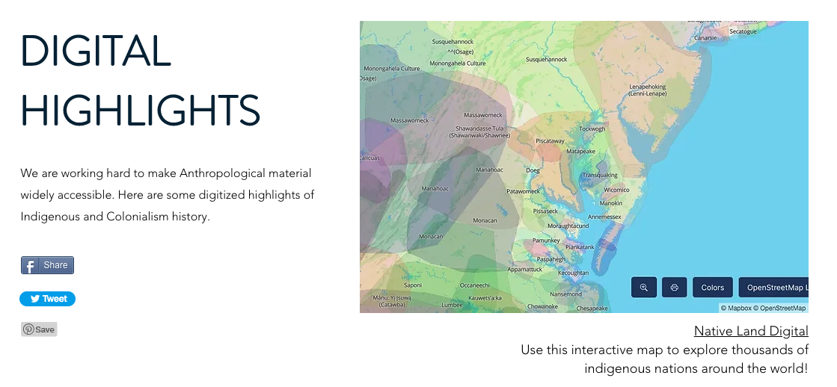
ENGAGEMENT & SPREAD
Implement a community forum directly to the site
Highlight digital media, photographs, archival collections, etc.
Have contact information readily available

Slide 7
HAVE YOU BEEN WAITING FOR SOMETHING?
CoPAR Redesign Version 1.0

Slide 8
1-2 Months
Work on new web design
Implement community forums
Social media engagement
PRIORITY #1
2-3 Months
Outreach & collaboration with indigenous communities
Link website to UMD pages
PRIORITY #2
2-3 Weeks + Ongoing
Finishing Touches
Continuous updating for publications
Uploading digitized media
Keep current with forums
PRIORITY #3

Slide 9
Thanks for listening!
Can I Answer Any Questions?
Hannah Milillo
Information Challenge 2023
CoPAR Redesign
Special thanks to my mentor Jacob

