Slide 1
T1A3 – Terminal Application
Joshua Nahlous

Slide 2
AGENDA
Introduction
Features within the Application
Decisions and Explanations

Slide 3
INTRODUCTION
This is an Application that is used to request certain information from a HTTP data log.

Slide 4
Features within the Application

Slide 5
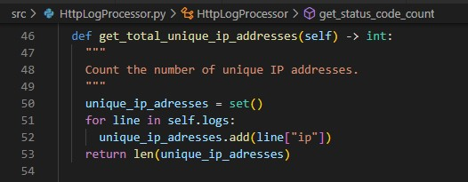
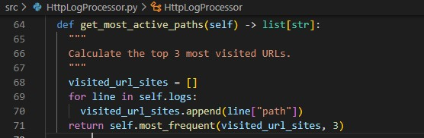
Feature 1:
Count the number of unique IP Addresses
Feature 2:
Calculate the top 3 most active IP Addresses
Feature 3:
Calculate the top 3 most visited URL’s
`--unique_clients`
Finds the most unique IP Addresses within the logs
`--most_active_clients
Finds the most active user IP Addresses in the logs
`--most_visited_paths
Finds the most visited paths in the logs

Slide 6
Decisions and Explanations

Slide 7
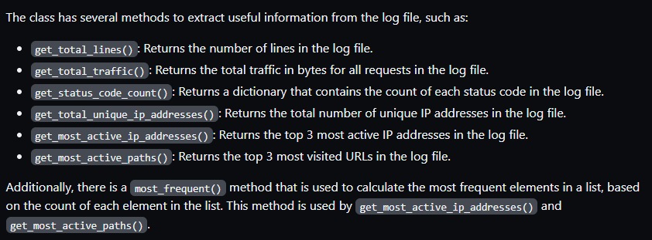
AREAS OF FOCUS
HttpLogParaser Class
Http Log
Top K Frequent Elements Function
A Http log created using https://www.mockaroo.com/
The function `most_frequent` takes two arguments as input, a list of strings `items` and an integer `k`, and returns a list of strings as output.
It first initializes an empty list called `res` to store the most frequent strings.

Slide 8
THANK YOU
Joshua Nahlous
https://github.com/Hmmmm-Josh\
https://github.cohttps://github.com/Hmmmm-Josh/JoshuaNahlous_T1A3_TerminalApplicationm/Hmmmm-Josh/JoshuaNahlous_T1A3_TerminalApplication
https://youtube.com

