Slide 1

UNIVERSITY OF COMPUTER STUDIES (MONYWA)
JAVASCRIPT PROJECT (CS-2254)
EXCHANGE RATE CALCULATOR

Slide 2
Supervised By Daw Myat San Nwe
MEMBER LISTS
2CS-43: Mg Hein Htet Aung
2CS-204: Mg Hmue Set San
2CS-205: Mg Aung Kyaw Thein
2CS-206: Mg Thet Aung Zin
2CS-8: Ma Phyo Thiri Kyaw
2CS-29: Ma Ingyin San

Slide 3
Outlines
1. Abstract
2. Introduction
3. Objectives
4. Implementation of the project
5. Conclusion
6. Lesson Learned
7. References

Slide 4
Abstract
This project can exchange currency that uses throughout the world.
The usage is aim for the people who works in the fields related to business enterprises such as banking, trading, stock market etc.
The user can check the exchange rates in this project. Therefore, not only the user can view the exchange rate but also the user can calculate the desired exchange rate.

Slide 5
Introduction
This project can exchange currency that uses throughout the world. For instance, the user can exchange from MMK (Myanmar Kyat) to JPY (Japanese Yen) vice versa can also exchange JPY to MMK. And then, this project include history list so that the user can view the list that exchange from one to another. This history list is made by using Date & Time to review the specific amount of time and currency fluctuations. Finally, the project makes responsive for all devices and creates dark & light mode as user interface.

Slide 6
Objectives
To convert quickly between different foreign currencies
To check the exchange rates
To make easily the user calculate the exchange rates
To review the history calculated

Slide 7
Implementation of the Project
Using HTML, CSS
Pages are created by using HTML.
User interface designs are used with CSS like inserting images, background, font-style, table layout and responsive (media-query) etc.
Using JavaScript
Buttons are created by using DOM Event Handlers.
Table rows are created by using DOM (Document Object Model)
Functions are created to calculate the operations of tasks.
Object array is used to store the currency rates
Date object is used to get the current date of time

Slide 8
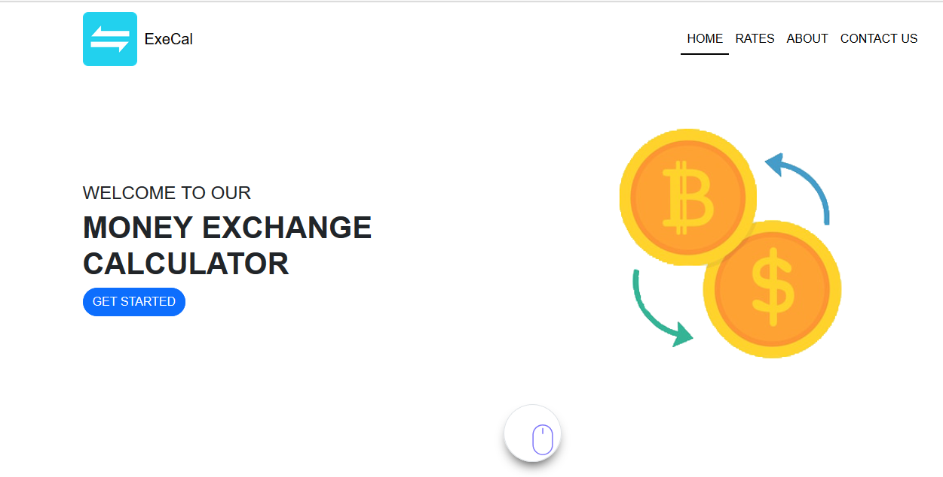
Home
This is our home page.
Figure 1 Home Page

Slide 9
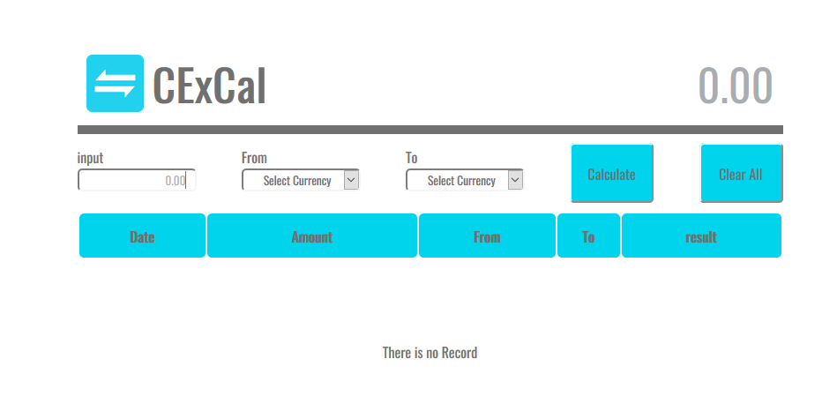
If the user click on the GET STARTED button, the user will see this calculate page.
Figure 2 Calculate Page

Slide 10
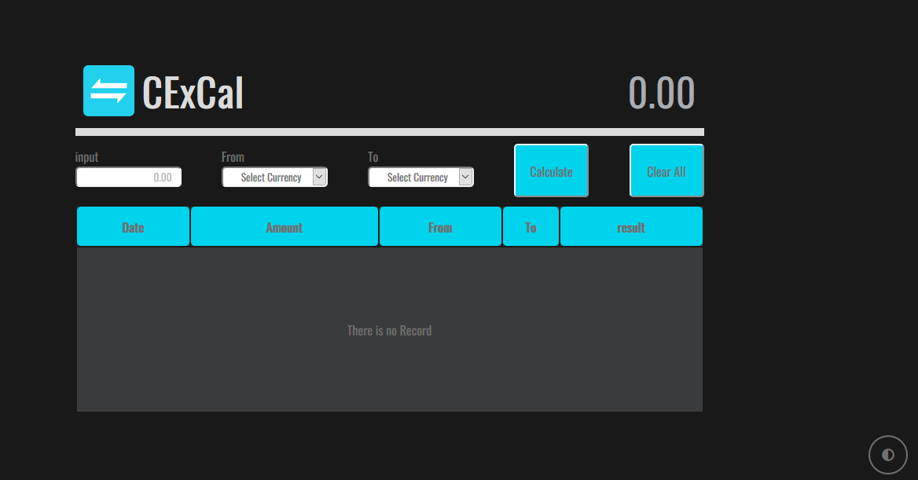
If the user click the dark/light mode, the user will see like this.
Figure 3 Calculate Page with dark mode

Slide 11
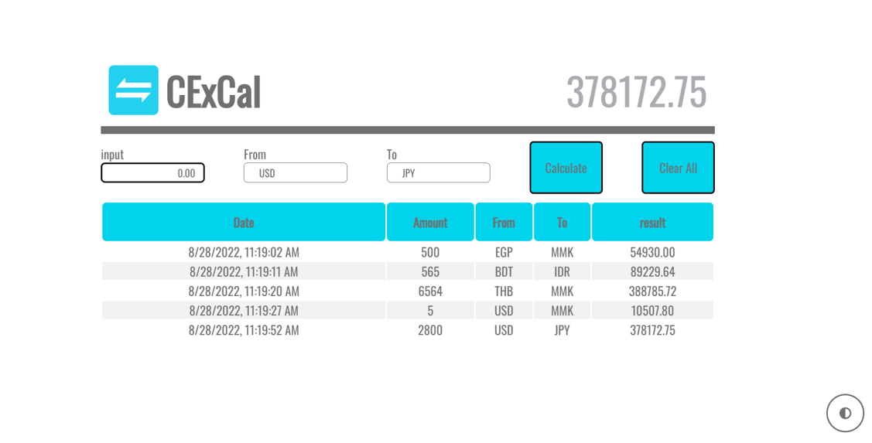
This is the results for the calculated rates.
Figure 3 Calculate Page with dark mode

Slide 12
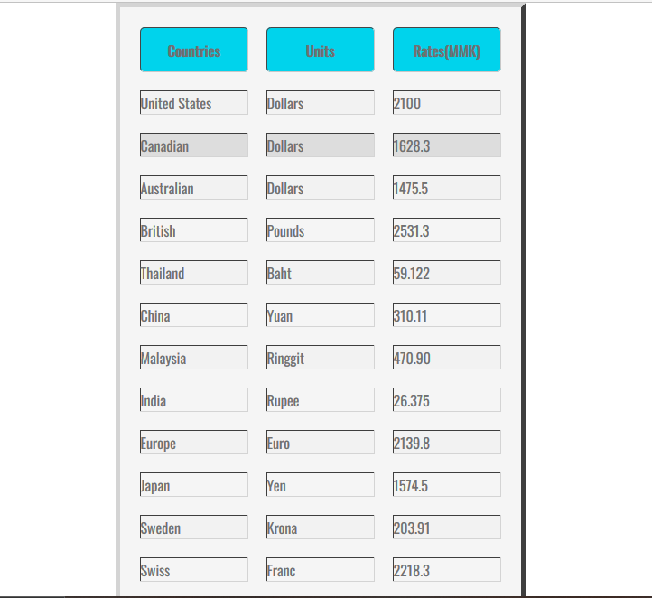
Rates In this page, the user can check the exchange rates.
Figure 4 Calculate Page with results

Slide 13
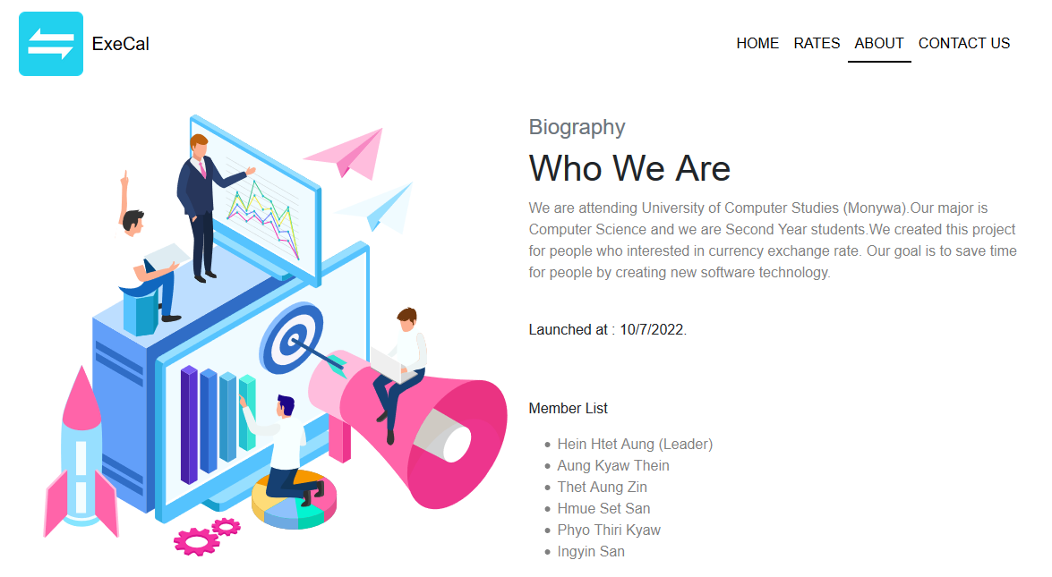
About This page is about us. It describes about the members and launched time of this project.
Figure 6 About Page

Slide 14
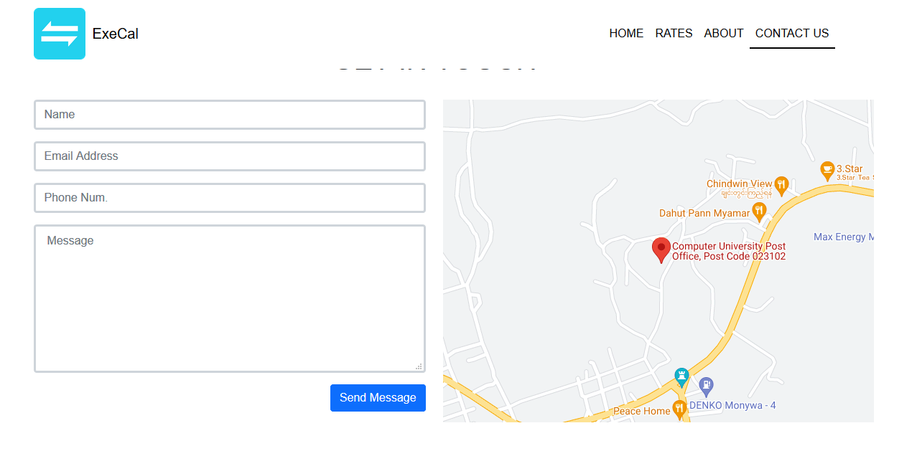
Contact Us The user can contact us in this page if the user have something to say and ask for us.
Figure 7 Contact Us Page

Slide 15
Conclusion
This project is exchange rate calculator. It helps to check the amount the users want to change and convert the desired currency directly. So, this project will be useful for everyone.

Slide 16
Lesson Learned
We have got many experiences and advantages by creating this project. They are:
Understanding the overview of project planning and scheduling
Knowing the principal tasks of project to complete rapidly
Good skills for time management
Improving teamwork skills
Realizing and applying the use of HTML, CSS and JavaScript
Getting problem solving skills
Applying creative thinking skills for project design

Slide 17
References
Nicholas C. Zakas, “Professional JavaScript for Web Developers”
http://www.google.com
http://www.developer.mozilla.org

Slide 18
Thank You!!!

